Slide 1
Soil Mechanics
Prof. Krunoslav Minažek
Josip Juraj Strossmayer University of Osijek

Slide 2
Contents
Soil formation
Basic physical soil properties
Soil classification
Index tests
Classification symbols

Slide 3
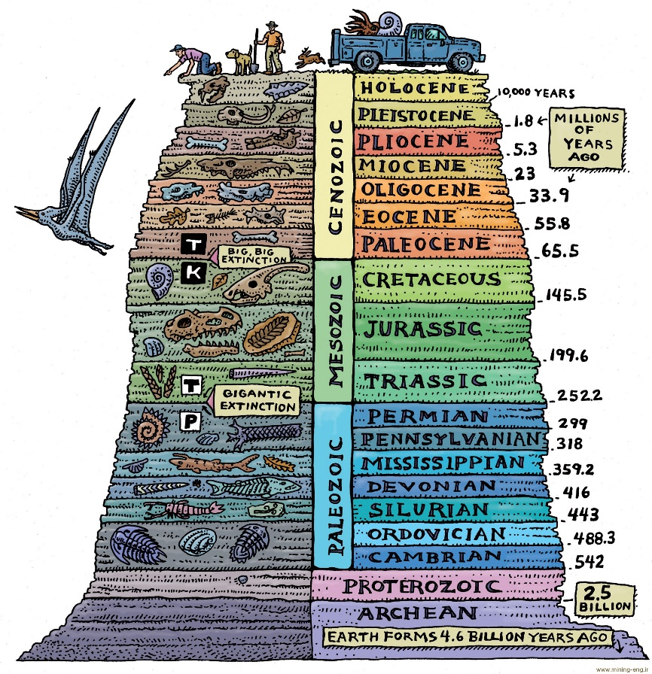
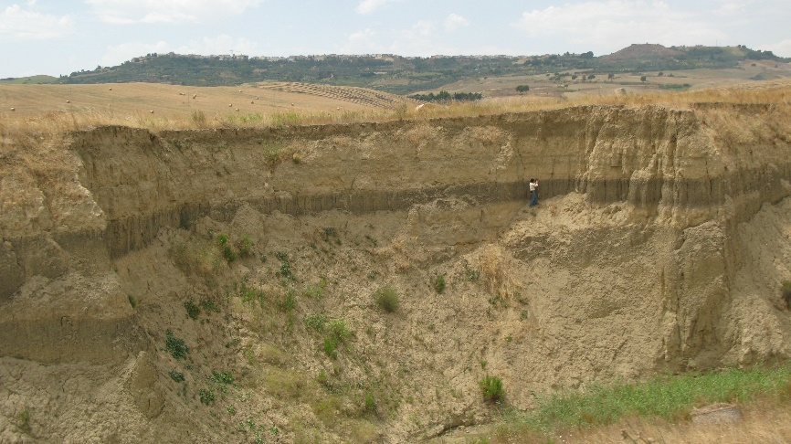
Soil formation
DEGRADATION – DECOMPOSTION OF BASE ROCK
TRANSPORTATIN – BY WATER, WIND OR ICE
SEDIMENTATION (in water, influenced by chemystry, overburden)
MINERALOGYCAL COMPOSITION
HUMAN ACTIVITY
SOIL FORMATION – particles
    Honeycomb structure
    Fluffy structure
    Complex structure

Slide 4
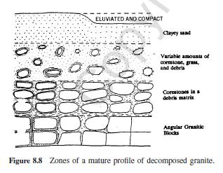
Transportation and sedimentation
Sand particles
Wind direction
erosion
alluvion
alluvion
erosion

Slide 5
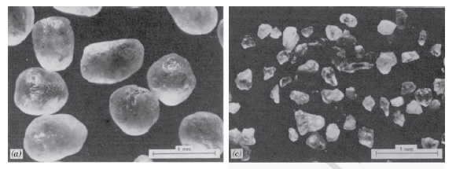
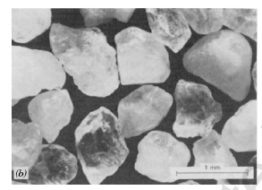
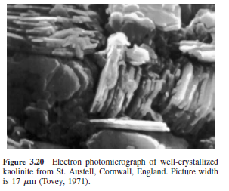
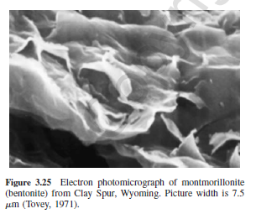
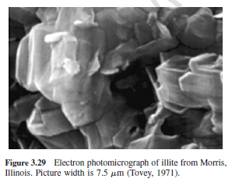
Minerals of sand and clay
Sand minerals
Clay minerals

Slide 6
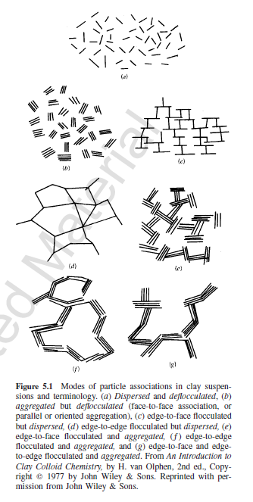
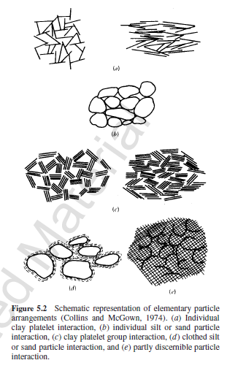
Particle associations and arrangements
Complexity of particle associations and arrangements
Influence on physical and mechanical soil properties

Slide 7
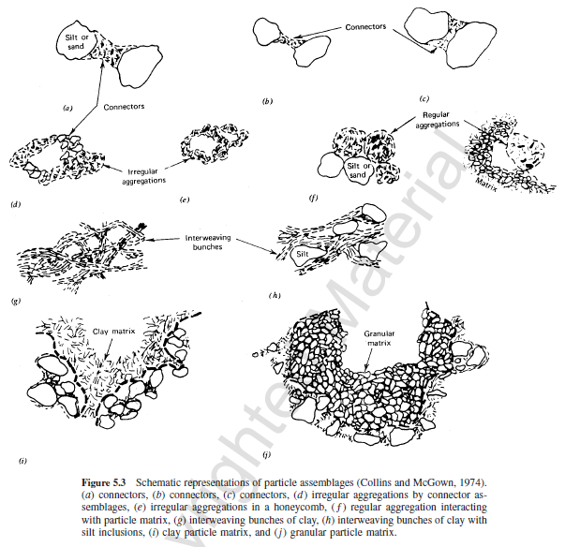
Particle assemblage
Soil matrix is assembled as mixture of different type of soil particles
Influence on physical and mechanical soil properties

Slide 8
Basic physical soil properties
Size and coposition of particles
    FINE GRAINED SOIL – COHESSIVE SOILS (clay and silt)
    COARSE GRAINED SOIL – NONCOHESIVE SOILS (sand and gravel)
    Relative porosity
    Void ratio
air
water
Solid particles

Slide 9
Soil density
density (of naturally) moist soil: ρ = M/V,
soil dry density: ρ_{d} = Md/V,
density of solid particles: ρ_{s} = Md/V_{c}
where: M=mass of naturally moist soil sample,
V = volume of soil sample,
M_{d}= mass of dry sample (equal to mass of soil particless =M_{c})

Slide 10
Determination of soil particles density

Slide 11
Soil moisture content
soil moisture: w = M_{v}/M_{d} = (M-M_{d})/M_{d}
(note: moisture content is defined as ratio between mass of water and solid particles ie dried sample, and not the wet sample, sample is dried at 105⁰C for 16-24 hours in order to remove all unbound water)
Saturation ratio Sr = V_{v} / V_{p}
(Sr is often expressed as percentage, ie Sr=0,45, means Sr=45% that is 45% of pore volume is filled with water, sample with Sr=100% is completely saturated).

Slide 12
Typical values
Porosity – clay, silt 0.4-0.7 (0.5)
Porosity – gravel , sand 0.2-0.4 (0.3)
Density – clay, silt 1.6 - 2 Mg/m³
Density – gravel, sand 1.8-2.2 Mg/m³
Solid particles density – all soils - 2,5-2,7 Mg/m³

Slide 13
Soil granulometric content
(G) Gravel 60 – 2 mm (coarse, medium, fine)
(S) Sand 2 – 0,06 mm (coarse, medium, fine)
(M) Silt 0,06 – 0,002 mm
(C) Clay ispod 0,002 mm
(6-2 system )
Sieving – gravel and sand
Hydrmetric analysis -aerometer – clay and silt

Slide 14
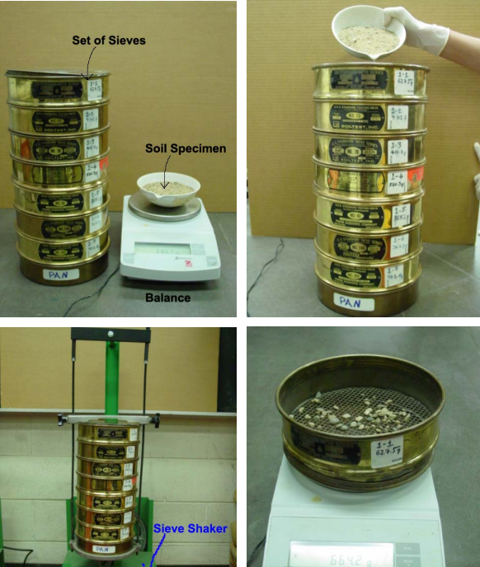
Sieving – gravel and sand
set of sieves of different apperture sizes positioned with larger size apertures above smaller ones,
sieves with sample poured at the upper sieve are shaked and mass of remains on every sieve is measued

Slide 15
Hydrometric analysis– principle

Slide 16
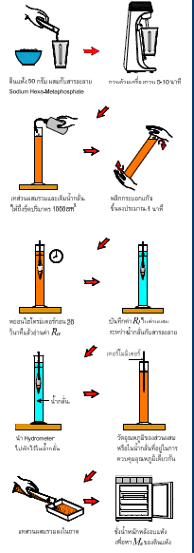
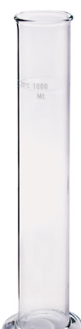
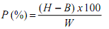
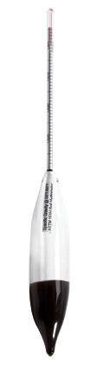
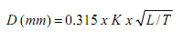
The hydrometric analysis procedure
% of particles, for each hydrometer reading
Calculate P - H = reading in the blurred sample,
B = reading in distilled water,
W = mass of soil sample
particle diameter with P% - for each
Hydrometer reading,
K = constant, L = length of hydrometer,
T = time in min.

Slide 17
Granulometric curve: percentages of mass of particles with different diameter in the sample total
GRAVEL
SAND
SILT
CLAY
100%
0 %
60
2
0.06
0.002
Log D (particles diameter, mm)

Slide 18
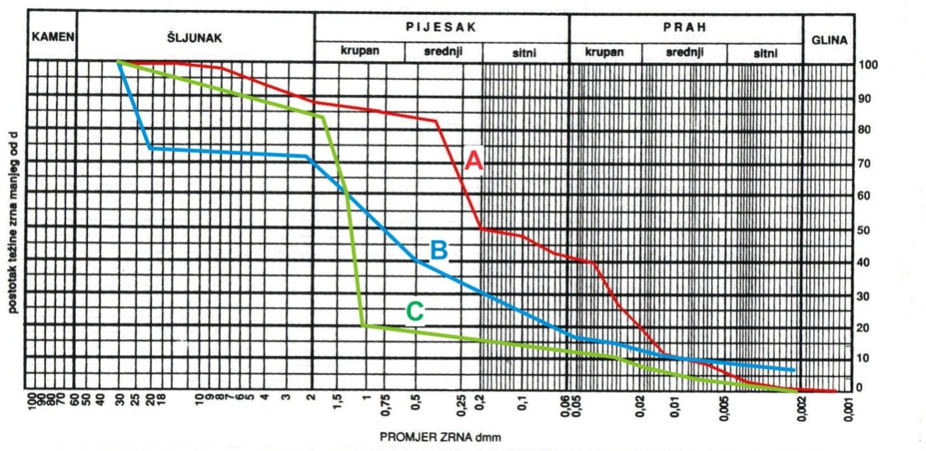
Example of granulometric curve
STONE
GRAVEL
SAND
SILT
coarse
medium
fine
coarse
medium
fine
CLAY
Mass of particles with diameter less the d percentage (%)
PARTICLE DIAMETER, d (mm)

Slide 19
Silt and clay - consistency
Depends on natural moisture content, related to liquid and plastic limit:
Liquid limit W_{L}
Plastic limit W_{P}
Srinkage limit W_{S}
solid_W_{S}_semi-solid_W_{P} _ plastic _ W_{L} _ liquid

Slide 20
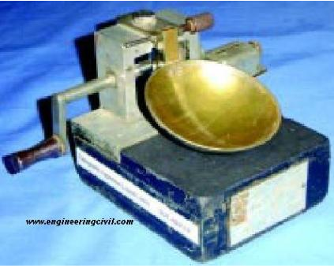
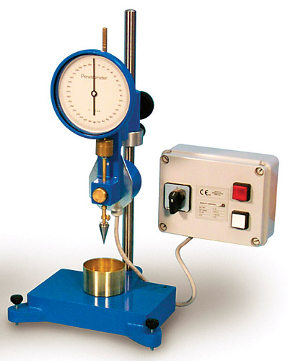
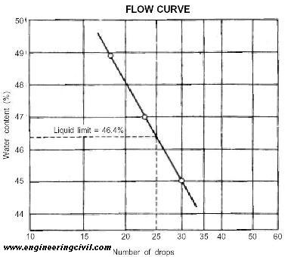
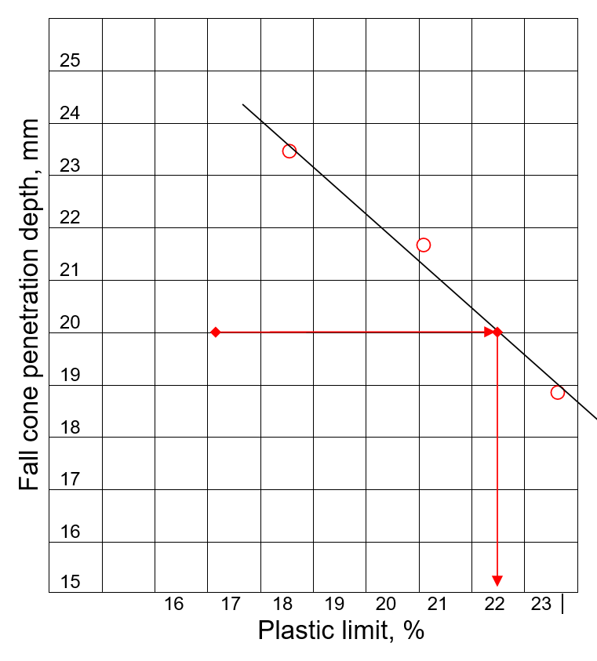
Liquid limit determination
CASAGRANDE METHOD
FALL CONE METHOD

Slide 21
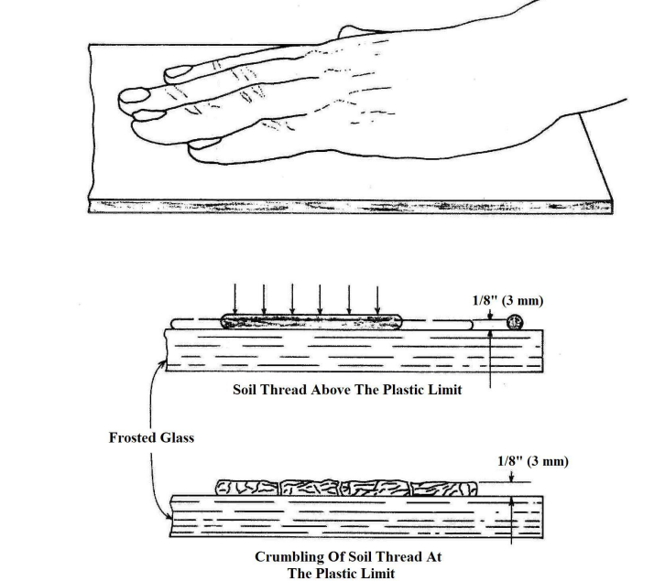
Plastic limit determination
Rolling the soil by hand on glass base unitl crumbling at 3 mm diameter occurs.

Slide 22
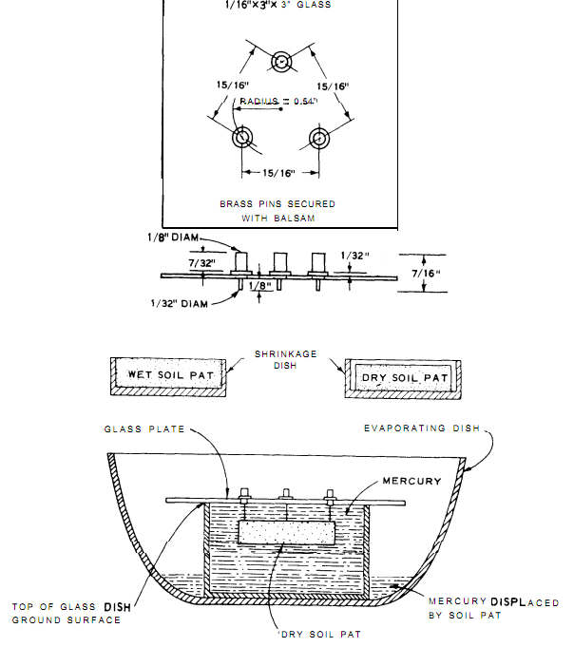
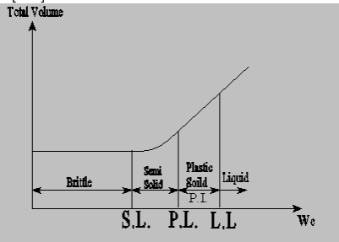
Shrinkage limit determination
SHRINKAGE LIMIT:
The mositure of the sample when further
Moisutre reduction does not results in
volume reduction
– several atempts during drying
and sample volume measurement

Slide 23
Index parameters for cohessive soil
Plasticity index: I_{p}=w_{L}-w_{P}
Consistency index: I_{c}=(w_{L}-w₀)/I_{p}
I_{c} and consitency: < 0,25 – very soft;
0,25-0,50 – soft
    0,50-0,75 – firm, 0,75-1,0 – stiff
    > 1,0 – very stiff
    (ISO 14688)

Slide 24
Index parameters – non cohessive soil
Relative density:
I_{D}= (e_{max}-e₀)/(e_{max}-e_{min})
e_{max}=maximal porosity, e_{min}=minimal porosity, e_{o}= actual porosity (natural, insitu), min. and max. porosities are determined using lab. tests)
Correlation to relative density (ISO 14688):
  I_{D}=0-0.15 - very loose
  I_{D}=0.15-0.35 - loose
  I_{D}=0.35-0.65 - medium dense
  I_{D}=0.65-0.85 - dense
  I_{D}=0.85-1.00 - very dense

Slide 25
Soil Classification (USCS –ASTM D2487-6)
Noncohessive soil – gravel G, sand S
well-graduated – W, poor-graduated P
GW, GP, SW, SP
Cohessive soil – clay C, silt M
High plasticity, low plasticity
Plasticity chart: w_{l} – I_{p}
CH, CL, MH, ML
Combinations noncohessive-cohessive soils: GW-GC, SP-SM...

Slide 26
Classification of non cohessive soil
Noncohessive soils – well-graduated (W),
poor-graduated (P), uniformly-graduated (U).
GRAVEL
SAND
SILT
CLAY
100%
0 %
60
2
0.06
0.002
Log D (mm)

Slide 27
Description of granulometric curve
Characteristic diameters for the description of the granulometric curve are: D₁₀, D₃₀, D₆₀
The granulometric composition curve for noncohessive soil is characterized by the following parameters:
uniformity coefficient: C_{u} = D₆₀ / D₁₀,
coefficient of curvature: C_{c} = D30² / (D₁₀xD₆₀)
According to the shape of the curve, soil can be:
well-graduated - contains a wide range of grains of different diameters
        for gravel: C_{u} > 4, and 1 < C_{c} < 3
        for sand: C_{u} > 6, and 1 < C_{c} < 3
poorly-graduated - particles of some diameters are missing
uniformly graduated - not present in all classification systems - contains particles of predominantly narrow spectrum in diameter

Slide 28
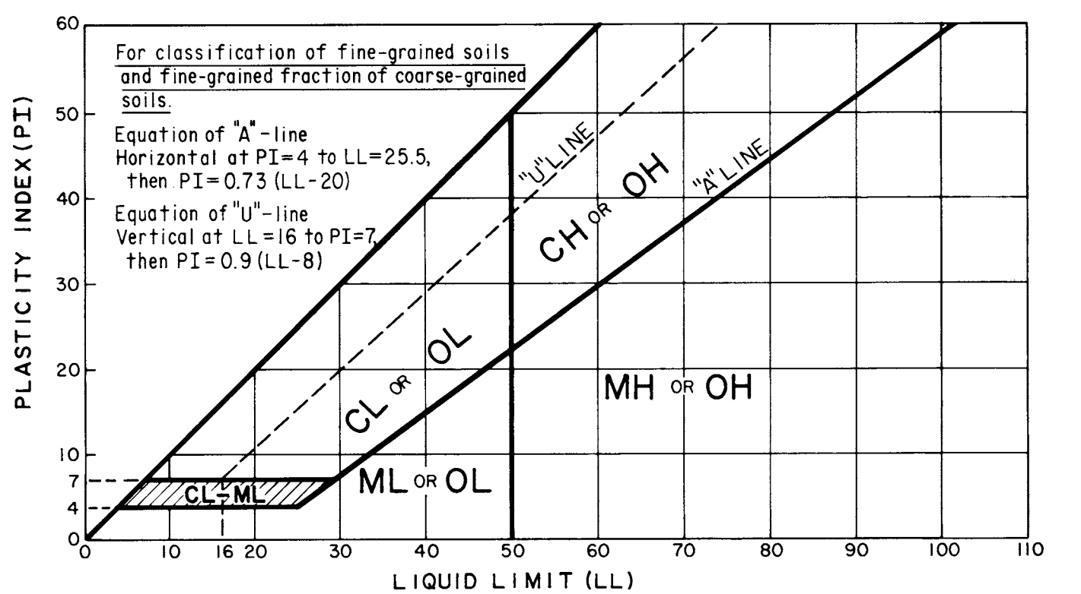
Soil classification – Cohessive soil (plasticity chart)

Slide 29
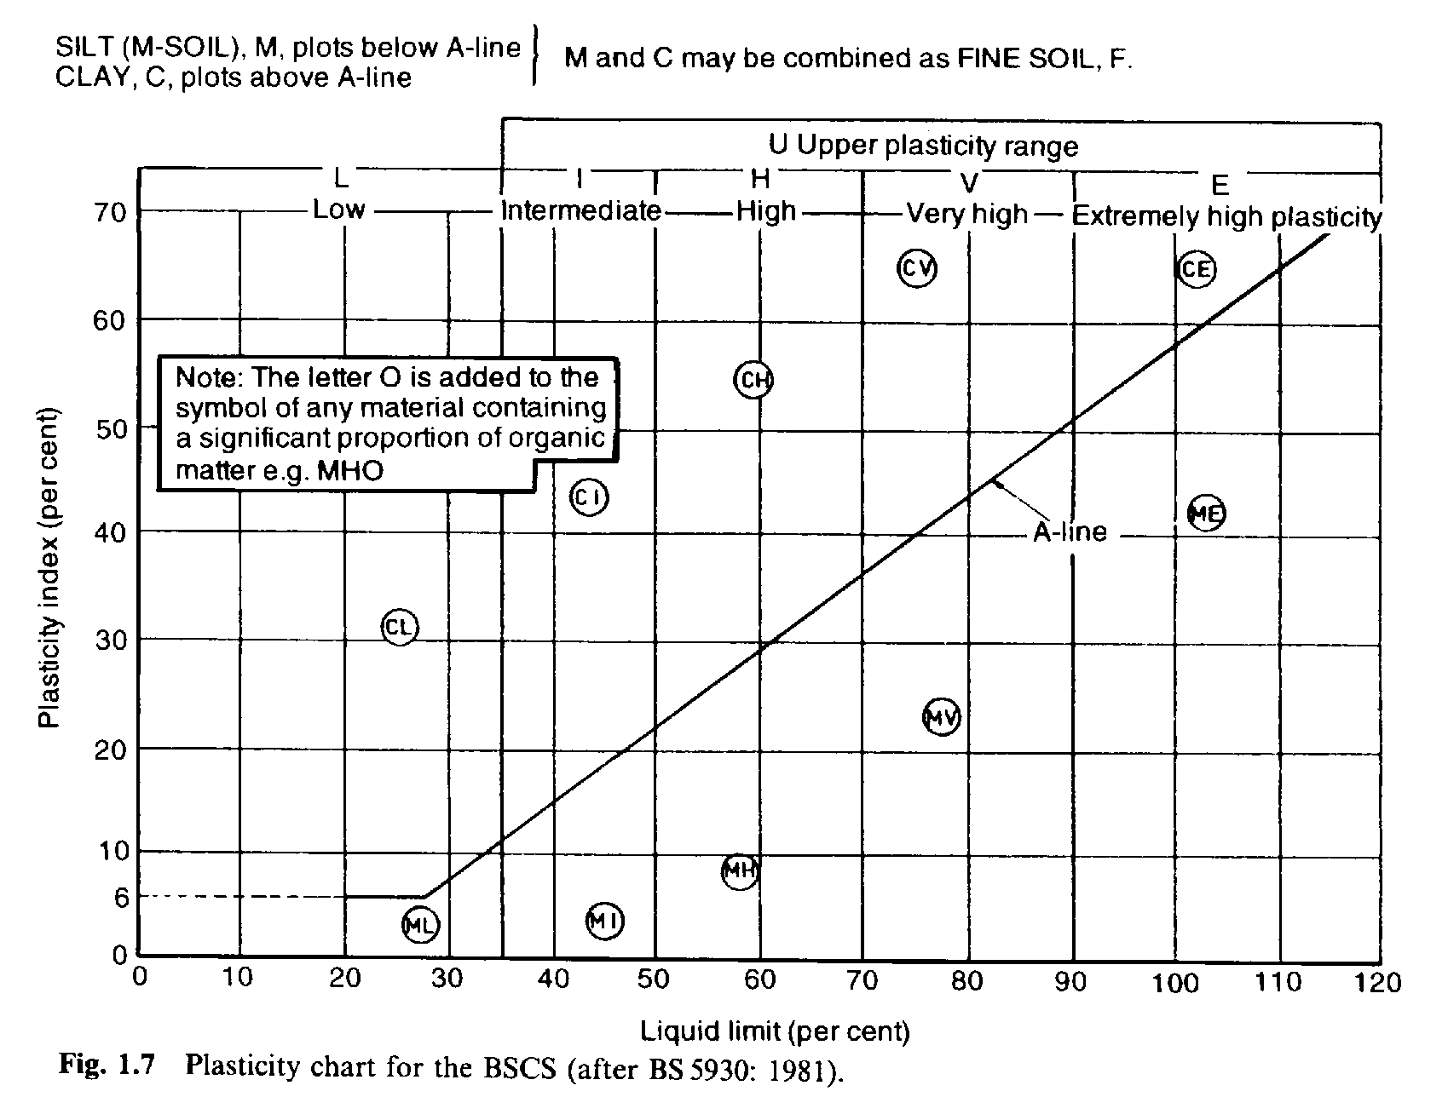

Slide 30
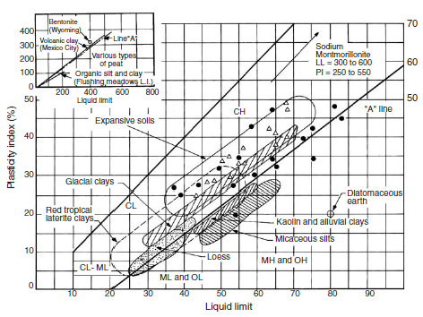

Slide 31
USCS Classification - Summary

Slide 32
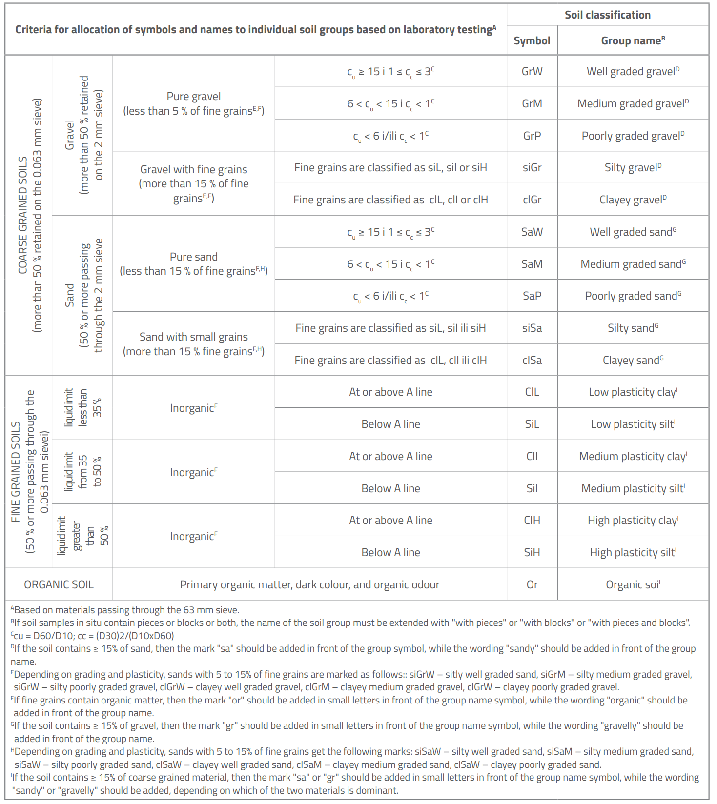
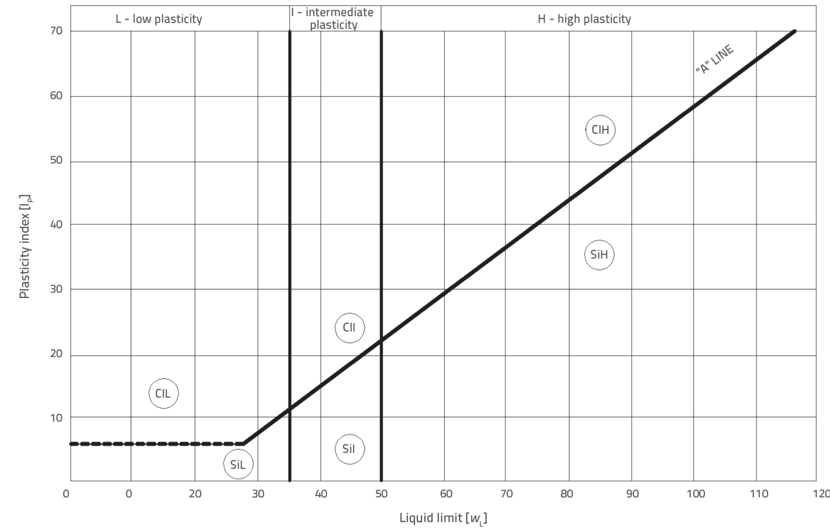
ESCS classification (EN ISO 14688-2:2018)

Slide 33
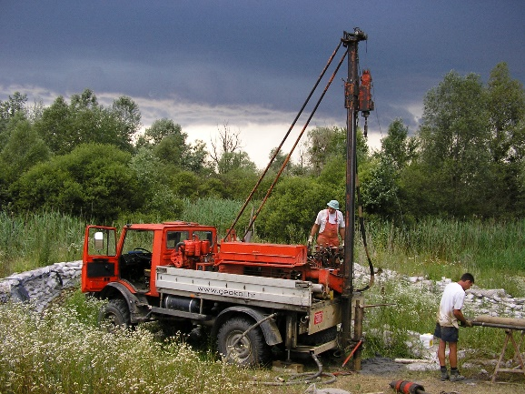
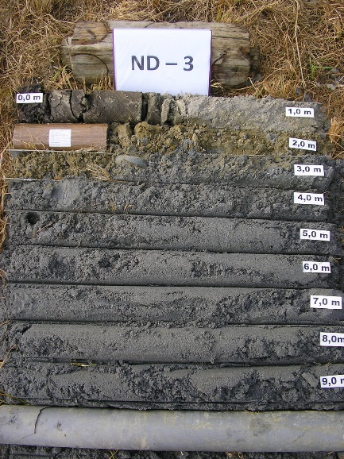
Field determination and classification
Field determination from bored soil core
Important for overall soil description – fresh sample from soil mass
Soil description: type of soil (predominant soil – estimate of granulometric content), plasticity, consistency, colour, gloss (waxy glow...), smell (, presence of organic content, particle shape, roundness

Slide 34
References
Mitchell, J.K. and Soga, K. (2005) Fundamentals of Soil Behavior. 3rd Edition, John Wiley & Sons, Hoboken.
Engineering Properties of Soils Based on Laboratory Testing Prof. Krishna Reddy, UIC EXPERIMENT 6 GRAIN SIZE ANALYSIS (SIEVE AND HYDROMETER ANALYSIS
ASTM D 2487 – 06 Standard Practice for Classification of Soils for Engineering Purposes (Unified
Soil Classification System)
EN ISO 14688-2:2018 Geotechnical investigation and testing - Identification and classification of soil – Part 2: Principles for a classification

