Slide 1
Earthquake Engineering Appendix 3
Prof. Rosario Ceravolo – Eng. Gaetano Miraglia
Politecnico di Torino

Slide 2
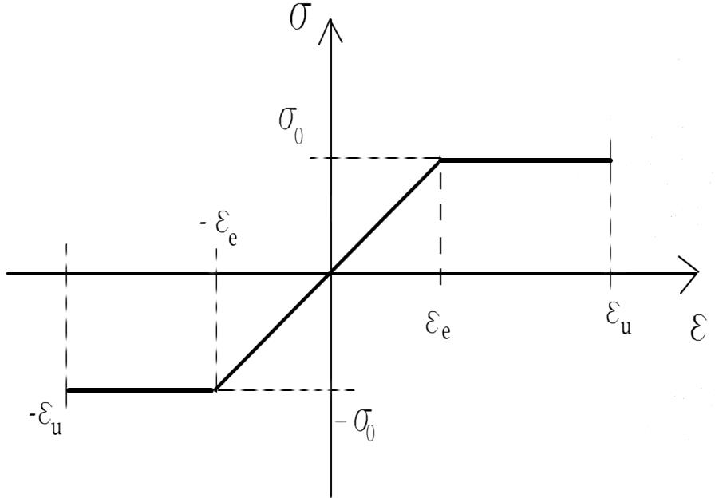
Structural ductility
When studying the elasto-plastic behaviour of omogeneous beams and monodimensional stuctures usually the following assumptions are made:
Hypothesis that sections are plane after bending.
Small displacemebts.
Elastic- perfectly plastic material (Prandtl’s law).
Instability phenomena excluded.
Definitions:
- M_{e}: elastic moment value, at
which Ε,
its elastic
maximum deformation, reaches
limit ε_{e};
M_{u}: ultimate moment, such that Ε = Ε_{u};
M_{p}: plastic moment, such that Ε = ∞;
μ₀ = Ε_{u}/Ε_{e} : ductility of the material;
� = M_{p}/M_{e}: shape factor of the section.

Slide 3
Ductility of the section
Rectangular section
Navier’s assumption:
Ε _{e =} Ε
h
2
since
Y e
Y
= ^{h} ⋅ ^{Ε e}
where
e
2
Ε
_{Ε e =} σ o
E
⎛
h ⎞ h
⎛ σ o ^{⋅ b ⋅} Ye ⎞ Ye
σ _{o} ⋅ b ⋅ h² σ _{o} ⋅ b ⋅ Y ²
σ _{o} ⋅ b ⋅ h²
⎛
_{1 Ε} 2 ⎞
M = 2⎜σ _{o} ⋅ b ⋅ ⎟ ⋅ − 2⎜
⎟ ⋅ =
₋ e ₌
⋅ ⎜1 −
⋅ e ⎟
⎝
2 ⎠ 4
⎝
2
⎠
3
4 3
4
⎜
3
2
⎟
⎝
⎡
Ε ⎠
⎡
₁ ⎛ Ε
⎞2⎤
₁ ⎛ χ
⎞2⎤
σ
⋅ b ⋅
2
⋅ ⎢
⎢
h
⎜ e ⎟ ⎥ ⎜ e ⎟ ⎥
Considering that:
M p
=
o
₄ =>
M = M ⎢1− ₃ ⋅_{⎜ Ε ⎟ ⎥} = M _{p} ⋅ ⎢1− ₃ ⋅_{⎜ χ}
⎟ ⎥
u p
Ε χ
Ε χ
⎢⎣
⎝ u ⎠ ⎥⎦
⎢⎣
⎝ u ⎠ ⎥⎦
Observing that:
μ =
u
=
u
0
e e
⎛
b h 2 h
σ
⋅ b ⋅
h
2
2
3
Moreover, since: M = 2
⎞
o
M p
e
⎜σ
o
⋅ ⋅ ⋅ ⋅ =
=
⎝
2 2 ⎟ 3 2
6
⎠

Slide 4
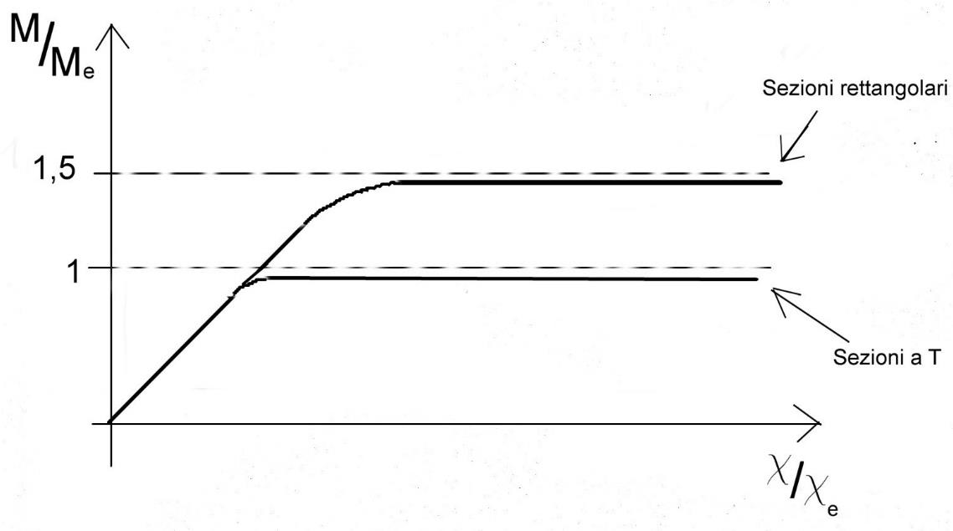
-σ0
⎡
⎛ _{χ}
⎞2⎤
⎡
⎛ _{χ}
⎞2⎤
=> M
= _{M ⎢}1
⋅ ⎢ ₋ ¹ ⋅⎜ e ⎟ ⎥ ₌ M e ⎢
₋ ⎜ e ⎟ ⎥
A1
A1 -
⎟ ⎥
⎢3
⎢⎣
⎜ _{χ}
⎟ ⎥
-
p
⎢⎣
3 ⎜ χ
⎠ ⎥⎦
2
⎠ ⎥⎦
⎝
⎝
Thus the shape factor for rectangular
sections is:
+
A2
+
A2
3
2
σ0
A
σ0
=
M
p
M e
=
A₁ = A₂ = ₂
If the web is very thin, ≅ 1 and one has:
M ≅ 2 ⋅ b ⋅ s ⋅ ^{h} ⋅σ = b ⋅ s ⋅ h ⋅σ
p 0
0
2
Actually, many other factors can influence moment-curvature diagrams, among which:
Presence of self-equilibrated stresses;
Steel hardening branch (usually neglected for possible instability);
Cracks and bond loss in composite materials;
Instability.

Slide 5
Ductility of the structure
The structure’s ductility brings many advantages:
P
Ductile failure;
Smoothing internal load diagrams and
δ
α
redistribution properties in statically
M/Me
indeterminate structures;
3. Attenuation of the effects of seismic actions, as well as dynamic and impulsive ones (impacts).
1
χe
χ/χe
However, high ductility in the material or section does
not entail a high ductility in the structure.
The length plasticised
of the segment
1
Depends on hardening in the M-χ diagram.
l
Example: cantilever beam with concentrated load at the free edge
1
l
l
α = ∫ χ (x)dx
0
( ) ( ) e
δ = ∫ M₁ x ⋅ χ x dx
0
M1(x)
l
-
δ
δ
α
α
μ =
u
e
μ =
u
δ
α
e
e

Slide 6
The structure’s ductility increases with an appreciable hardening in the moment-curvature diagram, and in particular with the section shape factor.
The ductility is limited by the fact that plasticisation only extend to some portions of the structure.
This is due to the gradient of flexural moment, i.e. to shear.
μ₀ = 5 ÷10 ⇒ μ_{α} = 1,69 ÷1,79
per sezioni rettangolari
Struttura più duttile
Shear plasticisation in the web
Effect of shear
Shear can play an important role in the plasticisation of H beams, to such an extent that sometimes the web is considered to be already plasticised, assuming that the collapse happens with the plasticisation of the flanges.
The prior plasticisation of the web with respect to the flanges allows to conceive ductile bracing systems.
In particular, the bracing is designed so that shear plasticisation happens prior to the instability in the bracings, which would activate a sudden collapse, with little dissipation.

Slide 7
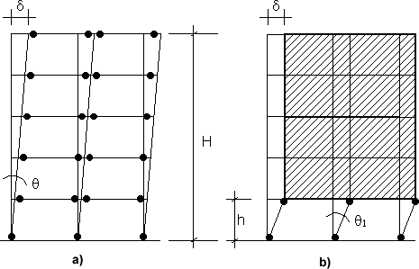
In the case of structures with many degrees of freedom (e.g. frames) global ductility does not coincide with those of the single elements, but it will depend on the topology of the structure, and on relative dimensioning of the different elements.
Objectives to pursue in order to increase the ductility of a frame subjected to horizontal forces are:
Plastic hinges in only edge sections of the beams;
Exclusion of hinges in the columns, except for the hinges in the columns at the base sections.
Plasticisation mechanisms:
hinges at the beam edges and at the base sections (optimal);
Hinges in the pillars of the ground floor (to avoid)

Slide 8
In order to obtain the optimal mechanism the plastic rotation is to be:
delayed with respect to that of the beams assigning them an incresed resistance (criterion of «capacity design»)
controlled with adequate confinment rebars (criterion of «local ductility»).
Plastic hinges in the pillars are not desirable as long as they can activate storey mechanismis.
Storey mechanisms are almost always due to sudden changes in resistance or stiffness between the ground floor and upper floors, due to complete or partial exclusion or removal of the infill walls (structural regolarity).
Rotation ductility demand of the columns increases linearly with the number of storeys. Except for low-rise buildings, no confinment rebars can provide columns with such an high ductility, the collapse being inevitable (e.g. buildings on “pilotis”).
In current seismic design, in presence of “pilotis”, resistance increases of 40% are applied to design loads for buildings up to 8 storeys, and adequately higher (100%) for taller buildings (minimal).

Slide 9
Shear induces low ductility mechanisms.
Severe damage in beam-column nodes has very detrimental effects:
it increases displacements without a signicant increase in dissipation;
it reduces reinforcement bond of bars in the beams of r.c. frames;
extremely difficult and costly recover of damaged concrete nodes.
To attain ductility, actions should be put in place in order to enhance:
plastic deformation capacity;
energy dissipation;
resistance.
And, at the same time, the design shall:
foster a mainly flexural behaviour, avoiding brittle and scarcely dissipative collapse modes, such as those associated to shear;
make plastic hinges to form in beams rather than colums, by giving extra resistance to the latters;
guarantee the integrity of beam-column nodes, also under strong ground motions;
provide sufficient ductility to structural portions and elements where important anelastic strain demands are expected (local ductility).

Slide 10
And, at the same time, the design shall:
foster a mainly flexural behaviour, avoiding brittle and scarcely dissipative collapse modes, such as those associated to shear;
make plastic hinges to form in beams rather than colums, by giving extra resistance to the latters;
•
•
guarantee the integrity of beam-column nodes, also under strong ground motions; provide sufficient ductility to structural regions and elements where important anelastic
strain demands are expected (local ductility).
While the first two requirements are mainly satisfied by capacity design, the last two ones usually refer to detailing and reinforcement minima, in addition to specific structural verifications (e.g. at the beam-column nodes).
The local ductility criterion requires:
improving of the ductile behaviour of the materials;
ductile section design for r.c. beams and columns.

Slide 11
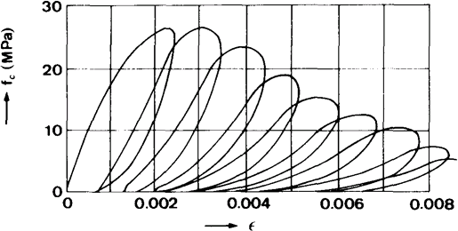
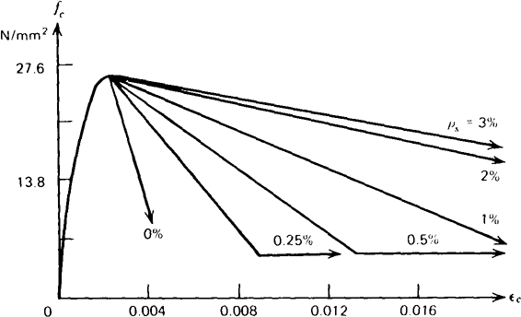
Materials: concrete
Cyclic compression test on concrete: influence of confinment

Slide 12
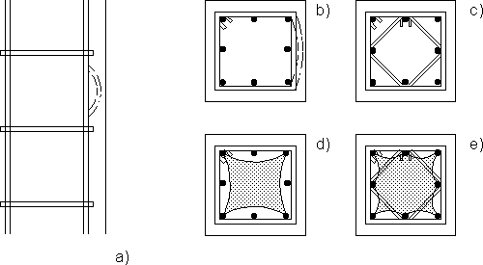
Materials: reinforcement steel.
Steel exhibits a hysteretic behaviour without important degradation phenomena. However, dangerous degradation phenomena are observed in compression due to rebar buckling. In
r.c. elements, buckling of the longitudinal bars is partially contrasted by the concrete cover.
In order to limit this effect it is necessary to provide for articulated stirrups, in order to reduce the buckling length of the bars.
Buckling of the longitudinal bars and containment by the stirrups

Slide 13
Materials: bond
The experimental behaviour under cyclic loading of the steel-concrete shows to be scarcely dissipative with marked degradation.
Thus, bond loss must be excluded, taking care, at both design and execution stages, all details influencing steel-concrete interaction.
The following aspects become relevant:
anchoring of the bars.
bar splice.
structural detailing.
Steel-concrete bond is favourably affected by:
by the presence of confinment stress, as produced
adequate tranverse confinment reinforcing (stirrups)
compression stress acting orthogonally on bond of bars (e.g. passing through the joint at
beam-column nodes).

Slide 14
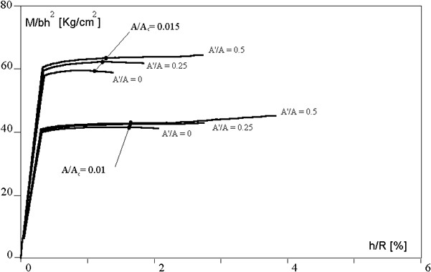
Ductile design of r.c. sections
Influence of compression reinforcement on moment-curvature diagrams.

Slide 15
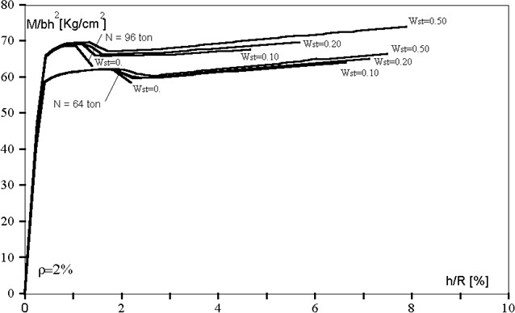
Ductile design of r.c. sections
Influence of transverse reinforcement (percentage) on moment-curvature diagrams.

Slide 16
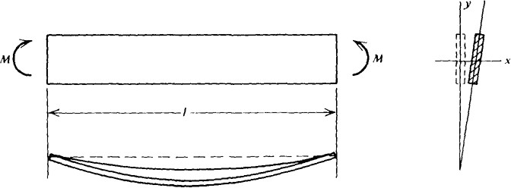
Geometric limitations
Reduction of ductility due to premature instability (global, Eulerian, lateral, torsional etc.).

Slide 17
Provisions of local ductility
Geometric limitations:
risk of instability in case of eccessively slender elements;
conversely, in case of eccessively short elements the influence of shear can be predominant.
Limitations on longitudinal reinforcement:
limit the tension reinforcement ratio in flexural reinforced concrete members to avoid compression failure of concrete before the tension failure of steel, so as to improve section ductility.
limit the total area of steel bars in columns under a given percentage, in order to: i) ensure an adequate plastic rotation capacity in the critical regions/dissipative zones;
ii) avoid difficulties connected to the execution of details in presence of eccessive
longitudinal reinforcement.
Limitations on transverse reinforcement:
confinment of concrete to obtain an effective bond between steel and concrete;
supporting effect provided by the stirrups, which avoids buckling in compressed longitudinal bars;
increase of the resistance to shear of structural elements.

