Slide 1
Seismic Protection of historical buildings
Lesson 2
Prof. Rosario Ceravolo – Eng. Gaetano Miraglia
Politecnico di Torino

Slide 2
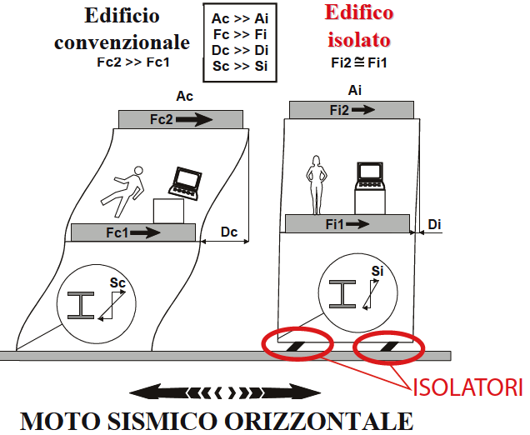
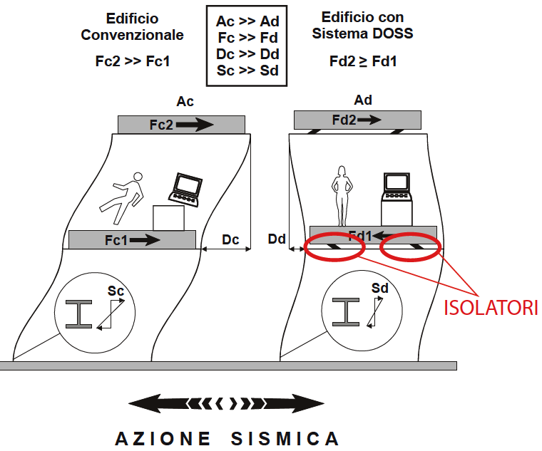
DEVICES/SYSTEMS OF
ISOLATION AND DISSIPATION
ISOLATION SYSTEMS
Base isolation systems:
Laminated rubber bearings
High damping rubber bearings
Lead-rubber bearings
Steel ball bearings
Friction pendulum bearings
Teflon bearings
Flexible/sleeved foundation piles
Suspended buildings
Soft first story systems
‘’BACK UP’’ SYSTEMS
Soft landing systems
Uplift restraints
Horizontal stoppers
Shock absorbers

Slide 3
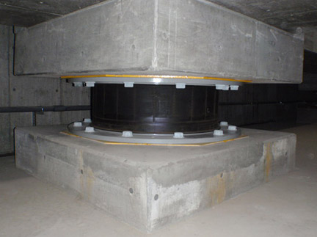
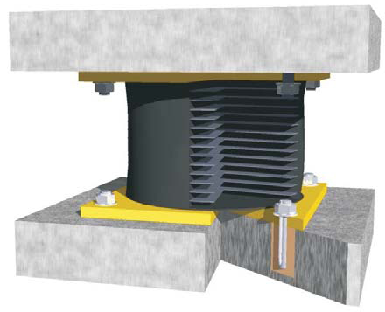
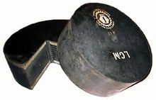
LAMINATED RUBBER BEARINGS
Laminated rubber bearings
Alternate layers of elastomeric material and vulcanized reinforcement steel plates. Versatile and widely used solution, in Italy (es. Centro Amministrativo Telecom ad Ancona, first application) and abroad for being an effective and relatively cheap solution.

Slide 4
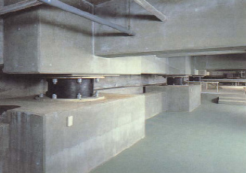
Seismic isolation with rubber devices (OILES GRP building, Fujisawa, Japan).

Slide 5
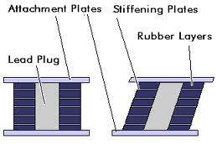
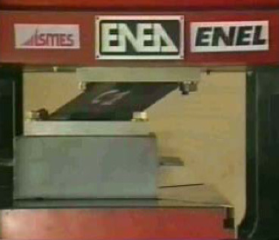
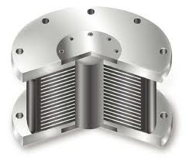
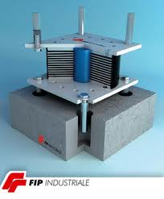
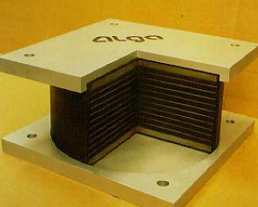
HIGH DAMPING RUBBER BEARINGS
LEAD-RUBBER BEARINGS
They present a central lead core, providing a high level of damping (of up to 30% in small and 10% large deformations). First application in Wellington (New Zealand): William Clayton building, 1981.
They differ from standard ones for the employ of high damping rubbers (es. High Damping Ferrite Rubber HDFR). Damping values up to 12-15%.

Slide 6
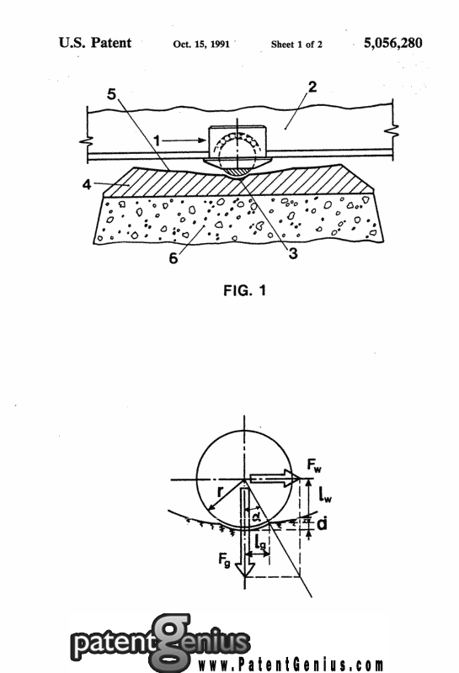
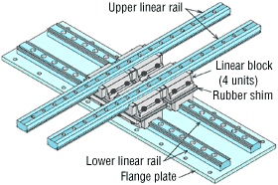
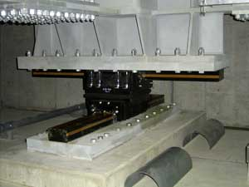
“SHOCK EVADER” BEARINGS
Antifriction and Multi-Step Base Isolation System (AF-MS)
Completed with a steel cable system that limits displacements.
Excellent behavior with respect to impulsive components, since “shock evader” name .

Slide 7
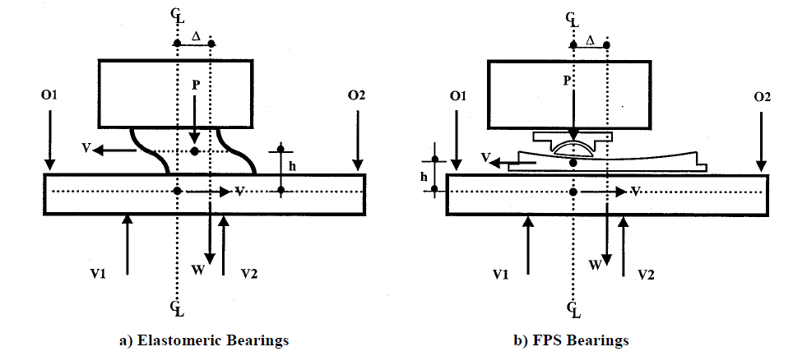
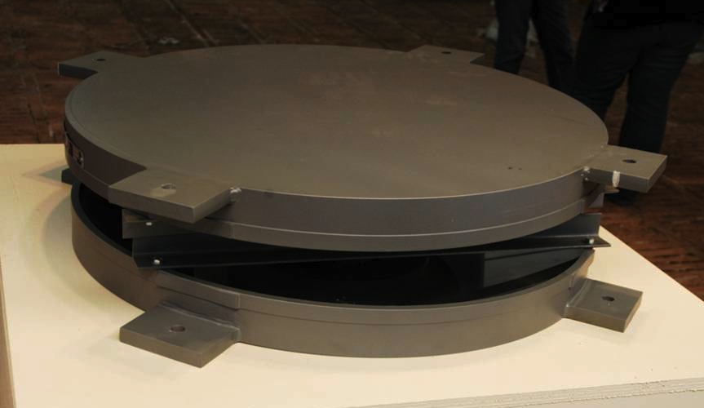
FRICTION PENDULUM BEARINGS
Articulated friction slider mounted on a Teflon support. It can move on a spherical concave steel surface.

Slide 8
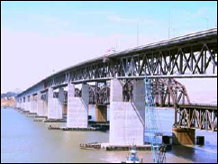
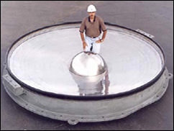
Benicia-Martinez Bridge nella San Francisco Bay Area.
Friction Pendulum System (FPS) are installed between the piers and the deck, allowing design spectral accelerations of 7 g, with horizontal displacements exceeding 1 m (about 5 s natural period).

Slide 9
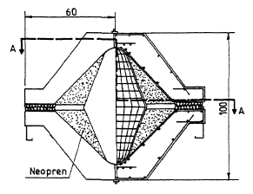
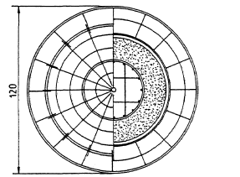
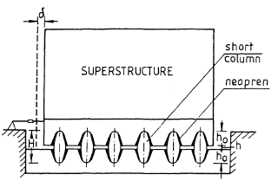
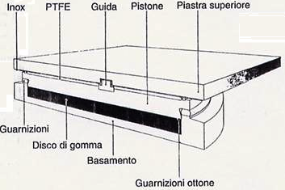
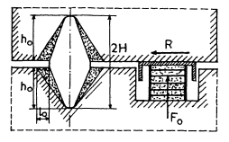
PENDULUM RUBBER BEARING
Pendulum Rubber Bearing (PRB). R.C. short columns embedded in neopren. It combines the advantages of kinematic systems with those of rubber bearings.
SLIDING BEARINGS IN TEFLON
System based on mutual sliding of two Teflon plates.
Il sistema con dissipatore

Slide 10
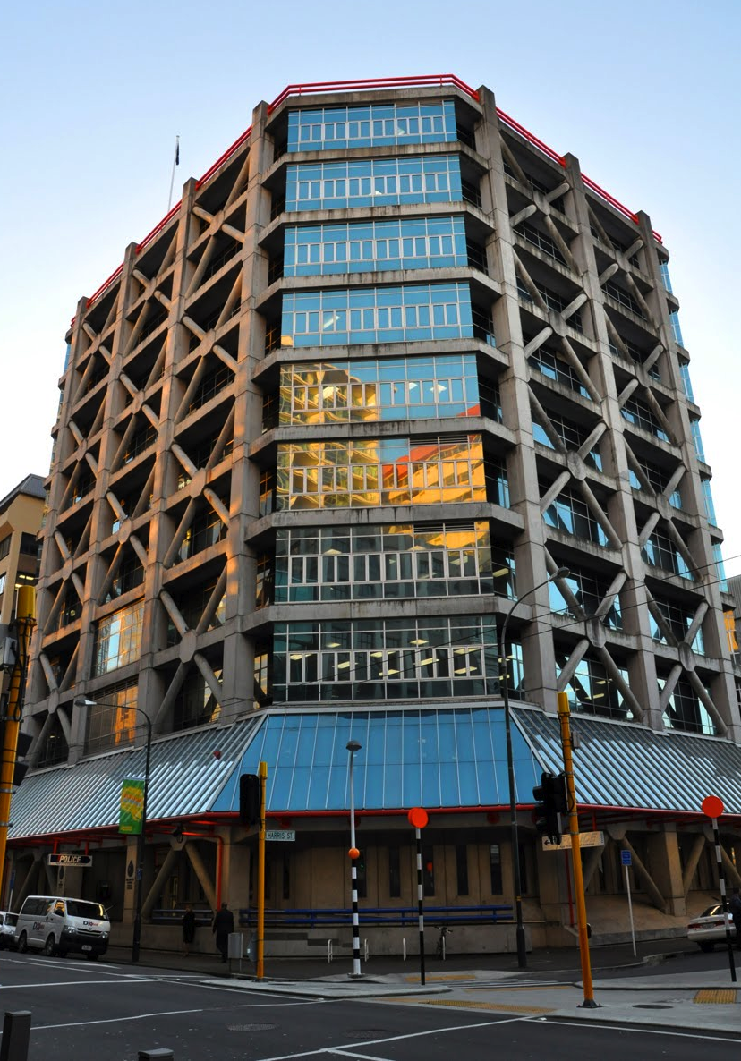
SLEEVED PILES
Example:
Wellington Central Police station
Spherical bearings on the cap.
Isolation degree limited by the pile’s bearing capacity.
The system is usually complemented by horizontal restraint and damping devices (e.g. lead extrusion).
Spherical Allowed up to 400 mm of displacement in any horizontal direction

Slide 11
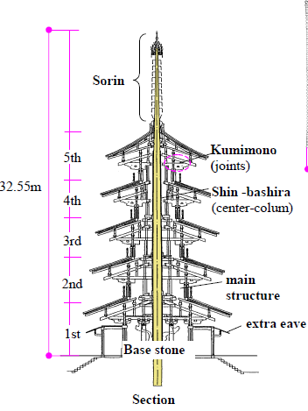
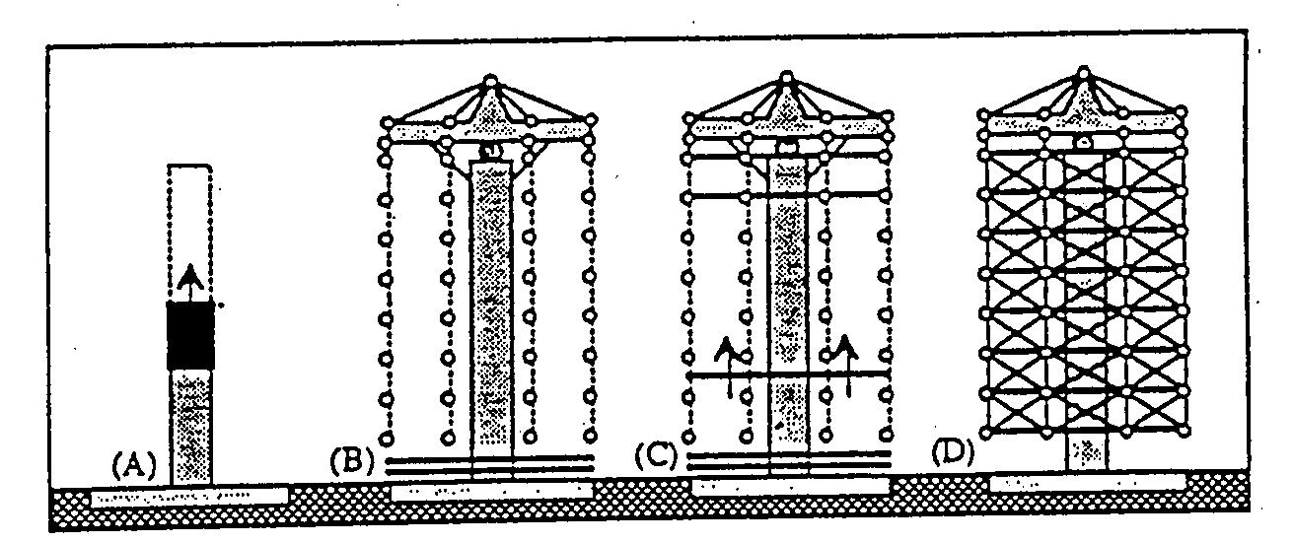
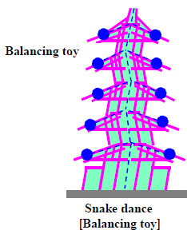
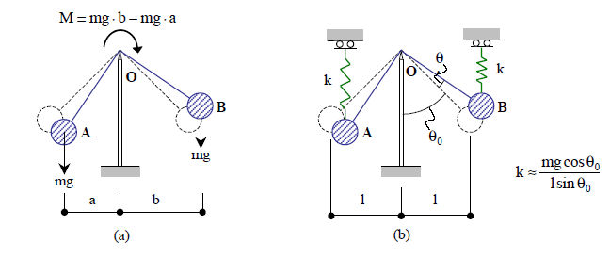
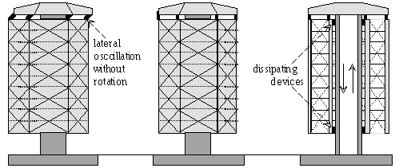
SUSPENDED BUILDINGS
Pagoda
Stages of the construction process (lift-slab)
Elasto-plastic restraint devices to avoid vibrations during normal serviceability (wind, ambient, etc..)
Model describing the “balancing toy” effect, which is typical of pagodas.

Slide 12
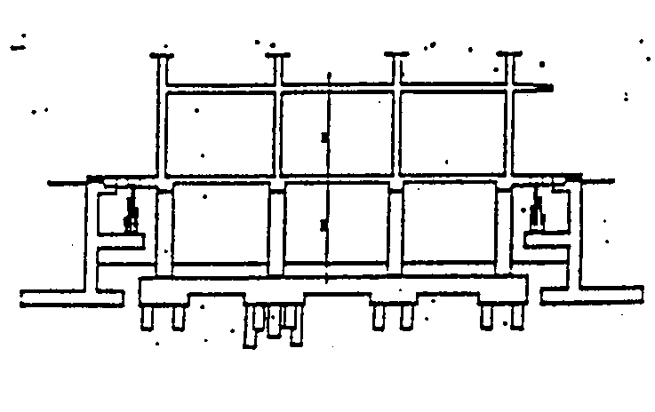
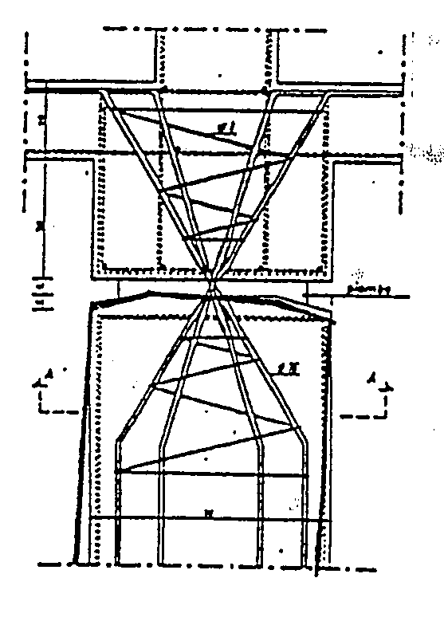
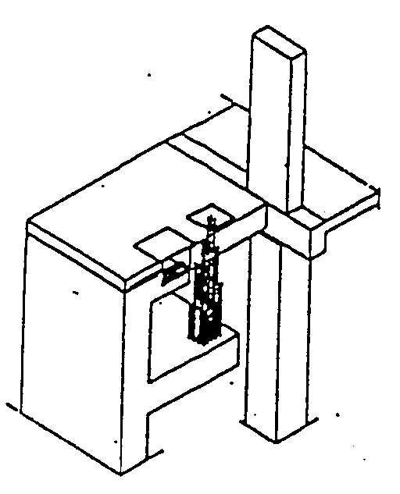
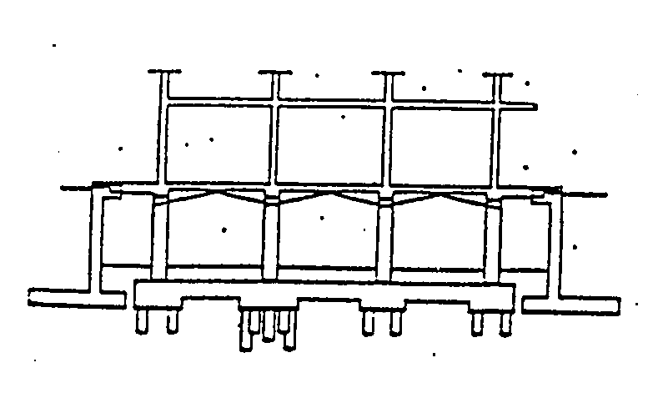
SYSTEMS WITH SOFT FIRST STORY
These systems consist of:
a foundation system with a 1st order columns hinged at the top.
an elastic restoring system.
an elastic-brittle device, which is designed for wind actions.
The restoring system includes:
Bundles of R.C. bars
steel rods (e.g. prestressed concrete strands)
Elastic-brittle stiffener (left hand) and 1st order column hinged at the top (slide on the right)

Slide 13
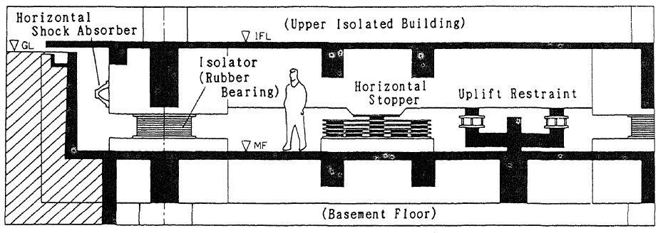
BACKUP SYSTEMS/DEVICES
They are supplementary devices to avoid the effects of anomalous earthquakes (crucial aspect in isolation systems)
Scheme with different isolation and backup devices
They can be classified into:
uplift restraints
horizontal stoppers
horizontal shock absorbers
soft landing devices

Slide 14
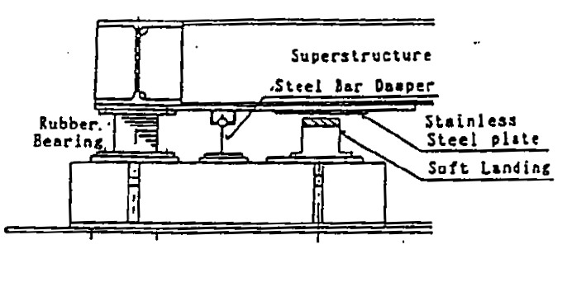
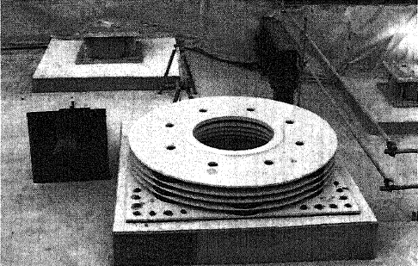
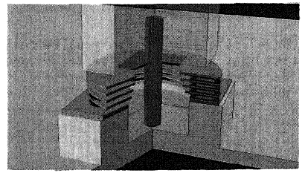
When the lateral deformation exceeds the clearance of 30 cm, the internal cylinder gets into the dishes/rings, one after another, from the upper to the lower, gradually supplying a softening reaction.
Scheme of base isolation with soft landing device, which tends to lower as a consequence of the lateral deformation of rubber bearings.
Scheme of a horizontal stopper.
Steel dishes of a horizontal stopper

Slide 15
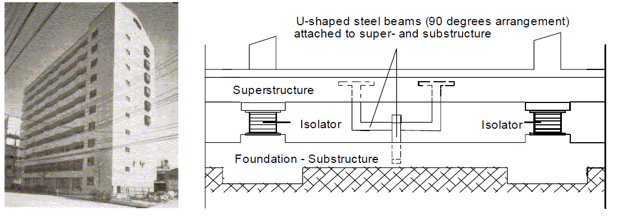
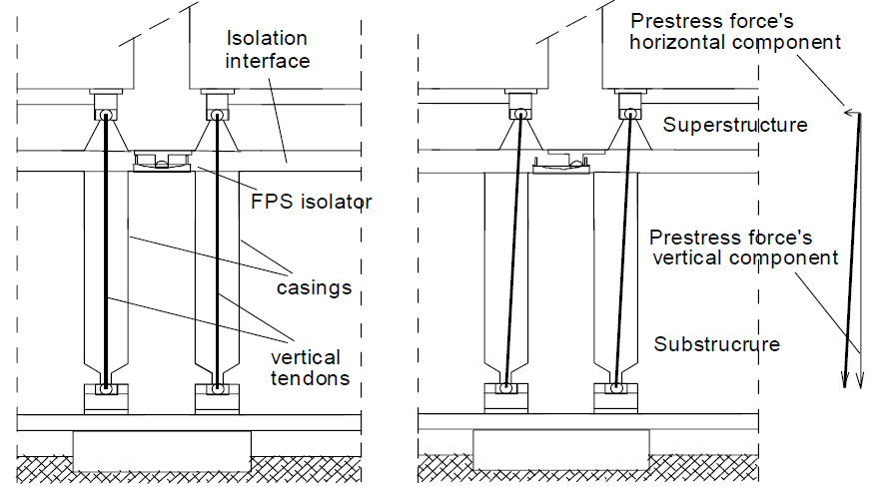
Uplift restraint system (Minami-Koshigaya building, Japan)
FPS with uplift restraints (isolation devices with prestress system)

Slide 16

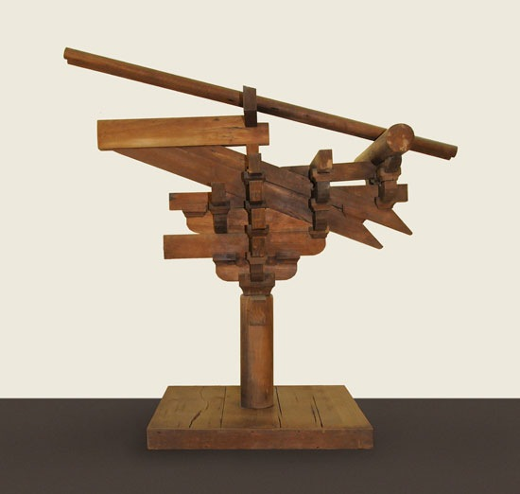
“DOU GONG” 斗拱”
The “Dou Gong” was recognized to be the ancestor of modern passive control devices. From a seismic point of view, it consists of a typical connection detail of traditional Eastern architecture. Apparently, the use of multiple “dou gong” constitute an effective dissipation strategy against earthquakes.

Slide 17
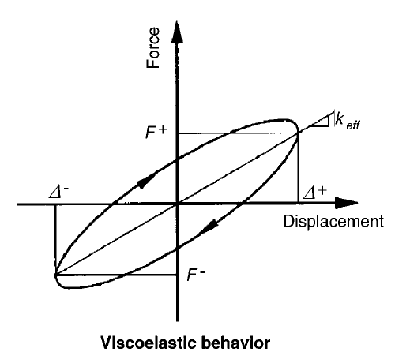
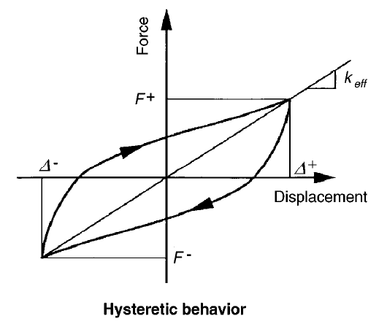
ENERGY DISSIPATION SYSTEMS/DEVICES
Rate dependent dissipation devices:
Acrilic/ viscolelastic
High damping rubber
Viscous fluid
Spring viscous
Oleodynamic
Rate independent dissipation devices:
Friction metal bracings
Friction rotation joints
Friction articulated quadrangles
Lead extrusion
Yiealding steel bar
Yielding steel honeycomb
Yielding steel clessidra

Slide 18

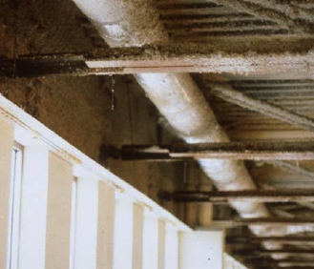
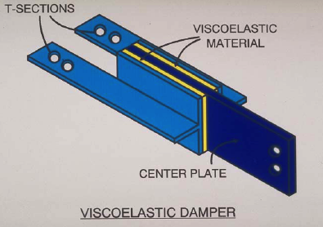
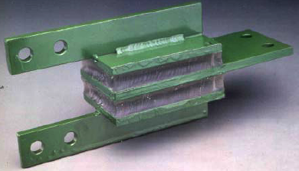
Rate dependent dampers
VISCOELASTIC DAMPERS
Detail of the
World Trade Center:
Viscoleastic dampers

Slide 19
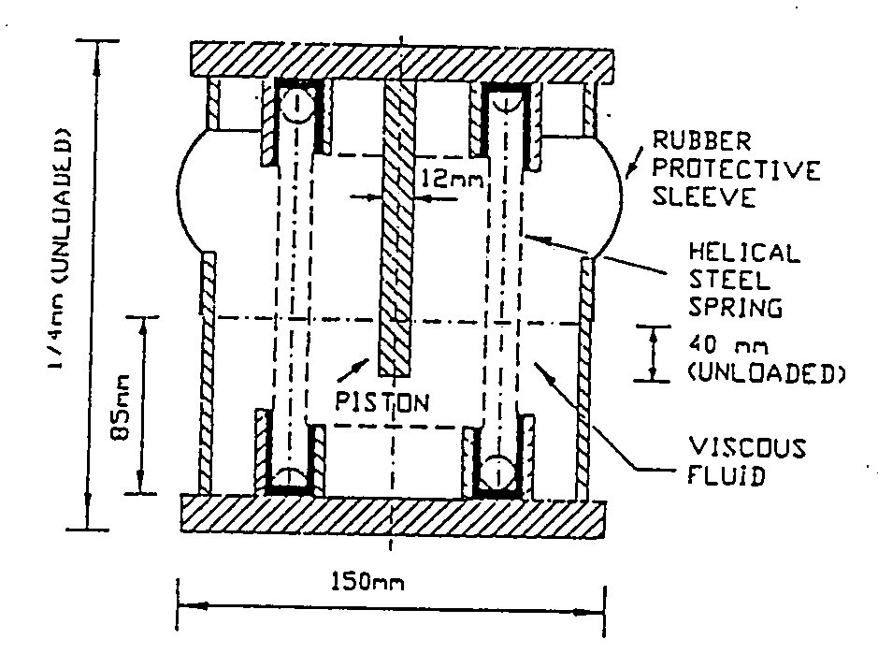
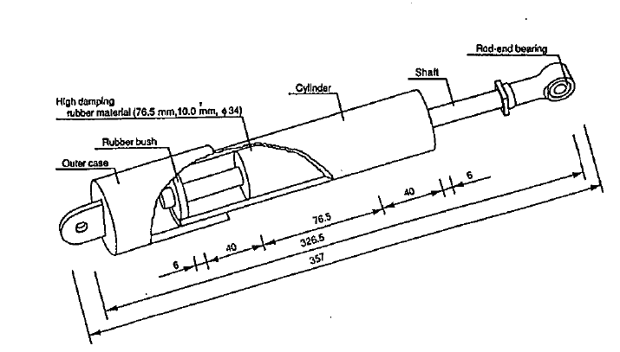
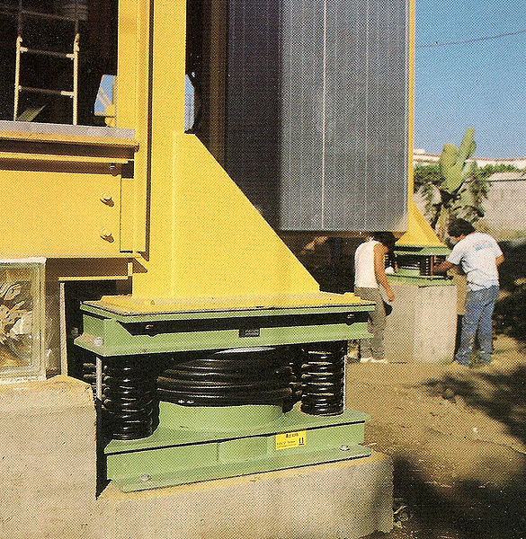
RUBBER DAMPERS
SPRING VISCOUS DAMPERS
They can be either of the sandwitch type or the cylindric one. Generally they use high damping elastomeric material, e.g. SEBS (Styrene-Etyrene-Butadien-Styrene).
The figure below reports a typical cylindric rubber dissipator.

Slide 20
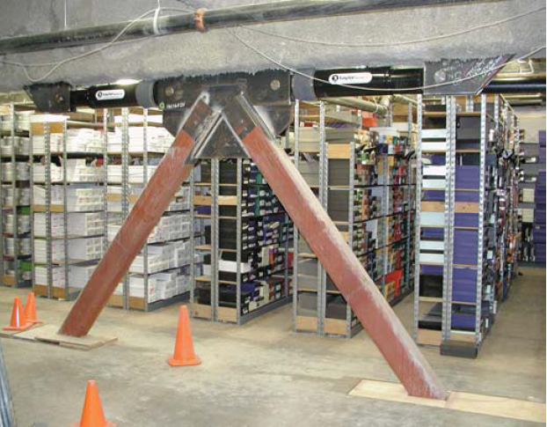
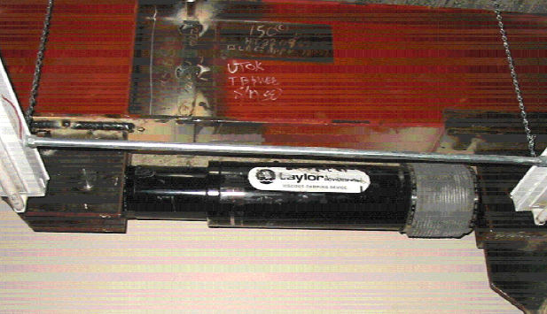


VISCOUS FLUID DAMPERS
A Viscous fluid dampers (VFD) (e.g. oil, silicon etc.) consists of oil cylinder, piston, piston rod, lining, medium, pin head and other main parts. The piston is equipped with damping structure and the cylinder is full of fluid (oil, silicone etc) damping medium.
Example of «chevron» bracing with viscous fluid dampers.
Typical force-displacement cycle at constant velocity.

Slide 21


Integrating VFDs in bracing systems
DIAGONAL
CHEVRON

Slide 22

Integrating VFDs in bracing systems

Slide 23




Rate independent dampers
Earthquake Engineering 15.22
FRICTION DAMPER BRACED SYSTEM (FDBS)

Slide 24



FRICTION DAMPERS
Demonstration of a friction articulated quadrangle.
Beam-column connection with rotational friction damper
“Sumitomo” friction damper

Slide 25

LEAD EXTRUSION DAMPER

Slide 26






YIELDING STEEL DAMPERS
Main characteristics:
Definite hysteretic behaviour
Number of significant cycles: 20 to 40
High dissipation efficiency
APPLICATION: Centro Direzionale ENEL, Naples
CRESCENT-SHAPED ELEMENTS
DISSIPATING ELEMENT WITH DOUBLE TAPERED PINS AND HYSTERETIC CYCLE

Slide 27





Characterization test of the Butterfly element
APPLICATION: Bolu Viaduct, Istanbul – Ankara motorway
BUTTERFLY ELEMENTS

Slide 28




SLIDING ELEMENTS:
flat surface sliders with dampers
APPLICATION: Sa-Chun Bridge, Corea del Sud
APPLICATION: Marquam Bridge, Oregon, USA

Slide 29


Hysteretic behavior of the honeycomb damper
HONEYCOMB ELEMENT
Integration of the honeycomb damper in a frame

Slide 30



Added Damping And Stiffness (ADAS)

Slide 31

DYNAMIC CHARACTERIZATION OF SEISMIC DEVICES
As for the dynamic characterization of devices, they are tested in the direction of their dissipation behaviour, which can be either rate independent (e.g. hysteretic) or rate dependent (e.g. viscous), or a combination of the two cases.

Slide 32



Slide 33


SPECIAL ELEMENTS:
ER, MR, SHAPE MEMORY ALLOYS
Comparison between shape memory alloy (black) and steel ties (fucsia)

Slide 34




The shape memory alloy devices were used to connect the roof to the walls of the two transept tympani.
APPLICATION: Basilica di San Francesco, Assisi, Italy
(damaged by 1997 Umbria-Marche earthquake)
During September 1997 Umbria-Marche earthquake, the Basilica di San Francesco in Assisi suffered the partial collapse of the frescoed vaults and the detachment of several blocks from the tympanum of the left transept, caused by the pounding of the roof.
The subsequent restoration and seismic reinforcement work led to the reopening of the upper church in November 1999. Two types of devices were used for the reinforcement:
- shape memory alloy devices;
- dynamic constraint devices (hydraulic couplers or shock transmitters), similar to fluid viscous dampers that still allow deformations at low velocities, but are blocked in the typical range of velocities induced by earthquakes.

Slide 35


ISOLAMENTO SISMICO DEI PONTI
Elasto-Plastic device on all piers.
Elasto-Plastic device on a single pier.
Coupling a bearing system with a shock transmitter:
SL= sliding support
EP= Elasto-Plastic device
ST= shock-transmitter
The use of a viscous oleodynamic damper, ST, makes the structure statically indeterminate for dynamic actions (seismic, wind) and, at the same time, makes the device not interfere with slow actions (creep, temperature, foundation settlements, etc.).

Slide 36



Elasto-plastic device on all piers.
Coupling a bearing system with a shock transmitter:
SL= sliding support
EP= Elasto-Plastic device
ST= shock-transmitter
RION-ANTIRION, main bridge (Greece)
Details of the isolation system

Slide 37


DAMS
Scheme of a dam isolated with air-bags
Dam behavior in case of explosion without or with isolation system

Slide 38





APPLICATIONS OF SEISMIC ISOLATION
Visco-elastic dampers installed in the Gentile Fermi school in Fabriano
Seismic isolation on plants: tanks of EgeGaz in Aliaga (Turkey)
Bronzi di Riace, system with marble rolling balls (horizontal shock evader) and vertical damper between steel plates.

Slide 39








F. JOVINE SCHOOL IN SAN GIULIANO DI PUGLIA
Collapse after 31–10-2002 earthquake
Firemen station in Foligno: (64 HBRD+4 SD)
Reconstruction
Model of the final project
Seismic retrofitting of the Santuario della Madonna
delle Lacrime in Siracusa

Slide 40




DIFFUSIONE DELL’ISOLAMENTO SISMICO

Slide 41



Edifici sismicamente isolati in: Giappone, Cina e
USA

Slide 42
STRUCTURAL CONTROL STRATEGIES
PASSIVE CONTROL
Base isolation
Energy dissipation
Tuned mass systems (tmd, tld)
ACTIVE CONTROL
Active control
Hybrid control
Semi-active control

