Slide 1
Seismic Protection of historical buildings
Lesson 3
Prof. Rosario Ceravolo – Eng. Gaetano Miraglia
Politecnico di Torino

Slide 2
STRUCTURAL CONTROL
In particular, when addressing civil engineering structures, there is considerable uncertainty, including nonlinearity, associated with both physical properties and disturbances such as earthquakes and wind, the scale of the forces involved can be quite large, there are only a limited number of sensors and actuators, the dynamics of the actuators can be quite complex, the actuators are typically very large, and the systems must be fail-safe (Soong 1990).
Modern active control of civil structures officially started in the late Eighties and consolidated during the Nineties.
Many structures, such as tall buildings and flexible spacecrafts, are designed using vibration suppression as a part of the total design. Structural control provides an important new tool for earthquake engineering.
First, a clarification of the difference between active and passive control is in order. Basically, an active control system uses some external adjustable or active device (actuator) to provide control.
Passive control, on the other hand, depends only on a fixed (passive) change in the physical parameters of the structure. Active control depends on current measurements (feedback or feed-forward/closed-loop), unlike passive control.
Control for civil engineering has a number of distinctive features, due to implementation.
Active control systems can be grouped into three categories:
- Purely active (force actuators);
- Hybrid, combining active and passive control technologies;
- Semi-active (adjustable physical parameters, no energy added).

Slide 3
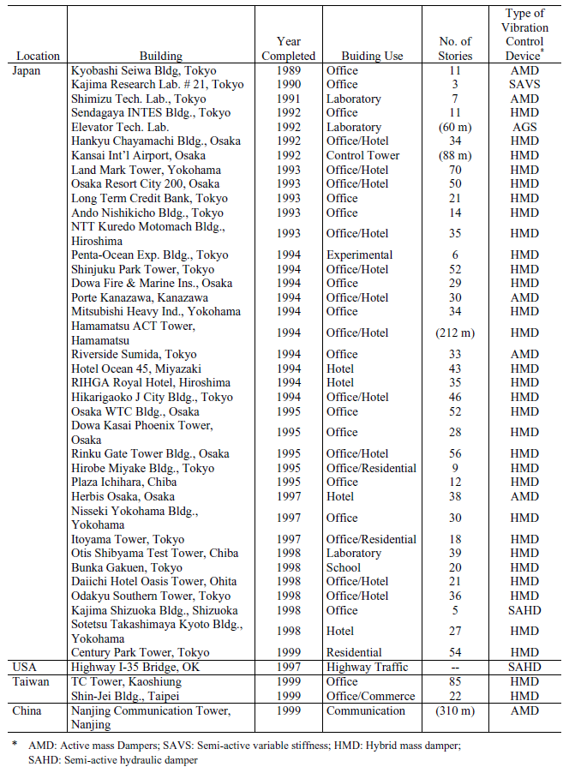
PED: Passive Energy Dissipation

Slide 4
Full-scale example of hybrid control
The hybrid mass damper (HMD) is the most common control device employed in full-scale civil engineering applications. An HMD is a combination of a passive tuned mass damper (TMD) and an active control actuator. The ability of this device to reduce structural responses relies mainly on the natural motion of the TMD. The forces from the control actuator are employed to increase the efficiency of the HMD and to increase its robustness to changes in the dynamic characteristics of the structure. The energy and forces required to operate a typical HMD are far less than those associated with a fully active mass damper system of comparable performance.
An example of such an application is the HMD system installed in the Sendagaya INTES building in Tokyo in 1991. the HMD was installed atop the 11th floor and consists of two masses to control transverse and torsional motions, while hydraulic actuators provide the active control capabilities.
The top view of the control system is also shown where ice thermal storage tanks are used as mass blocks so that no extra mass must be introduced. The masses are supported by multi-stage rubber bearings intended for reducing the control energy consumed in the HMD and for insuring smooth mass movements

Slide 5
Full-scale example of active control
Design constraints, such as severe space limitations, can preclude the use of an HMD system. Such is the case in the active mass damper or active mass driver (AMD) system designed and installed in the Kyobashi Seiwa Building in Tokyo and the Nanjing Communication Tower in Nanjing, China.
The Kyobashi Seiwa Building, the first full-scale implementation of active control technology, is an 11-storey building with a total floor area of 423 m².
The control system consists of two AMDs where the primary AMD is used for transverse motion and has a weight of 4 tons, while the secondary AMD has a weight of 1 ton and is employed to reduce torsional motion. The role of the active system is to reduce building vibration under strong winds and moderate earthquake excitations and consequently to increase comfort of occupants in the building.
In the case of the Nanjing Communication tower, numerous physical constraints had to be accounted for in the system design of the mass damper. The physical size of the damper was constrained to a ring-shaped floor area with inner and outer radii of 3 m and 6.1 m, respectively. In addition, the damper was by necessity elevated off the floor on steel supports with Teflon bearings to allow free access to the floor area.

Slide 6
The final ring design allowed the damper to move ± 750 mm from its rest position. Simulations indicate that this stroke is sufficient to control the tower; however, a greater stroke would allow substantially more improvement in the response. The strength of the observation deck limited the weight of the damper to 60 tons. Lack of sufficient lateral space made the use of mechanical springs impractical for restoring forces. Thus the active control actuators provide restoring force as well as the damping control forces.
The final design of the active mass damper uses three servo-controlled hydraulic actuators, each with a total stroke of ±1.50 m and a peak control force of 50 kN. These actuators are arranged 120º apart around the circumference of the ring. The actuators control three degrees of freedom: two orthogonal lateral directions of motion and torsional rotation, which is held to zero.
Since the frictional force between the Teflon bearings and mass can have a critical influence on the response of the system, a detailed analysis was performed to verify the system performance in the presence of this friction.

Slide 7
Full-scale example of semi-active control
Sack and Patten (1993) conducted experiments in which a hydraulic actuator with a controllable orifice was implemented in a single-lane model bridge to dissipate the energy induced by vehicle traffic, followed by a full-scale experiment conducted on a bridge to demonstrate this technology. This experiment constitutes the first full-scale implementation of structural control in the US.
Control strategies based on semi-active devices combine the best features of both passive and active control systems. The close attention received in this area in recent years can be attributed to the fact that semi-active control devices offer the adaptability of active control devices without requiring the associated large power sources. In fact, many can operate on battery power, which is critical during seismic events when the main power source to the structure may fail. In addition semi-active control devices do not have the potential to destabilize (in the bounded input/bounded output sense) the structural system.
One means of achieving a semi-active damping device is to use a controllable, electromechanical, variable-orifice valve to alter the resistance to flow of a conventional hydraulic fluid damper. A schematic of such a device is given in next figure.

Slide 8
Conceived as a variable-stiffness device, Kobori et al. (1993) and Kamagata and Kobori (1994) implemented a full-scale variable-orifice damper in a semi-active variable-stiffness system (SAVS) to investigate semi-active control at the Kobori Research Complex. The overall system is shown in figure where SAVS devices were installed on both sides of the structure in the transversal direction. The results of these analytical and experimental studies indicate that this device is effective in reducing structural responses.
A semi-active damper system was then installed in the Kajima Shizuoka Building in Shizuoka, Japan. As seen in the second figure, semi-active hydraulic dampers are installed inside the walls on both sides of the building to enable it to be used as a disaster relief base in post-earthquake situations (Kobori, 1998; Kurata et al., 1999). Each damper contains a flow control valve, a check valve and an accumulator, and can develop a maximum damping force of 1000 kN.
It is seen that, under typical design earthquake motion, both story shear forces and story drifts are greatly reduced with control activated. In the case of the shear forces, they are confined within their elastic-limit values while, without control, they would enter the plastic range.

Slide 9
Another class of semi-active devices uses controllable fluids, schematically shown in next figure. In comparison with semi-active damper systems described above, an advantage of controllable fluid devices is that they contain no moving parts other than the piston, which makes them simple and potentially very reliable.
Two fluids that are viable contenders for development of controllable dampers are:
(a) electrorheological (ER) fluids
(b) magnetorheological (MR) fluids
The essential characteristic of these fluids is their ability to change reversibly from a free-flowing, linear viscous fluid to a semi-solid with a controllable yield strength in milliseconds when exposed to an electric (for ER fluids) or a magnetic (for MR fluids) field.
Some obstacles remain in the development of commercially feasible damping devices using ER fluids. For example, the best ER fluids currently available have a yield stress of only 3.0–3.5 kPa and cannot tolerate common impurities (e.g. water) that might be introduced during manufacturing or use. In addition, safety, availability, and cost of the high-voltage required to control the ER fluids need to be addressed.
Recently developed MR fluids appear to be an attractive alternative to ER fluids for use in controllable fluid dampers. MR fluids typically consist of micronsized, magnetically polarizable particles dispersed in a carrier medium such as mineral or silicone oil.

Slide 10
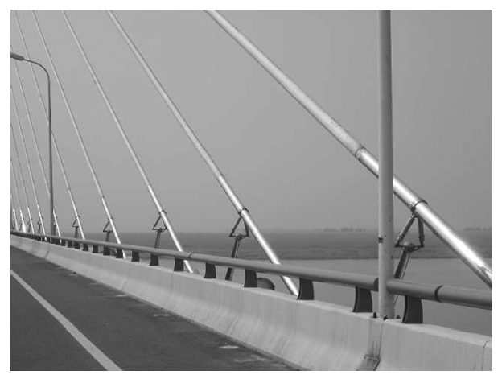
Achievable yield stress of an MR fluid is an order of magnitude greater than its ER counterpart and MR fluids can operate at temperatures from −40 to 150C with only modest variations in the yield stress. Moreover, MR fluids are not sensitive to impurities such as those commonly encountered during manufacturing and usage, and little particle/carrier fluid separation takes place in MR fluids under common flow conditions. The more, controllable devices using MR fluids have the potential of being much smaller than ER devices with similar capabilities.
The first figure comes from the design of a full-scale, 20-ton MR damper (Carlson and Spencer, 1996), see figure showing that this technology is scalable to devices appropriate for civil engineering.
In 2001, two 30-ton MR fluid dampers were installed between the 3rd and 5th floors of the Tokyo Natural Museum of Engineering Science.
In 2002, MR dampers were used to retrofit a cable-stayed bridge crossing the Dongting Lake in China to mitigate rain–wind-induced vibration of the cables (see figure below).

Slide 11
Models for active control
Modern active control methods operate into the space state. In more detail, a state space model for control should satisfy two basic requirements:
- being a reduced order model;
being discrete-time, as output and input are in form of discrete-time samples.
Model reduction
A difficulty with many control methods is that they work with a small number of DOFs, whilst structural systems have a large number of DOFs. One approach to this problem is to reduce the size of the original model to relevant DOFs.
Relevant DOFs are usually those that are directly loaded and cannot be considered as slave DOFs, according to the static reduction proposed by Guyan (1965) .
By defining a slave DOFs vector u₂:
one gets a coordinate transformation from the full coordinate system u and the reduced coordinate system, u₁:
Hence, the second order equation of motion may be rewritten in the reduced form, by introducing reduced mass and stiffness matrices:
The first order state space equation may be then constructed from the reduced matrices and vectors.

Slide 12
Continuous time models for control
Since the complete set of states is difficult to monitor in practical applications, the measured output vector {y(t)} from a limited number of sensors, say p(p‹‹2n), is some combination of the state vector, i.e.
Active control is most often formulated in the state space by:
where 2nx1 state vectors and 2nx2n matrices have a similar definition as in Lesson 6. The only difference regards excitation consisting now of two parts associated to dynamic loading {w} and control force {u}, respectively.
where [D] is the px2n output matrix. In the absence of time delay, the control forces are calculated directly from the multiplication of output measurements by constant feedback gains, or
Furthermore:
where [G] is the qxp time-invariant feedback gain matrix.
In which [B₁] and [E₁] matrices are nxq and nxr connectivity matrices, depending on the q and r locations of control and external forces, respectively.

Slide 13
Controllability and observability
The standard check for controllability of a system is a rank test of a certain matrix. The previous state space system may be demonstrated to be controllable if and only if the 2n x 2nq matrix, defined by
has rank 2n. In this case the pair of matrices [A], [B] is said to be controllable and [R] is called the controllability matrix for the matrix pair.
A similar concept is the idea that every state variable in the system has some effect on the output of the system. This is called observability. A system is observable if by examining the output of the system about the state variables can be determined, which happens when the 2n x 2np matrix
has rank 2n.
Controllability and observability represent two major concepts of modern control system theory. These concepts were introduced by Kalman in 1960.
In very simple systems, controllability is an intuitive concept. The figure represents an uncontrollable system versus a controllable one.
A formal definition of controllable system is often given in the state space system:

Slide 14
Discrete time models for control
State space observer model
The discrete time version of the state space equation for control reads
Recall the discrete equation of a controllable and monitored system (Lesson 6):
having posed
In the general case, states are not measured directly, so the model should be able to distinguish between estimated (with hat) and measured quantities.
A model accounting for this distinction is the state space observer model:
The equation above gives the relationship of states at two consecutive discrete times.

Slide 15
Substitution of the second equation into the first gives:
The equation governing the estimation error reads:
If the observer state matrix is asymptotically stable, then for large k the estimated state tends to the true state.
In principle, one could choose the observer gain matrix [r] to make the state estimator error to diminish as quick as possible (e.g. deadbeat observer gain).
In the presence of unmeasured excitation and noise the quickest observer is the Kalman filter.
Thus one has:
where:

Slide 16
Kalman filter
Errors at time k read:
The Kalman filter is a recursion that provides the “best” estimate of the state vector x.
Let’s simplify notation and assume F_{k} represent the measured dynamic loading and/or control force.
Estimate the state x of a linear stochastic difference equation:
with error covariance matrices:
where apex “-” means after prediction and before observation.
where process noise w (including unmeasured input) is assumed to be white zero-mean Gaussian, with covariance matrix Q.
Define a measurement vector state y:
Kalman filter is employed to update the estimate, as well as the covariance matrix, based on new information coming from measurements.
where process noise v is white zero-mean Gaussian, with covariance matrix R.

Slide 17
Time update (predictor):
- Update expected value of x:
Kalman dimonstrated that the optimal gain is:
- Update error covariance matrix P:
Measurement update (corrector):
- Update expected value of x:
where innovation is:
- Update error covariance matrix P:

Slide 18
Implementation issues
Basic components of an active control system are combination of analog and digital electronics, as well as electro-servo-hydraulics:
Sensors
Digital controller
Control algorithms
Control force generation devices
When only the structural response variables are measured, the control configuration is referred to as feedback control since the structural response is continually monitored and this information is used to make continual corrections to the applied control forces.
A feedforward control results when the control forces are regulated only by the measured excitation, which can be achieved, for earthquake inputs, by measuring accelerations at the structural base.
In the case where the information on both the response quantities and excitation are utilized for control design, the term feedback-feedforward control is used.
Typical issues of active control :
limited number of sensors and controllers/actuators
modeling errors
spillover effect (possible excitation of the unmodeled dynamics)
discrete-time implementation
time delay
control-structure interaction

Slide 19
Time delay, in particular, has always been a major issue. Delay is not due to computation (only a second’s fraction) but to the dynamics of actuators. Hence the actuator dynamic should be included in the model of the structure.
Other practice-based important issues:
custom-designed overall system configuration, software/hardware integration, digital/analog controller integration
custom-designed system status monitoring
automatic operations of force generators
multi-protection fail-safe measures
control performance verification

