Slide 1
Seismic Protection of historical buildings
Lesson 7
Prof. Rosario Ceravolo
Politecnico di Torino

Slide 2
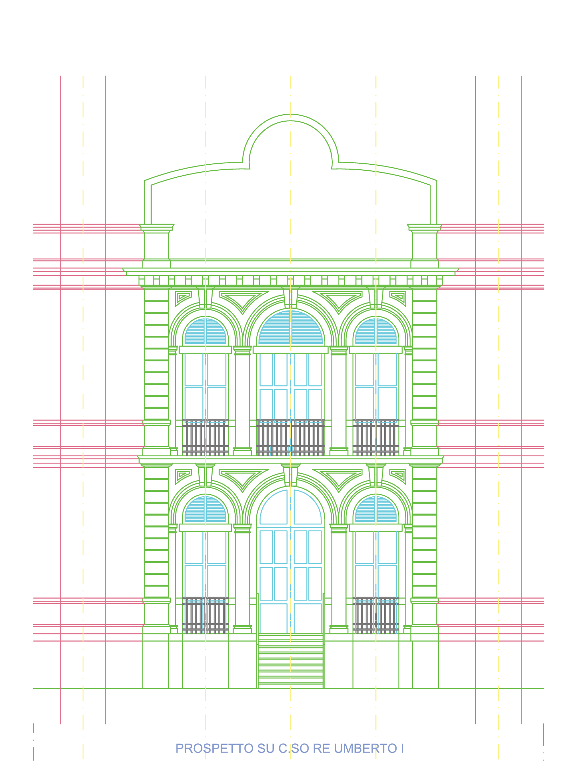
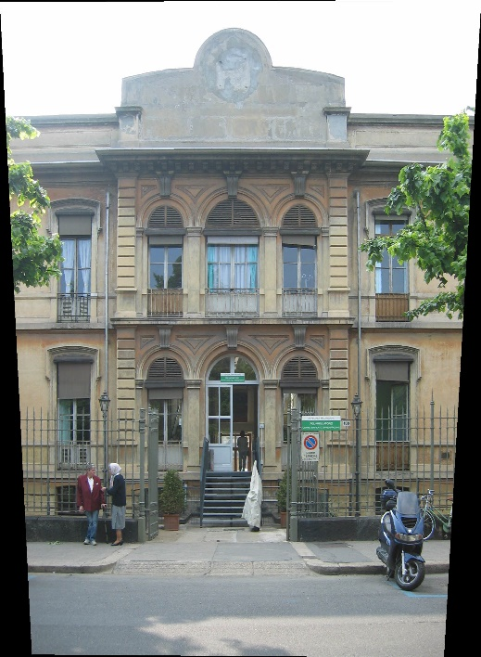
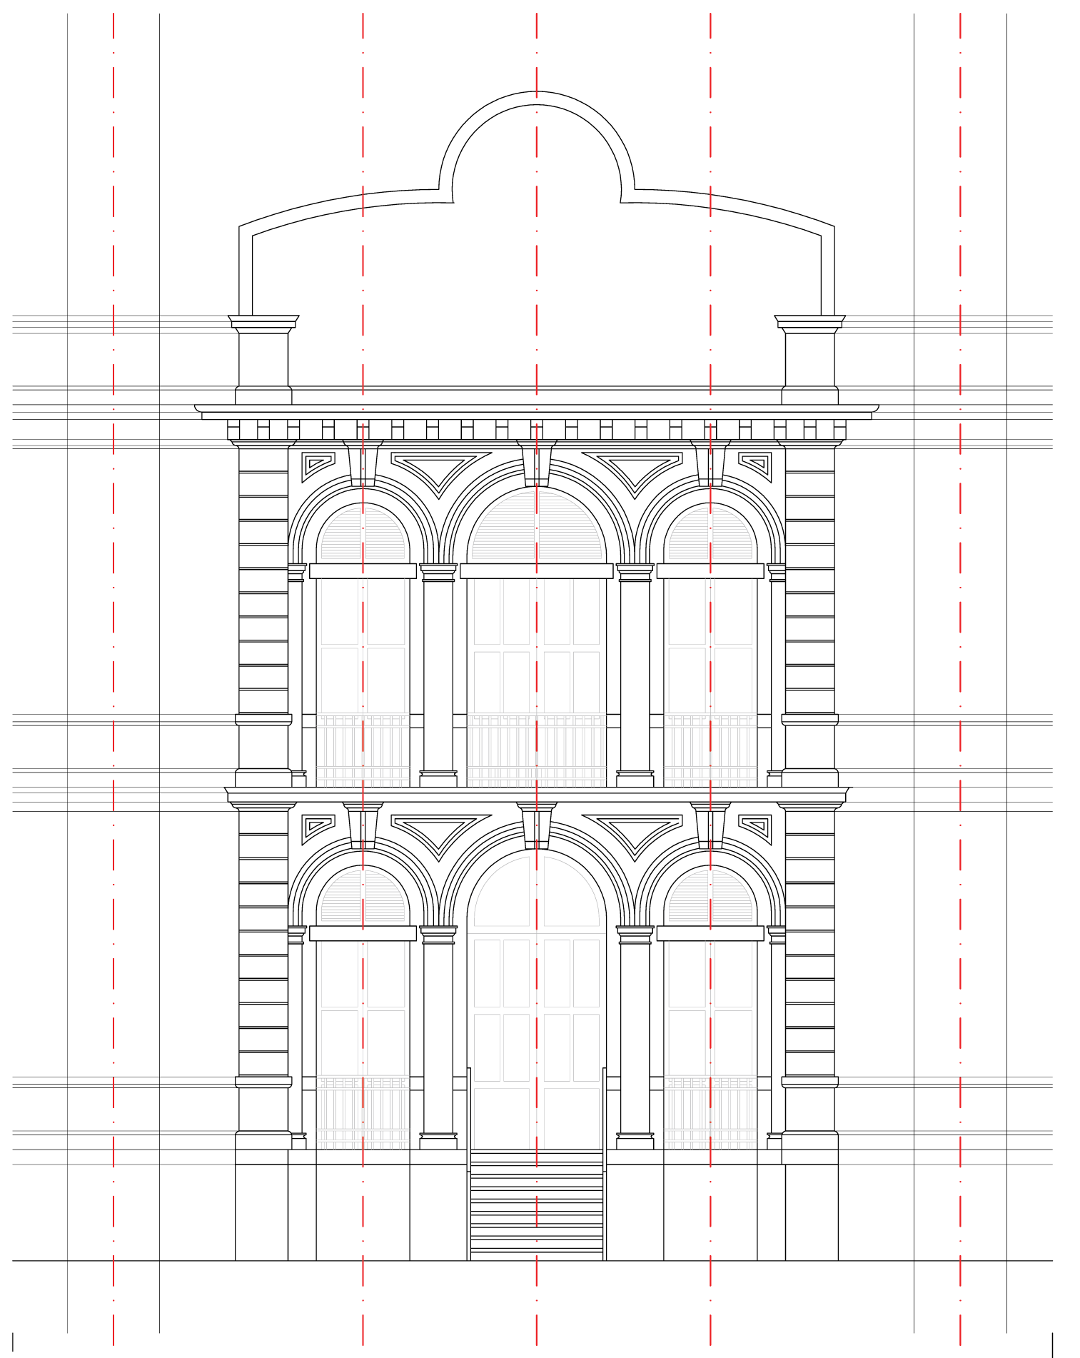
Monographic course on Masonry Structures in Seismic Regions
Prof. ing. R. Ceravolo
Topic: Design and evaluation of masonry structures: existing buildings
Part 3: Knowledge of the building

Slide 3
Levels of knowledge
The identification of the level of knowledge is obtained on the basis of three types of data (Italian standards):
Geometry
Construction details
Properties of materials

Slide 4
Geometry
With regard to geometry, without distinction for the different levels of knowledge (Italian standards):
Survey, floor by floor, of all the masonry elements, vaults, floors, roofing, stairs and their representation in plan, elevation and sections;
Identification of the loads weighing on each wall element.
Type of foundations;
Representation of any cracking state (detachments, rotations, sliding, displacements outside the plane) and deformation (out of plumb, swelling, depressions in the vaults);

Slide 5
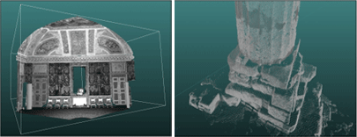
Geometry: Cracking and Deformation State
Digital image obtained by laser scanner
Digital image obtained by laser scanner

Slide 6
Construction Details
The construction details to be examined are (Italian standards):
quality of the connection between vertical walls
quality of the connection between floors and walls and possible presence of floor curbs
existence of lintels with bending resistance above the openings
presence of thrusting elements and any systems able to eliminate the thrust
presence of highly vulnerable elements, including non-structural ones
type and quality of the masonry
Checks are classified in:
Limited on-site checks: they are based on visual surveys, following plaster removal and essays in the masonry. The quality of the connections can also be deduced from the appropriate knowledge of the types of floors and masonry.
Extensive and exhaustive in situ checks: they are based on visual surveys, carried out using tests in the masonry. The examination of the construction details, referred to in the previous list, must be systematically extended to the entire building.

Slide 7
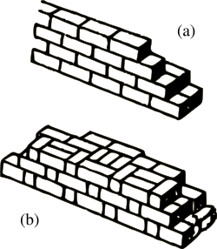
Construction Details: Type of Masonry
Weaving
Presence of transverse elements or diatons (figure)
Shape, type and size of the elements
Horizontality of the positions
Regular joint offset
Mortar quality and consistency

Slide 8
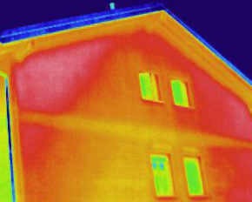
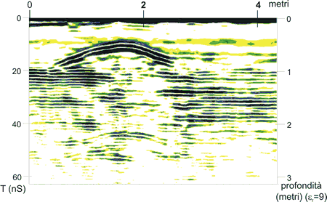
Geometry and Inaccessible Details
Thermographic image:
Humidity of the facade
Image of the discontinuity of the underground obtained through georadar

Slide 9
Properties of Materials
The quality of the masonry must be carefully checked for (Italian standards):
compliance with the rule of art;
the presence or absence of transversal connection elements between the facings, shape, type and size of the elements, texture, horizontality of the layings, regular offset of the joints, quality and consistency of the mortars;
the characterization of mortars (type of binder, type of aggregate, level of carbonation) and of stones and bricks (physical and mechanical characteristics) by means of experimental tests.
Mortars and stones are collected in situ, taking care to remove the mortars inside (at least 5-6 cm deep in the wall thickness).
Investigations on materials are divided into:
Limited in situ investigations: based on visual examinations, they serve to complete the information on the properties of the materials obtained from the literature, or from the regulations in force at the time of construction.
Extensive in situ investigations.
Comprehensive in situ investigations.

Slide 10
Properties of materials: limited in situ verifications
Visual examinations are conducted after the removal of a plaster area of at least 1mX 1m, in order to identify the shape and size of the blocks of which it is made, preferably performed at the corners, in order to check the grips between the walls.
The compactness of the mortar, the monolithicity, the quality of the internal and transverse connection must be evaluated, even in an approximate form, through localized tests that affect the wall thickness.
In the end, a typology consistent with the table annexed to the regulations will be identified

Slide 11
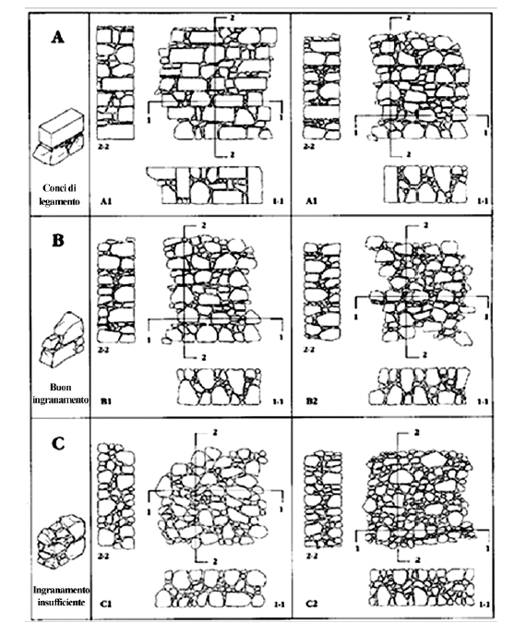
Property of materials: visual examinations
The quality of the masonry depends above all on the geometry and arrangement of the stones that constitute it: stones of such size as to ensure the monolithic nature of the masonry are a sign of the good functioning of the work.
Conversely, if the "aggregate" is small in size, the connection is entrusted to the mortar which by its very nature, especially in older buildings, is often unable to perform its function.

Slide 12
Property of materials: extended in-situ verifications
Visual examinations (already foreseen for limited in situ investigations) must be carried out in an extensive and systematic manner, with superficial and internal tests for each type of masonry present.
A destructive test is required for each type of masonry present (double flat jack, characterization of the mortar and possibly of the block), aimed at typing the masonry according to the table annexed to the regulations. Non-destructive testing in addition, but not as a substitute.
Alternatively, tests on buildings with proven typological correspondence can be used (for materials, sizes and construction details).

Slide 13
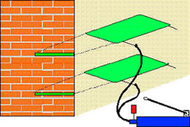
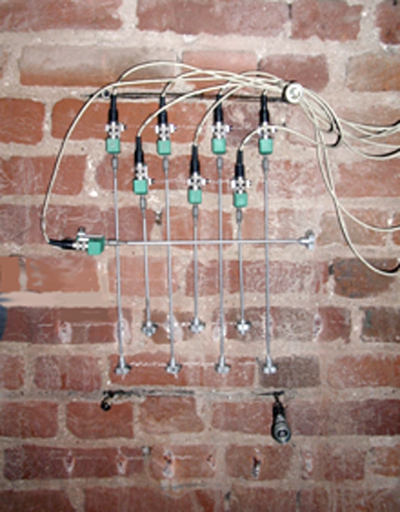
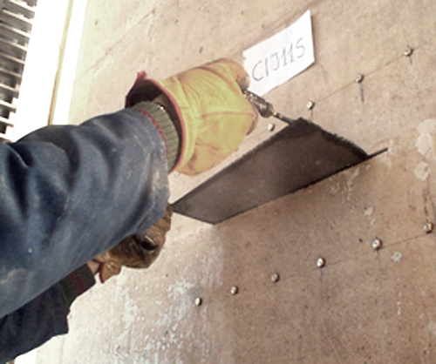
Property of materials: extended in-situ verifications
Images compression test with double and single jack
Mortar: chemical composition of the binder

Slide 14
Property of materials: exhaustive in situ verifications
In a systematic way, as for the extended investigations, visual investigations and superficial and internal essays (endoscopy) will be made.
The measurement of the mechanical characteristics of the masonry is obtained with tests in situ or in the laboratory (on undisturbed elements).
The tests may include diagonal compression or compression-shear tests on panels. Non-destructive testing in addition, but not as a substitute.
In this case, the results will be compared and possibly integrated with those reported in the annexed table.

Slide 15
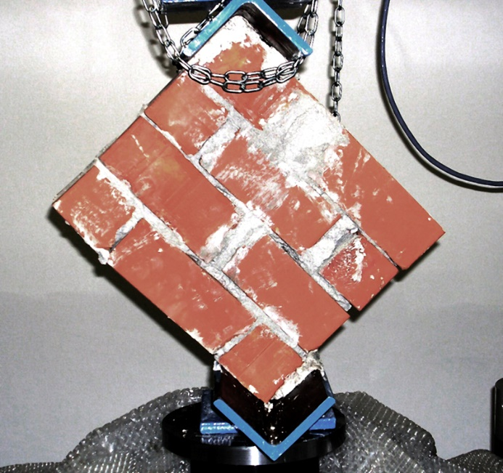
Property of materials: destructive tests in the laboratory
Diagonal compression test
Compression and shear test

Slide 16
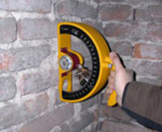
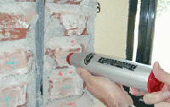
Property of materials: non-destructive tests
Elastic rebound test on blocks (a) and mortars (b)
Sonic test

Slide 17
Levels of knowledge
With reference to the level of knowledge acquired, the confidence factors (FC) are applied (Italian standards):
Level of knowledge | Geometry | Construction Details | Property of Materials | FC
LC1 | Structural survey | Limited verifications | Limited investigations | 1.35
LC2 |  | Extensive and Exhausted checks | Extensive investigations | 1.20
LC3 |  |  | Exhausted investigations | 1.00
The confidence factor FC depends on the level of knowledge, by which the resistance values obtained for the various materials must be divided in order to satisfy the seismic checks.

Slide 18
Levels of knowledge: mechanical parameters
Mechanical parameters:
LC1: the minima of annexed table
LC2: average values of annexed table.
LC3:
  where available at least three experimental resistance values: average of the results.
  where two values are available: if included in the interval of table, the corresponding average value is assumed, if it exceeds the interval, the maximum value of the latter is assumed, if it is lower, the experimental value is assumed.
  where a value is available: if it is included in the interval of table, the corresponding average value is assumed, if it exceeds or is lower, the experimental value is assumed.
For elastic moduli: test average or average values of table

Slide 19
Level of knowledge attachment: historical research
TOOLS | REPORTS and GRAPHICS
Archival research; bibliographic research; study of the historical development of the factory; historical study of the instability and restoration and consolidation interventions; study of contemporary construction techniques; archaeological and stratigraphic research; historical study of exceptional events; cataloging of architectural heritage. | Historical report divided by themes; historical episodes register; plans and graphs relating to historical situations; filing of building units.

Slide 20
Level of knowledge attachment: morphological survey
TOOLS | REPORTS and GRAPHICS
Photographic survey; architectural photointerpretation; survey of reference points and straightening; digitized photographic images; manual measurement; photogrammetric restitution by means of automatic programs. | Planimetry; plans of the various floors; roofing plan; listed plans; prospectuses; sections; details of the finishes; decorative details; photographic documentation.

Slide 21
Level of knowledge: survey of masonry structures
TOOLS | REPORTS and GRAPHICS
Identification of load-bearing walls; identification of the materials and the wall weaving by means of: direct visual tests, perforations and endoscopies, thermographs; identification of the constructive characteristics of the vaults and domes and survey of the fillings; experimental investigations using flat jacks for the measurement of stress in masonry; dynamic characterization and modal identification tests. | Plans and sections of the structures; drawing of the construction details, with particular reference to the type of masonry and the joints; definition of the deformation and dynamic parameters of the structures; report on the effectiveness of the elements designed to eliminate the thrusts on the basis of static or dynamic experimental measurements; detailed structural diagrams, including all lintels, non-structural elements with high vulnerability and any thrusting elements.

Slide 22
Level of knowledge: survey of wooden structures
TOOLS | REPORTS and GRAPHICS
Measurement of dimensions and identification of essences and warping; survey of the geometry of the structures; survey of connections and construction details; load tests on floors; dynamic tests on floors. | Plans and sections of the structures; drawing of the construction details, with particular reference to the type of masonry and the joints; definition of the deformation and dynamic parameters of the structures; report on the effectiveness of the elements designed to eliminate the thrusts on the basis of static or dynamic experimental measurements; detailed structural diagrams, including all lintels, non-structural elements and systems with high vulnerability and any thrusting elements.

Slide 23
Level of knowledge: survey of concrete structures
TOOLS | REPORTS and GRAPHICS
Identification and survey of the geometry of the structures; identification and survey of the warping and geometry of the floors; survey of the size and geometry of the reinforcements with assays and metal detectors; load tests on floors; dynamic tests on floors. | Plans and sections of the structures; drawing of the construction details, with particular reference to the type of masonry and the joints; definition of the deformation and dynamic parameters of the structures; report on the effectiveness of the elements designed to eliminate the thrusts on the basis of static or dynamic experimental measurements; detailed structural diagrams, including all lintels, non-structural elements with high vulnerability and any thrusting elements.

Slide 24
Level of knowledge: survey of steel structures
TOOLS | REPORTS and GRAPHICS
Identification and survey of structural steel elements; identification and survey of tie rods and metal elements; load tests on floors; dynamic tests on floors; dynamic and static tests on tie rods for the identification of stresses; in situ electrical conductivity and ultrasound tests to verify the continuity of the tie rods. | Plans and sections of the structures; drawing of the construction details, with particular reference to the type of masonry and the joints; definition of the deformation and dynamic parameters of the structures; report on the effectiveness of the elements designed to eliminate the thrusts on the basis of static or dynamic experimental measurements; detailed structural diagrams, including all lintels, non-structural elements with high vulnerability and any thrusting elements.

Slide 25
Identification of damages and instabilities
TOOLS | REPORTS and GRAPHICS
Direct visual investigation of the lesions with control of the position of the stop and measurement of the width using crackmeters; dating and analysis of the evolution of the lesions by visual investigation of pre-existing grouts, plasters, paintings, alloys, consolidations and finishing works; identification of the relative directions and movements that produced in the cracks by analyzing their patterns; direct measurement of overhangs; measures of structural failure and deformation of horizontals by leveling; detection of internal cracks and dislocations in the masonry by means of perforations, endoscopic investigations, ultrasonic radar; ambient and forced vibration tests. | Classification of individual cracks and faults; photographic documentation; scheme of cracking plexuses and instabilities; scheme of the mechanisms of damage and collapse; diagnostic interpretation of dynamic tests and damage models; thematic mappings..

Slide 26
Identification of materials and damage: masonry
TOOLS | REPORTS and GRAPHICS
Chemical-physical analysis of the masonry components (mortars, stones, bricks, blocks); mechanical laboratory analyzes by means of destructive resistance tests on samples of the masonry components; sonic tests on samples of the masonry components; destructive tests of diagonal compression on elements taken from the structures; combined destructive tests of vertical compression and shear on elements taken from the structures; sonic tests on masonry elements; perforations; endoscopic, ultrasonic, thermographic and radar analyzes for verifying the warping and consistency of the masonry; dynamic environmental and forced tests with indirect determination of the mechanical resistance characteristics; in situ tests for the determination of the compressive strength and the modulus of elasticity (double flat jack) and of the shear strength and the tangential modulus of elasticity (eg shove test); survey of the percentage of humidity; survey of the characteristics of the deterioration. | Report on the characteristics of the walls and degradation phenomena; report on the characteristics of the masonry including quantitative information on the strength of the different materials from destructive tests; plans, elevations and sections with an indication of the characteristics of the different types of walls and the phenomena of decay.

Slide 27
Identification of materials and degradation: wooden elements
TOOLS | REPORTS and GRAPHICS
Direct analysis for the detection of defects and the class of wood; laboratory analysis for the identification of the wood species; survey of the percentage of humidity; sonic and ultrasonic analyzes for quality verification; laboratory analysis for the identification of fungi, molds and insects. | Report on the characteristics of wooden materials and on degradation phenomena; graphical drawings with the localization of the various wooden elements and the phenomena of decay.

Slide 28
Identification of materials and degradation: iron elements
TOOLS | REPORTS and GRAPHICS
Chemical-physical laboratory analyzes on samples to determine the characteristics and methods of realization; mechanical laboratory analysis for the identification of tensile strength and ductility; survey of the state of conservation and of corrosion and oxidation phenomena. | Report on the characteristics of the iron and steel elements, and on the degradation phenomena; drawings with the localization of the various metallic elements and the phenomena of degradation.

Slide 29
Identification of materials and degradation: stone materials
TOOLS | REPORTS and GRAPHICS
Identification of origin; ultrasound sampling to define the characteristics of homogeneity and continuity of the various elements. | Report on origin, characteristics and degradation phenomena; graphical drawings with the location of the various stone elements and degradation phenomena.

Slide 30
Identification of materials and degradation: concrete
TOOLS | REPORTS and GRAPHICS
In situ rebound tests and analysis; chemical-physical analysis on samples; mechanical analysis on core samples; ultrasound sampling for the definition of continuity characteristics; identification of metal reinforcements through direct investigations and with metal detectors; identification of cracking and degradation phenomena of concrete and corrosion and oxidation of reinforcements. | Report on the characteristics of concrete and metal bars; graphic drawings with the localization of the concrete elements and structures with localized degradation phenomena.

Slide 31
Identification of materials and damage: finishes
TOOLS | REPORTS and GRAPHICS
Physical-chemical analysis of materials; survey and characterization of degradation phenomena. | Report on the characteristics of the finishes and on the phenomena of degradation; thematic graphics with localization of degradation phenomena.

Slide 32
Monitoring
TOOLS | REPORTS and GRAPHICS
Deformometric lights; mechanical deformometric bases; mechanical inclinometer bases; electronic bases with occasional control; dynamic monitoring systems with ambient noise. | -

Slide 33

Knowledge levels according to OPCM 3274:
Hypothesis Of Application To The "Mimo Carle" Pavilion Of The Mauriziano
Umberto I Hospital In Turin
R. Ceravolo, O. Cupi
  Knowledge of the building is divided into the following points:
  Historical archive research;
  Geometric survey;
  Structural survey and levels of knowledge according to the Ordinance P.C.M. 3274/2003 (old Italian standards).

Slide 34
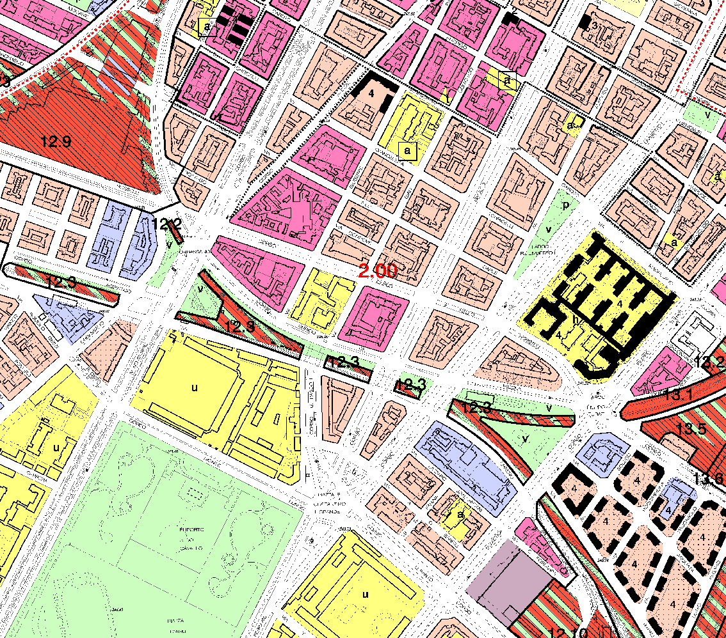
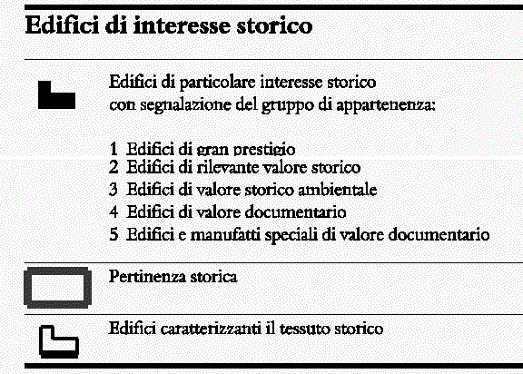
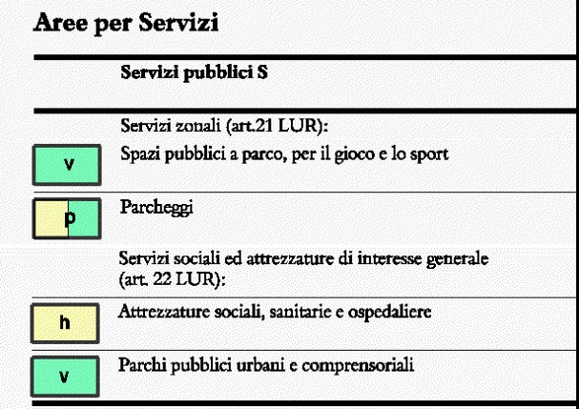
Urban Framework

Slide 35
Archive Historical Research
  It extended to the following archives:
  Archive of the Mauritian Order;
  Historical Archive of the City of Turin;
  Turin Building Archive;
  chronological reconstruction of events

Slide 36
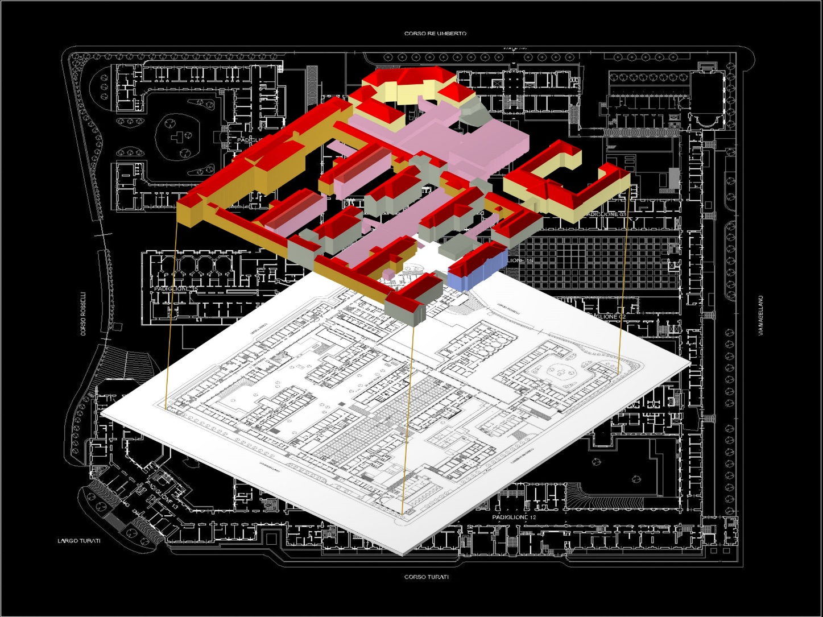
Archive Historical Research
  Historical-volumetric Evolution
2005

Slide 37
Archive Historical Research
  Chronology of events:
  December 1910: Prof. Antonio Carle's offer, for the construction of a new pavilion for the study and treatment of the digestive tracts;
  July 1911: Granting of the building permit;
  September 1912: Inauguration of the "Mimo Carle" pavilion
  April 1931: Granting of modifications to the "Mimo Carle" pavilion:
    - construction of a new gastropathy department in the basement;
    - construction of the interspace along Corso Re Umberto;
    - construction of a connecting tunnel between the pavilion and the adjacent one;
  1990s: Demolition of the aforementioned connecting tunnel;
  2003-2004: Change of intended use - construction of the outpatient clinic and the C.U.P. (Unified Booking Center).

Slide 38
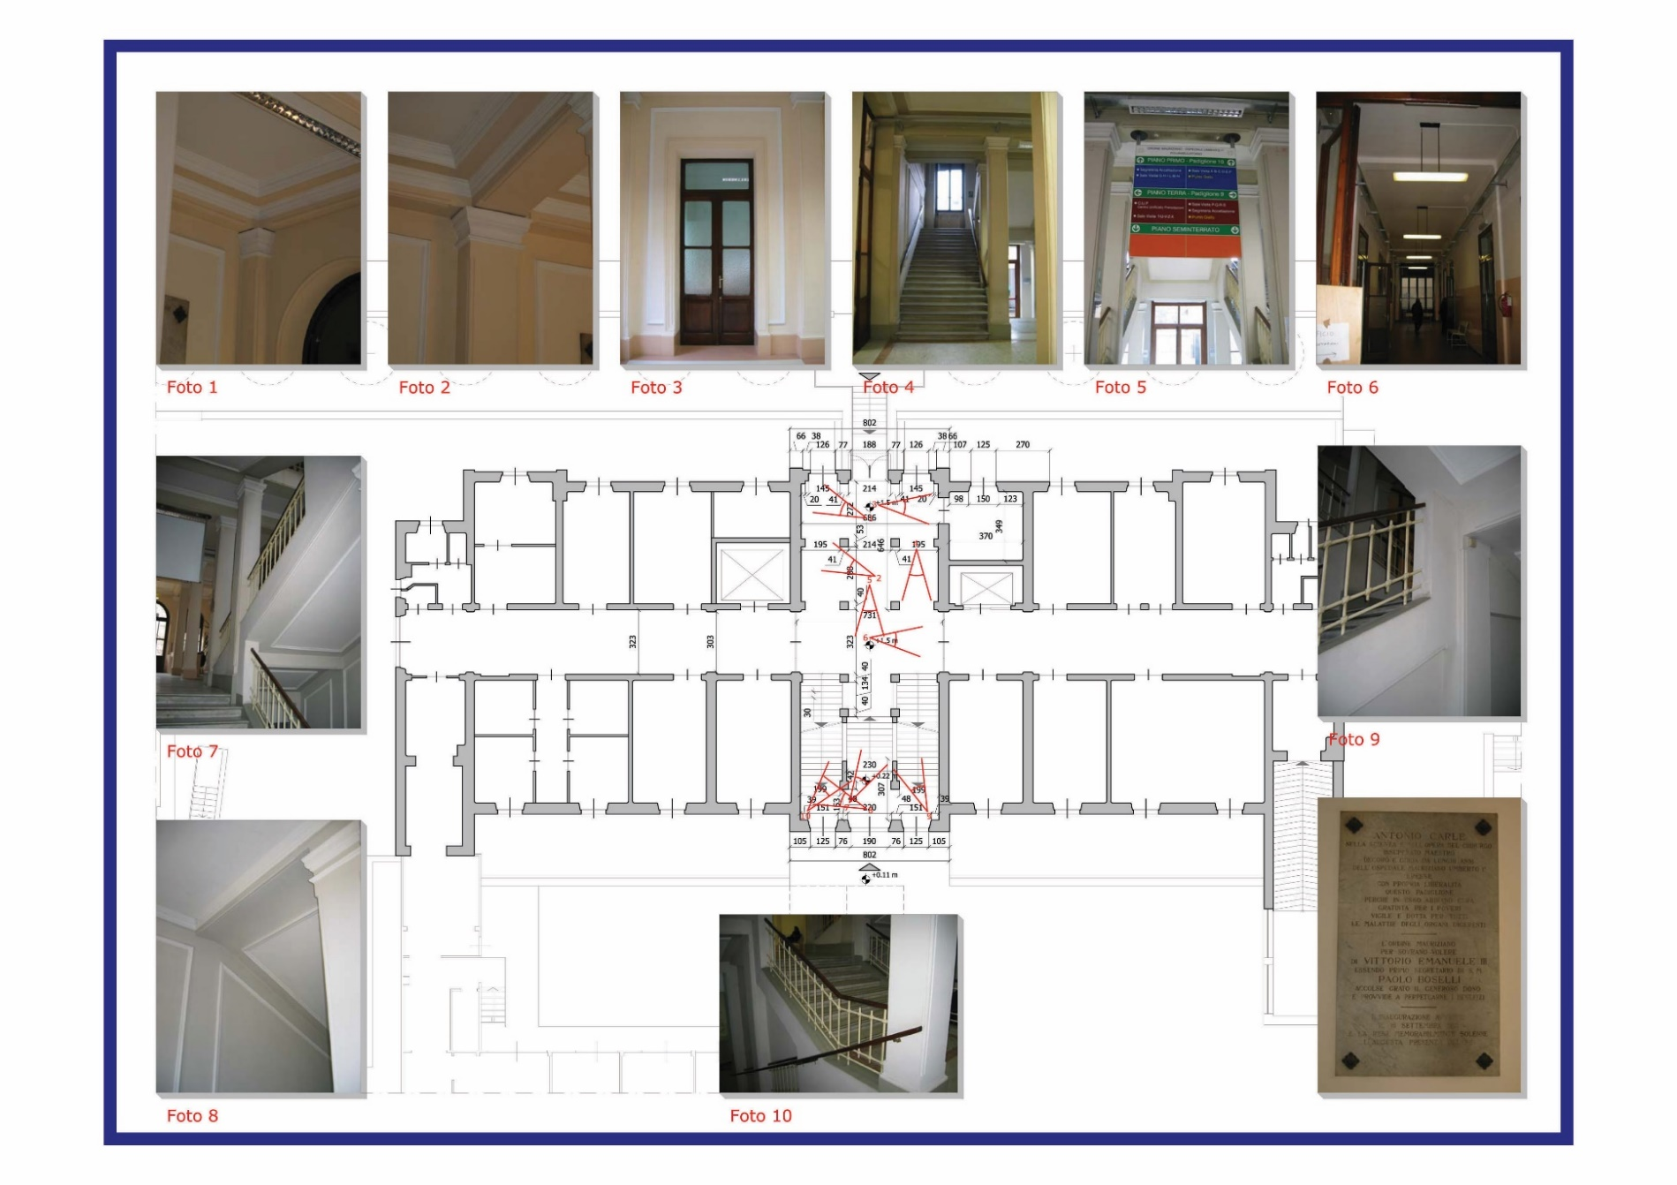
Photographic Survey

Slide 39
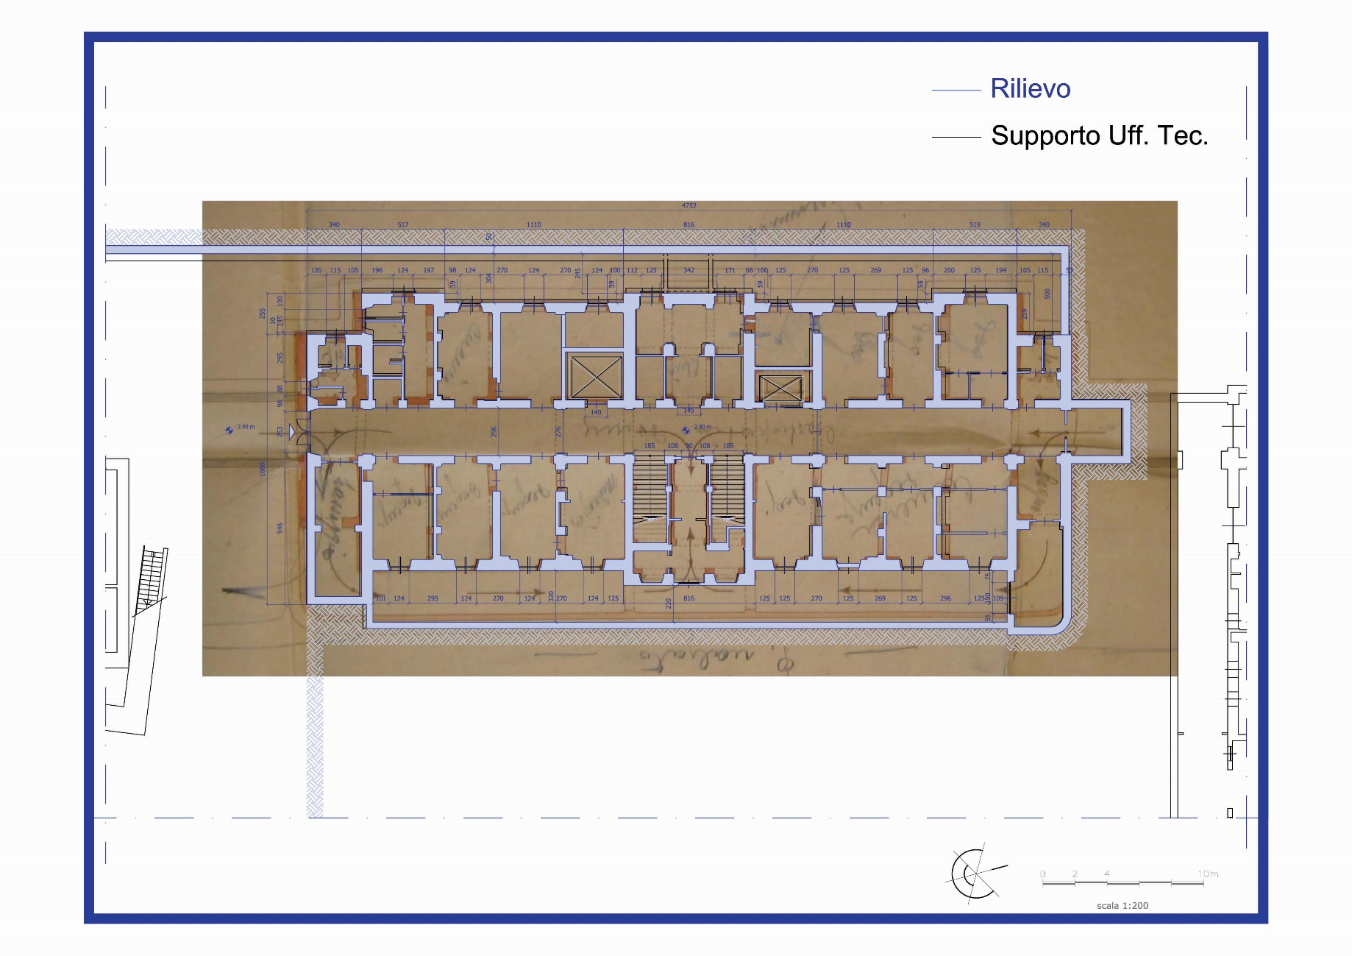
Geometric Survey: Comparison of Base Supports

Slide 40
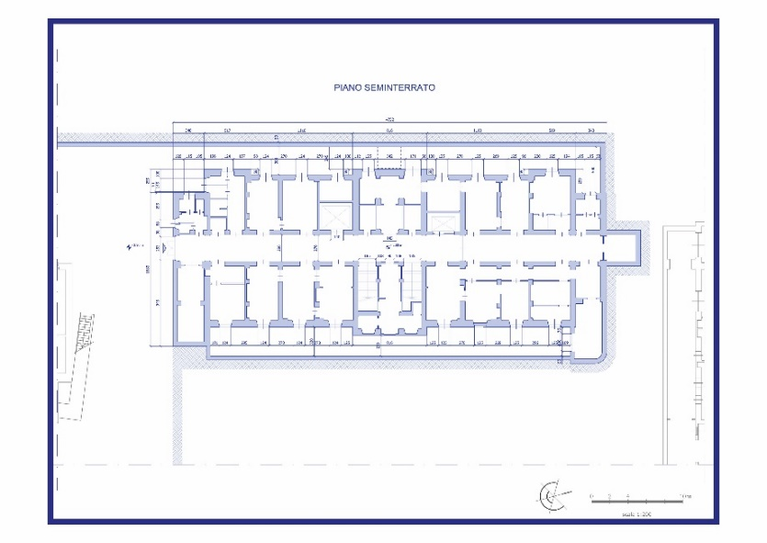
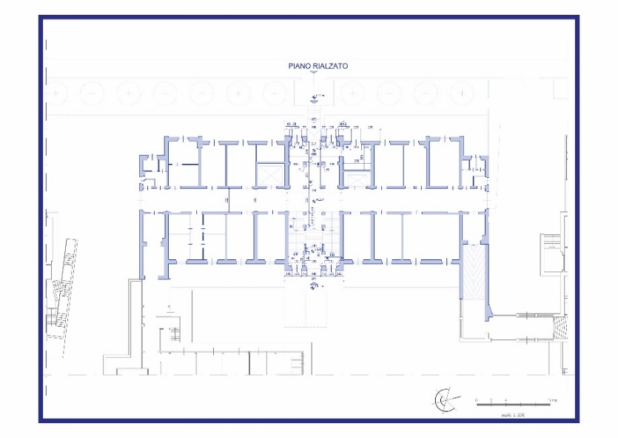
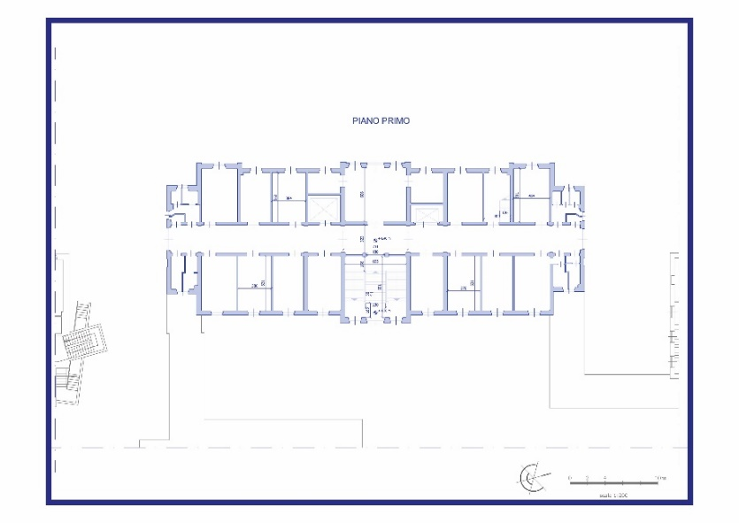
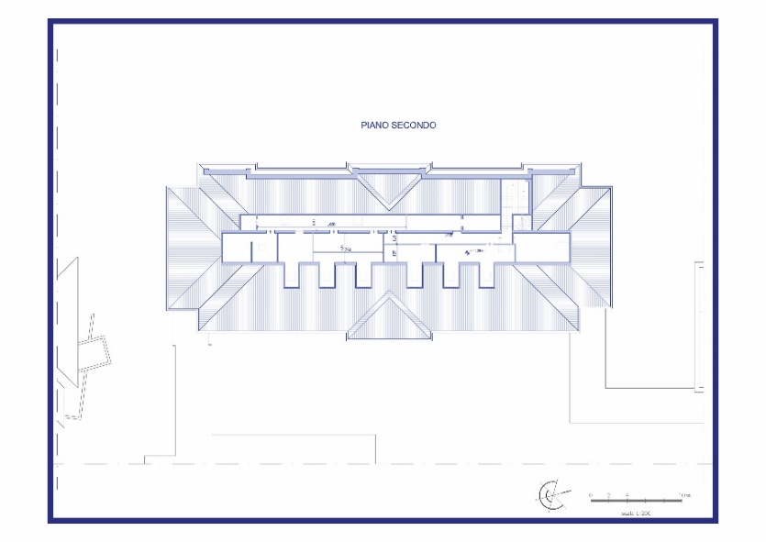
Geometric Survey: Plans

Slide 41
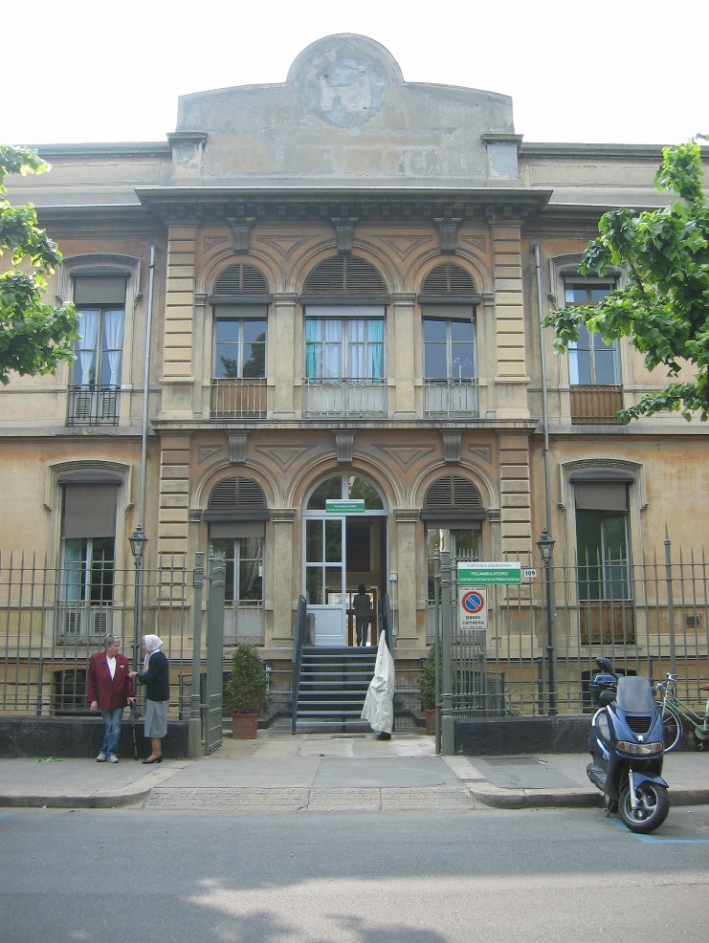

Geometric Survey:
Photographic Straightening

Slide 42
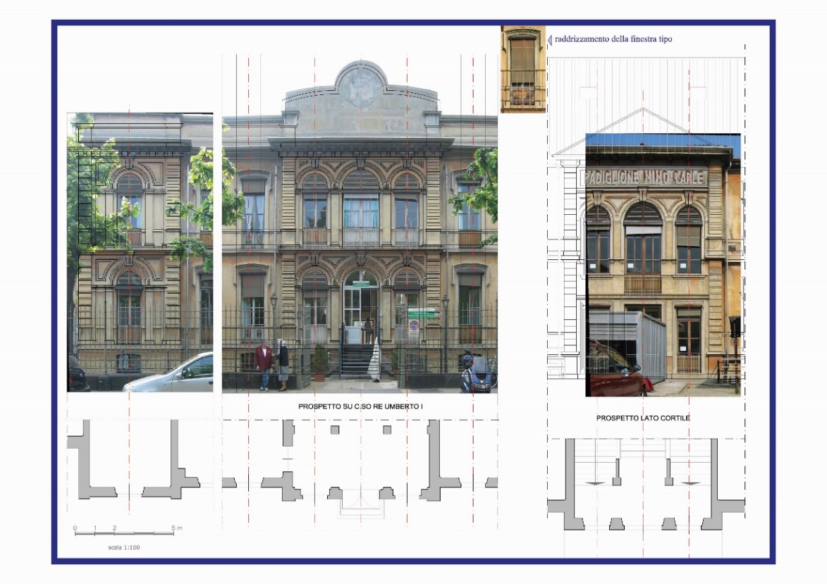
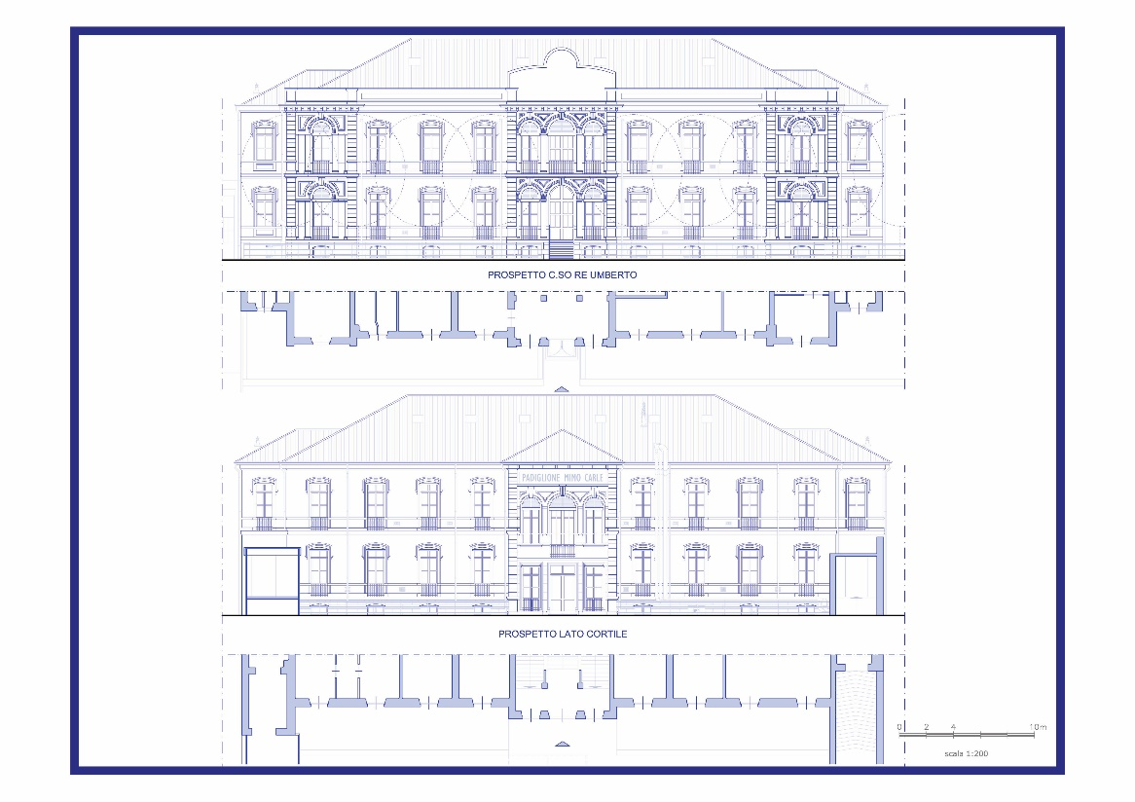
Geometric Survey: Elevations

Slide 43
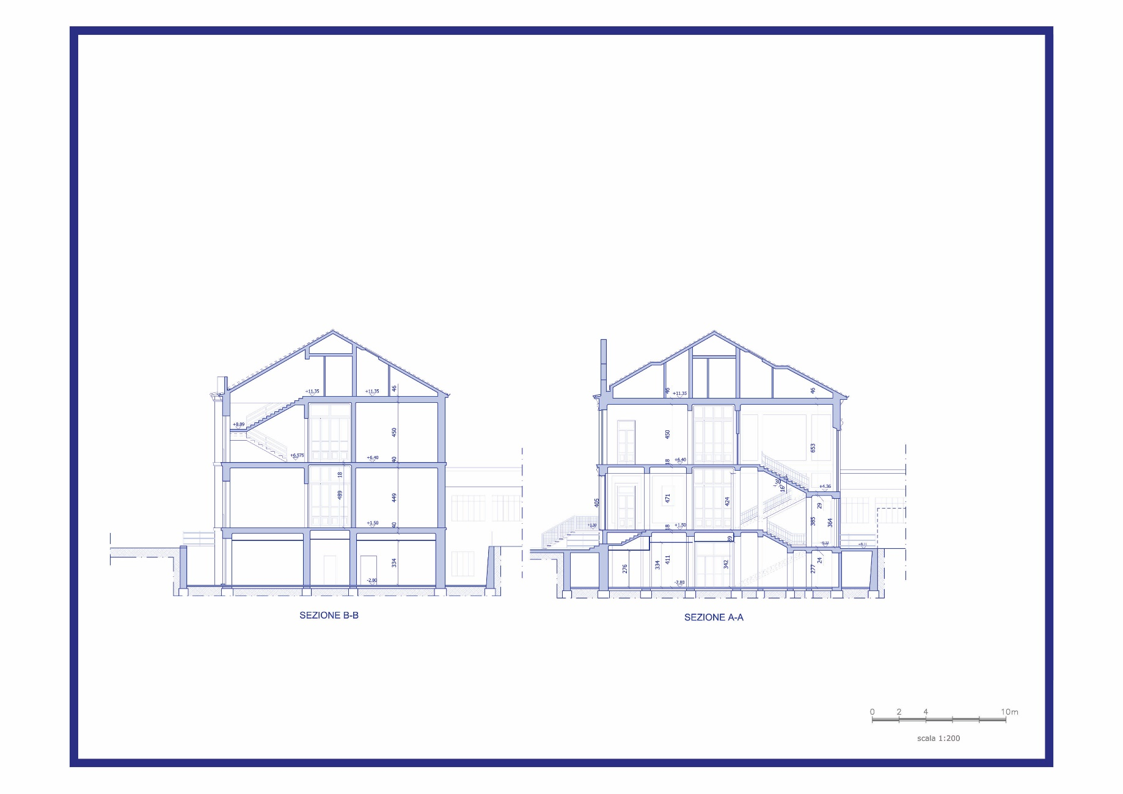
Geometric Survey: Sections

Slide 44
Structural Knowledge:
"Levels Of Knowledge"
  Ordinance 3274 standard deals with existing masonry buildings in point 11.5 of Annex 2.
  The standard identifies 3 levels of knowledge:
Livello di conoscenza | Fattore di confidenza
LC1 | 1,35
LC2 | 1,20
LC3 | 1,00
  The confidence factor FC depends on the level of knowledge (point 11.5.2), so the strength values obtained for the various materials must be divided in order to satisfy the seismic checks.

Slide 45
Order 3274/2003: "Levels Of Knowledge"
  The definitions that in the Ordinance help define the level of knowledge:
  Geometry (structural)
  Construction details:
    they are distinguished:
      Limited on-site checks
      Extensive and comprehensive on-site checks
  Properties of materials: the following are distinguished:
      Limited in situ investigations
      Extensive in situ investigations
      Comprehensive in situ investigations

Slide 46
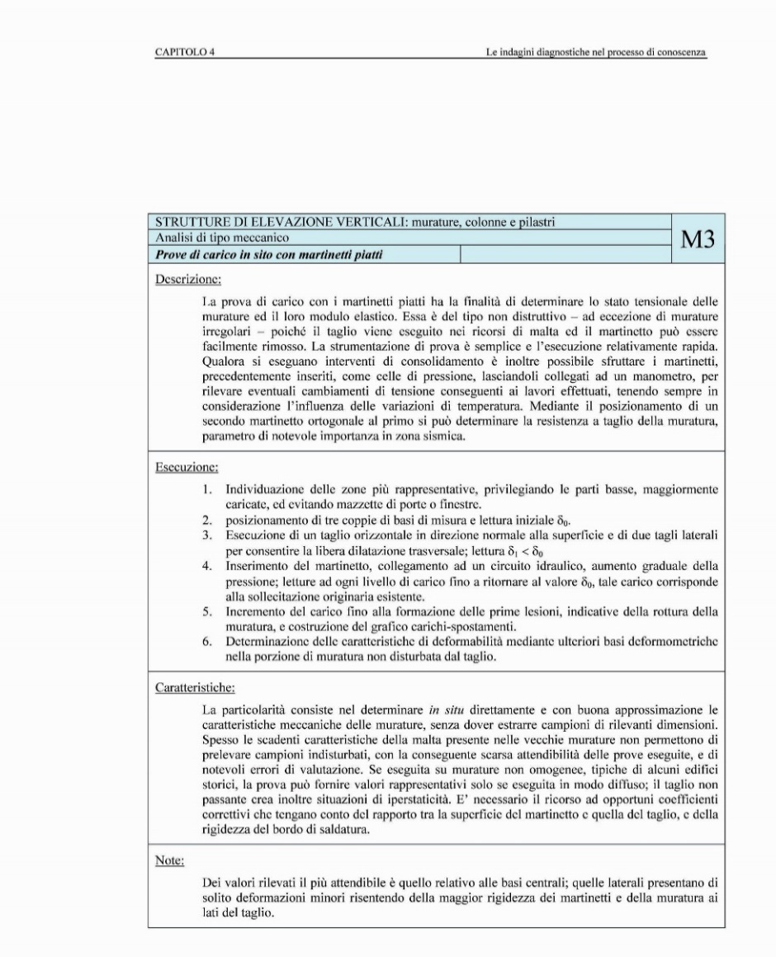
Diagnostics In The Knowledge Process
Type of Analysis
Technology Unit
TEST NAME
Codification
Description
Method of Execution
Characteristics
Notes

Slide 47
"Levels Of Knowledge" Project
  Acquired Knowledge
  Hypothesis on the structural conformation of the building
  Choice of investigations
Drafting of an organic investigation plan

Slide 48
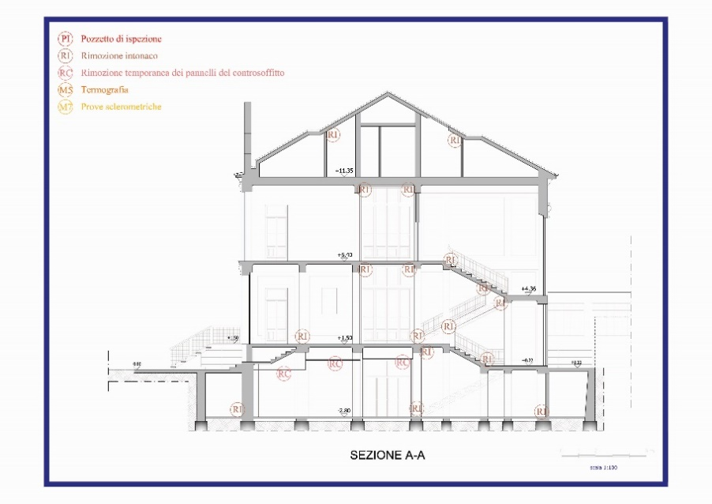
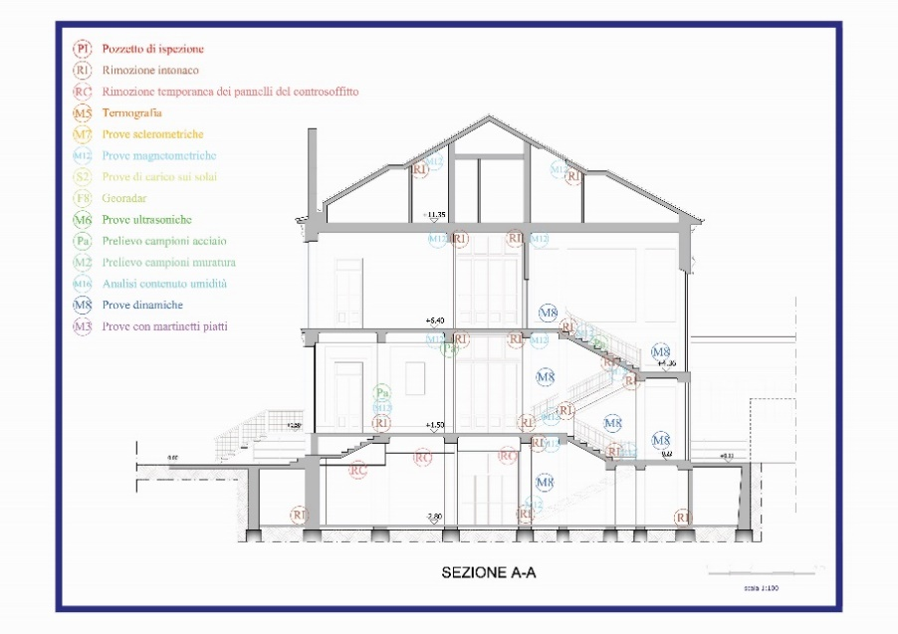
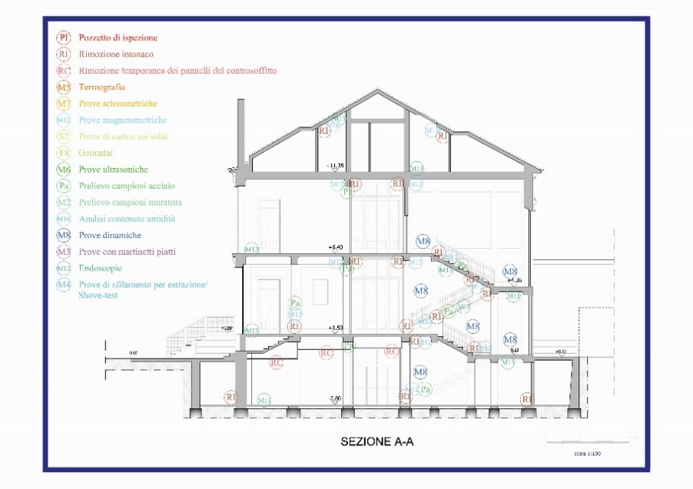
"Levels Of Knowledge" Project

Slide 49
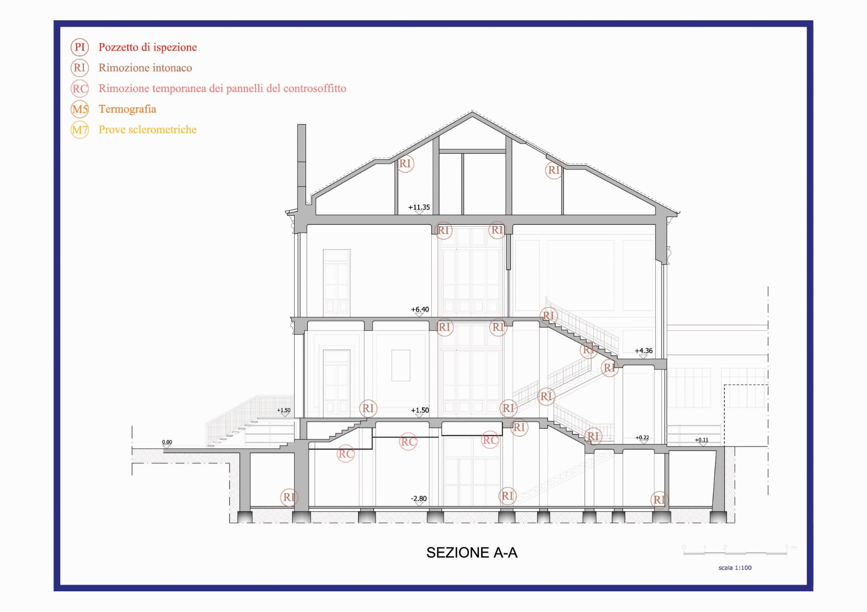
"Levels Of Knowledge" Project

Slide 50
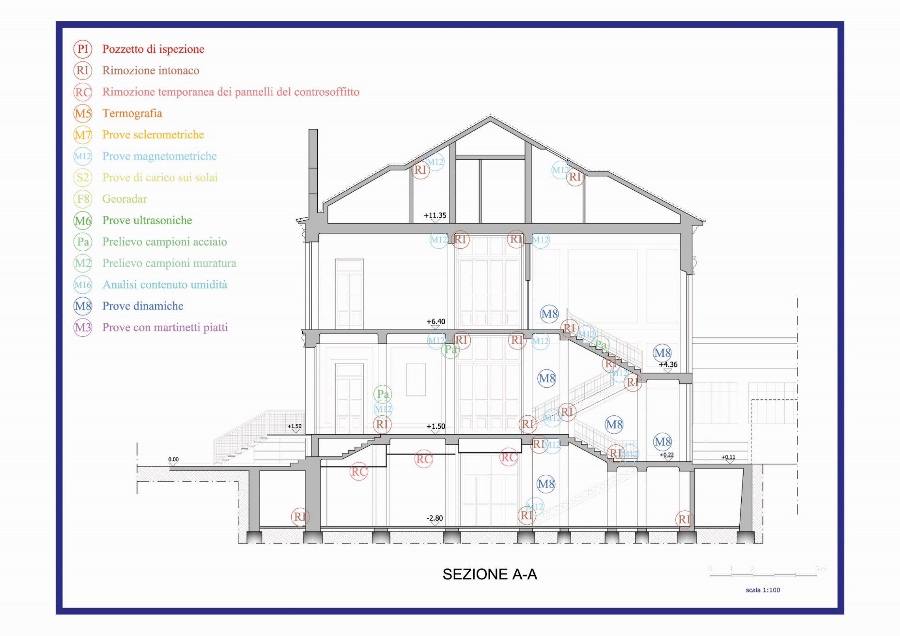
"Levels Of Knowledge" Project

Slide 51
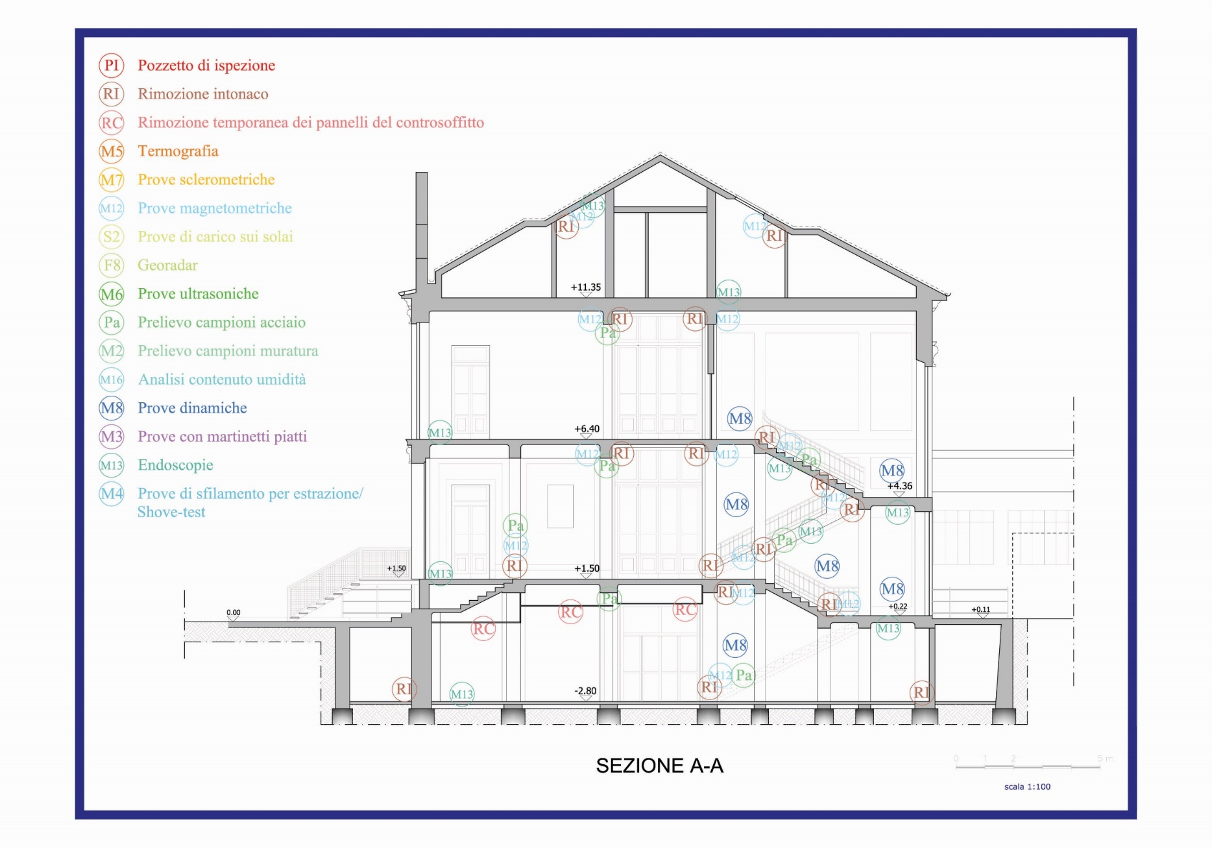
"Levels Of Knowledge" Project

Slide 52
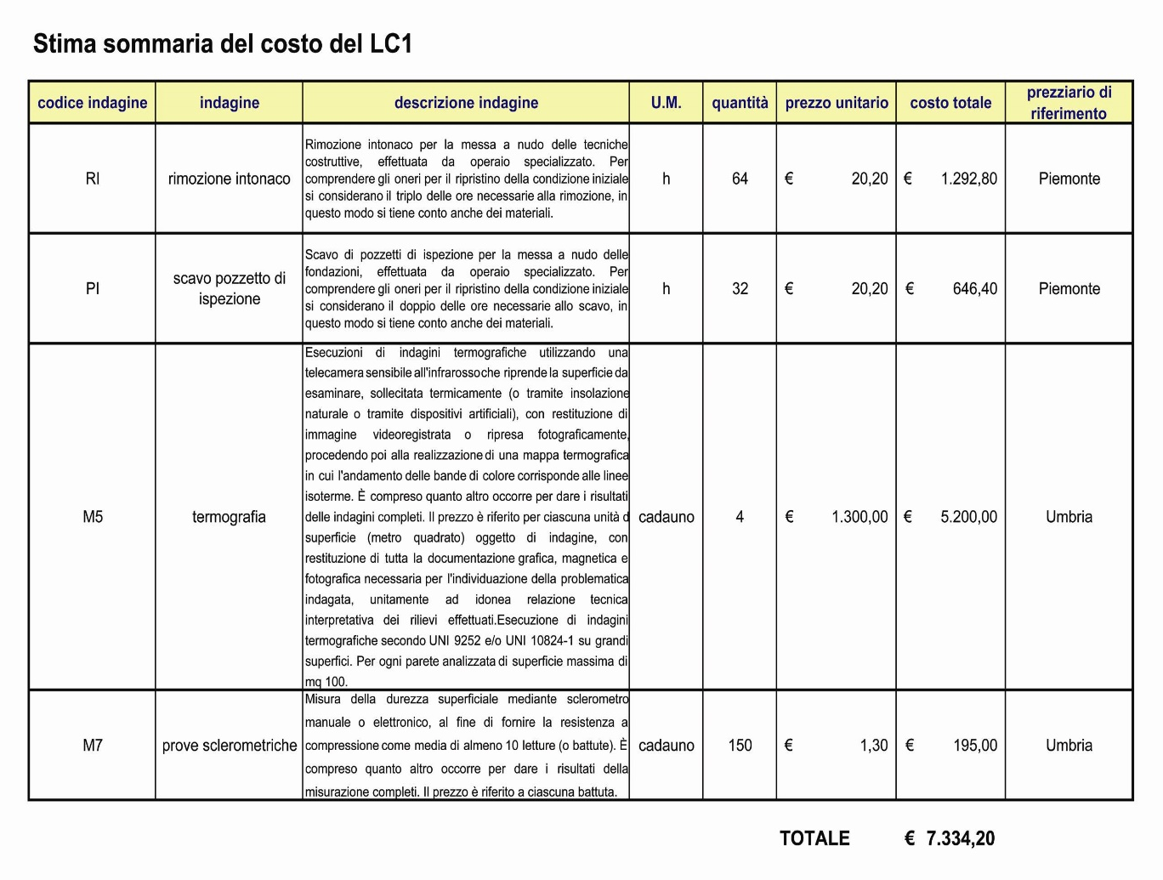
Economic Evaluation
Of The "Levels Of Knowledge"
PURPOSE: credibility and practicality of the knowledge level project.
Summary estimate of the costs of each level of knowledge
Investigation Code
Quantity
Investigation Name
Unit Price
Investigation Description
Total Cost
Unit of Measure
Reference Price
Total Estimated Lc Cost

Slide 53
Economic Evaluation
Of The "Levels Of Knowledge"
To get an idea of the costs of knowledge, the results of the estimates made are reported:
Level of Knowledge | Total Cost Estimated
LC1 | € 7.334,20
LC2 | € 42.744,00
LC3 | € 73.906,40

Slide 54
Out-of-plane verification of non-structural element
Bending check
W_{a}
4,30 m
F_{a}
h/2
0,4 m
1 m
the F_{a} is defined in point 4.9 of the Ordinance.
M_{sd} = F_{a} h/2 = 48,46 kNm
e = M_{sd} / W_{a} = 1,55 m
The action of the earthquake causes the panel to overturn
Solution: stiffen the panel with an additional structure.

