Slide 1
Seismic Protection of historical buildings
Lesson 8
Prof. Rosario Ceravolo
Politecnico di Torino

Slide 2
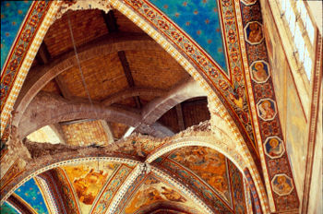
Monographic course on Masonry Structures in Seismic Regions
Prof. ing. R. Ceravolo
Topic: Design and evaluation of masonry structures: existing buildings
Part 4: Guidelines for the evaluation and mitigation of seismic risk to cultural heritage

Slide 3
Contents of presentation
The identification of the level of knowledge is obtained on the basis of three types of data:
Knowledge path (Part 1)
Seismic Safety Assessment (Part 2)
Structural interventions in seismic areas for listed buildings (Part 3)

Slide 4
Reference Italian legislation framework for protected masonry constructions
Circ. 1996
General instructions for the preparation of restoration projects in architectural heritage of historical-artistic value in the seismic area
in fact replaced by chapter 6 of the Directive
D. lgs. 42/2004
Code of cultural heritage and landscape
Art. 29 of the Code - structural improvement
Art.30 -conservation obligations
P.C.M. Directive 12 October 2007
For the assessment and reduction of seismic risk and cultural heritage
Operational guidelines, binding for the cultural heritage but applicable to all masonry and wood constructions

Slide 5
Some significant aspects of the directive
Multiscale analysis: from the territorial to the local scale, of the single building, up to that of the single structural element
Construction safety is measured against stability (ULS) and damage / functionality (DLS) and damage to artistic assets (ALS). Often DLS and ALS coincide, but not always (e.g. thick plasters)
Strict fulfillment of the checks is not mandatory, but the seismic safety index is integrated with the other judgment criteria
Further provisions regarding the knowledge of the building, structural modeling and seismic improvement criteria
Explicit technical reference in Annex 2 of PCM 3274 and its subsequent amendments and additions

Slide 6
Seismic improvement
For the protected cultural heritage it is in any case necessary to follow improvement interventions.
With the term of improvement, we must mean the execution of works capable of providing the building with a greater degree of safety with respect to seismic actions with a level of seismic protection not necessarily equal to that provided for new buildings.
However, it is considered necessary to calculate the ground acceleration levels corresponding to the achievement of each precise limit state for the structural type of the building.
This comparison is one of the quantitative elements to be considered in the overall qualitative judgment (which considers the conservation needs, the will to preserve the building from the earthquake, and the safety requirements in relation to the use and function performed).

Slide 7
Levels of evaluation of seismic improvement
LV1: allows the evaluation of collapse acceleration through simplified methods based on a limited number of geometric and mechanical parameters or using qualitative tools (visual interrogation, reading of construction characters, critical and stratigraphic survey).
LV2: evaluations to be adopted in the presence of local interventions on limited areas of the building, which do not significantly alter the ascertained structural behavior, for which local analysis methods are suggested: in this case the evaluation of the internal collapse acceleration artefact, however requested, is carried out with the instruments of level LV1.
LV3: project of interventions that modify the ascertained structural functioning or when an accurate assessment of the seismic safety of the building is required; in this case, the assessments must concern the entire building, and can use the local models provided for the LV2 level, but applied in a generalized way on the different elements of the building, or a global structural model.

Slide 8
Seismic safety index
The seismic safety index is the ratio between the acceleration that brings the work to a limit state (eg ULS) and the design acceleration.
Importance factor γ_{I} to be applied to the design acceleration corresponding to the standard protection level:
Category of use | Relevance category
 | Limited |  | Average |  | High
 | P. ecc. | γ_{I} | P. ecc. | γ_{I} | P. ecc. | γ_{I}
Occasional or not used | 40% | 0,50 | 25% | 0,65 | 17% | 0,80
Frequent | 25% | 0,65 | 17% | 0,80 | 10% | 1,00
Very frequently | 17% | 0,80 | 10% | 1,00 | 6,5% | 1,20
Table 2.1 - Probability of excess in 50 years accepted for the seismic action (P) and corresponding factors of importance γI for ULS verification of protected cultural assets

Slide 9
Seismic action
According to what is reported in Annex A of the Ministerial Decree January 14, 2008 (TU 2008), the estimate of the spectral parameters necessary for the definition of the project seismic action is carried out by calculating them directly for the site in question, using as a reference the information available in the reference grid (shown in table 1 in attachment B of the Ministerial Decree of 14 January 2008).
With regard to seismic actions, it is convenient to refer to TU 2008, also because an experimental "Response spectra" spreadsheet has been published on the website of the Superior Council of Public Works (file size rar - 40.0 Kb). Version 1.0.3 is on the course / standards page.
Other useful and updated material can be found on the website
http://www.rete.toscana.it/sett/pta/sismica/index.shtml

Slide 10
Knowledge of the artifact
identification of the building.
the geometric survey of the building in its current state including any cracking and deformation phenomena.
identification of the evolution of the building.
the identification of the constituent elements of the resistant organism.
the identification of the material, their state of degradation, their mechanical properties.
knowledge of the subsoil and foundation structures.

Slide 11
Levels of knowledge and confidence factors

Slide 12
For the interpretation of the table it is necessary to refer also to order 3431
For details see the Knowledge Levels Comment document on the course / standards page.

Slide 13
Assessment of seismic safety
The assessment of seismic safety, and verification of the improvement, is carried out with reference to the seismic safety index, defined as follows:
Where a_{SLU} is the ground acceleration that leads to the achievement of the ultimate limit state; γ_{I} is the factor of importance; S is the factor that takes into account the stratigraphic profile of the foundation subsoil and any morphological effects; a_{g} is the reference acceleration of the site.
LEVELS OF ASSESSMENT OF SEISMIC SAFETY
LV1: qualitative analysis and evaluation with simplified mechanical models.
LV2: evaluation of single macroelements (local collapse mechanisms). This level refers to individual parts of the building.
LV3: overall evaluation of the seismic response of the building. This level determines the acceleration of the soil that brings the construction as a whole or individual significant parts (macroelements) to the ultimate limit state. A global model is often used, but it is also possible to break down the structure into macro-elements.

Slide 14
Use of safety assessment levels
LV1: used for territorial vulnerability investigations.
LV2: it is applied in case of restoration interventions involving single parts of the building. In these cases, the assessment of the overall seismic safety can be estimated with the tools of the LV1 assessment level.
LV3: must be adopted in the design of interventions that modify the ascertained functioning of the building and, in any case, when the restoration concerns a strategic building. The assessment can also be performed with the same methods as for the LV2 level but systematically on each element of the construction.

Slide 15
Models and typologies
Although the concept of typology is badly suited to historical artifacts, recurring characters can be recognized in most historical constructions. Exemplary indications are then provided for the analysis and evaluation of the seismic response in the case of the most common types of protected artifacts.
Buildings, Villas and Other Structures With Spine Walls and Intermediate Floors.
Churches and Other Structures With Large Halls, Without Intermediate Floors.
Towers, Bells and Other Structures With Mainly Vertical Development.
Masonry Bridges, Triumphal Arches and Other Arched Structures.

Slide 16
Palaces, villas and other structures with spine walls and intermediate floors
This typology refers to buildings with even complex planimetric development, consisting of a system of perimeter and internal load-bearing walls, arranged in different directions and by a system of intermediate horizontal floors/slabs. The adoption of an equivalent frame model is very realistic. Any interactions with other constructions can be simulated with additional seismic forces or by inserting horizontal constraints of appropriate stiffness.
LV1 - MODEL FOR BUILDINGS
Simplified mechanical model that provides a quantitative assessment of the acceleration of collapse, in the hypothesis that this occurs due to failure of the walls in its own plane, as part of an overall behavior of the manufact.
In the event that the building is more vulnerable to some local mechanism (due to lack of connections), compared to its global behavior, the horizontal acceleration leading to the ultimate limit state of that macro-element must be evaluated and compared with that obtained by the model illustrated below.

Slide 17
LV1 - Model for buildings
With reference to the condition that leads to the achievement of the ULS, it is possible to obtain the value of the spectral ordinate of the elastic response:
F_{SLV} is the shear strength of the building;
q is the behaviour factor, which can be assumed to be between 3 and 3.6, for buildings with regular elevation and number of floors greater than or equal to 2, and between 2.25 and 2.8 in the other cases
E* is the participating mass fraction on the first vibration mode;
M is the global seismic mass.
The shear resistance of the building is obtained as the lowest of those evaluated according to two perpendicular directions, generally assumed according to the prevailing axes of the load-bearing walls. The model consists in considering, for each direction, the vertical bearing wall panels and in assuming that the collapse occurs when the average shear stress reaches a given percentage of the shear strength of the masonry material. Considering, for example, the x direction and a generic floor i, the shear strength is evaluated as follows:
A_{xi} it is the resistant area of the masonry;
β_{xi} a coefficient of irregularity in plan; μ_{xi} a coefficient that considers the homogeneity of stiffness and resistance of the masonry walls;
ξ_{xi} a coefficient related to the type of failure of the walls at i-th floor;
ζ_{x} a coefficient related to the resistance of masonry horizontal strips;
τ_{dxi} the design shear strength of the walls at i-th floor;
к_{i} is the ratio between the seismic shear at the i-th floor and the total seismic force.

Slide 18
Levels of knowledge: types of collapse
The two main recurrent collapse mechanisms in this typology are considered in the assessment:
Collapse due to soft storey, which occurs when one storey is decidedly weaker than the others, so the construction is unable to exploit the dissipative and displacement capacities of the others, which remain in the elastic phase;
Uniform collapse, which occurs when the collapse occurs with the failure of the horizontal masonry strips at the level of the architraves/spandrels, and the vertical elements (panels) collapsing at the base of the first level due to bending.
WEAK FLOOR
UNIFORM
In order to determine the ground acceleration that leads to the attainment of the building collapse limit conditions, it is therefore necessary to determine:
For all storeys except the ground one, the acceleration of the storey collapse (collapse due to soft storey);
For the ground storey, the acceleration evaluated considering both collapse mechanisms

Slide 19
Towers, bell-towers and other structures developing in height
For this typology linear modelling is often reliable, the analysis of choice being therefore the multimodal one.
Simplified bending verifications, with partialization, according to the two main directions of inertia of the section and possibly at different heights.
Sometimes vertical crack patterns are highlighted, which can divide the structure into parts: ideal panels can be identified for the purposes of checks.
In squat towers, shear collapses are often observed after strong earthquakes.

Slide 20
Churches, buildings of worship and other structures with large halls, without intermediate floors
Conceptually different is the modeling for churches:
Very diversified architectural types and geometries. It is impossible to develop a single simplified analytical calculation model;
For churches, a global assessment of the entire building would make little sense, as the collapse occurs distinctly on the individual parts (facade, apse, etc.).
Local mechanisms also occur in buildings, but mainly in the smaller buildings of historic centers, while in buildings the quality of the connections is sufficient to guarantee global behavior.
For the churches, therefore, the proposed models are based on a reading of the constructive characteristics of the building, in the different architectural elements that compose it (macro-elements); in particular, on the basis of the specific vulnerabilities found (poor masonry quality, absence of connections, presence of thrusting elements, etc.) and the presence of construction elements of anti-seismic protection (tie-roads, buttresses, etc.) a score is calculated, called INDEX OF VULNERABILITY.

Slide 21
Churches, buildings of worship and other structures with large halls, without intermediate floors
This index would have a purely qualitative meaning; however, having been evaluated following the recent earthquakes in Italy (Umbria-Marche, Molise, Salò, etc.) it was possible to calibrate it on the basis of a statistical correlation between the seismic acceleration and the limit state of damage or collapse produced.
From the vulnerability index it is possible to trace the seismic acceleration on the ground corresponding to the different limit states. The statistical database is very large (over 3000 churches) and the confidence in the evaluation is very good.
This model has the limit of not being based on a strictly mechanical evaluation, but has the advantage of explicitly taking into account (unlike the building model) all the qualitative information resulting from direct knowledge of the building.
The 28 Mechanisms are Listed in Annex C of the Guidelines together with a List of Related Presidia and Indicators of Vulnerability, the Relevance of which Allows to Define the Vulnerability Index

Slide 22
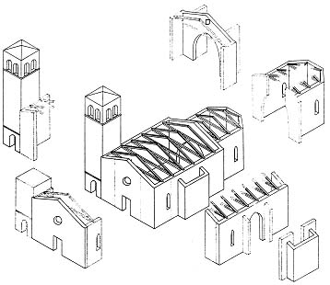
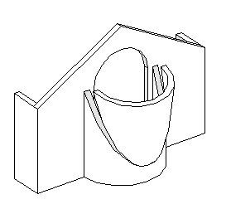
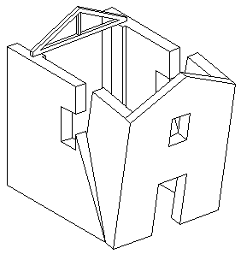
Level of knowledge: survey of wooden structures
Starting from the Umbria-Marche earthquake, the emergency damage survey was done with a form that requires a survey of the damage level in the individual macroelements, recognizing through a qualitative diagnostic judgment the activated collapse mechanism and the sources of vulnerability.
This approach has the necessary speedy character and is useful for:
a) usability; b) emergency works; c) cost estimate; d) start-up and control of projects.
BREAKDOWN INTO MACRO ELEMENTS

Slide 23
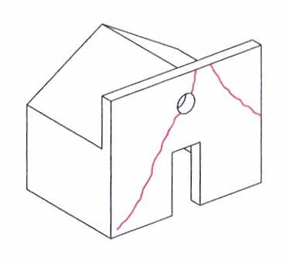
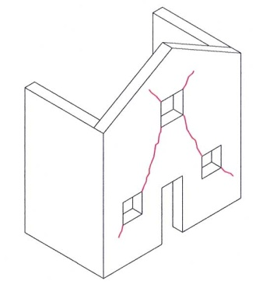
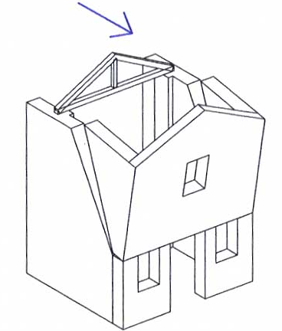
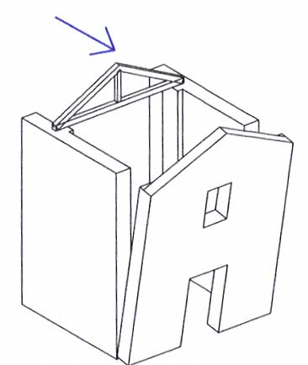
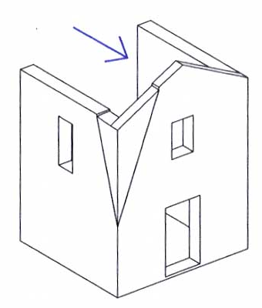
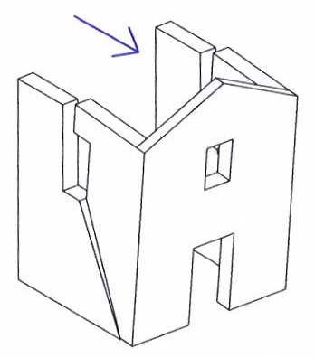
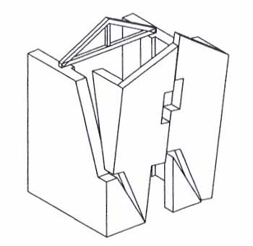
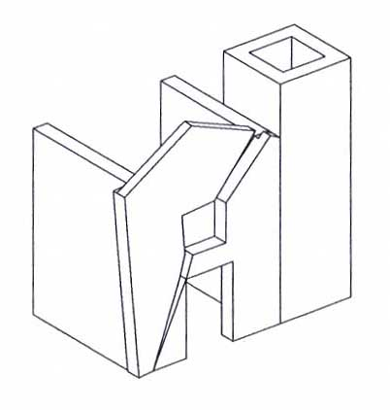
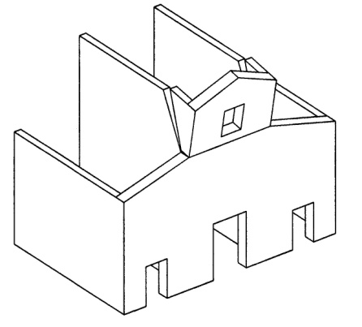
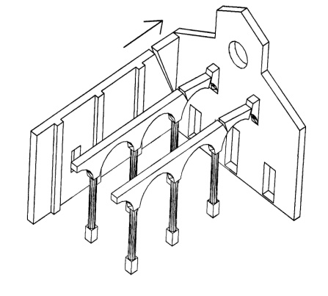
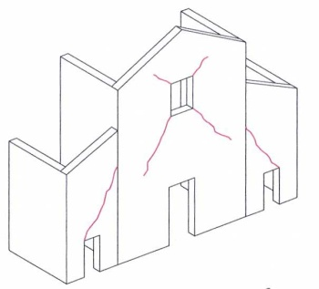
The survey datasheet of the churches
Overturning of the facade
In-plane mechanisms of the facade

Slide 24
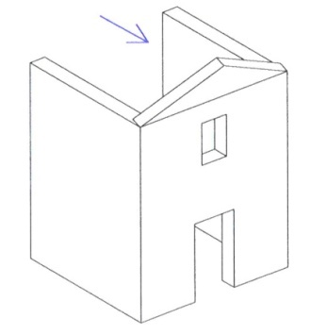
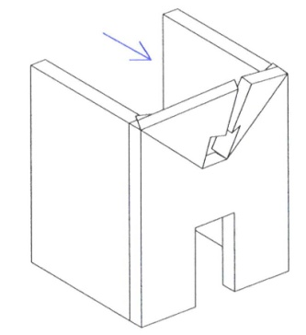
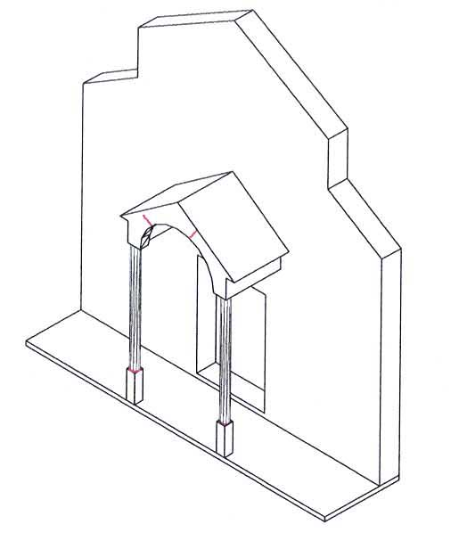
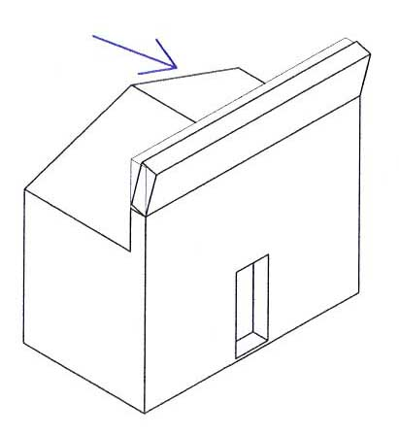
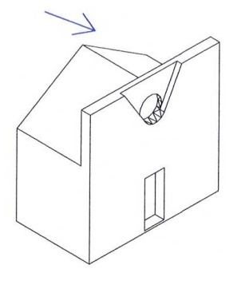
The survey datasheet of the churches
MECHANISMS IN THE TOP OF THE FACADE
PROTHYRUM OR NARTHEX

Slide 25
DPM (Damage Probability Matrices)
Umbria
I_{mcs} = V | I_{mcs} = VI | I_{mcs} = VII | I_{mcs} = VIII
Marche
I_{mcs} = V | I_{mcs} = VI | I_{mcs} = VII | I_{mcs} = VIII
d=0.20
d=0.26
d=0.43
d=0.58
d=0.22
d=0.28
d=0.36
d=0.64

Slide 26
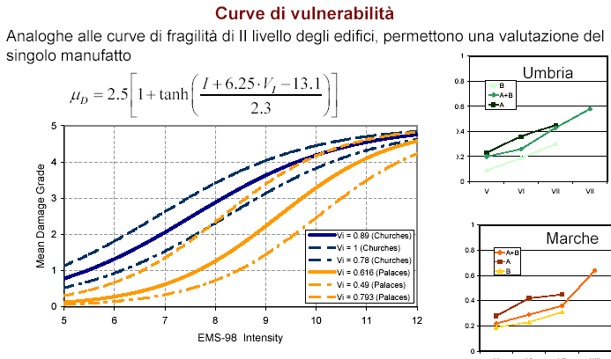
Vulnerability Curves

Slide 27
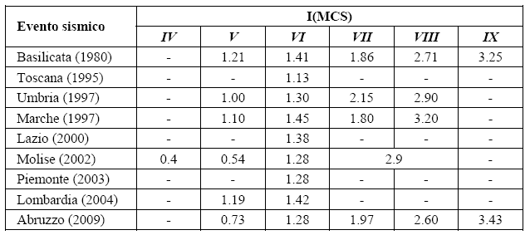
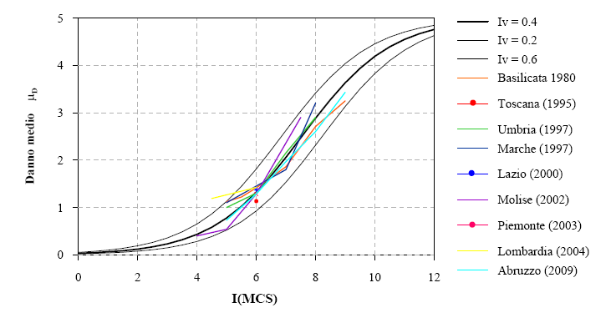
Seismic crisis in Abruzzo: 6 april 2009
Binomial distribution coefficient (μD) for different seismic events
Church vulnerability curves and average damage for various seismic events

Slide 28
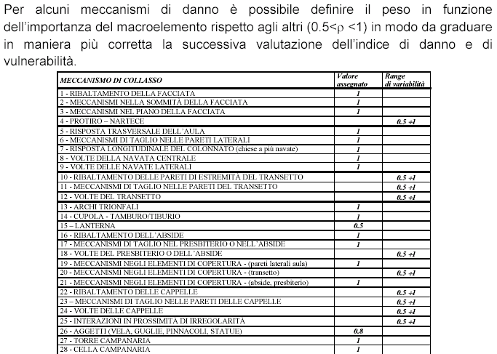
Release of Vulnerability - Annex C - Guidelines

Slide 29
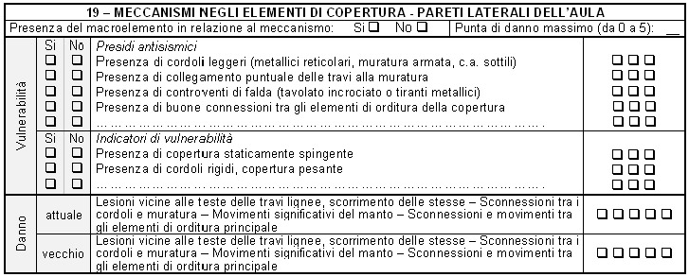
Release of Vulnerability - Annex C - Guidelines
The vulnerability box indicates a series of anti-seismic defense elements that can counteract the activation of the kinematics and a series of vulnerability indicators that can instead increase the propensity to damage. For each one, the detector must highlight the presence or absence (Yes - No), and in the right column express a judgment on the effectiveness of that constructive detail, modulating his opinion on three different levels:
0: ineffective; 1: modest; 2: good; 3: completely effective

Slide 30
Index of Vulnerability
where: v_{ki} and v_{kp} are, respectively, the score obtained from the survey of the vulnerability indicators and anti-seismic devices, in relation to the following criterion
The vulnerability index varies between 0, when there are effective anti-seismic devices and no structural deficiency, to 1 representative of the opposite case.

Slide 31
LV1 - Model for churches
Vulnerability curves
These data can be directly used to predict the impact of an earthquake of a given intensity on the historical heritage.
Once the vulnerability index is known, it is possible to trace the seismic acceleration on the ground corresponding to the various limit states.
I_{d}=0.76
Limit representative of the achievement of USL
I_{d}=0.40
Limit representative of the achievement of the DLS

Slide 32
Bridges in masonry, triumphal arches and other arched structures
In the case of horizontal seismic action, the system is damaged in a non-symmetrical way, with the formation of four hinges, two in the piers and two in the arch, with a lesion on the intrados slightly displaced with respect to the key and one on the extrados of the kidneys.
In the case of arches of great span, the earthquake can induce a non-synchronous motion at the base of the piers.
In bridges, local collapse mechanisms are possible in the gables/tympanums, above the arches, which behave like real retaining walls and overturn even for low values of the seismic action.

Slide 33



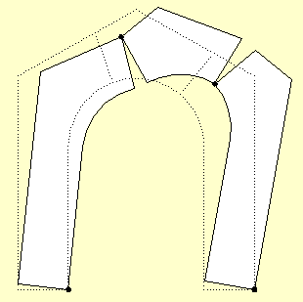
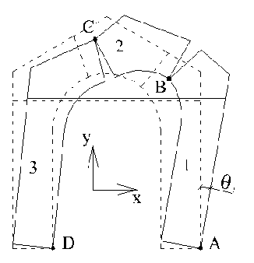
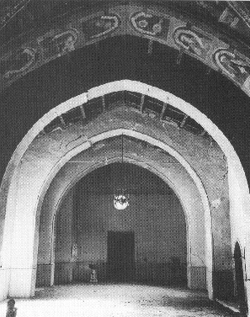
LV2 - Local Mechanisms
λ
Δx₁=θ₁(y_{A}-y₁) Δy₁=θ₁(x₁- x_{A})
Δx₂=θ₁(y_{A}-y_{B})+θ₂(y_{B}-y₂) Δy₂=θ₁(x_{B}-x_{A})+θ₂(x₂-x_{B})
Δx₃=θ₃(y_{D}-y₃) Δy₃=θ₃(x₃-x_{D})
Δl=θ₃(y_{catena}-y_{D}) - θ₁(y_{catena}-y_{A})
C2
C3
C1

Slide 34
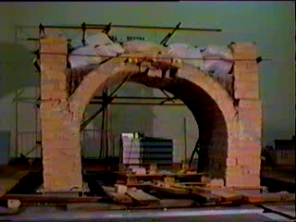
LV2 - Local Mechanisms
Tests on vibrating table performed at ENEA Casaccia, Rome

Slide 35
LV2 - Local Mechanisms
Incremental Limit Analysis
Evaluation of the seismic horizontal multiplier with increasing of the displacement of a control node, till to the loss of static equilibrium
a₁
a₀
step 1
a_{i}
step 0
step i
PUSHOVER CURVE
Displacement of the control node

Slide 36
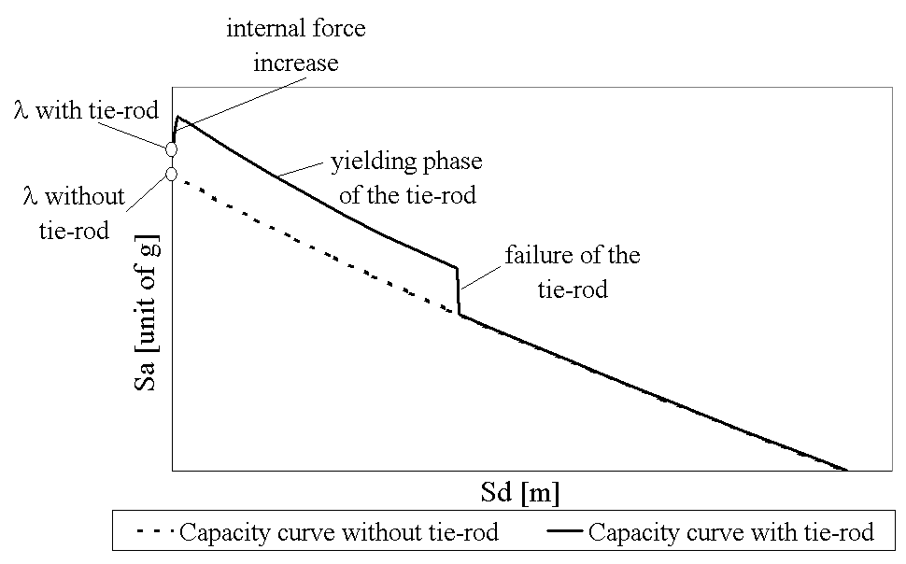
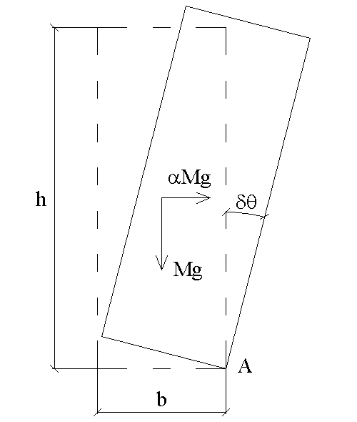
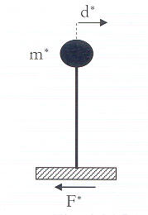
LV2 - Local Mechanisms
Displacement approach: to consider the resources in the non-linear phase as evidenced by the observation of damage and experimental campaigns
Capacity Curve
Representation as equivalent SDOF.
Capacity in terms of displacement (part of the displacement for which equilibrium is possible only in the absence of seismic action).
Control of other local limit conditions (extension of beams, etc.).

Slide 37
LV2 - Local Mechanisms
Displacement approach: to consider the resources in the non-linear phase as evidenced by the observation of damage and experimental campaigns

Slide 38
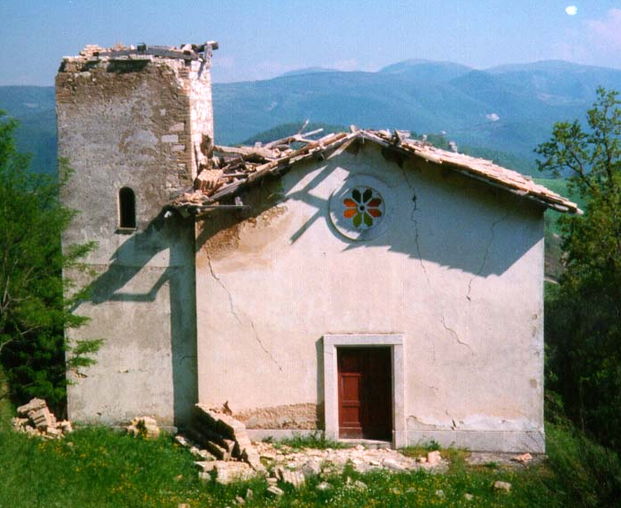
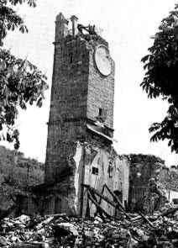
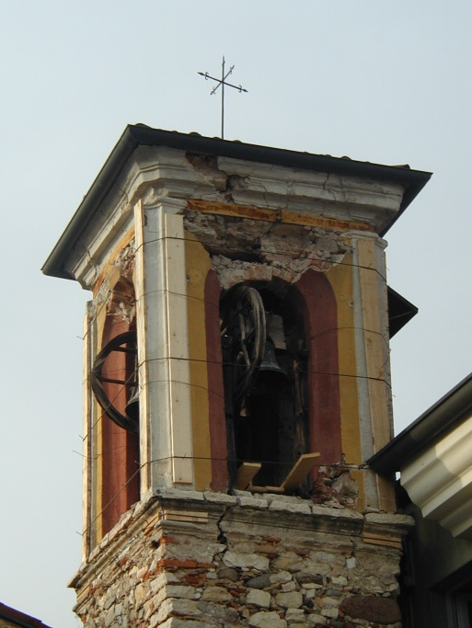
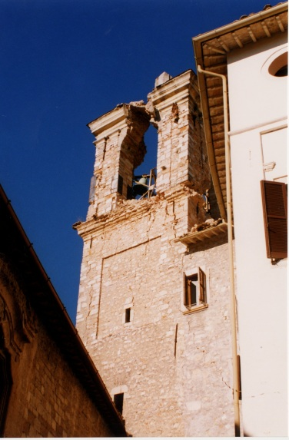
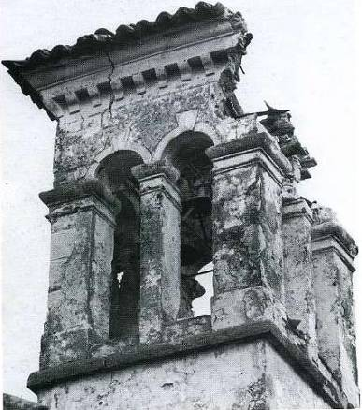
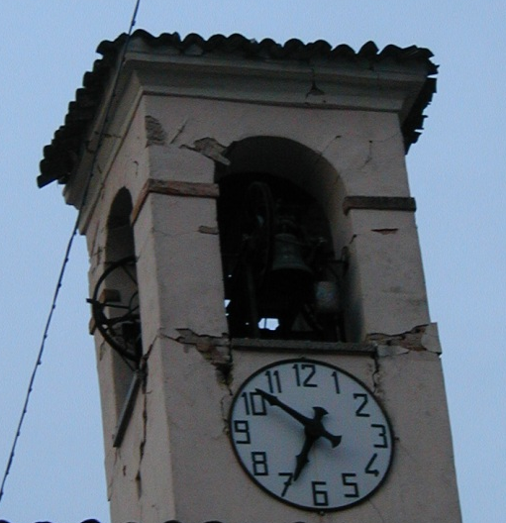
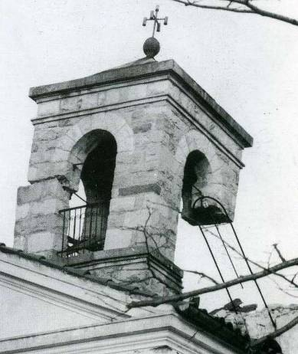
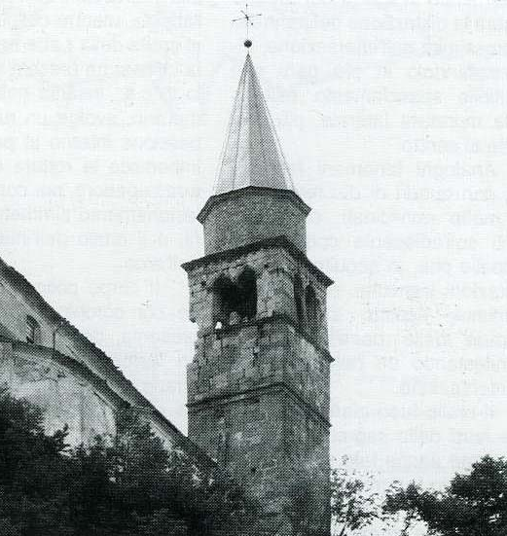
LV2 - Local Mechanisms
The analysis was focused on the bell cells as they were the most vulnerable macro-elements.
S. Stefano – Nocera Umbra - (PG)
Tarcento – (UD)
S. Maria delle Grazie – Salò - (BS)
S. Maria Assunta – Sellano - (PG)
S. Maria Assunta - Casacco - (UD)
S. Lorenzo - Sabbio Chiese – (BS)
SS Trinità di Monteaperta - Taiapana – (UD)
S. Stefano – Cesclans - (UD)

Slide 39
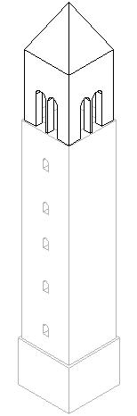
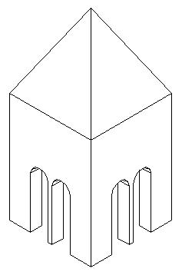
LV2 - Local Mechanisms
Definition of demand spectra at different altitudes from the base of the building
?
Input accelerogram for the cell
Input accelerogram for the cell
Ground accelerogram

Slide 40
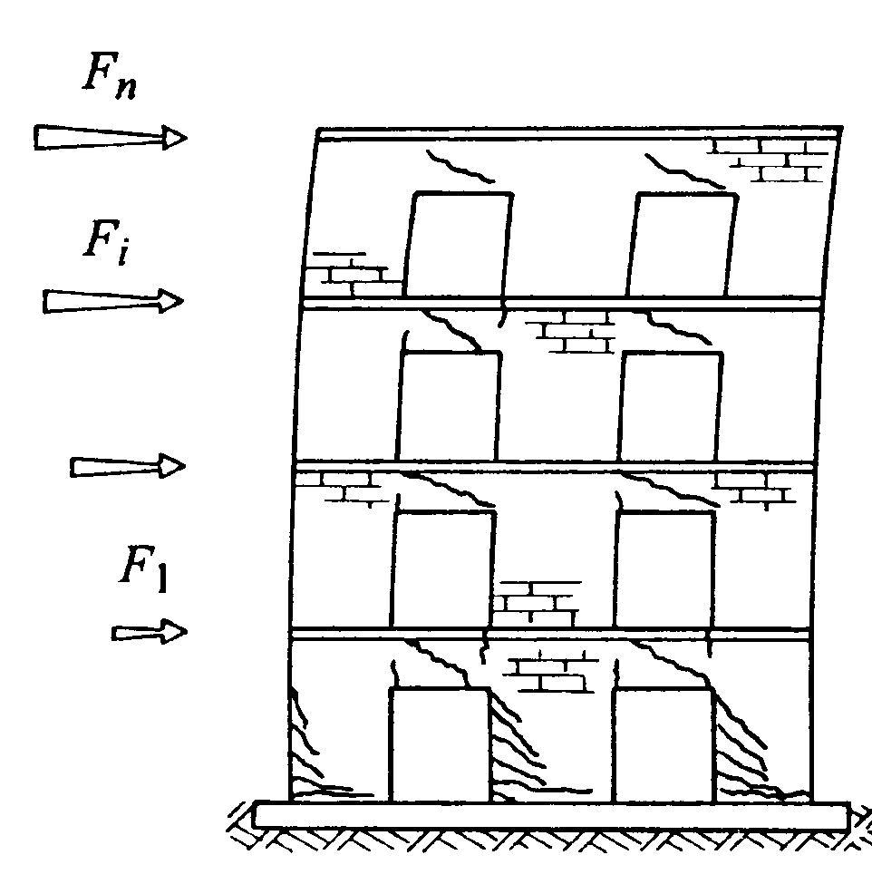
LV3 - The Equivalent Frame Model
Walls constitute the primary supporting structure.
The horizontal strips (with architraves) are secondary structural elements that create a coupling between the males.
MASCHI
FASCE

Slide 41
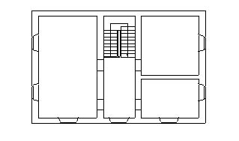
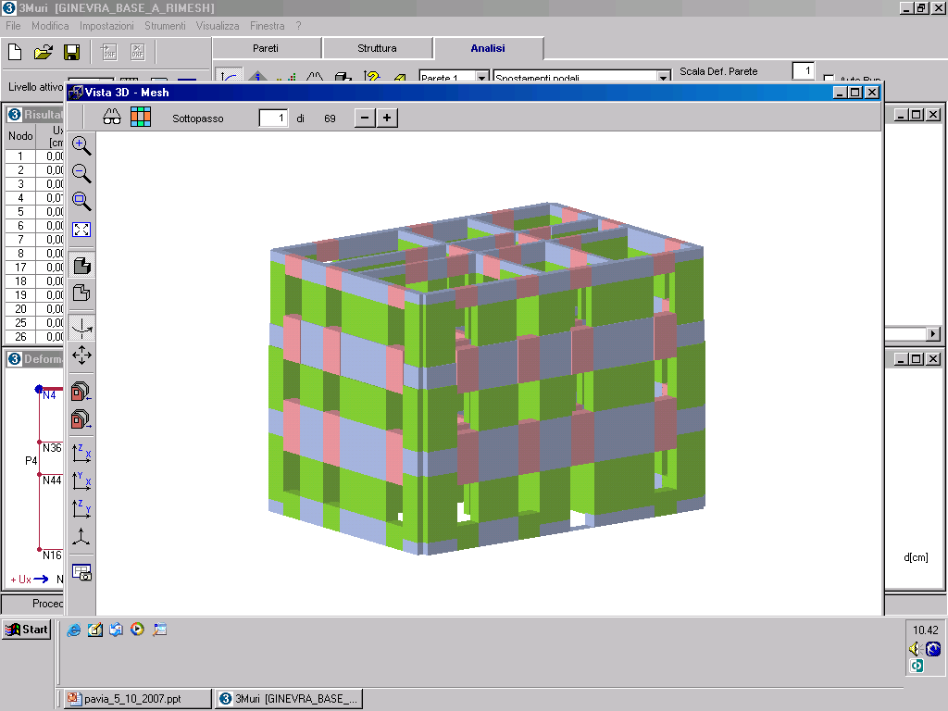
Tremuri
Software for 3D nonlinear analysis of masonry buildings (pushover, dynamic) (freeware for research use)
3D nodes: 5 d.o.f → they come out from two 2D nodes
3D node
2D nodes: 3 d.o.f. in the wall plane
2D node
TREMURI: Research version: Galasco A., Lagomarsino S., Penna A.,2002, Programma di calcolo TREMURI: Analisi sismica 3D di edifici in muratura, Università di Genova ; Commercial version: 3Muri Program release 4.1.0 (http://www.stadata.com)
3D node

Slide 42
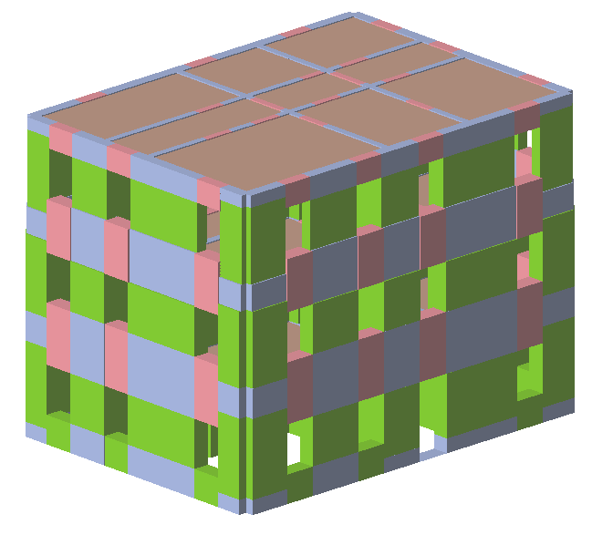
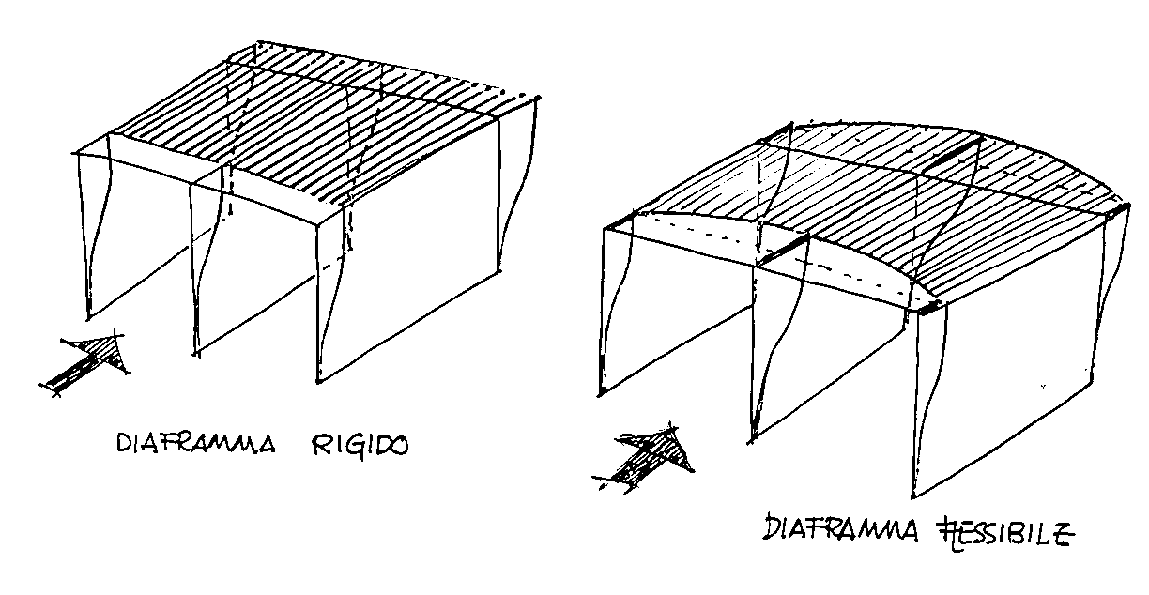
Tremuri
Sharing of 2D nodes masses to the 3D nodes
Flexible diaphragms

Slide 43
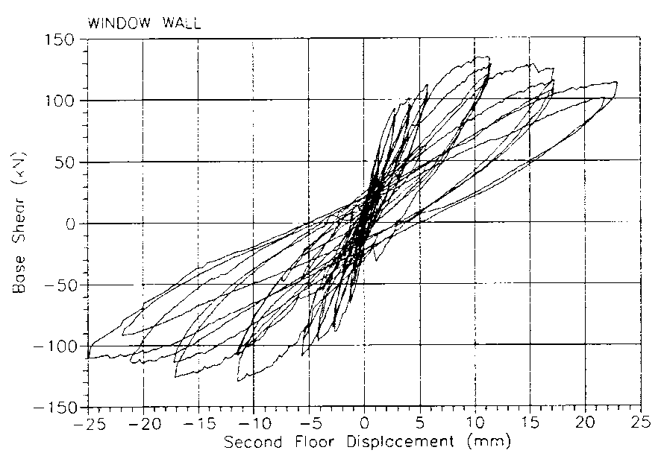
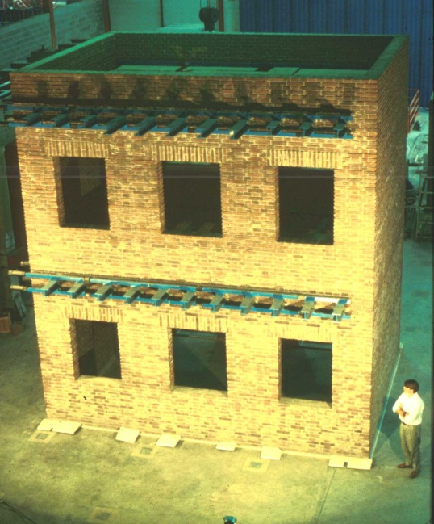
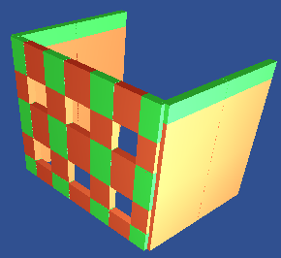


Modelling of a full scale experimental test
equivalent frame model
(University of Pavia – Magenes & Calvi, 1997)

Slide 44

Non-Linear Dynamic Analysis

Slide 45



Pushover Analysis – Capacity Spectrum Method

Slide 46



The use of 3d pushover analysis
For an aware retrofitting
The role of spandrel beams
The actual behaviour of existing masonry buildings is between two limit cases

Slide 47

Mechanisms for axial and bending force (rocking)
Lesione alla base del lato in trazione
Rottura dello spigolo in compressione
Damage Mechanism In The Stressed Walls In The Plane
ROCKING
Shear mechanisms
A.
B.
1) Lesione passante tra giunti e blocchi
Lesione continua sui giunti principali
2) Lesione a scaletta sui giunti princ. e second.
In reality mixed mechanisms are often occurred.

Slide 48





Damage Mechanism In The Stressed Walls In The Plane
Different mechanical response (Walls)
1) Geometric Ratio of The Panels (h / d)

Slide 49

Significant parameters:
Parameters that determine the answer
2) Constraints
In reality, intermediate constraint
Lack of specific experimental tests for comparison

Slide 50


Significant parameters:
Parameters that determine the answer
3) Normal Compression Stresses
Breakage due to cut with ladder passing between main and secondary joints
Breakage due to cut with continuous injuries between joints and blocks

Slide 51


Significant parameters:
Parameters that determine the answer
4) Weaving Orientation
MASCHI
FASCE
Lack of experimentation
(Genovese 2004)

Slide 52
Significant parameters:
Parameters that determine the answer
4) Weaving Orientation
MASCHI
FASCE
Lack of experimentation
(Genovese 2004)

Slide 53
Strength criterion for the flexural failure of pier
REVIEW OF LITERATURE SIMPLIFIED MODELS
Reference stress
Limit strength domain
In which point/section is calculated?
(Reference section)
Which type of stress is considered? (Normal, tangential, principal?)
Ref.: Calderini C, Cattari S, Lagomarsino S. (2009a). “In-plane strength of unreinforced masonry piers”. Earthquake Engineering and Structural Dynamics, 38(2), 243-267.

Slide 54
Strength criterion for the flexural failure of pier
Flexural Behaviour
Failure modes: Rocking and/or Crushing
Reference stress
Base section
Highest normal compressive stress
Compressive strength of masonry
Calculation of the reference stress on the basis of the beam theory
k_{1r} depends on the slenderness and the boundary conditions of the pier
k_{2r} depends on the assumed stress distribution at the compressed toe

Slide 55


Strength criterion for the flexural failure of pier
Shear Behaviour – Coulomb Type Models
Diagonal Cracking through Joints
Mann and Müller theory (1980)
Failure modes: Bed Joint Sliding – Diagonal Cracking through Joints
Shear Strength of Masonry (xy plane)
Reference Stress
Base or central section
Mean or highest shear stress
Parameters
Failure mode
k_{1d}
k_{1s}
Function of the assumed constitutive law
Bed Joint Sliding
1
c
μ
Diagonal Cracking th. Joints
Function of the slenderness
1

Slide 56
Strength criterion for the flexural failure of pier
Shear Behaviour – Principal Stress Models
Failure modes: Diagonal Cracking
Reference Stress
CENTRAL SECTION
HIGHEST MAXIMUM PRINCIPAL STRESS
Diagonal tensile strength of masonry
Calculation of the reference stress
Function of the slenderness

Slide 57

Strength criterion for the flexural failure of spandrel beams
Diagonal Cracking failure mode
Existing buildings: In both cases, due to the moderate values of axial load acting on spandrels (Case 1) or to the lack of coupled tensile resistant elements (Case 2), Rocking tends to prevail over Diagonal Cracking much more frequently than that testified by earthquake damage observation in existing buildings or in experimental campaigns
Due to the unconsistent hypotheses adopted in models a large number of historical-existing buildings are assessed as “unsafe” according to current seismic codes
It seems reasonable to assume that masonry spandrels supply further unknown resources with regard to the flexural response

Slide 58



Strength criterion for the flexural failure of spandrel beams
Due to orientation of mortar joints, an “equivalent” tensile strength for masonry can be assumed
a’) tensile failure of the block
σ_{y}
b’) shear failure of the horizontal mortar joints
Reference volume
Failure path
Increasing h=f_{tu}/f_{cu}
N_{u} = dtf_{cu}; M_{lim} = td²f_{cu}/4
Ref.: Cattari S., Lagomarsino S. (2008). “A strength criterion for the flexural behaviour of spandrels in un-reinforced masonry walls”, Proc. of the 14th World Conference on Earthquake Engineering, Beijing, China.
The strength increase is remarkable in particular for low values of N, which is the case of spandrel beam elements

Slide 59




Validation of the proposed model
Analysis of failure mechanisms that occurred
( damage pattern : l=1.35, D_{x}/D_{y}=4, P=225 kN, N=0 )
SQUAT SPANDREL
SQUAT SPANDREL
inelastic normal strains along x
inelastic normal strains along x
inelastic shear strains (xy)
Phase A: opening of head joints in tense corners after the attainment of the maximum tensile value of s_{x} at the end sections of spandrel
Phase B: the spandrel gradually starts to behave as an “equivalent strut” with the formation of a diagonal crack
Diagonal Cracking failure
SLENDER SPANDREL
In the case of slender (l=2) spandrel only the Phase A occurs; the failure mechanism may be classified as Rocking (without the next activation of Diagonal Cracking)
Rocking failure

Slide 60


Comparison with experimental data
Experimental test performed at University of Trieste ( Gattesco et al. 2008)
Different spandrel have been tested varying the lintel typology (wooden lintel or flat masonry arch) with and without strengthening (performed by inserting a steel tie)
Experimental set-up
Comparison with the model proposed in Cattari&Lagomarsino 2008

Slide 61



Large scale application – Vicoforte’s Dome
Main Constitutive Elements
DOME
UPPER RELIEVING ARCHES
IRON RINGS (UPPER LEVEL)
OVAL OPENINGS
IRON RINGS (LOWER LEVEL)
LOWER RELIEVING ARCHES
BUTRESSES

Slide 62


Large scale application – Vicoforte’s Dome
Dome Coordinate Systems
Structure Coordinate Systems
y_{i}
y_{i}
x_{i}
x_{i}
x_{i}
y_{k}
y_{i}
x_{k}
y_{j}
x_{j}

Slide 63









Large scale application – Vicoforte’s Dome
Principal inelastic strains (openings of mortar bed joints)
INTERNAL VIEW
SOUTH
WEST
NORTH
EAST
EXTERNAL VIEW
SOUTH
WEST
NORTH
EAST
Dead loads + soil settlements: loss of simmetry in damage

Slide 64
Comparison between detailed and equivalent frame models
Finite elements discretization
Equivalent frame idealization
Pier response in term of generalized stresses

Slide 65
Comparison between detailed and equivalent frame models

Slide 66
Comparison between detailed and equivalent frame models
DAMAGE STATE AT COLLAPSE
PROPOTYPE
EQUIVALENT FRAME
FEM

Slide 67
Project of the intervention
Preliminary project of the intervention
Identification and knowledge of the construction through the modules proposed by the Ministry for Cultural Heritage and Activities (Annex A);
Project of diagnostic investigations to be carried out in the definitive phase;
Illustrative report of the construction in its current state, with description of its seismic history and seismic behavior ascertained on a qualitative basis, and preliminary assessment of seismic safety through simplified models of LV1 level
Final project of the intervention
justifiably define the reference seismic action adopted for the site;
illustrate the results obtained from the diagnostic analyzes carried out on the product;
illustrate the mechanical model of the structure adopted for the seismic analysis, motivating the choice of the type of analysis carried out and classification according to the envisaged LV2 and LV3 assessment levels;
provide the final judgment on the effectiveness of the intervention.
Executive (detailed) project
It prescribes the executive methods of the technical operations to be performed;
Defines any further investigations to be carried out on site during the first phase of the works;
Indicates the checks and controls to be carried out on site;

