Slide 1
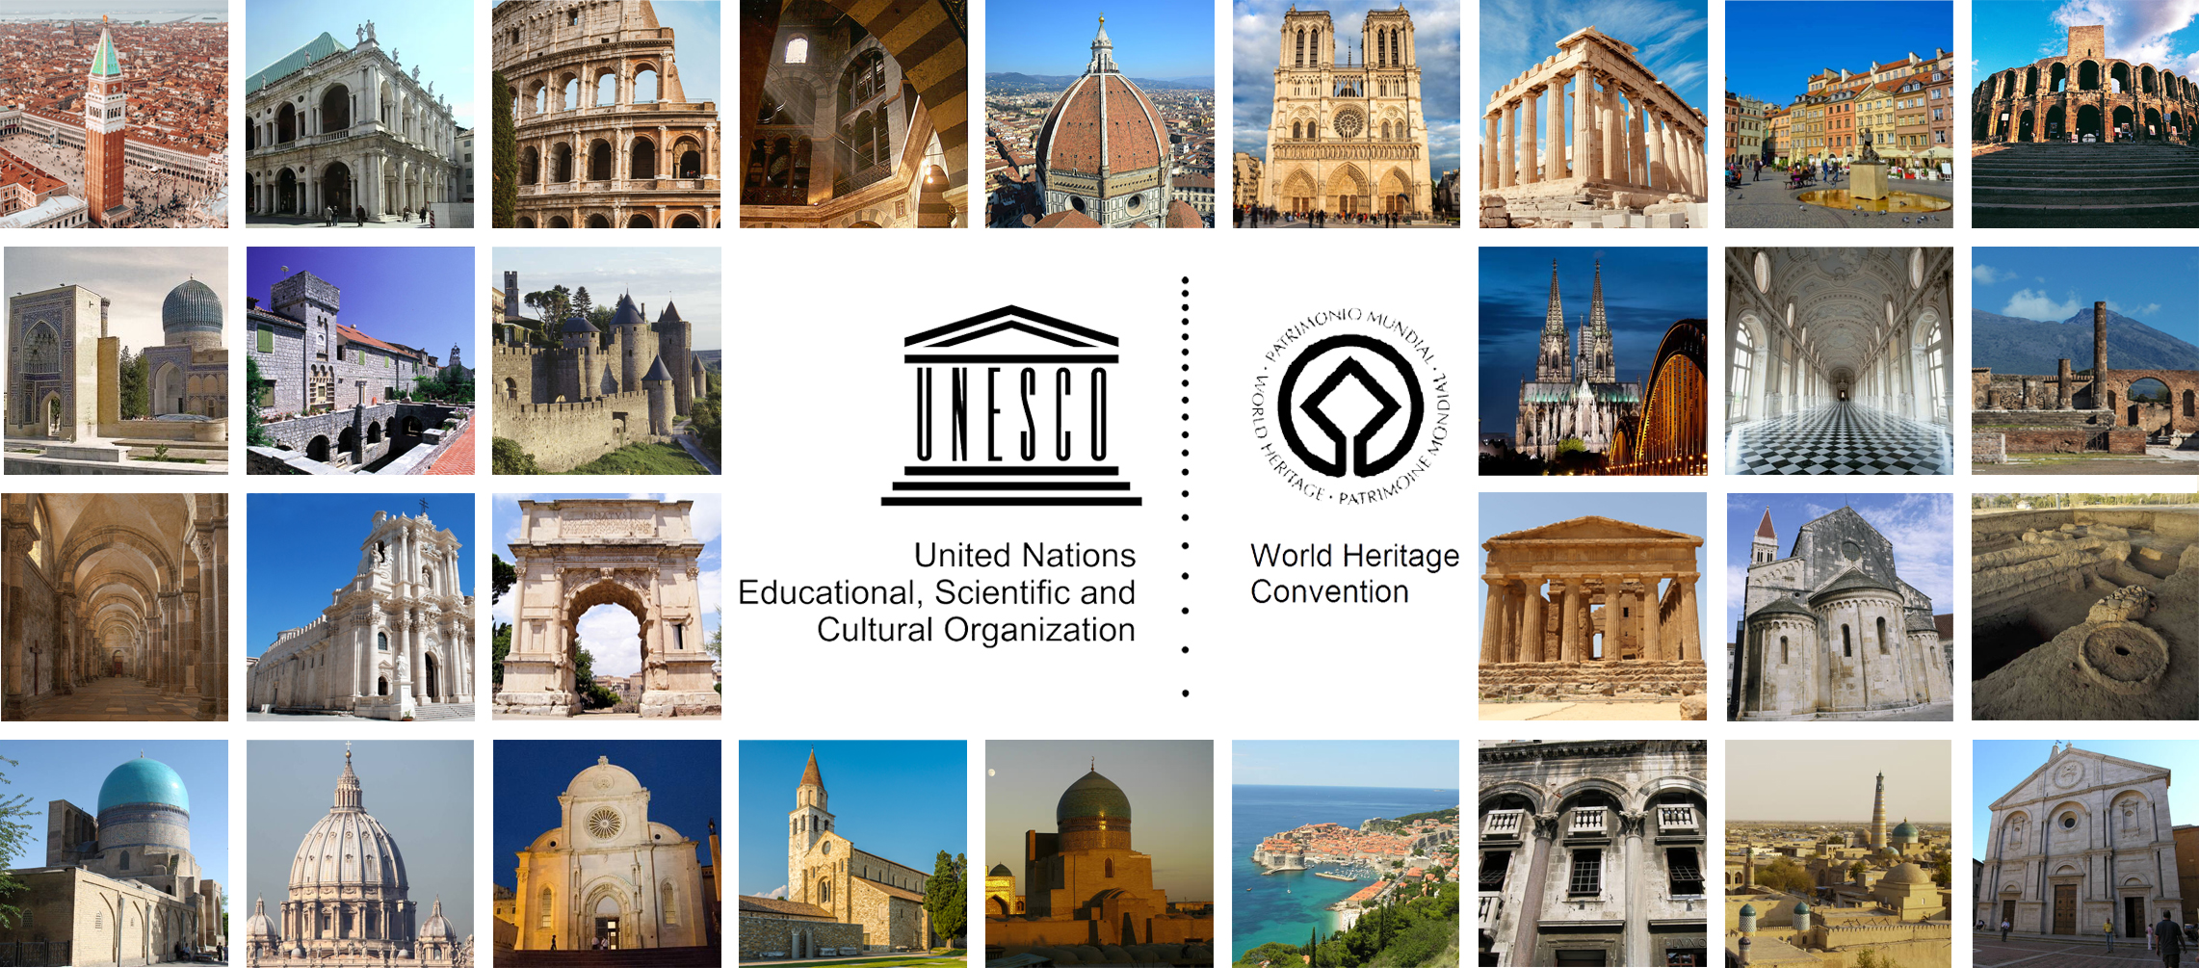
Restoration 1: History and theories. RESTORATION IN THE 20TH CENTURY
Prof. Carla BARTOLOZZI – Politecnico di Torino

Slide 2
RESTORATION IN THE 20TH CENTURY: ALOIS RIEGL
Alois Riegl was an art historian belonging to the Vienna School of art history.
He changed the approach to the conservation for two reasons:
-he introduces a new concept of monument which is linked to the concept of time and anticipates the current idea of a monument as a document
-he formulates a system of values which can be identified in each monument.
He faces the problem of protecting monuments in the dual role of art historian and superintendent of the Central Commission for Art and Historical Monuments.
Among his major wiritings on the preservation of the cultural heritage: “The modern cult of monuments” (1903). This essay represents the introduction to a plan for a law.
Definition of monument:
-intentional monument: built by man in order to pass on to future generation an event
-unintentional monument: recognized by posterity as a historical or artistic monument, beyond the intentions of people who created it.

Slide 3
RESTORATION IN THE 20TH CENTURY: ALOIS RIEGL
Every monument of art is also a historical monument, since it represents a precise point of development of that art.
The historical value is objective.
The artistic value of a monument derives from the compatibility of the ancient artwork to the artistic ideals of the time. The artistic value is relative, subjective: it tends to change from one subject to another and from time to time.
For this reason we must talk about historical monuments and historical value and no more about historical-artistic monuments.
Riegl proposes a new idea of conservation according to which a monument must be preserved simply as a document.
Riegl is also important for his theory of values.
Riegl defines a series of values that involve the monument and influence the restorer:
-commemorative values
-contemporary values

Slide 4
RESTORATION IN THE 20TH CENTURY: ALOIS RIEGL
COMMEMORATIVE VALUES:
Historical value: connected with the fact that the monument is a testimony of human creation. It is the value of the monument as an expression of the civilization and culture that produced the monument.
This historical value requires the best possible preservation of a monument in its present state.
Age value: connected to the imperfection, to the sign of the passage of time, to the degradation of form and color. The best example of age value is offered by the ruin.
The age value requires to protect monuments from human action (additions, replacements, additions) and leave them to the action of nature.
Deliberate commemorative value: connected to the commemorative purposes of a monument.
Restoration is a fundamental requirement of deliberate monuments.

Slide 5
RESTORATION IN THE 20TH CENTURY: ALOIS RIEGL
CONTEMPORARY VALUES:
Use value: connected to the satisfaction of practical needs. The use value requires meeting the practical needs of man.
The use value contrasts with the age value that requires not to intervene, this non-intervention can make the use of the monument impossible.
The use value must prevail, when the degradation of a monument is such as to lead to the abandonment of the monument for safety reasons.
The restorer must recognize the values ​​and make a decision.
Relative art value: It is the value according to which the ancient work is appreciated. It is connected to the compatibility and correspondence of the monument to the artistic ideals of the present time. It is a subjective value.
Newness value: it is the value that a building possesses as new. According to the newness value, the work must appear complete as if it were new.
Riegl is critic of the public perception of the monument: according to the masses, only the new and complete is beautiful; the old, degraded is considered ugly.

Slide 6
RESTORATION IN THE 20TH CENTURY: ALOIS RIEGL
Bell tower of the basilica of Aquileia, Udine (Italy)
The bell tower is of medieval origin.
It is an example of reuse of Roman material for constructive reasons. Transformations and interventions involving above all the upper part.
During the nineteenth century the building underwent restoration: a first phase of restoration was carried out in 1876-1877.
The works include the replacement of the covering stones of the lower part. The ancient stones were removed and new stones were laid. A total replacement of the stones was carried out.
A stone slab with the date 1877 recalls the restoration.

Slide 7
RESTORATION IN THE 20TH CENTURY: ALOIS RIEGL
Bell tower of the basilica of Aquileia, Udine (Italy)
At the beginning of the 20th century the condition of the bell tower was bad. There were structural problems, degradations due to lack of maintenance. At the beginning of the twentieth century a restoration project for the bell tower was finally done. The project was verified by Alois Riegl: he was a member of the Central Commission for Art and Historical Monuments.
Riegl presented a report on the work to be done: the designers must ensure the safety and conservation of the bell tower. The report contains an explicit reference to the principles of Riegl: he is recommended to take into account the importance of the value of antiquity. According to Riegl it is important to preserve the effects of natural degradation. The project supervised by Riegl determined the replacement of about 10% of the stones. The overall effect seems to respect the age value.
Left: survey made at the beginning of the twentieth century before Riegl's restoration

Slide 8
RESTORATION IN THE 20TH CENTURY: ALOIS RIEGL
Bell tower of the basilica of Aquileia, Udine (Italy)
Upper part: restorations made in 1905-1908 by Alois Riegl. The partial replacement allowed the conservation of the non-uniformity of the surface
Lower part: restorations made in 1877. Here the stones were completely replaced.

Slide 9
RESTORATION IN THE 20TH CENTURY: ALOIS RIEGL
Bell tower of the basilica of Aquileia, Udine (Italy)
Different result of the 2 restorations (1877 and 1905-1908).The age value is respected here through the partial replacement of the stone elements.

Slide 10
RESTORATION IN THE 20TH CENTURY: GUSTAVO GIOVANNONI
Gustavo Giovannoni was an important figure in the field of restoration in the first half of the 20th century.
One of the first Italians who had influence at European level. His theory often did not correspond to the design choices. In 1931 he organized a conference in Athens: the conference produced the first international charter of restoration (Athens Charter).
Giovannoni was a student of the Faculty of Engineering in Rome.
He was also a scholar of architectural history and he witnessed the transformations taking place in Rome: the city was subject to urban transformation.
Rome became the capital of the kingdom of Italy in 1870. It was made similar to other European capitals. The city was the protagonist of demolitions that had the task of making the city more comfortable and more suited to the needs of progress, transport and hygiene.
His theories involving the urban scale were influenced by these transformations.

Slide 11
RESTORATION IN THE 20TH CENTURY: GUSTAVO GIOVANNONI
Giovannoni was against stylistic restoration and in favor of scientific restoration: restoration is a science, a rigorous discipline, which must ensure the conservation of the integrity of the monument.
Steps of the restoration:
-survey
-analytical research
-examination of the historical and artistic data
-detailed technical plan
-continuous monitoring work
-documentation of the “before” and the “after” through photographs
-preservation of all the elements that were removed and replaced
Giovannoni is important for his studies on the urban environment: he underlines the close relationship between building and environment, he wants to enlarge the concept of monument, which he sees no longer limited to the single object.

Slide 12
RESTORATION IN THE 20TH CENTURY: GUSTAVO GIOVANNONI
2 types of monuments: - dead monuments: buildings that can no longer have a useful function for the society coinciding with the original one - living monuments: buildings that can still have a useful function for society. The definition of living and dead monuments is attributed to the ruined buildings.
Categories of restoration interventions:
1-consolidation: technical operation aimed at extending the life of the building. 2-recomposition: reassembly of the original dismembered elements of a building. 3-liberation: elimination of improper elements and restoration of the original use of the building. 4-completion: partial reconstruction of a monument and addition of secondary parts. 5-innovation: insertion of new parts. For Giovannoni it doesn’t correspond to a restoration but to an integration of newly designed parts
Consolidation, recomposition: dead monuments. Liberation, completion and innovation: living monuments

Slide 13
RESTORATION IN THE 20TH CENTURY: GUSTAVO GIOVANNONI
Church of Sant’Andrea, Orvieto (Terni, Italy)
Medieval church adapted to the dictates of the Counter-Reformation. Next to the church is the bell tower. Giovannoni carries out a restoration intervention to better integrate the church into the city context.

Slide 14
RESTORATION IN THE 20TH CENTURY: GUSTAVO GIOVANNONI
Church of Sant’Andrea, Orvieto (Terni, Italy)
Façade: restoration of the rose window, elimination of the cusps of the roof and creation a gabled roof. Bell tower: demolition of the baroque roof and insertion of openings and battlements.
Demolition of the adjacent buildings and creation of a portico. Intervention of liberation and restoration

Slide 15
RESTORATION IN THE 20TH CENTURY: GUSTAVO GIOVANNONI
Church of Sant’Andrea, Orvieto (Terni, Italy)

Slide 16
RESTORATION IN THE 20TH CENTURY: GUSTAVO GIOVANNONI
Abbey of Saint Galgano, Siena (Italy)
According to Giovannoni the abbey was a living monument: it had to be completed and restored. Giovannoni's idea was not followed: it was restored as if it were a dead monument. Consolidation and recomposition operations were carried out.

Slide 17
RESTORATION IN THE 20TH CENTURY: GUSTAVO GIOVANNONI
RESTORATION IN THE 20TH CENTURY: Gustavo Giovannoni
Abbey of Saint Galgano, Siena (Italy)

Slide 18
RESTORATION IN THE 20TH CENTURY: GUSTAVO GIOVANNONI
Giovannoni's most original contribution is linked to a new discipline: urban restoration.
Protagonist in the acquisition of the value of urban environments, but above all in the definition of a new intervention strategy in the old city.
Book: Historic cities and new construction, 1931. Giovannoni theorises an alternative practice to demolitions: thinning out the built fabric. The practice of thinning out is less invasive than demolition: it is a set of small road widening and partial demolition of blocks in order to improve the hygienic conditions and to free the architectural monuments.
Exemples of thinning out:
-demolition of the additions that over time were built in the courtyards in order to achieve a hygienic improvement
-design of cuts that the urban fabric and save the monuments

Slide 19
RESTORATION IN THE 20TH CENTURY: GUSTAVO GIOVANNONI
Renaissance Quarter, Rome (Italy)
In 1908 the new town development plan of Rome was presented: it consisted of cuts in the urban fabric,
the widening of the via dei Coronari and the partial demolition of the north side of Piazza Navona.
Giovannoni condemned the principles of the plan and proposed a more cautious approach: removal of some buildings or blocks without importance and replacement with small squares and gardens

Slide 20
RESTORATION IN THE 20TH CENTURY: GUSTAVO GIOVANNONI
Renaissance Quarter, Rome (Italy)

Slide 21
RESTORATION IN THE 20TH CENTURY: GUSTAVO GIOVANNONI
Renaissance Quarter, Rome (Italy)
1913: publication of an article illustrating the application of thinning out to the Renaissance Quarter.
Giovannoni studied the arrangement of the Via dei Coronari: recognition of the monuments to be safeguarded, partial demolition of some buildings or blocks and replacement with small squares and gardens. The goal is rehabilitation with limited demolitions.

Slide 22
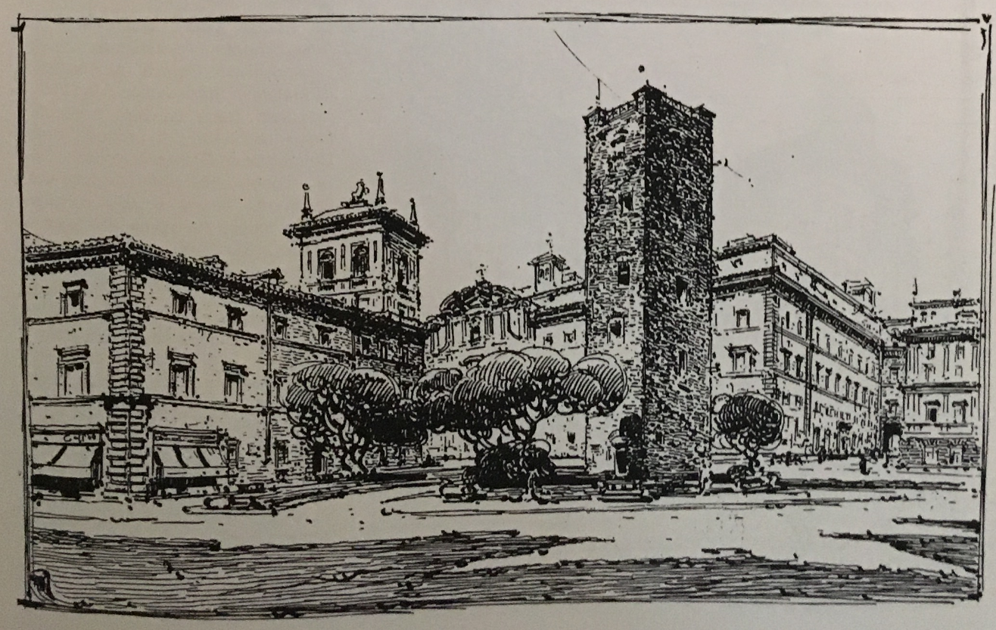
RESTORATION IN THE 20TH CENTURY: GUSTAVO GIOVANNONI
Renaissance Quarter, Rome (Italy)
The intervention has the function of improving the hygienic conditions and freeing the architectural testimonies. The liberation of these monuments is illustrated in some sketches.
After this proposal Giovannoni is called to take part in a commission for a new study of the area. The final solution includes the indications expressed by Giovannoni in 1913.

Slide 23
RESTORATION IN THE 20TH CENTURY: GUSTAVO GIOVANNONI
Giovannoni participated in the drafting of international and national documents on the protection and restoration of monuments.
1931: Athens charter. The charter established the rules of international restoration: these rules were also dictated by Giovannoni.
Principles of the charter:
- maintenance, where possible, of the occupation of the monuments which guarantees their continuity. - use of modern materials for the consolidation of ancient buildings and more especially of reinforced concrete. Reinforced concrete must be hidden. - respect for the character and appearance of the city, especially near ancient monuments, for which the environment must be the object of special care.
1932: Italian charter of restoration. It ratified the contents of the Athens charter. Living and dead monuments. Consolidation, recomposition for dead monuments and completion and restoration of living monuments.

Slide 24
RESTORATION IN THE 20TH CENTURY
All European countries were involved in the Second World War (1939-1945).
All charters and regulations concerned restoration interventions but not entire reconstructions. Theories of restoration were inadequate to the current situation: the main requirement was to rebuild what had largely disappeared.
The concepts of minimum intervention and distinguishability were difficult to apply.
A collective feeling led to restoration and reintegration: historical, aesthetic but also psychological value of the buildings (attachment of the population to a monument, recognition of its identity in the monument).
The restoration must give a solution to a sudden destruction not to a progressive degradation.
Restorations were not based on shared principles, but according to the abilities of individual architects.

Slide 25
RESTORATION IN THE 20TH CENTURY
Palazzo dei Trecento, Treviso (Italy)
Partial destruction of the building.
Application of the theories codified by pre-war international charters.

Slide 26
RESTORATION IN THE 20TH CENTURY
Palazzo dei Trecento, Treviso (Italy)
The missing part was rebuilt.
The addition is made slightly behind the original.
In the foreground the authentic part of the building. In the background the addition. There is a separation line. Distinguishability.

Slide 27
RESTORATION IN THE 20TH CENTURY
Church of Santa Chiara, Naples (Italy)
The church was built in the 14th century.
In the XVIII century the church was subject to transformations to be adapted to the Baroque
View toward the presbytery taste.

Slide 28
RESTORATION IN THE 20TH CENTURY
Church of Santa Chiara, Napoli (Italy)
In 1943 the church was hit by a bombing.
The bombing brought to light the traces of the medieval structures under the baroque decorations.
View towards the entrance

Slide 29
RESTORATION IN THE 20TH CENTURY
Church of Santa Chiara, Naples (Italy)
The project determined the elimination of what remained of the baroque church and the restoration of the medieval building based on the traces.
Survey after the bombing and restoration project

Slide 30
RESTORATION IN THE 20TH CENTURY
Chiesa di Santa Chiara, Napoli (Italy)
Left: reconstruction of the trusses (trusses are made of reinforced concrete, the surface imitates wood according to the Athens charter).
Right: view towards the entrance after restoration

Slide 31
RESTORATION IN THE 20TH CENTURY
Old town, Warsaw (Poland)
Warsaw was the symbol of the destroyed city. Respect for psychological value led to the reconstruction of the city as it was where it was. Documents from all over the world were found: the documents showed the city before the bombing. Market Square: only a few facades remained. The square was rebuilt as it was.
Respect for the formal image. Structures made of reinforced concrete. The interior spaces were adapted to the new laws.

Slide 32
RESTORATION IN THE 20TH CENTURY
CESARE BRANDI
Art historian, Director of the Central Institute for Restoration in Italy.
Brandi supports the idea of ​​critical restoration aimed at the transmission of the artwork to the future.
According to Brandi each artwork has two instances: - historical instance (the artwork is a human produce) - esthetic instance (the artistic quality that makes a work an artwork) Restoration must give preference to the esthetic instance, because it what makes a work an artwork. Restoration is the discipline that must help to recognize the value of the artwork.
If the work is incomplete, restoration should aim to reestablish the potential unity of the artwork.
Restoration must not commit falsification and must not cancel every trace of the passage in time. Possible restitution of missing parts if they compromise the completeness of a whole. Integrations of missing parts should be explicit, recognizable.

Slide 33
RESTORATION IN THE 20TH CENTURY
ROBERTO PANE
He was an architect and a professor.
He confirms the presence of historical and aesthetic instances in the theory of restoration.
Importance of critical judgment: critical restoration. Restoration must be carried out according to the taste of the time.
Restoration must not commit falsification.
The restorer must have the capacity to harmonize the old parts and the new (ancient / new relationship).
He was in favor of experimenting with new materials, accepting new functions useful to society (the intended use may be different from the original but must be compatible)
Pane was in favor of the protection of ancient historical town centers:
from the conservation of the single monument to that of the whole urban environment. Contribution to the Venice charter in 1964.

Slide 34
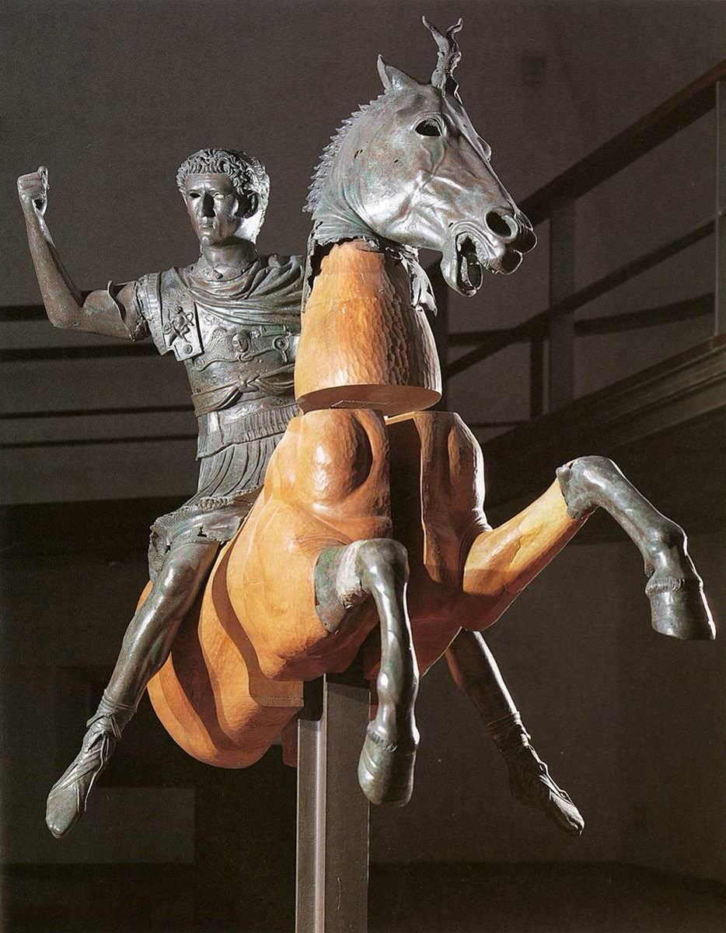
RESTORATION IN THE 20TH CENTURY
Equestrian statue of Domitian-Nerva, Naples (Italy)
The conservative intervention acquires a new meaning: to re-establish the potential unity of the artwork.
No addition of fake parts: the addition is distinguishable. Critical and creative conception of restoration.

Slide 35
RESTORATION IN THE 20TH CENTURY
Tower Salomon, Visegrad (Hungary)
The restoration intervention determined the volumetric integration. The intervention respects the ancient parts. The additions are authentically modern and have a treatment of the surface that makes them distinguishable. Interior: reintegration of the image of the vaults by recomposing the few surviving pieces.

