Slide 1
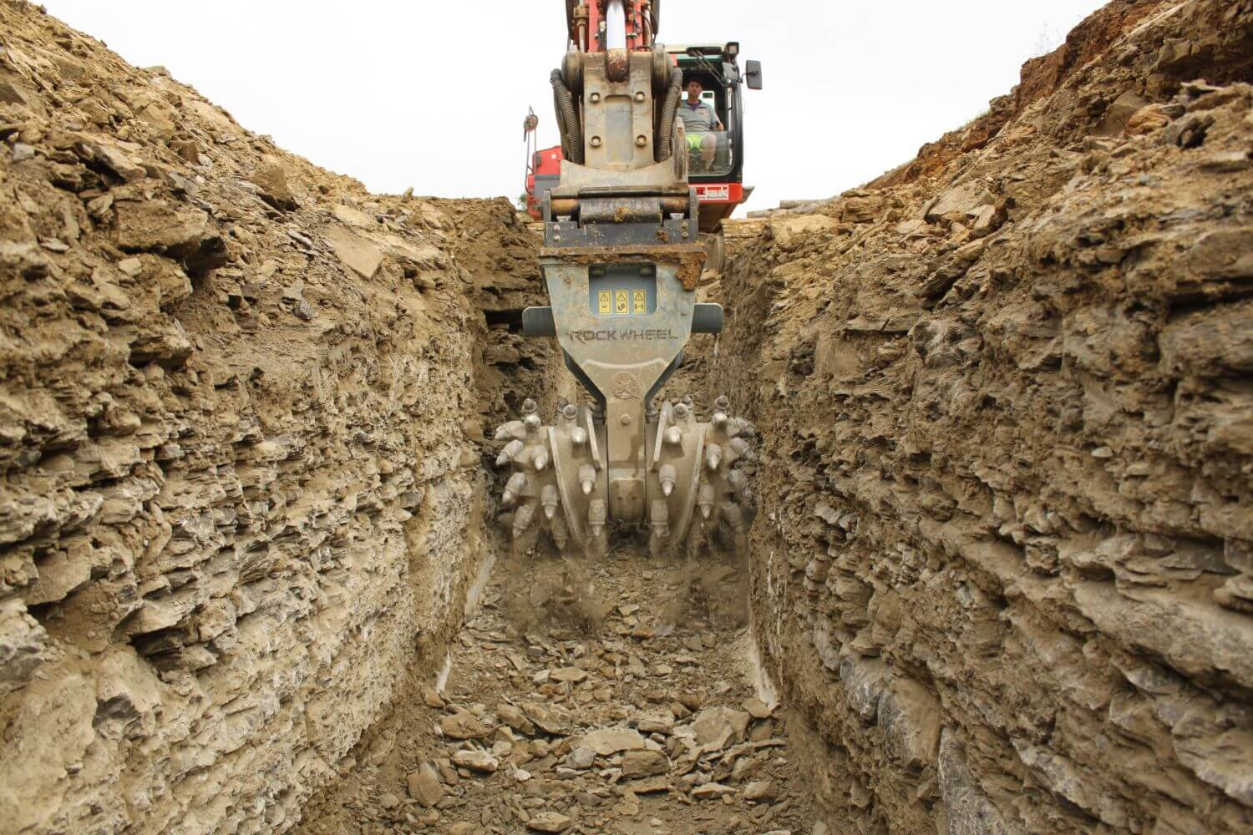
Module Geotechnical and Hydrogeological Risk Assessment and Mitigation
Exercise E-3, Seepage Trench
Use of a trench cutter in the rock, more precisely in limestone with changing permeability (source: https://www.baumaschinendienst.de/artikel/einsatz-der-rockwheel-d20-grabenfraese-11752/).

Slide 2
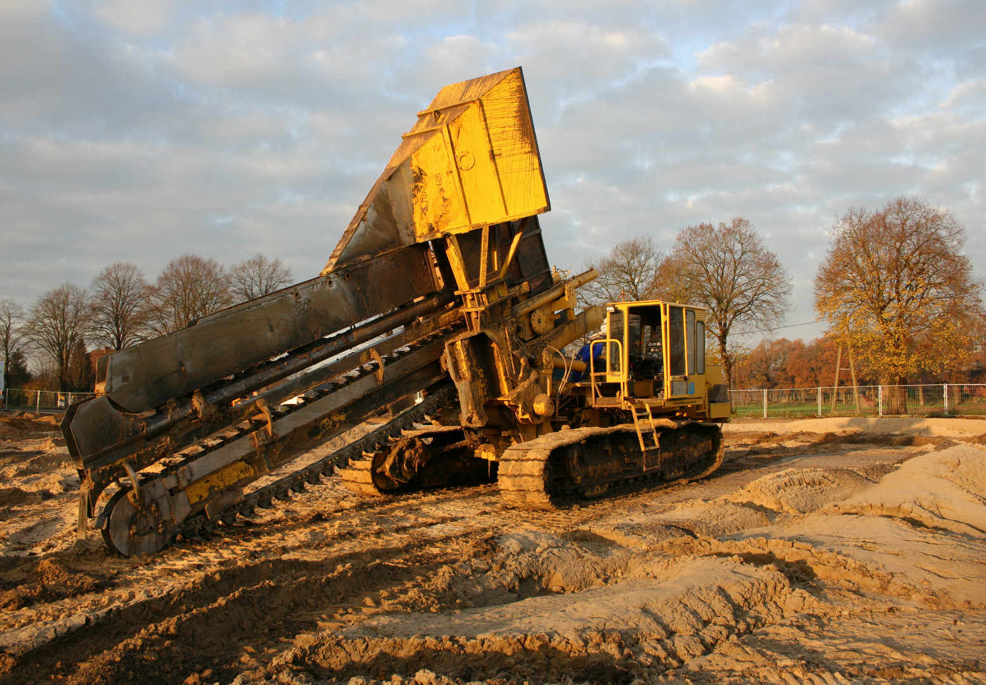
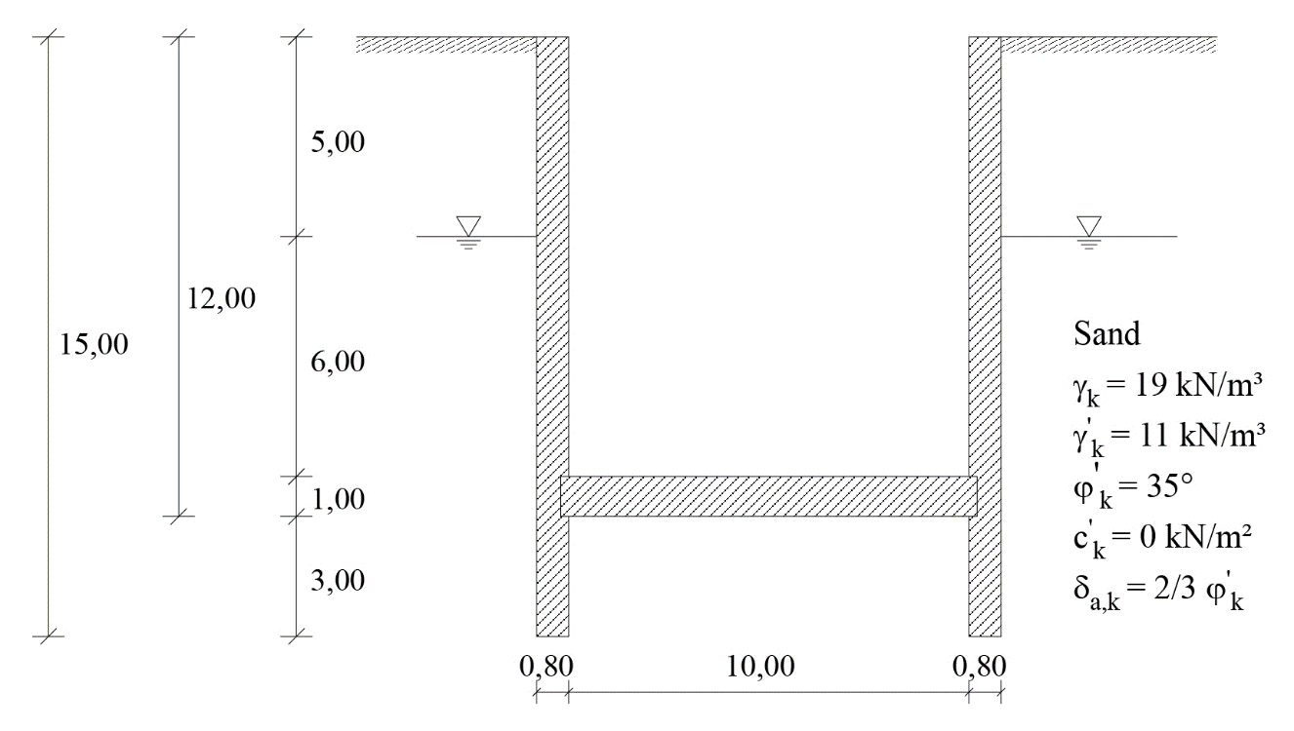
Setting up of a seepage trench with trench cutting machine
Trench cutter for soil, filling of the drainage gravel behind it by the attached funnel (source: https://www.fotocommunity.de/photo/grabenfraese-duc-tac/23712158).

Slide 3
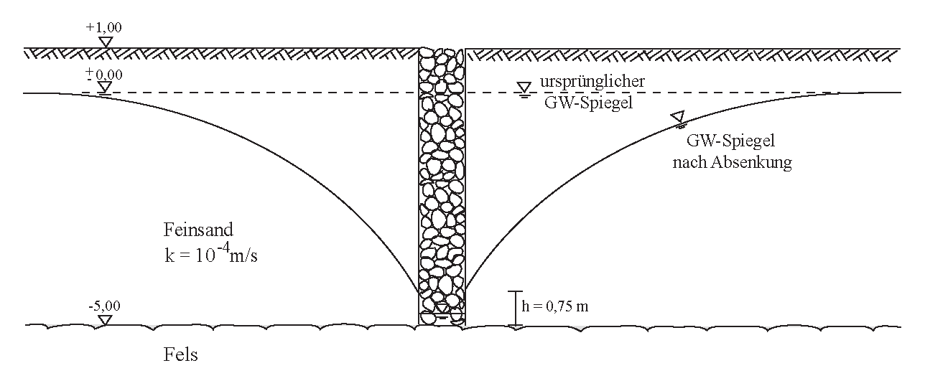
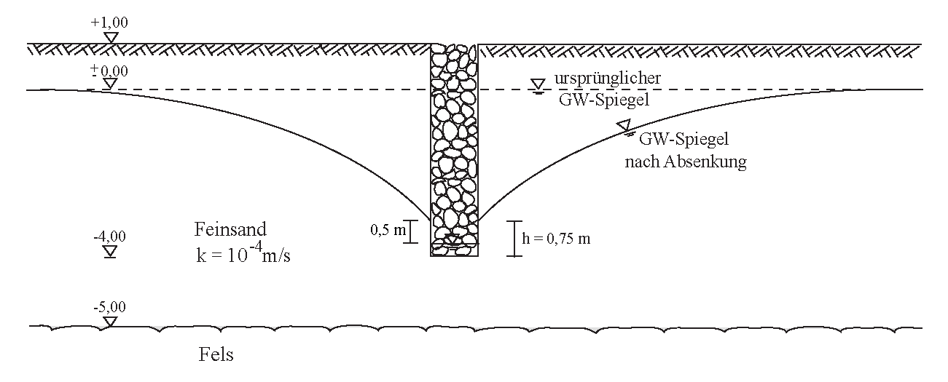
Assignment of tasks
Exercise E-3: Seepage Trench
For a seepage trench, the design variants shown in Figures E-3.1 and E-3.2 are available. Determine the amount of water per metre of trench length.
original groundwater level
groundwater level after drawdown
Figure E-3.1: perfect seepage trench.
fine sand
rock
original groundwater level
Figure E-3.2: imperfect seepage trench.
groundwater level after drawdown
fine sand
rock

Slide 4
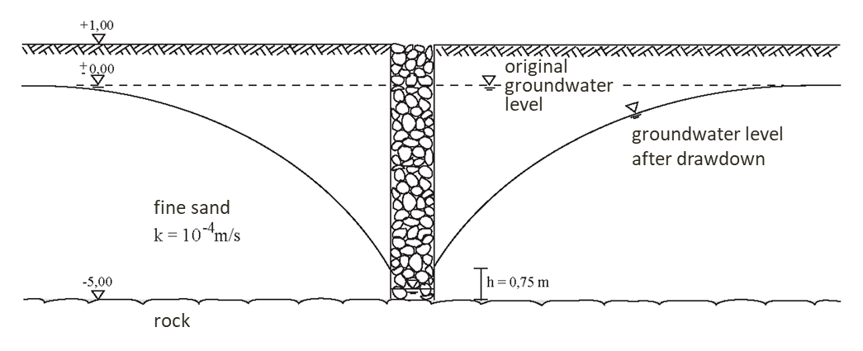
Inflow to the perfect seepage trench or slot
Exercise E-3: Seepage Trench - Solution
Inflow to the perfect seepage trench/ slot
$q=\frac{k}{2}∙\frac{\left(H^{2}−h^{2}\right)}{R}$ for one-sided inflow
(see script Grundbau, equation (2.4), page 2.7)
Distance of the original groundwater surface to the bottom of the seepage trench:
$H=5,00 m$
Distance of the bottom of the seepage trench to the lowered groundwater table at the margin of the seepage trench:
$h=0.75 m$
Permeability coefficient of the soil:
$k={10}^{−4}m/s$
Lowered groundwater table at the margin of the seepage slot:
$s=H−h=5.00−0.75=4.25 m$
Range of the seepage trench from the margin of the seepage ditch:
$R=1500∙s∙\sqrt{k}=1500∙4.25∙\sqrt{{10}^{−4}}=63.75 m$ (see script Grundbau, equation (2.5), page 2.7)
A further development of the trench formula are the equations according to Chapman. A height difference $S_{i}=h−h_{0}$ (seepage length or section) between the water level $h_{0}$ in the seepage trench and the water level $h$ in the soil when entering the seepage ditch is taken into account (Fig. 2.9, see script Grundbau, page 2.7 and page 2.8).
Note: The division sign ÷ in the equation in the script means "from to". This spelling can be found in geotechnical literature.

Slide 5
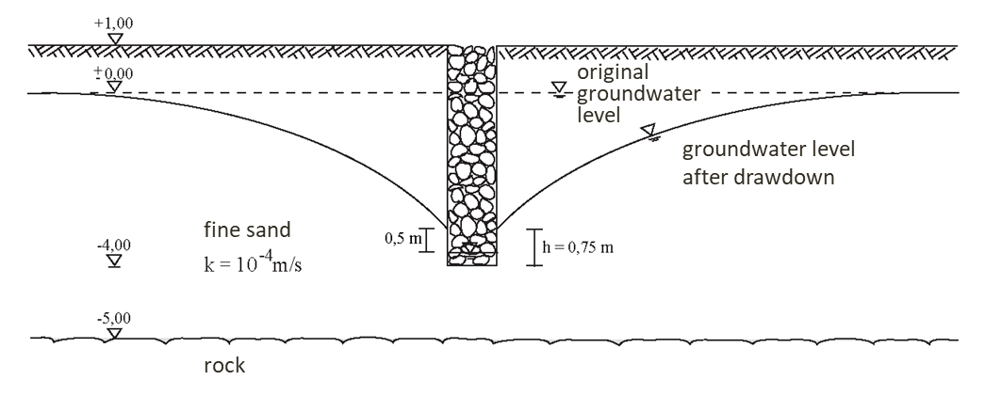
Inflow to the (im)perfect seepage trench or slot 1
Inflow:
$q=2∙\frac{{10}^{−4}}{2}∙\frac{{5.00}^{2}−{0.75}^{2}}{63.75}$ for two-sided inflow
$q=3.833∙{10}^{−5} {m^{3}}/{\left(m∙s\right)}$
$q=0.03833 l/{\left(m∙s\right)}$
$q=138.00 l/{\left(m∙h\right)}$
Inflow to the imperfect seepage trench/ slot-schlitz
$q=\left(0.73+0.27∙\frac{T−t_{0}}{T}\right)∙\frac{k}{2∙R}∙\left(T^{2}−{t_{0}}^{2}\right)$ for one-sided inflow
Distance of the original groundwater surface to the impermeable layer:
$T=5.00 m$
Distance of the groundwater level in the middle of the slot to the impermeable layer:
$t_{0}=\left(5.00−4.00\right)+\left(0.75−0.50\right)=1.25 m$
Permeability coefficient of the soil:
$k={10}^{−4}m/s$

Slide 6
Inflow to the (im)perfect seepage trench or slot 2
Lowered groundwater table at the margin of the seepage slot:
$s=H−h=4.00−0.75=3.25 m$
Range of the seepage trench from the middle of the seepage trench:
$R=1500∙s∙\sqrt{k}=1500∙3.25∙\sqrt{{10}^{−4}}=48.75 m$
Inflow:
$q=2∙\left(0.73+0.27∙\frac{5.00−1.25}{5.00}\right)∙\frac{{10}^{−4}}{2∙48.75}∙\left({5.00}^{2}−{1.25}^{2}\right)$ for two-sided inflow
$q=4.483∙{10}^{−5}{m^{3}}/{\left(m∙s\right)}$
$q=0.04483 l/{\left(m∙s\right)}$
$q=161.39 l/{\left(m∙h\right)}$

