Slide 1
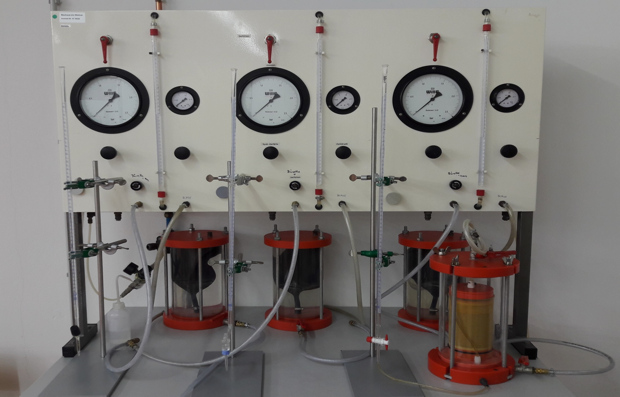
Module Geotechnical and Hydrogeological Risk Assessment and Mitigation
Exercise E-2, Permeability Tests
Overall view of the facility for testing water permeability of soils in the laboratory of the Chair of Geotechnics (Photo: Aselmeyer, 08.11.2017).

Slide 2

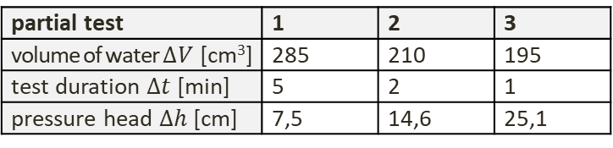

Assignment of Tasks and Input D
Exercise E-2: Permeability Tests
Evaluate the following two permeability tests: (sample diameter $D = 100 mm$, sample height $h = 200 mm$).
constant hydraulic/ pressure head :
(distance of the standpipes: $d=150 mm$)
variable hydraulic/ pressure head :
(cross-sectional area riser pipe: $A_{2}=0,08 {cm}^{2}$)
partial test | 1 | 2 | 3
volume of water $∆V$ [cm³] | 285 | 210 | 195
test duration $∆t$ [min] | 5 | 2 | 1
pressure head $∆h$ [cm] | 7,5 | 14,6 | 25,1
readout | 1 | 2 | 3 | 4
date | 26.04. | 26.04. | 26.04. | 28.04.
time [h:min] | 08:30 | 10:15 | 16:30 | 09:00
water level [cm] | 96,5 | 86,5 | 58,7 | 4,8
Figure E-2.1:
Permeability test with constant hydraulic/ pressure head.
Figure E-2.2:
Permeability test with variable hydraulic/ pressure head.

Slide 3
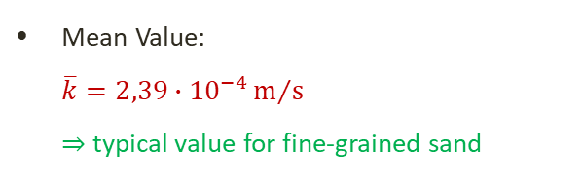
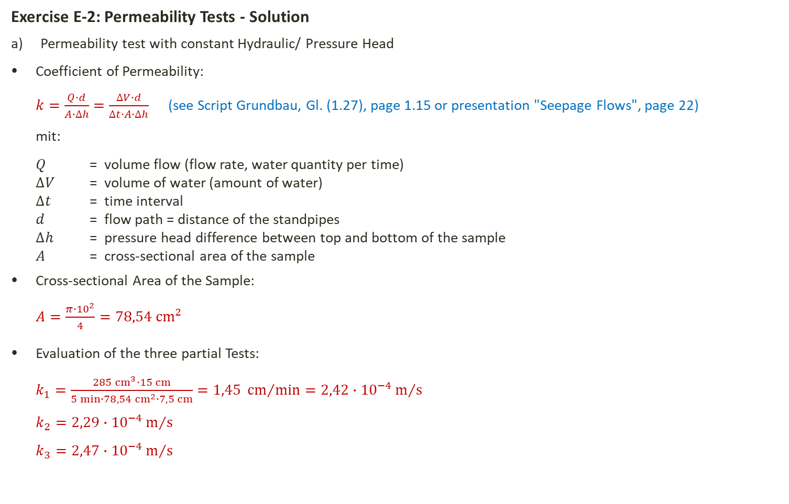
Permeability Test with constant Hydraulic/ Pressure Head
Exercise E-2: Permeability Tests - Solution
Permeability test with constant Hydraulic/ Pressure Head
Coefficient of Permeability:
$k=\frac{Q∙d}{A∙∆h}=\frac{∆V∙d}{∆t∙A∙∆h}$ (see Script Grundbau, Gl. (1.27), page 1.15 or presentation "Seepage Flows", page 22)
mit:
$Q$ = volume flow (flow rate, water quantity per time)
$∆V$ = volume of water (amount of water)
$∆t$ = time interval
$d$ = flow path = distance of the standpipes
$∆h$ = pressure head difference between top and bottom of the sample
$A$ = cross-sectional area of the sample
Cross-sectional Area of the Sample:
$A=\frac{π∙{10}^{2}}{4}=78,54 {cm}^{2}$
Evaluation of the three partial Tests:
$k_{1}=\frac{285{ cm}^{3}∙15 cm}{5 min∙78,54 {cm}^{2}∙7,5 cm}=1,45 {cm}/{min}=2,42∙{10}^{−4}m/s$
$k_{2}=2,29∙{10}^{−4}m/s$
$k_{3}=2,47∙{10}^{−4}m/s$
Mean Value:
$\overline{k}=2,39∙{10}^{−4}m/s$
⇒ typical value for fine-grained sand

Slide 4
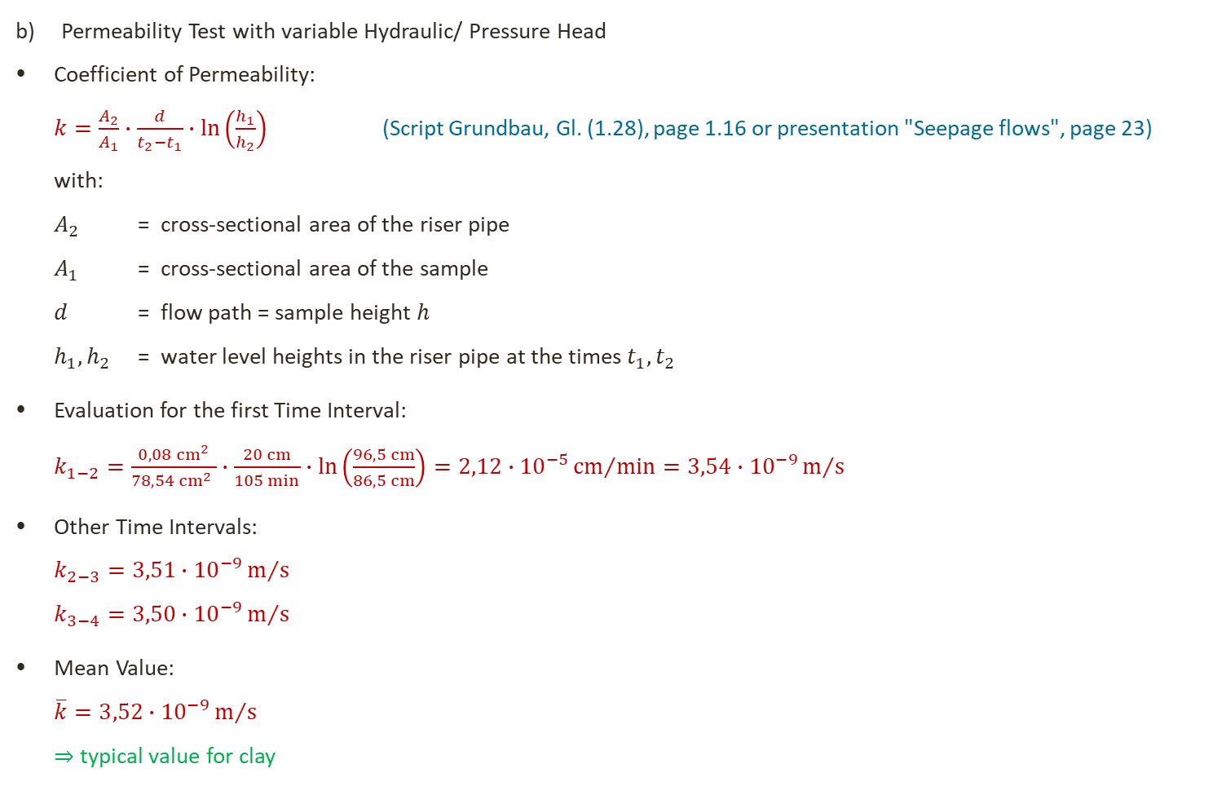
Permeability Test with variable Hydraulic/ Pressure Head
Permeability Test with variable Hydraulic/ Pressure Head
Coefficient of Permeability:
$k=\frac{A_{2}}{A_{1}}∙\frac{d}{t_{2}−t_{1}}∙\ln\left(\frac{h_{1}}{h_{2}}\right)$ (Script Grundbau, Gl. (1.28), page 1.16 or presentation "Seepage flows", page 23)
with:
$A_{2}$ = cross-sectional area of the riser pipe
$A_{1}$ = cross-sectional area of the sample
$d$ = flow path = sample height $h$
$h_{1}, h_{2}$ = water level heights in the riser pipe at the times $t_{1}, t_{2}$
Evaluation for the first Time Interval:
$k_{1−2}=\frac{0,08 {cm}^{2}}{78,54 {cm}^{2} }∙\frac{20 cm}{105 min}∙\ln\left(\frac{96,5 cm}{86,5 cm}\right)=2,12∙{10}^{−5}{cm}/{min}=3,54∙{10}^{−9}m/s$
Other Time Intervals:
$k_{2−3}=3,51∙{10}^{−9}m/s$
$k_{3−4}=3,50∙{10}^{−9}m/s$
Mean Value:
$\overline{k}=3,52∙{10}^{−9}m/s$
⇒ typical value for clay

