Slide 1
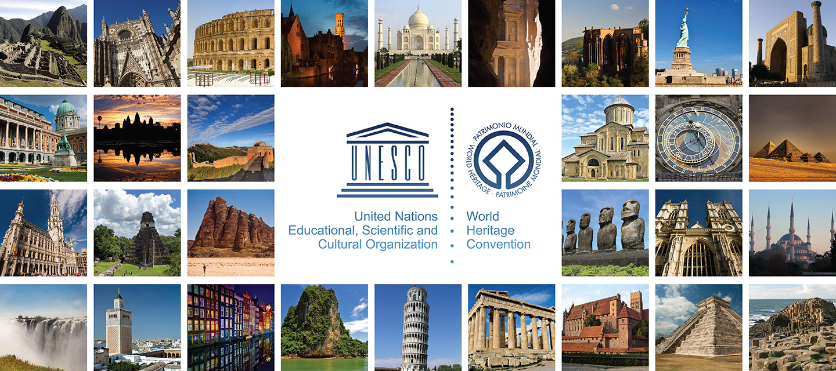
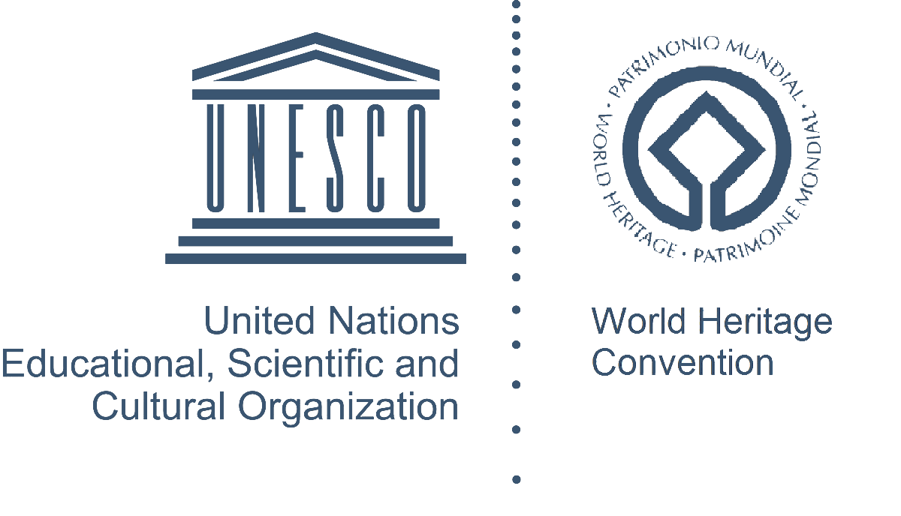
Co-funded by the Erasmus+ Programme of the European Union
Prof. Rustam Mukimov
Tajik Technical University named after acad. M.S.Osimi,
Department of Architectural Environment Design and Restoration
Lecture 10. Modern Architecture (from 1991 to the present)

Slide 2
Lecture 10. Modern Architecture (from 1991 to the present)
CONTENT OF THE COURSE "History of architecture of Central Asia"
General information about the Architecture of Central Asia. Periodization of the history of architecture of Central Asia
The history of architecture of the bronze and the early iron ages in Central Asia
Architecture of early statehood (V - IV centuries BC) in Central Asia
Architecture of antiquity (IV century BC - IV century AD)
Architecture of the Early Middle Ages (VI - early VIII centuries) in Central Asia
Architecture of early Islam (IX - X centuries; XI -early XIII centuries) in Central Asia
Architecture of the XIV - XV centuries in Central Asia
Architecture of the Late Middle Ages (XVI-late XVIII centuries) in Central Asia
Architecture of the New Age (the second half of the XIX - the entire XX centuries)
Modern Architecture (from 1991 to the present)

Slide 3
CONTENT
Lecture 10. Modern Architecture (from 1991 to the present)
Lecture 2. Basics of the concepts of "Architectural monument" and "Restoration"
Terms and concepts
The main part of the lecture "Modern Architecture (from 1991 to the present)"
- modern architecture and urban planning of Central Asia and its development trends;
architecture and urban planning of Kazakhstan;
architecture of Turkmenistan;
architecture of Uzbekistan;
architecture of Tajikistan;
- architecture of Kyrgyzstan.
3. Problems
4. Conclusion
5. References

Slide 4
Terms and concepts
Lecture 10. Modern Architecture (from 1991 to the present)
CENTRAL ASIA is a subregion of Asia that stretches from the Caspian Sea in the west to China and Mongolia in the east, and from Afghanistan and Iran in the south to Russia in the north. The region consists of the former Soviet republics of Kazakhstan, Kyrgyzstan, Tajikistan, Turkmenistan, and Uzbekistan. It is also colloquially referred to as "The -Stans" as the countries all have names ending with the Persian suffix "-stan", meaning "land of".
MIDDLE ASIA - part of the Asian territory of the former USSR, where the former union republics of Uzbekistan, Tajikistan, Turkmenistan and Kyrgyzstan were located.
THE NEW TIME - according to the formation history of Tajikistan the New Time covers the 60s of the XIX - 80s of the XX century, which corresponds to the transition period in the construction of Soviet socialism.
MODERN TIME - for Tajikistan it corresponds to the 90s of the XX century, i.e. the construction of a free democratic society.
MODERN TAJIKISTAN means the territory of the period when Tajikistan gained its statehood at the beginning of the XX century, when the Tajiks formed into a modern nation.
MODERN ARCHITECTURE is a style of building that emphasizes function and a streamlined form over ornamentation. This design aesthetic is a departure from more elaborate and decorated homes like Queen Anne, Victorian, or Gothic Revival styles. Modern architecture usually involves sharp, clean lines.
ARTISTIC HERITAGE - all historically enduring in the culture created in previous eras, artistic values ​​of the past, having a national or universal significance

Slide 5
Map of the modern states of Central Asia
Lecture 10. Modern Architecture (from 1991 to the present)

Slide 6
Modern architecture and urban planning of Central Asia and trends in its development
Lecture 10. Modern Architecture (from 1991 to the present)
In Central Asia, in ancient times, a cultural, economic, spiritual community developed between the countries and peoples that inhabited this peculiar geographical environment - a huge region of the Asian continent. In this regard, the architecture and urban planning of Central Asia has a remarkable and unique history, confirming the existence of a stable tradition and close relationships in the material culture of the Kyrgyz, Uzbeks, Kazakhs, Turkmens, Iranians, Tajiks, Afghans and other peoples. In certain periods of history, Central Asia was a single state-territorial entity, i.e. interstate, interethnic relations have always existed here. This circumstance gives us the right to talk about the architecture of Central Asia as a kind of integrity.
The Central Asia region covers the territory of several countries, which is confirmed by natural geographical and socio-economic factors. Currently, more than 170 million people live here. Their rapprochement was facilitated by the close interweaving of political destinies, linguistic and cultural integrity, as well as a similar religion. Since ancient times, a characteristic feature of the ethno-social structure of the states of Central Asia has been the proximity of two forms of life: settled life and nomadism.
At the beginning of the 20th century, there was no concept of "Central Asia" as a single socio-cultural entity. Such states as Kazakhstan, Uzbekistan, Turkmenistan, Tajikistan, Kyrgyzstan, entered the rigid framework of the Soviet totalitarian architecture. Iran and Afghanistan were in this period away from the civilizational steps of the twentieth century. The territory of Central Asia was interpreted in Soviet times as "Central Asia".
In general, it can be said that in terms of architecture and urban planning, Central Asia is divided into two parallel groups - this is the post-Soviet territory and all other states that are part of the region. If the post-Soviet states are closely interconnected, then all the rest are scattered and attract attention only from the outside. The historical differences between these two territories of Central Asia determines their relatively independent development.
Let us briefly characterize the general and specific features of modern architecture and urban planning of the countries that were previously part of the post-Soviet space, only in the aspect of the search for national identity in architecture.

Slide 7
Dwelling of nomads and farmers of Central Asia
Lecture 10. Modern Architecture (from 1991 to the present)

Slide 8
Architecture and urban planning of Kazakhstan
Lecture 10. Modern Architecture (from 1991 to the present)
In the new conditions of the development of the architecture of sovereign Kazakhstan, the tasks of national cultural revival came to the fore, for the solution of which it is necessary to turn to the origins and traditions of the Kazakh people. The process of development and flourishing of the culture of the nation is closely connected with the study of the historical and cultural heritage of the people.
Interest in traditions is determined not only by cognitive considerations, it allows you to study the cultural heritage to identify the leading creative principles in order to master the most progressive of them in modern architectural and construction practice. This, today, is one of the main problems facing the architects of Kazakhstan. Today's approach to the problem of originality is unthinkable without mastering the advanced architectural traditions of different regions of Kazakhstan, near and far abroad. There was a clear need to express in architecture its belonging to a particular national culture. The values ​​of the past must become active participants in the life of the present. The continuity of cultural values ​​is their most important property. But tradition cannot be inherited - it must be conquered.
Architectural creativity, based on the recognition of the value of spatial and temporal factors of the place, must inevitably resolve the contradictions between the old and the new, turn tradition into the basis of innovation and lead to the creation of a modern national form.
Modern architecture is always developing in interaction with the artistic heritage. Artistic heritage - all historically enduring in the culture created in previous eras, artistic values ​​of the past, having a national or universal significance.

Slide 9
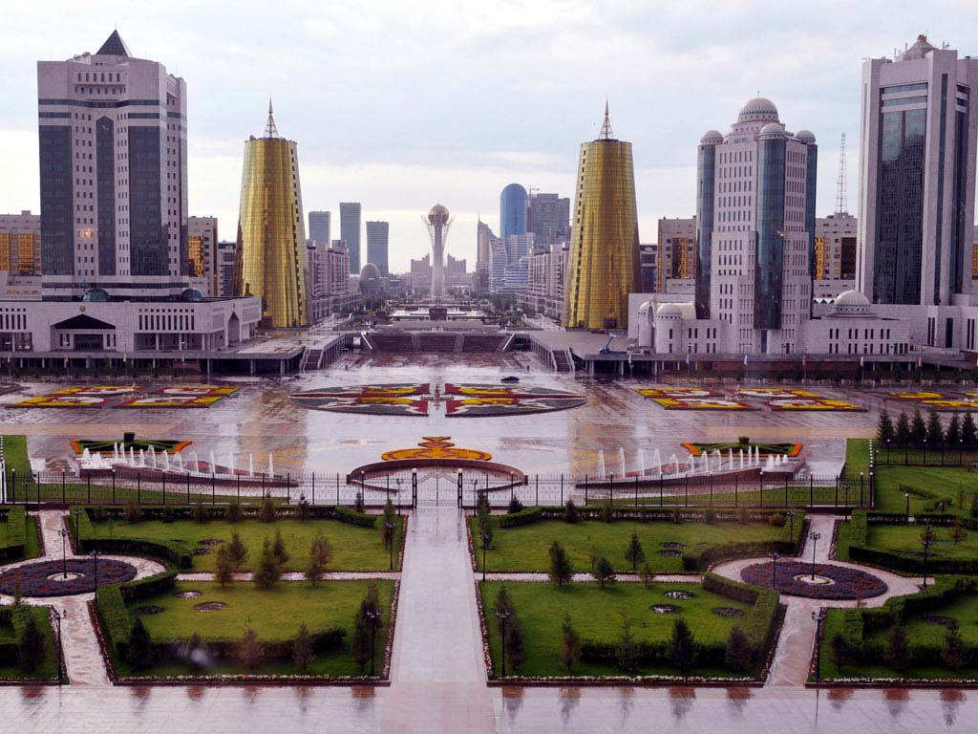
The building of the architectural firm "SA Architects" in Nur-Sultan. Sights of Astana
Lecture 10. Modern Architecture (from 1991 to the present)

Slide 10
BAITEREK TOWER IN ASTANA
Lecture 10. Modern Architecture (from 1991 to the present)

Slide 11
Architecture of Turkmenistan
Lecture 10. Modern Architecture (from 1991 to the present)
After the whole of Turkmenistan saw off its ruler Turkmenbashi with honors, a new era began in the country. His political heir, Gurbanguly Berdimuhamedov, took over the administration of the Republic of Turkmenistan. Having publicly announced his adherence to Niyazov's course, the new president is slowly but consistently implementing a revision of his legacy. The vector was marked a few months ago, when Berdymukhammedov, without saying anything about the end of the “Golden Age of the Turkmens” (as the period of his reign was called under Niyazov), announced the beginning of a new era - the “Great Revival”. The revival, in fact, began before it was said about it.
Within a year, the new president returned to Turkmenistan a full secondary and higher education, the Academy of Sciences, pensions, allowances for large families, single mothers, and even journalists' fees. Internet cafes and subscriptions to print media, including foreign ones, have been opened in Ashgabat and regional centers. At the same time, Berdymukhammedov called for the revival of the national opera, the circus, and the development of a network of cinemas and libraries. The monuments of Turkmenbashi were removed, his architectural structures, the purpose of which was to glorify the personality of Saparmurat Niyazov, were removed to the backyards of Ashgabat.
Thus, a new development of architecture and urban planning of Turkmenistan was proclaimed, which headed for the creation of a new style, a new typology of buildings, the direction of creating a "garden city", respect for the ecological balance of nature and man.

Slide 12
Ministry of Health of Turkmenistan
Lecture 10. Modern Architecture (from 1991 to the present)

Slide 13
Palace of Happiness in Ashgabat
Lecture 10. Modern Architecture (from 1991 to the present)

Slide 14
Architecture of Uzbekistan
Lecture 10. Modern Architecture (from 1991 to the present)
Having gained independence, the Republic of Uzbekistan radically changed its attitude towards its historical heritage, established extensive ties with foreign countries, developed the foundations of a national ideology, and successfully carried out socio-economic reforms. These large-scale changes gave a powerful impetus to the development of architecture based on new spiritual ideals, updated opportunities and a new social order.
The new social base of construction and modern building materials have radically changed the attitude of architects to their field of activity. Their increased professionalism helped to more clearly define the role of architecture as a habitat and activity of a person who has freed himself from all prejudices of the former ideology, to find a convincing figurative answer to the changed demands of a democratic society. The architects see their main task in the search for new means of creating an architectural image of a modern building, deeply national in spirit. To do this, they use available tools, including a wide range of modern building materials. But the main breeding ground for the birth of the Uzbek architecture of the XXI century was the historical heritage and national traditions. The rich experience of Uzbek architects and builders of the past also helps to take into account the natural and climatic conditions of the construction area. The professional ability to use all aspects of architectural creativity is now the main criterion for evaluating architectural objects.
Of course, the majority of Uzbek architects are still only looking for their own path, and on this path one cannot do without mistakes and miscalculations. At the same time, it is impossible not to see that over the past decades, the architecture and urban planning of Uzbekistan has taken a giant step towards acquiring its national identity. Evidence of this is the many housing and civil construction projects built over the years.

Slide 15
NEW BUILDINGS IN TASHKENT
Lecture 10. Modern Architecture (from 1991 to the present)

Slide 16
Ташкент. Арт-галерея
Lecture 10. Modern Architecture (from 1991 to the present)

Slide 17
Architecture of Tajikistan
Lecture 10. Modern Architecture (from 1991 to the present)
In Tajikistan, elements of classical order architecture are still relevant if it is necessary to give buildings a luxurious and representative character. Classical style, expressed in simplicity and harmony of lines. In the central part of Dushanbe, until recently, “Stalinist” architecture or, in other words, “Stalinist Empire” prevailed. The streets are not wide and are buried in the greenery of giant plane trees, closing their crowns high above the roadway.
In the last three 10 years in Dushanbe, as well as in the whole republic, a number of directions have been outlined in relation to the interaction of traditions and modernity, which successfully meets the tasks of creating a national identity in modern architecture. At the same time, features of an international community within the Central Asian region are revealed.
In parallel with the trends of modernism, there has always been the idea of returning traditions to the architecture of Tajikistan. The trends in the use of historical and local (local) principles remain the main thing in theoretical research in this direction. These trends can be divided into two types: 1 - the use of traditional motifs at the decor level; 2 - use of traditional elements as symbols. In some buildings, historical forms have been used without change (mainly in mosques) or there is a mixture of styles.

Slide 18
PALACE OF THE NATION OF TAJIKISTAN
Lecture 10. Modern Architecture (from 1991 to the present)

Slide 19
MINISTRY OF FOREIGN AFFAIRS OF TAJIKISTAN
Lecture 10. Modern Architecture (from 1991 to the present)

Slide 20
Architecture of Kyrgyzstan
Lecture 10. Modern Architecture (from 1991 to the present)
One of the directions of modern architecture of Kurgyzstan is the search for a plastic form and artistic language of ethno-cultural objects that reflect the aesthetic ideals and oriental ideas of the people about the harmonious organization of the vital-spatial environment. This is evidenced, in particular, by the architecture of the state ethno-cultural complex "Manas ayyly", built for the millennium of the epic "Manas" in Bishkek, and "Manas ordosu" in Talas in 1995, the school building in the Alai district (architect S. Amyrkulov), “Kyrgyz Aiyly” (Bishkek and Osh).
In ethno-cultural objects, the architectural environment, as a rule, is filled with attributes of the traditional objective world of nomads, sculptural, symbolic, decorative elements, etc., associated with the signs of the culture of Kyrgyzstan.
The figurative and subject attributes in the projects of teahouses, tyulekans, historical and memorial complexes, individual residential buildings, etc. are strictly corresponding circumstance, drawing the attention of the consumer, as he moves in space, to historical, aesthetic, spiritual associations associated with the culture of Kyrgyzstan. At the same time, it is clear that the historical and cultural subject content of their space sometimes contradicts the modern function and content of such objects.

Slide 21
BISHKEK. CITY HALL "ASKA-TASH"
Lecture 10. Modern Architecture (from 1991 to the present)

Slide 22
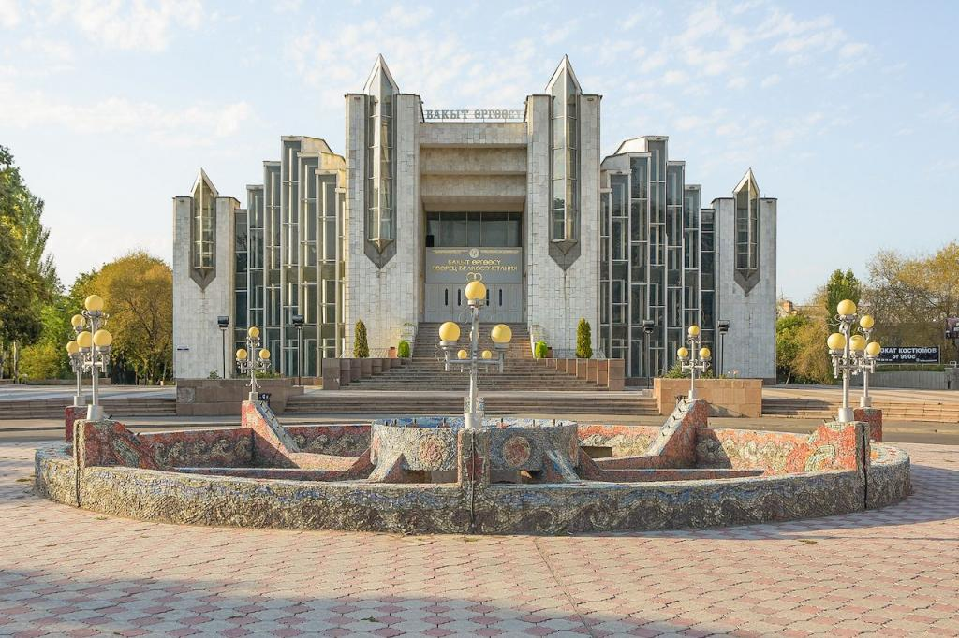
MATRIMONIAL PALACE
Lecture 10. Modern Architecture (from 1991 to the present)

Slide 23
Problems
Lecture 10. Modern Architecture (from 1991 to the present)
The main problem of modern architecture in the countries of Central Asia is the search for its own identity, the national identity of the people and their architecture. In order for this search to be fruitful, it is necessary to know the history of one's own people, their worldview and attitude. It is necessary to carefully treat the heritage of the ancestors, which carries many features of the national worldview and attitude.
The use of this national philosophy will allow in the future to determine the direction of the search for its architecture, its national identity and color.

Slide 24
Conclusion
Lecture 10. Modern Architecture (from 1991 to the present)
One of the directions of modern architecture of the countries of Central Asia has become a critical attitude towards history, which is expressed by the attitude towards historical traditions in almost all historical and architectural areas. This new historicism (critical historicism) manifests itself in one form or another in all the countries of Central Asia. The architectural tradition in the field of architectural history today has become disillusioned with the path it has taken because it has never been able to reveal its historical value as an art. Today, a new view of history is being formed - critical and heuristic, where heuristic means the search for a new attitude to architecture empirically, through trial and error. It is impossible to find a momentary answer to the further development of architecture; new experiments and trials are needed, albeit erroneous at first glance. Only time can give an answer to the question of what trend, style or direction is acceptable for the architecture of a particular country in Central Asia.

Slide 25
References
Lecture 10. Modern Architecture (from 1991 to the present)
R.S. Mukimov, S.M. Mamadzhanova. Architecture of Tajikistan. - Dushanbe: Maorif, 1990. - 170 p., ill.2.
S.M. Mamadzhanova. Traditions and modernity in the architecture of Tajikistan (on the example of Dushanbe). - Dushanbe: "Irfon" - "Meros", 1993. - 368 p., ill.3.
R.S. Mukimov. Theory and history of Tajik architecture. - Dushanbe: Ed. "Meros", 2002. - 540 p.4.
D.Omuraliev, O.Volichenko. The latest architecture of Central Asia (trends, results, prospects). - Bishkek: "Aldabakan-Kep", 2012. - 100 p., ill.

