Slide 1
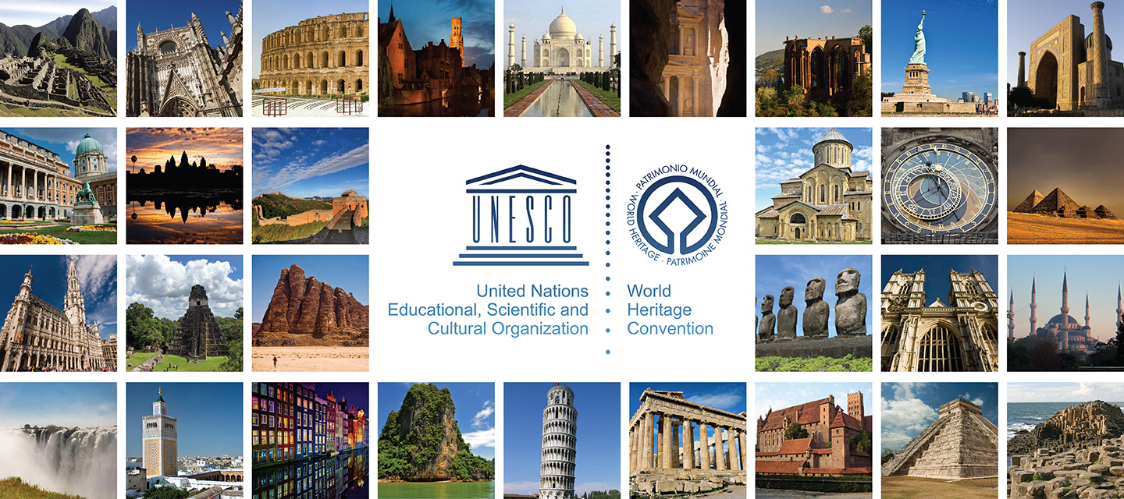
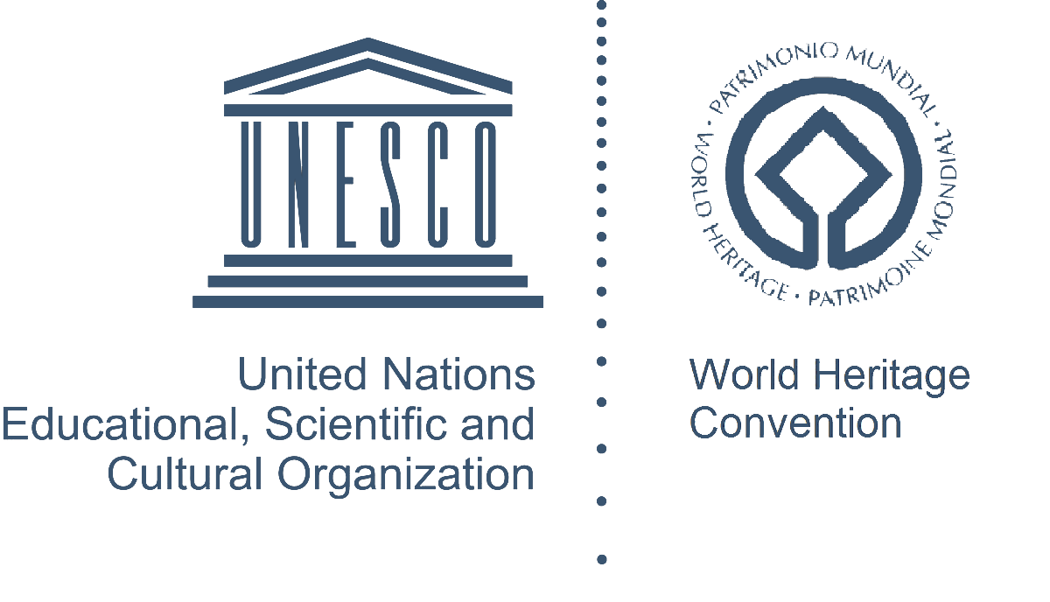
Co-funded by the Erasmus+ Programme of the European Union
Prof. Rustam Mukimov
Tajik Technical University named after acad. M.S.Osimi,
Department of Architectural Environment Design and Restoration
Lecture 2. THE HISTORY OF ARCHITECTURE OF THE BRONZE AND THE EARLY IRON AGES IN CENTRAL ASIA
~

Slide 2
Lecture 2. THE HISTORY OF ARCHITECTURE OF THE BRONZE AND THE EARLY IRON AGES IN CENTRAL ASIA
CONTENT OF THE COURSE "History of architecture of Central Asia"
General information about the Architecture of Central Asia. Periodization of the history of architecture of Central Asia
The history of architecture of the bronze and the early iron ages in Central Asia
Architecture of early statehood (V - IV centuries BC) in Central Asia
Architecture of antiquity (IV century BC - IV century AD)
Architecture of the Early Middle Ages (VI - early VIII centuries) in Central Asia
Architecture of early Islam (IX - X centuries; XI -early XIII centuries) in Central Asia
Architecture of the XIV - XV centuries in Central Asia
Architecture of the Late Middle Ages (XVI-late XVIII centuries) in Central Asia
Architecture of the New Age (the second half of the XIX - the entire XX centuries)
Modern Architecture (from 1991 to the present)

Slide 3
CONTENT
Lecture 2. THE HISTORY OF ARCHITECTURE OF THE BRONZE AND THE EARLY IRON AGES IN CENTRAL ASIA
Terms and concepts
The main part of the lecture "The history of architecture of the bronze and the early iron ages in Central Asia"
- the history of clay bricks in Central Asia;
- the earliest clay houses in Central Asia;
- sarazm - early settlement in the foothill zone of Central Asia;
- architectural and construction art of sarazm builders;
- earlier urban settlement altyn-depe in southern Turkmenistan;
- cult ideology of the altyn-depe ancient inhabitants;
3. Problems of preservation of ancient clay settlements
4. Conclusion
5. References

Slide 4
Terms and concepts
Lecture 2. THE HISTORY OF ARCHITECTURE OF THE BRONZE AND THE EARLY IRON AGES IN CENTRAL ASIA
Central Asia is a vast, landlocked region of Asia. According to UNESCO's definition, the region includes, in addition to Kazakhstan, Kyrgyzstan, Uzbekistan, Turkmenistan and Tajikistan, Mongolia, northwestern China, southern and southeastern Russia, Afghanistan, northwestern India, northern Pakistan, and northern Iran.
The Middle East is a historical, cultural and geographical concept that designates the territories of Central Asia, Iran and Afghanistan, which together with the Middle Eastern countries are part of the Southwest Asian region.
The Middle Asia is part of the Asian territory of the former USSR, where the former Soviet republics of Uzbekistan, Tajikistan, Turkmenistan and Kyrgyzstan were located
Civilization is a cultural community of people with a certain social genotype, a social stereotype, which has mastered a large autonomous, closed world space, and therefore has gained a strong place in the world community.
The Neolithic or New Stone Age is the last epoch of the Stone Age, characterized by the settlement of the population, the emergence of cattle breeding and agriculture, the invention of ceramics. This Age corresponds to the VIII-III thousand BC.

Slide 5
Terms and concepts
Lecture 2. THE HISTORY OF ARCHITECTURE OF THE BRONZE AND THE EARLY IRON AGES IN CENTRAL ASIA
The Bronze Age is an epoch of human history distinguished on the basis of archaeological data, characterized by the leading role of bronze products, which was associated with the improvement of the processing of such metals as copper and tin obtained from ore deposits, and the subsequent production of bronze from them.
The New Iron Age is an epoch in the primitive and early class history of mankind, characterized by the spread of iron metallurgy and the manufacture of iron tools; it lasted from the IX-VII century BC to the I century AD.
Tradition is a phenomenon of material or spiritual culture, social or family life, consciously transmitted from generation to generation.
Ziggurat is an ancient temple building in the form of a tower, which first appeared among the ancient Assyrians and Babylonians. The tower looks like several stepped terraces placed one on top of the other, with a wide base and a noticeable narrowing to the top.
Astral deity is the deification of heavenly bodies among many primitive peoples.
The "golden ratio" is the ratio of two values a and b, which are not equal to each other. This unequal division is called the golden ratio. In general, from the point of view of mathematics, the golden ratio is an ideal proportion.

Slide 6
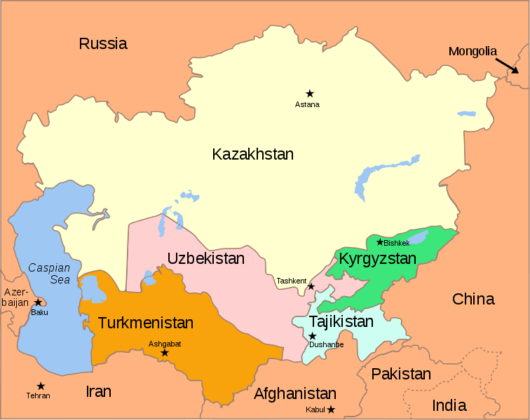
Map of Central Asia and the Great Silk Road from China to Rome through the lands of Middle Asia
Lecture 2. THE HISTORY OF ARCHITECTURE OF THE BRONZE AND THE EARLY IRON AGES IN CENTRAL ASIA

Slide 7
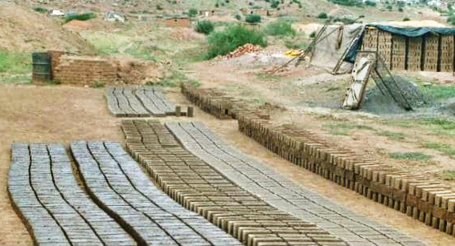
The history of clay bricks in Central Asia
Lecture 2. THE HISTORY OF ARCHITECTURE OF THE BRONZE AND THE EARLY IRON AGES IN CENTRAL ASIA
The vast territory of Central Asia belongs to one of the most favorable areas of our planet for the development of ancient civilizations. Powerful loess layers on the plains of Central Asia provided builders with the simplest and most suitable material - clay. The absence of scaffolding and the ubiquity of the loess in the most ancient period led to the widespread use of loess - pakhsa and raw bricks as the main building materials throughout the Middle East.
Top picture: world centers of agriculture(according to academician-breeder N.P. Vavilov).
No. 6 is the South-West Asian center, which includes Middle Asia.
Bottom picture: Clay is one of the most ancient building materials of the Near and Middle East

Slide 8
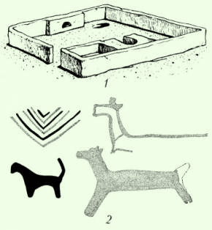
Jeytun settlement, Southern Turkmenistan, VI thousand BC Residential house, reconstruction.
Lecture 2. THE HISTORY OF ARCHITECTURE OF THE BRONZE AND THE EARLY IRON AGES IN CENTRAL ASIA
Approximately in IX-V thousand BC in Central Asia, the Neolith (New Stone Age) begins. Its main content was the "Neolithic revolution" (the transition from gathering to producing economy). Already in the V millennium BC, the dwellings of the early Neolithic settlements of the south of Turkmenistan, Jeytun were built from clay blocks of oval cross-section with a diameter of 20-25 cm and a length of 60-70 cm.

Slide 9
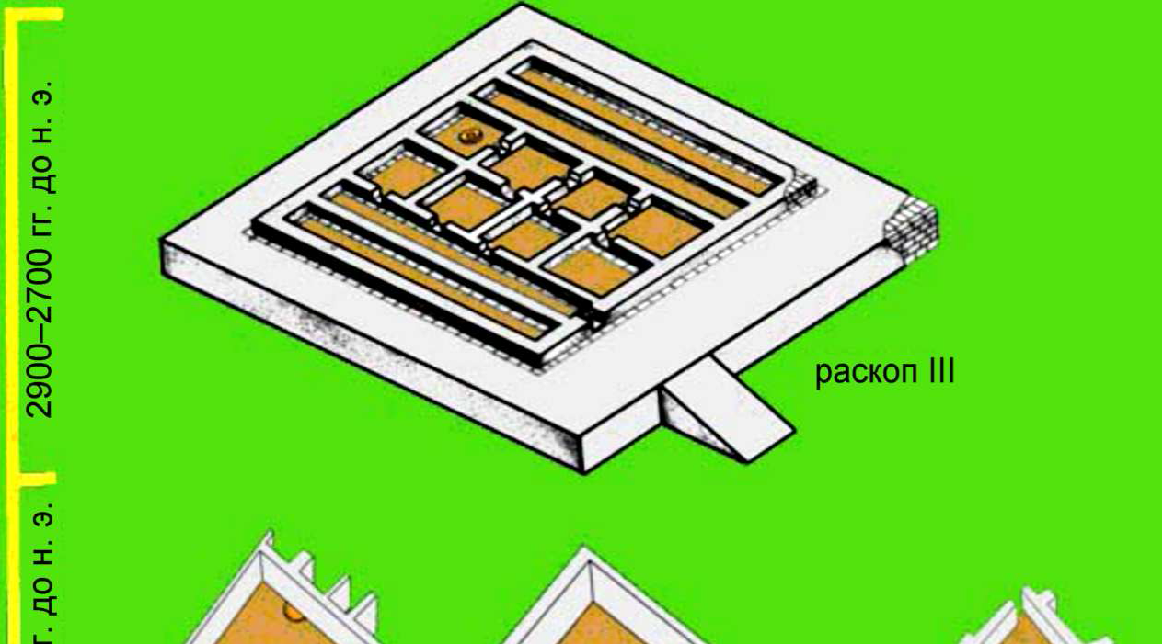
Sarazm, Central Tajikistan. A palace and religious building. 2800-2700 BC
Lecture 2. THE HISTORY OF ARCHITECTURE OF THE BRONZE AND THE EARLY IRON AGES IN CENTRAL ASIA
One of the largest ancient agricultural oases in Central Asia was the Zeravshan River basin with a length of more than 700 km. Therefore, in 1976 the discovery of the Sarazm settlement in 15 km west of ancient Penjikent and 45 km east of Samarkand was a material confirmation of the first early agricultural monument in the Central Asian Interfluve of the Syr Darya and Amu Darya. The settlement of Sarazm with an area of about 100 hectares has archaeological layers of the Late Eneolithic and Early Bronze Ages.
The cult ideology of Sarasm of the Bronze Age is represented by a monumental building of 12 rooms. One of the rooms served as a sanctuary. The building is constructed of rectangular raw bricks (57-58x27 - 28x12-13 cm). The building itself is strictly geometric in shape, built on a platform of 15x15 m, 0.75 m high.
A.Isakov, the first researcher of Sarazm, discovers the similarity of the monumental building with the Altyn-Depe ziggurat in Southern Turkmenistan. In general, the opening of a monumental building in Sarazm allowed A.Isakov to name it as a proto-urban type settlement.

Slide 10
The clay walls of Sarazm are under protection
Lecture 2. THE HISTORY OF ARCHITECTURE OF THE BRONZE AND THE EARLY IRON AGES IN CENTRAL ASIA

Slide 11
Sarazm. Palace and temple structure. III thousand BC. Geometric analysis of the plan.
Lecture 2. THE HISTORY OF ARCHITECTURE OF THE BRONZE AND THE EARLY IRON AGES IN CENTRAL ASIA
The excavations of Sarazm clearly show that the building culture was very developed here, and therefore we can talk about the existence of a formed construction industry with a system of architectural "design" in the III-IV thousand BC. The proof of the latter is the construction of the palace complex, which was distinguished by a well-developed layout, rectangular wall lines and proportional relationships of rectangular rooms, indicating the knowledge of the "golden section" system by the builders of Sarazm.

Slide 12
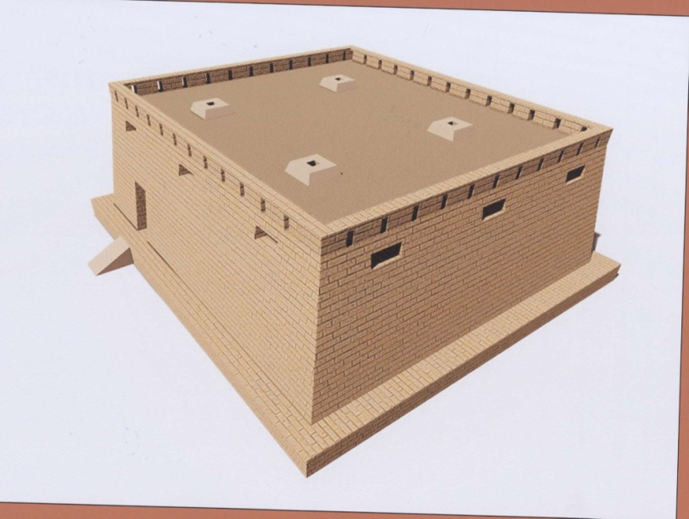
Sarazm. Palace and temple structure. III thousand BC. Graphic reconstruction of the palace-temple.
Lecture 2. THE HISTORY OF ARCHITECTURE OF THE BRONZE AND THE EARLY IRON AGES IN CENTRAL ASIA
This is an evidence of the early stage of the development of the architectural profession with a system of architectural structures’ harmonization. The builder of Sarazm was undoubtedly familiar with the construction industry and architecture of the Early kingdom of Ancient Egypt.

Slide 13
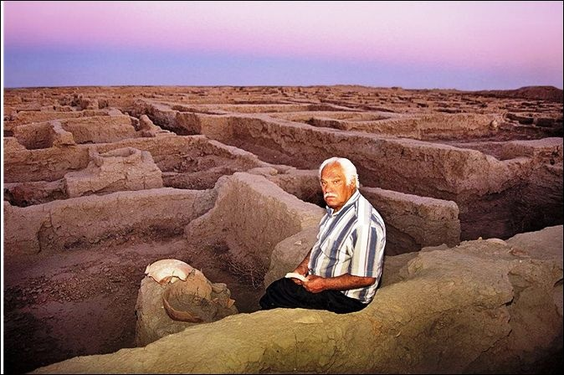
Archaeologist V.Sarianidi - the head of the excavations of Altyn-Depe
Lecture 2. THE HISTORY OF ARCHITECTURE OF THE BRONZE AND THE EARLY IRON AGES IN CENTRAL ASIA
One of the interesting settlements of Southern Turkmenistan of the Late Eneolithic and developed Bronze Ages (2100-1650 BC) is the settlement of Altyn-Depe, which in its flourishing era occupied an area of 26 hectares with a population of 5 thousand inhabitants. The settlement had a fairly clear planning structure, where there is a noticeable tendency to monumentality, strict geometricity in architecture. Altyn consisted of four different parts, each of which differed sharply from the others with the layout and building architecture. In the settlement there are quarters of artisans, wealthy citizens, nobles and a cult complex.

Slide 14
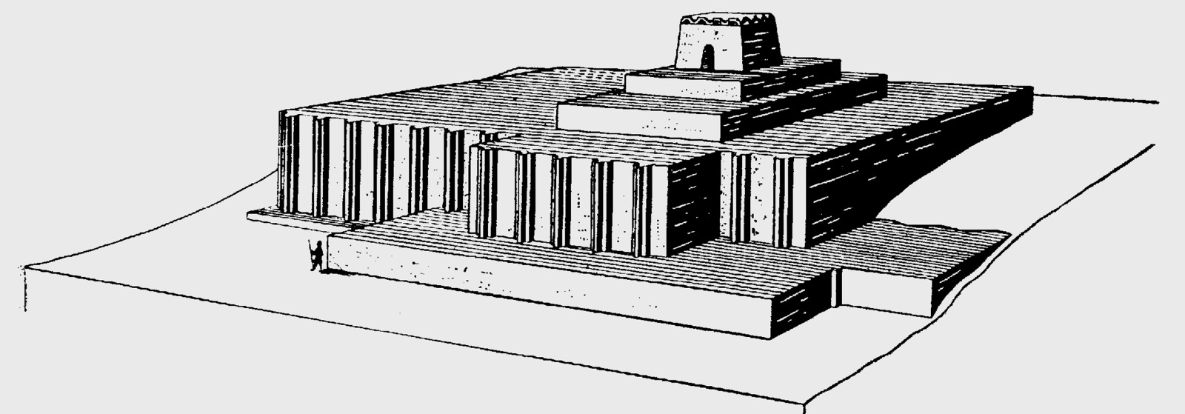
The cult center (ziggurat) in Altyn-Depe, the end of the III millennium BC Reconstruction.
Lecture 2. THE HISTORY OF ARCHITECTURE OF THE BRONZE AND THE EARLY IRON AGES IN CENTRAL ASIA
The cult center had existed in Altyn for several generations. A four-stage tower built of raw brick served as the architectural and compositional center. Its architecture reminds the famous ziggurats of Mesopotamia.

Slide 15
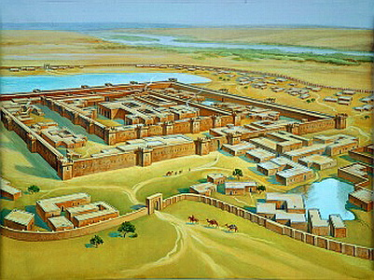
Altyn-Depe ("Golden Hill"), Southern Turkmenistan - a monument of the Eneolithic and Bronze Age (V - beginning of II millennium BC). Reconstruction.
Lecture 2. THE HISTORY OF ARCHITECTURE OF THE BRONZE AND THE EARLY IRON AGES IN CENTRAL ASIA
Altyn-Depe was dedicated to the astral deity, the moon god, performing in the form of a mighty bull. According to the assumption of V.M. Masson, the researcher of Altyn-Depe, it was the supreme deity of the entire settlement.

Slide 16
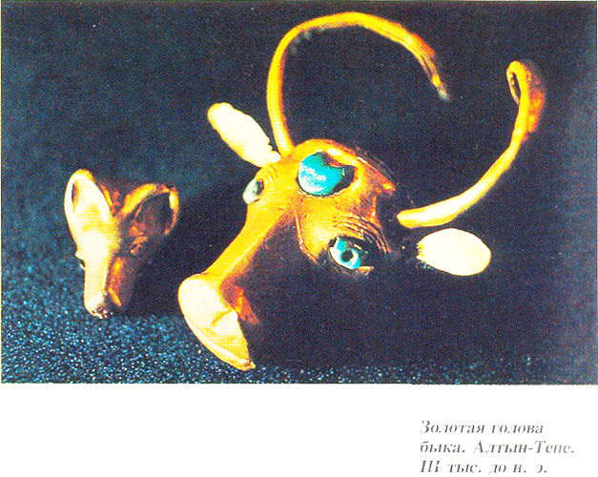
Altyn-Depe settlement. Astral (lunar) supreme deity: Golden Bull's Head, III millennium BC (Mary Regional Museum of Turkmenistan)
Lecture 2. THE HISTORY OF ARCHITECTURE OF THE BRONZE AND THE EARLY IRON AGES IN CENTRAL ASIA

Slide 17
Problems of preservation of ancient clay settlements
Lecture 2. THE HISTORY OF ARCHITECTURE OF THE BRONZE AND THE EARLY IRON AGES IN CENTRAL ASIA
One of the main problems of preservation of ancient monuments is the methods of fixing the ancient clay structures uncovered by archaeologists. This problem has already been raised at two international symposia of ICOMOS, since it is extremely important for the entire Middle and Near East. A practical solution has not yet been found. For a number of years, in Uzbekistan there have been conducted experiments to consolidate archaeological and architectural monuments made of raw materials with film coatings and various polymers, but so far there have been very few successes. Such is the conservation of the plaster walls of the Bronze Age settlement of Sappalytepe (II millennium BC), where their outer surface, covered with a film, holds well, but there remains a threat of absorption of soil salts into the adobe structure and, as a consequence, its destruction.
The method of calcining raw or adobe walls with infrared rays through metal sheets superimposed on them is also considered not reliable. Although it is fast and economical, but at the same time the clay is fused and it turns into ceramics, that is, both the structure of the base material and its external texture change. In addition, the destruction of masonry by soil salts is not eliminated.
Thus, for the preservation of clay structures uncovered by archaeologists, the simplest methods are applying clay-based lubricants, as well as the installation of canopies over archaeological objects to protect ancient clay walls from atmospheric phenomena (wind, rain, snow, dust storms, etc.).

Slide 18
Conclusion
Lecture 2. THE HISTORY OF ARCHITECTURE OF THE BRONZE AND THE EARLY IRON AGES IN CENTRAL ASIA
Almost all ancient and antique settlements in Central Asia are built of fragile building material which is a clay. Raw material, pakhsa, clay plasters, clay greases of roofs were all melted in ancient times, turning abandoned ancient settlements into shapeless clay hills-tepe. To all this should be added the extensive irrigation, road, civil construction, which are carried out by various departments, leading to the destruction of the clay remains of ancient settlements. In this regard, the following recommendations are possible for the neighboring countries of Central Asia:
to preserve and museumify archaeologically uncovered objects of historical heritage with organization of shelter from the climatic effects of the environment;
recommend to urban planning design organizations during development of general plans, as well as the projects of detailed planning of historically developed population centers, include in projects the preservation of archaeological zones or separate sites;
to train purposefully specialists in the conservation of clay monuments of antiquity for their physical preservation and salvation from the destructive actions of the forces of nature and people.
One of the main tasks facing the bodies on protection and use of monuments of cultural heritage is the need to preserve the ability of monuments to evoke certain aesthetic emotions in the viewer, that is, the task of increasing the artistic expressiveness of monuments of material culture by restoring them to their former appearance and beauty.

Slide 19
References
Lecture 2. THE HISTORY OF ARCHITECTURE OF THE BRONZE AND THE EARLY IRON AGES IN CENTRAL ASIA
Bachinsky N.M. Antiseismics in architectural monuments of Central Asia. - M.-L., 1949.
Bulatov M.S. Geometric harmonization in the architecture of Central Asia of the IX-XV centuries. - M.: Nauka, 1978; Ed. 2nd. - M.: Nauka, 1988. - 300 p., ill.
Voronina V.L. Ancient construction techniques of Central Asia // AofS. - 1953. - No. 3. - pp. 3-35.
Grazhdankina N.S. Architectural and construction materials of Central Asia. - Tashkent: Uzbekistan, 1988. - 296 p., ill.
Isakov A. Sarazm - the dawn of civilization // Merosi niyogon. - 1992. - Dushanbe. - No. 1. - pp. 21-24.
Conservation of architectural and archaeological monuments of the southern regions of the USSR //Materials of the meeting of the Scientific and Methodological Council Reports on the Protection of Cultural Monuments. Ministry of Culture of the USSR. – 4th issue. - M., 1969.
Masson V. M., Sarianidi V. I. Karakum - the dawn of civilization. M., 1972.
Mukimov R.S. History and theory of the Tajik architecture. - Dushanbe: TPI, 2002. - 420 p., ill.
Mukimov R., Mamadzhanova S., Mukimova S. Architectural art of the Aryans: the origins of formation. - Dushanbe: National Academy of Sciences of Tajikistan, 2020. - 200 p., ill.
Omuraliev D., Volichenko O. Ancient architecture of Central Asia. - Bishkek: KG USTA, 2006. - 200 p., ill.
Pugachenkova G.A. To the problem of preservation of archaeological monuments in the cities of Uzbekistan // SAU. - No. 12. - Tashkent, 1980. - pp. 24-26.
Sarazm - 5500. - Dushanbe: Ejod, 2006. - 96 p., ill.
Toatov Anvarsho. Historical monuments have a long life. - Dushanbe: Irfon, 1986. - 56 p., ill.

