Slide 1
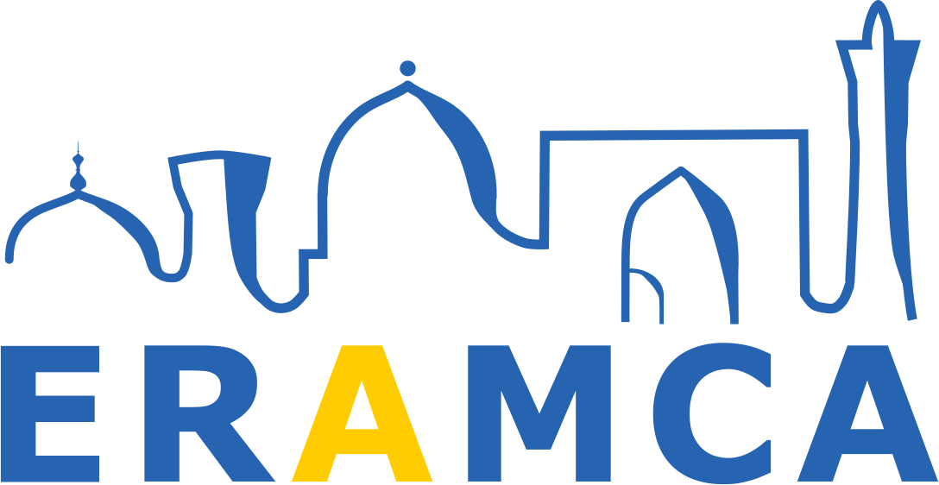
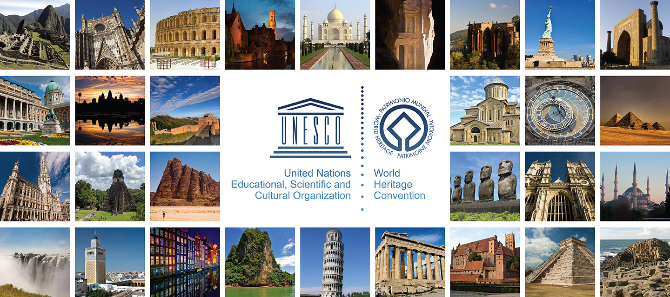
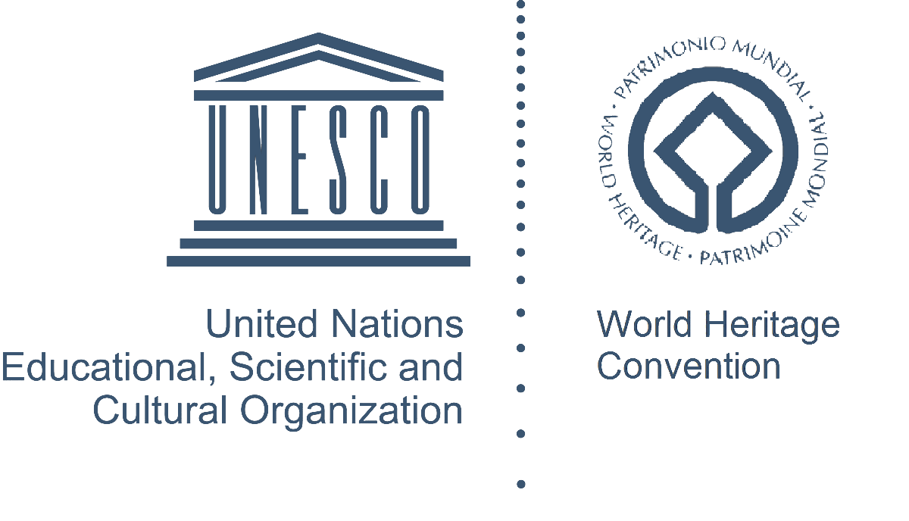
Co-funded by the Erasmus+ Programme of the European Union
Prof. Rustam Mukimov
Tajik Technical University named after acad. M.S.Osimi,
Department of Architectural Environment Design and Restoration
Lecture 6. Architecture of early Islam (IX - X centuries; XI -early XIII centuries) in Central Asia

Slide 2
Lecture 6. Architecture of early Islam (IX - X centuries; XI -early XIII centuries) in Central Asia
CONTENT OF THE COURSE "History of architecture of Central Asia"
General information about the Architecture of Central Asia. Periodization of the history of architecture of Central Asia
The history of architecture of the bronze and the early iron ages in Central Asia
Architecture of early statehood (V - IV centuries BC) in Central Asia
Architecture of antiquity (IV century BC - IV century AD)
Architecture of the Early Middle Ages (VI - early VIII centuries) in Central Asia
Architecture of early Islam (IX - X centuries; XI -early XIII centuries) in Central Asia
Architecture of the XIV - XV centuries in Central Asia
Architecture of the Late Middle Ages (XVI-late XVIII centuries) in Central Asia
Architecture of the New Age (the second half of the XIX - the entire XX centuries)
Modern Architecture (from 1991 to the present)

Slide 3
CONTENT
Lecture 6. Architecture of early Islam (IX - X centuries; XI -early XIII centuries) in Central Asia
Terms and concepts
The main part of the lecture "Lecture 6. Architecture of early Islam (IX - X centuries; XI -early XIII centuries) in Central Asia“:
- conditions for the development of the architectural and urban planning culture in the 9th-10th centuries;
- urban settlements and their complexes;
- rural settlements;
- typology of buildings of the 9th-10th centuries;
- monumental art and architecture;
- development conditions of the early Middle Ages (XI-Forer of the XIII centuries);
- cities and settlements. Traditions of fortification;
- continuity of traditions in civil architecture;
- the formation of a single architectural and artistic style.
3. Problems
4. Conclusion
5. References

Slide 4
Terms and concepts
Lecture 5. Architecture of the Early Middle Ages (VI - early VIII centuries) in Central Asia
CENTRAL ASIA is a subregion of Asia that stretches from the Caspian Sea in the west to China and Mongolia in the east, and from Afghanistan and Iran in the south to Russia in the north. The region consists of the former Soviet republics of Kazakhstan, Kyrgyzstan, Tajikistan, Turkmenistan, and Uzbekistan. It is also colloquially referred to as "The -Stans" as the countries all have names ending with the Persian suffix "-stan", meaning "land of".
THE SAMANID EMPIRE also known as the Samanian Empire, Samanid dynasty, Samanid amirate, or simply Samanids) was a Sunni Iranian empire, from 819 to 999. The empire was centred in Khorasan and Transoxiana; at its greatest extent encompassing modern-day Afghanistan, huge parts of Iran, Turkmenistan, Uzbekistan, Kyrgyzstan, Tajikistan, and parts of Kazakhstan and Pakistan.
MIDDLE ASIA - part of the Asian territory of the former USSR, where the former union republics of Uzbekistan, Tajikistan, Turkmenistan and Kyrgyzstan were located.
HULBUK is the capital of the Vose' District of the Khatlon Region, Tajikistan. It is located in the southern portion of Tajikistan 26 kilometres (16 mi) southwest of Kulob and 174 km (108 mi) south of Dushanbe.
THE KARA-KHANID KHANATE was a Turkic khanate that ruled Central Asia in the 9th through the early 13th century.
THE GHAZNAVID DYNASTY was a Muslim Turkic dynasty of mamluk origin, ruling at its greatest extent, large parts of Iran, Afghanistan, much of Transoxiana and the northwest Indian subcontinent from 977 to 1186. The dynasty was founded by Sabuktigin upon his succession to the rule of Ghazna after the death of his father-in-law, Alp Tigin, who was an ex-general of the Samanid Empire from Balkh, north of the Hindu Kush in Greater Khorasan.

Slide 5
The map of the state of the Samanids in the 9th-10th centuries. Maverannahr in the IX-XII centuries.
Lecture 6. Architecture of early Islam (IX - X centuries; XI -early XIII centuries) in Central Asia

Slide 6
The development conditions of the architectural and urban planning culture in the 9th-10th centuries.
Lecture 6. Architecture of early Islam (IX - X centuries; XI -early XIII centuries) in Central Asia
IX-X centuries in the architecture of Central Asia as a whole, it marks the formation of a qualitatively new style, excellent in its internal content and external expression from the style composed in the conditions of pre-Arab society. The entry of Maverannahr (Central Asian Mesopotamia), on the path of intensive feudalization, not only radically reflected in the field of architectural creativity. Having joined the caliphate, Central Asia joined the orbit of world caravan trade. Socio-economic shifts led to the growth of the rural population, crafts and trade, the merchant layer intensified, and the number of artisans increased. In the lives of cities, slavery acquired more and more importance.
The architecture of the period of Arab domination (VIII-IX centuries) in Central Asia is characterized by a resolute rejection of the synthesis of arts, which was previously widespread. This turned out to be a huge loss for the culture and art of the Central Asian peoples. However, the Arab conquest did not introduce noticeable changes in the development of architecture and urban planning in Central Asia.
In the IX-X centuries the country is liberated from Arab rule, the state of local dynasties of Tahirids and Samanids is created. The cities of Central Asia became more and more feudalized. The era of the IX-X centuries is recorded as the time of the formation of the feudal city.
It was the continuity and mutual enrichment of traditions that were the engine of architecture throughout antiquity and the early Middle Ages.

Slide 7
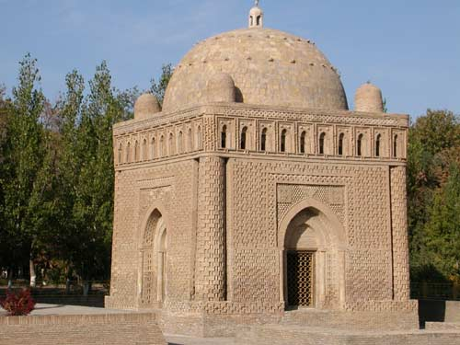
Dynastic mausoleum of the Samanids in Bukhara, IX-X centuries. General view after restoration. Mausoleum interior.
Lecture 6. Architecture of early Islam (IX - X centuries; XI -early XIII centuries) in Central Asia

Slide 8
Left picture: Mausoleum of Mirsaid Bakhrom in the Bukhara oasis, 10th century. Right picture: Mausoleum in the village of Tim, Samarkand region of Uzbekistan, X century.
Lecture 6. Architecture of early Islam (IX - X centuries; XI -early XIII centuries) in Central Asia

Slide 9
Urban settlements and their complexes
Lecture 6. Architecture of early Islam (IX - X centuries; XI -early XIII centuries) in Central Asia
In the IX-X centuries in the cities of Central Asia, the population is sharply increasing, which led to an increase in the territory of cities (the territory of Bukhara increased by 12-15 times, Samarkand - 3-4 times, and Binket - 20 times. New cities appear.
The large growth of cities was due to the concentration of handicraft production and trade in cities, the development of urban culture, science, art and architecture, the migration of the rural population to cities, where not only a strong handicraft and trade layer appeared, but also a humanistically minded scientific intelligentsia.
Central Asian cities produce marketable products and trade in the East with China, East Turkestan, in the northwest with Bulgaria and Russia, in the west with Khazaria.
In the tenth century Hulbuk, the capital of Khuttal, was the largest city of Tokharistan, with a richly decorated ruler's palace with a square courtyard in the middle and a central heating system made of underground ceramic work, also located under the floor. A large settlement with richly decorated dwellings on the territory of Khuttal was found near the village of Sayyod on the banks of the Pyanj.
In the middle of the 9th century, the territory of Bukhara, which had 11 gates, grew strongly. In the tenth century its entire central part was a bazaar, and the city as a whole completely lost the appearance of the former Shahristan. Rich castles, estates and palaces are being built behind Shahristan. Religious buildings are also being built, mainly mosques.
In the IX-X centuries Ferghana with relatively large and densely populated cities of Akhsikat, Khujand, Andukan, Kuba, Kand (Kanibodom), Asbara, and others was a large economically strong region of Maverannahr. Khujand had a circumference of 6-8 km. The largest city of Maverannahr remained in the 9th-10th centuries Samarkand, which had 12 gates.
After the Arab conquest, not all cities revive and develop. So, Penjikent until the 17th century. Due to periodic enemy destruction, it changed its location three times. In the era of the Samanids, the development of ancient Termez, founded in the 3rd century BC. as the Greco-Bactrian city of Demetrius.
Outside the fortifications of the early medieval Termez is Kyrk-Kyz, which means "Forty maidens", associated with the legend of the Amazon girls who lived in the fortified castle. According to a number of scientists, this building was the family estate of the Samanids.

Slide 10
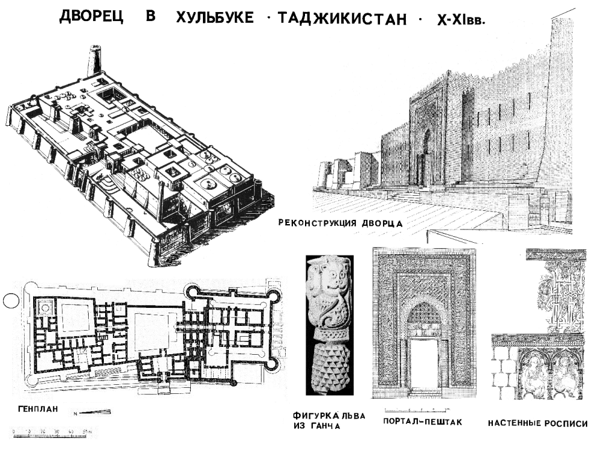
Lecture 6. Architecture of early Islam (IX - X centuries; XI -early XIII centuries) in Central Asia
Palace in Khulbuk, the capital of Khuttal. Southern Tajikistan.

Slide 11
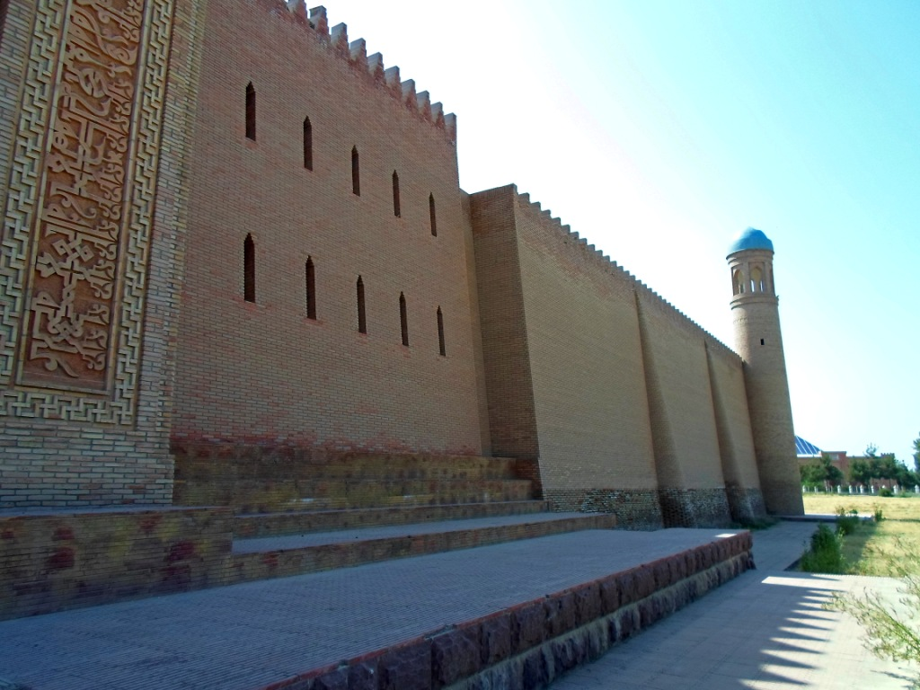
External walls of the palace in Khulbuk, X-XI centuries.
Lecture 6. Architecture of early Islam (IX - X centuries; XI -early XIII centuries) in Central Asia

Slide 12
Rural settlements
Lecture 6. Architecture of early Islam (IX - X centuries; XI -early XIII centuries) in Central Asia
Rural settlements of Central Asia in the 9th-10th centuries are mainly characterized by two monuments of Ustrushana: the compact unfortified Khonyailov settlement and the Karabulak settlement. Khon-Yaylov consisted of 7 complexes of continuous building of ordinary peasants. Rural settlements in the mountainous regions of Ustrushana, Ilak and Badakhshan also belonged to this type of settlements.
In general, in Ustrushan, Khujand and in general in Maverannakhr, the rural population lived largely compactly in fortified and unfortified villages, less in estates and castles. Some part of the population lived in large and medium-sized cities, doing agriculture.

Slide 13
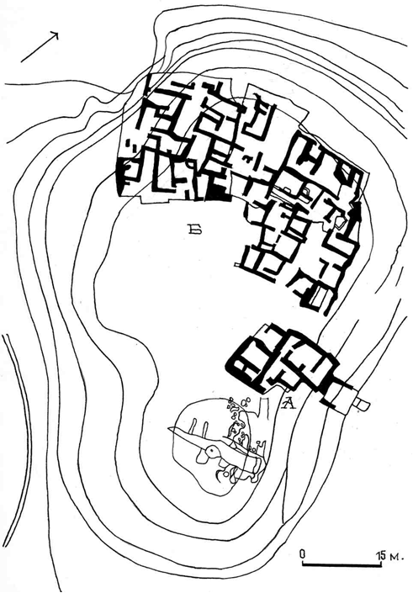
Ustrushana. The settlement of Karabulak in the Lailak region of Kyrgyzstan. Excavation plan, X-XII centuries: A – residential part of the settlement; B - the castle of the feudal lord.
Lecture 6. Architecture of early Islam (IX - X centuries; XI -early XIII centuries) in Central Asia

Slide 14
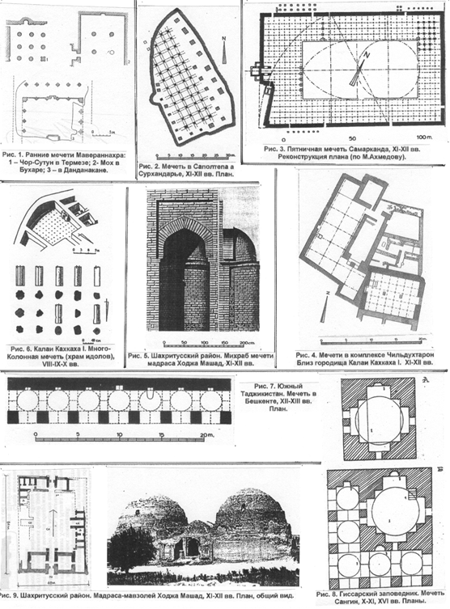
Mosques of Maverannahr IX-XIII centuries.
Lecture 6. Architecture of early Islam (IX - X centuries; XI -early XIII centuries) in Central Asia

Slide 15
Typology of buildings of the IX-X centuries
Lecture 6. Architecture of early Islam (IX - X centuries; XI -early XIII centuries) in Central Asia
The first surviving building in Central Asia made of baked bricks is the dynastic tomb of the Samanids in Bukhara (9th-10th centuries).
The appearance of an urban residential building in the 9th-10th centuries can be clarified by the example of the residential part of the complex of stone buildings Childukhtaron in the Shahristan region of Northern Tajikistan. This is a multi-room residential building of a centric type, square in plan, with a central square hall and rooms located around it with an enfilade organization along the main axis of the entrance vestibule - hall.
The vast majority of urban buildings were adobe-type shacks with flat roofs. Among the monotonous buildings of the cities, the houses of the nobility, the palaces of the rulers, stood out. High level in the IX-X centuries achieves the improvement of residential areas and the houses themselves. Large cities (Afrasiab, Bukhara, Herat, etc.) had underground sewerage and central water supply. The cities had pools to supply the inhabitants of the quarters with water.
Many temples of pre-Muslim cults were turned into Muslim mosques. The study of the types of mosques, their genesis and evolution made it possible to see in the architecture of these structures the continuity of pre-Islamic traditions of not only religious, but also civil architecture. The continuity of pre-Islamic traditions is also established in the addition of madras to the courtyard planning composition. The call to prayer was made from the minarets, the shape of which in each country repeated the local tower structures. In Central Asia, watchtowers and signal towers served as a building prototype for them.
Mausoleums, as funerary structures, have become one of the most common types of architecture in Central Asia. Most of their construction was associated with the religious ritual of worshiping the graves of the dead. The origins of the architectural forms of mausoleums go back to pre-Islamic times, when special structures were created to perform rituals, for example, the cult of ancestors.
As architectural monuments, irrigation facilities also deserve attention.

Slide 16
Left picture: Samarkand. Settlement Afrasiab, plan, X century. Below picture : plan of Bukhara, 10th century.
Lecture 6. Architecture of early Islam (IX - X centuries; XI -early XIII centuries) in Central Asia

Slide 17
Monumental art and architecture
Lecture 6. Architecture of early Islam (IX - X centuries; XI -early XIII centuries) in Central Asia
Under the pressure of Islam, fine arts lose their former diversity, and the masters are forced to turn all their skills to ornamentation, which becomes complex. New types of ornament appear - geometric and epigraphic - reflected in architecture.
In the IX-X centuries one of the most common types of decor was piece carving. They decorated panels, panels, vaults and mihrabs of the palace and religious buildings of Afrasiab, Khulbuk, Termez, etc. Painted pieces were widely used.
Another monument of ornamental decoration is the palace of Termez rulers. Here, all the walls, columns of the premises are decorated with carved pieces. Piece decor is also known in the mausoleum of the Samanids in Bukhara and other monuments of Maverannahr and Horosan.
Wood carving as a form of decorative art remained very common. Folk craftsmen continued to develop the traditions of pre-Islamic art here as well. In the villages of Obburdon, Fatmev, Kurud and Urmetan of Tajikistan, carved wooden columns were discovered, reminiscent of the rich world of pre-Islamic art.
In the IX-X centuries the tradition of carving on wet clay continued, a model of which is a clay mihrab with carved ornaments from Asht (X-XI centuries).
In general, in the visual arts of Central Asia in the 9th-10th centuries plant-geometric and floral ornaments replace compositions depicting people and animals.
In general, we can say that developed in the 9th-10th centuries the new artistic style of architectural and decorative art had a great influence on the subsequent development of the culture of the Tajik people.

Slide 18
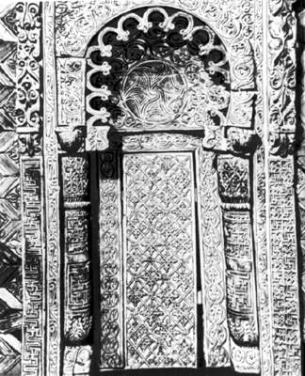
Below: a wooden mihrab from the village of Iskodar and a carved clay mihrab from the village of Asht (Northern Tajikistan)
Lecture 6. Architecture of early Islam (IX - X centuries; XI -early XIII centuries) in Central Asia

Slide 19
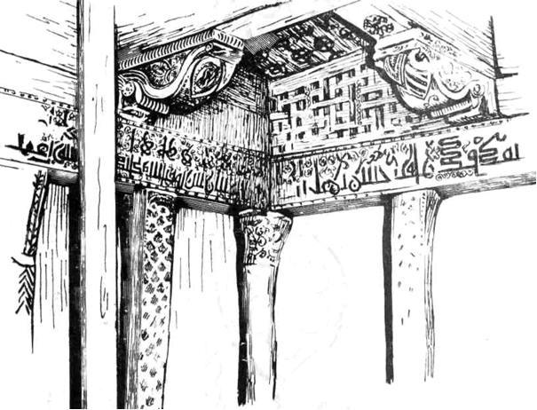
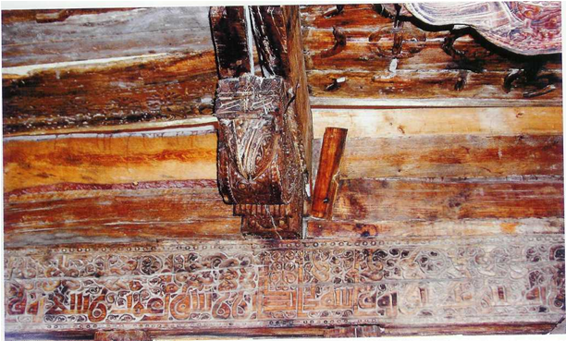
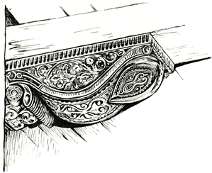
Isfara region, Tajikistan. Mazar Khazrati Shoh in the village. Chorkuh, IX-X centuries Architectural details made of wood.
Lecture 6. Architecture of early Islam (IX - X centuries; XI -early XIII centuries) in Central Asia

Slide 20
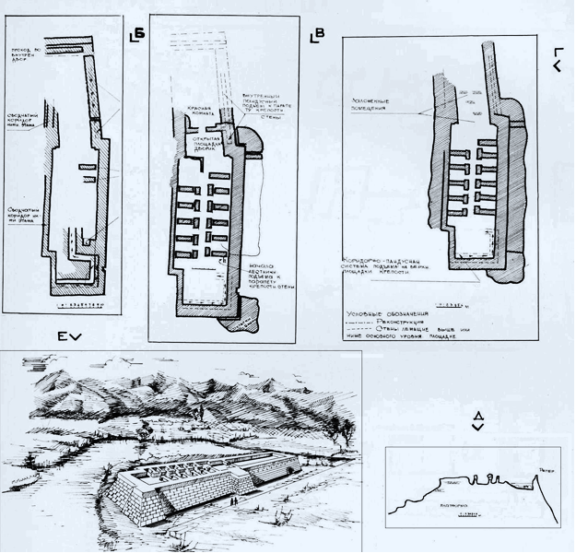
Northern Tajikistan. Fortified estate Kalai Bolo near Isfara: VI-VIII centuries; (upper, right); XI-XII centuries (left, bottom); XVIII-XIX centuries (bottom, right)
Lecture 6. Architecture of early Islam (IX - X centuries; XI -early XIII centuries) in Central Asia

Slide 21
Conditions for the development of the developed Middle Ages (XI-early XIII centuries)
Lecture 6. Architecture of early Islam (IX - X centuries; XI -early XIII centuries) in Central Asia
The year 999 is considered the time of the final decline of the Samanid state, which fell under the blows of the militant Turkic tribes, known as the Karakhanids. The state had two centers: in Kashgar and Balasagun. This division of the Karakhanid possessions into two parts, eastern and western, was preserved in the power of the Karakhanids until its end. Of all the representatives of this dynasty, Ibrahim Tamgach Bagra-khan stands out, from whom the madrasah named after him, the hospital, the men's bath and the large palace are known in Samarkand. He died in 1068 and two decades later (in 1089), as a result of the Seljuk invasion, the Karakhanid state lost its independence. At the beginning of the 13th century, the nominal head of the Karakhanids still ruled in Samarkand, who was later replaced by Khorezmshah Muhammad, who captured Maverannahr in the struggle against the Karakitays (Kidan nomads). It was at this time that the state of the Karakhanids ceased to exist.
On the territory of present-day Afghanistan in the XI-beginning of the XIII centuries the Tajik state of Ghurids is created with the capital in the city of Firugkuh (city of Jam). At the same time (X-XI centuries), the Ghaznavid state was created in Khorosan, which, under Sultan Mahmud, became one of the most powerful state of the Middle East in the XI century. This state fell under the blows of the Ghurids in 1188.
By the middle of the 11th century, a new state of the Seljukids, a Turkic-speaking union of the Oghuz tribes, was formed in Central Asia. In Central Asia, in addition to Horosan and the state of the Seljukids, Balkh, Termez, Bukhara, Samarkand, and Khorezm were included. The strong last ruler of the Seljuk state was Sanjar, the governor of Khorasan, and from 1118 - the sultan. Under him, Merv became the capital of the state (he died in 1156).
One of the brightest personalities in the Seljuk state was the Horosan Tajik Abuali Hasan ibn Ishok, the famous "Nizam al-Mulk" (1063-1093). He, being the wazir of the state, sought to revive the Samanid cultural traditions, contributed to the rise of science, education, trade, the construction of monumental buildings, including the madras, the growth of cities and crafts. The last great state of Central Asia, which rose at the end of the 11th-beginning of the 13th centuries, was Khorezm. Several monumental buildings in Urgench and many residential buildings remained in memory of the Khorezm state.

Slide 22
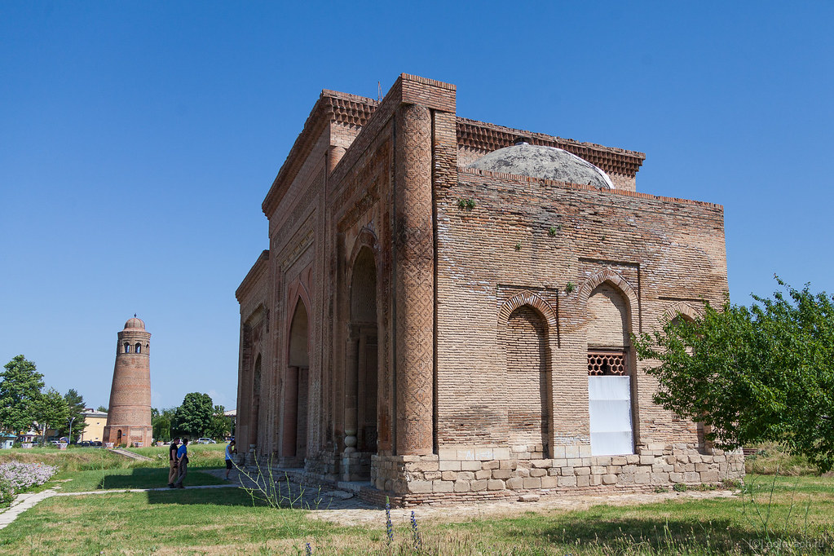
Uzgen (Kyrgyzstan). Mausoleum of Karakhanid and minaret 44 m high. XII century.
Lecture 6. Architecture of early Islam (IX - X centuries; XI -early XIII centuries) in Central Asia

Slide 23
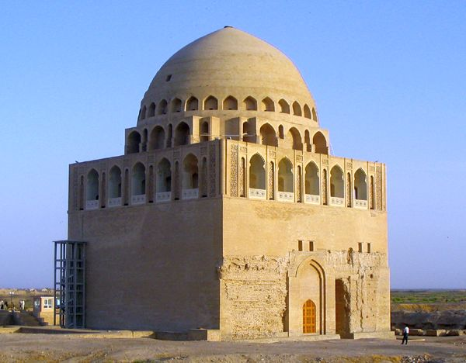
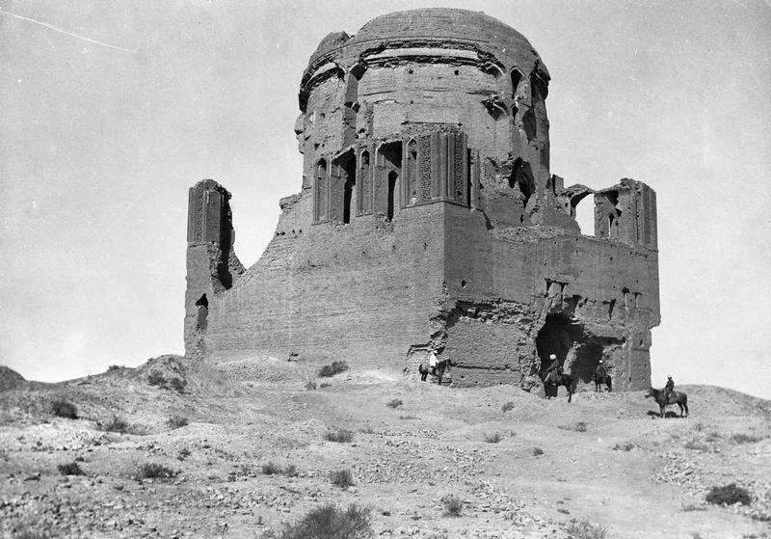
Mausoleum of Sultan Sanjar in Merv, XII century. Photo of the beginning 20th century (left). Photo from the 2000s After restoration.
Lecture 6. Architecture of early Islam (IX - X centuries; XI -early XIII centuries) in Central Asia

Slide 24
Cities and settlements. Fortification traditions
Lecture 6. Architecture of early Islam (IX - X centuries; XI -early XIII centuries) in Central Asia
By the beginning of the 11th century, the structure of the feudal city was determined, which was preserved until the 19th century. In the XII century Shahristan of Bukhara remains a vital part of the city.
Shahristan of Samarkand - Afrasiab continues to function, and the rabad of the city is already in the 10th century occupied a significant area south of Afrasiab: in the 11th century it was surrounded by a wall, destroyed in 1220 by order of Genghis Khan.
One of the largest cities in Central Asia is Merv, which in the XI century becomes the capital of the Seljuk state. Trade was conducted at several bazaars.
Examples of a well-fortified city in the second half of the 11th - first half of the 12th centuries serve Dakhistan, Balkh and Termez.
In Khorezm, the estates of landowners are surrounded by low adobe fences, which were adjoined by residential buildings with several rooms. In the Merv oasis, a composition is spread from a square hall with a central domed hall, sometimes rising to two floors. An example of fortification construction in northern Tajikistan is the Kalai-bolo fortress in the Isfara region. Built in the IV-VIII centuries and destroyed in the 10th century, in the 11th-12th centuries it has been significantly fortified and rebuilt. In the XI-XII centuries Khujand becomes one of the big cities of Central Asia.
The progressive development of architecture and art of the XI-beginning of the XIII centuries a tangible blow was dealt by the Mongol hordes of Genghis Khan, who in the 20s of the 13th century began the capture of Maverannahr. The seizure of the territory of Central Asia was accompanied by ruthless robberies, arson, the destruction of the civilian population, the destruction of cities and material values. The first major city was Otrar, which after 6 months of resistance was plundered and destroyed. The next cities were Sygnak, Binaket, Khujand and others. And only in the second half of the 13th and early 14th centuries a revival of construction activity begins, as evidenced by a number of examples from the architecture of Central Asia, in particular, Shakhi Zinda. At the beginning of the fourteenth century here arises the “northern group” of mausoleums, which still exists today (the mausoleums of Khoja Ahmad, Bezymyanny, etc.).

Slide 25
Continuity of traditions in civil architecture. Formation of a unified architectural and artistic style.
Lecture 6. Architecture of early Islam (IX - X centuries; XI -early XIII centuries) in Central Asia
The main distinguishing feature of the considered period of the Middle Ages is the continuity of traditions in architecture, urban planning, construction business and monumental construction and art.
Already in the XI-XII centuries in Central Asia, a wide interchange of masters of artistic professions was practiced, in particular, inviting architects who sometimes gained good fame from afar (architects Ali Bini Muhammad from Serakhs; Muhammad Bini Atsiz - the creator of the mausoleum of Sultan Sanjar, Abu-Nasr ibn Ahmad from Termez, etc.). Architecture and architectural decoration of Central Asia in the 11th - early 13th centuries developed in close cooperation with the architecture of Afghanistan and Iran (Khorosan).
The ruins of a country palace in the vicinity of medieval Termez provide an example of not only the dwellings of the rulers, but also a successful synthesis of architecture and fine arts. The building material of the palace is mostly raw, although burnt bricks are also used in some places. The architectural decor is simple and restrained. In the XII century all surfaces of the auditorium - from the panels to the locks of the vaults - were covered with a layer of ganch, on which a deep three-layer carving was applied.
On the territory of Tajikistan, most of the surviving monuments belong to religious architecture. The most ancient monument of the XI-XII centuries on the territory of Kabadian is the mausoleum of Khoja Mashad in the village of Sayed.
Among the numerous monuments of Kabadian, there are two interesting mausoleums - Khoja Durbad, built of burnt bricks, and mud-brick Tillo Khalodzhi. The decorative techniques of the architecture of Central Asia in the 11th-12th centuries characterize the two mausoleums of Khoja Nakhshron in the Tursunzadievsky region of Tajikistan.
In the Zeravshan valley from the 11th-12th centuries known mausoleum-mosque of Muhammad Bosharo near Penjikent. In 1332, a portal was added to the structure, decorated with carved terracotta and colored glazed tiles. In the village of Chorkuh, the wooden mausoleum of Khazrati posho Mir Khamza of the 12th-early 13th centuries survived with rich carvings. A classic example of carved wood from Central Asia in the 11th-12th centuries are wooden architectural details covered with carvings (one of them is a mihrab from the village of Iskodar).

Slide 26
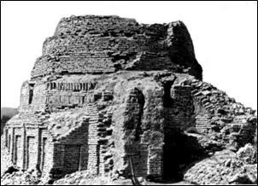
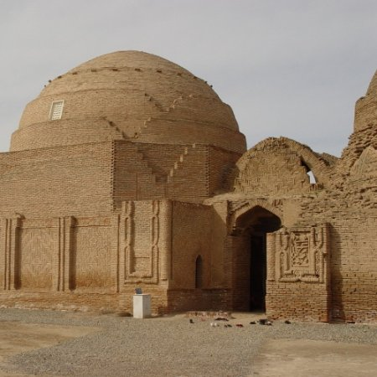
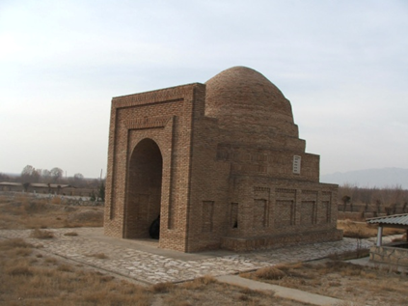
Below: mausoleum-madrasa of Khoja Mashad, Right picture: mausoleum of Khoja Durbad. XI-XII centuries Southern Tajikistan.
Lecture 6. Architecture of early Islam (IX - X centuries; XI -early XIII centuries) in Central Asia

Slide 27
Problems
Lecture 6. Architecture of early Islam (IX - X centuries; XI -early XIII centuries) in Central Asia
The main problem of preserving the cultural heritage of early Islam remains the preservation of fragile works of architecture made of clay from the effects of the external environment, as well as the lack of methods for preserving the surfaces of clay walls.
Another problem is the lack of qualified architect-restorers in Tajikistan and Uzbekistan.

Slide 28
Conclusion
Lecture 6. Architecture of early Islam (IX - X centuries; XI -early XIII centuries) in Central Asia
IX-X centuries in the architecture of Central Asia as a whole, marks the formation of a qualitatively new style, different in its internal content and external expression from the style that developed in the conditions of pre-Arab society. The entry of Maverannahr (Central Asian Mesopotamia) onto the path of intensive feudalization was not only radically reflected in the field of architectural creativity. Having become part of the Caliphate, Central Asia joined the orbit of world caravan trade.
On the territory of present-day Afghanistan in the XI-beginning of the XIII centuries. the Tajik state of Ghurids is created with the capital in the city of Firuzkuh (city of Jam). At the same time (X-XI centuries), the Ghaznavid state was created in Khorosan, which, under Sultan Mahmud, became one of the most powerful powers of the Middle East in the XI century. This state fell under the blows of the Ghurids in 1188.
By the middle of the 11th century, a new state of the Seljukids was formed in Central Asia. Merv became the capital of the state.
Nizam al-Mulk, as the vizier of the state, sought to revive the Samanid cultural traditions, contributed to the rise of science, education, trade, the construction of monumental buildings, including the madras, the growth of cities and crafts.
The last great state of Central Asia, which rose at the end of the 11th-beginning of the 13th centuries, was Khorezm.

Slide 29
References
Lecture 6. Architecture of early Islam (IX - X centuries; XI -early XIII centuries) in Central Asia
History of the Tajik people. Edited by B.A. Litvinsky and V.A. Ranov. T.1. – Dushanbe: AN RT, 1998.
M.E.Masson. New data on the ancient history of Merv // VDI, 1951. - M., No. 4.
B.G. Gafurov. Tajiks. Ancient and medieval history. - M .: Nauka, 1972. 8 VIA, in 12 volumes, vol. 1. - M .: Stroyizdat, 1970.
Ancient states of the Caucasus and Central Asia. – M.: Nauka, 1985.
G.A. Pugachenkova, E.V. Rtveladze. Northern Bactria-Tokharistan. Essays on history and culture. Antiquity and the Middle Ages. - Tashkent: Ed. "Fan", 1990.
Z.A. Arshavskaya, E.V. Rtveladze, Z.A. Khakimov. Medieval monuments of Surkhandarya. - Tashkent: Publishing house. lit. and arts, 1982.
A.M. Belenitsky, A.I. Bentovich, O.G. Bolshakov. Medieval city of Central Asia. – M.: Nauka, 1973.
L.S. Bretanitsky. Artistic heritage of the Near East of the epoch of feudalism. Fav. works. – M.: Soviet artist, 1988.
M.S. Bulatov. The Mausoleum of the Samanids is the pearl of the architecture of Central Asia. - Tashkent: Publishing house. lit. and arts, 1976.
R.S. Mukimov. Theory and history of Tajik architecture. - Dushanbe: Ed. "Meros", 2002.

