Slide 1
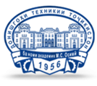
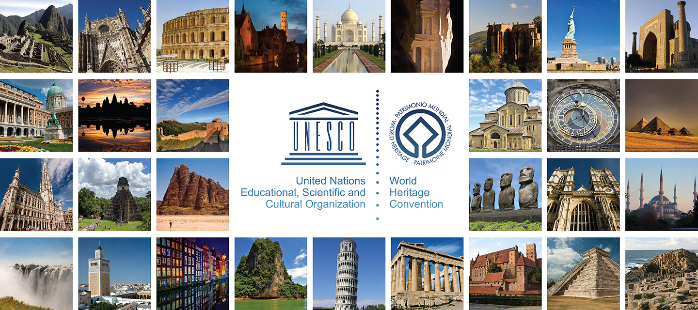
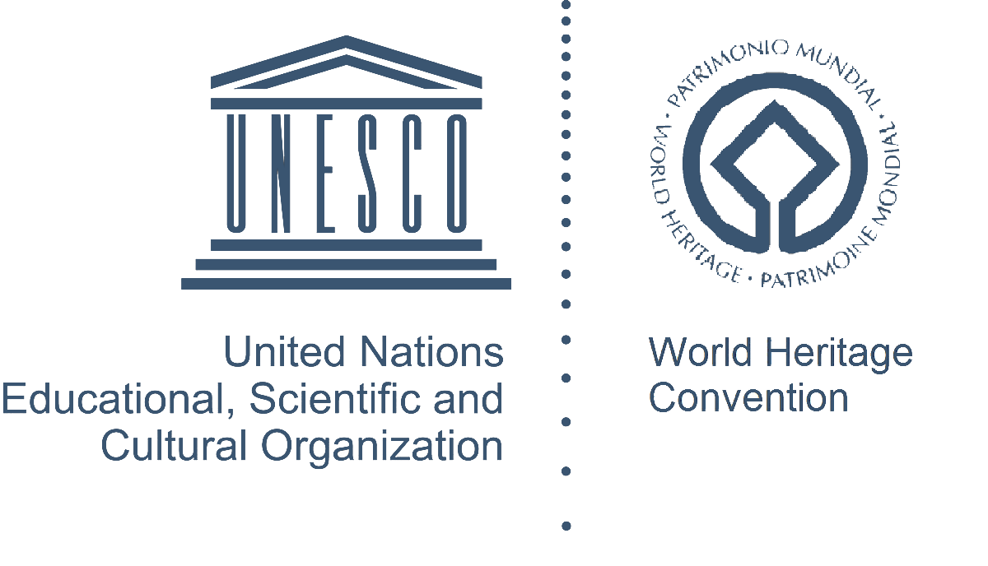
Co-funded by the Erasmus+ Programme of the European Union
Prof. Rustam Mukimov
Tajik Technical University named after acad. M.S.Osimi,
Department of Architectural Environment Design and Restoration
Lecture 8. Restoration in Central Asia in the Modern Era
(the second half of the XIX - early XХ centuries)

Slide 2
Lecture 8. Restoration in Central Asia in the Modern Era (the second half of the XIX - early XХ centuries)
CONTENT OF THE COURSE "RESTORATION"
1. General information on architectural monuments of the Central Asia
2. Basics of the concepts of "Architectural monument" and "Restoration".
3. General issues on restoration methods
4. The practice of engineering restoration in the Central Asia
5. The study of analogies in the restoration of architectural monuments
6. The formation of the theory and practice of restoration in the countries of Central Asia (Kazakhstan, Turkmenistan, Uzbekistan, Tajikistan, Kyrgyzstan, South-East of Russia).
7. The main works carried out at the restoration facility in the conditions of the Central Asian countries
8. Restoration in Central Asia in the Modern Era (the second half of the XIX - early XХ centuries).
9. Adaptation of architectural monuments and their complexes in modern conditions of Central Asian countries
10. Methods of graphic restoration of architectural monuments in the conditions of Central Asian countries

Slide 3
CONTENT
Lecture 8. Restoration in Central Asia in the Modern Era (the second half of the XIX - early XХ centuries)
Terms and concepts
Central Asia as a territory of Aryan tribes habitation since ancient times
Cult monumental constructions and their role in the history of civilization of the Middle Asia
Transformation of the preserved part of old buildings
Method of archaeological conservation
Implementation of fundamental documents for the protection and restoration of architectural monuments
Fundamentals of the formation of theoretical concepts on restoration
Creation of historical and cultural reserves as one of the urgent problems of restoration of cultural heritage objects
Restoration problems
Conclusion and recommendations
References

Slide 4
Terms and concepts
Lecture 8. Restoration in Central Asia in the Modern Era (the second half of the XIX - early XХ centuries)
AIVAN (Tajik) is a summer room open from one, two or three sides. The floor of the aivan is usually raised.
ANGOB (French) is a thin layer of well soaked clay for decorating and sealing the vessel walls (before burning the dried pot was lowered into a solution of fine clay).
ALABASTER (Greek) is a mineral, a kind of gypsum. Burnt construction gypsum, used for plastering works in a mixture with lime and sand.
ANALOGY (Greek) - similarity of objects (phenomena, processes, etc.) in any features.
ARK (Persian) is a citadel of a Central Asian feudal city.
BALKHI (Persian) is a type of vaulted construction erected on a rectangular base. Laying is carried out in inclined segments from four corners. The type of construction is named after the Balkh locality in Northern Afghanistan.
NEAR EAST - in historical and cultural terms and geographically it refers to the territories in western Asia and northeast Africa, where modern Arab states, Israel, Iraq, Cyprus, Turkey, etc. are located.
VASSA (Tajik) - semicircular blocks; used to fill in the gaps between the ceiling beams.
THT EAST is a historical, cultural and geographical concept that unites territories from the Mediterranean and Marmara Seas in the west to the Pacific coast of China. The term was first coined by the ancient Romans. Sometimes the East means the Near, Middle and Far East.
CLAY is a plastic sedimentary rock mainly consisting of clay minerals. It has been used as a building material since ancient times.
HILL-FORT is the remains of an ancient fortified settlement or city.
GUZAR (Tajik) - a traditional quarter into which a city or village is divided, forming a residential indivisible entity with its own socio-cultural (cult) center. In a number of districts of Tajikistan, the Guzar is called mahalla, for example, in Khujand.
GULDASTA (Tajik) - angular three-quarter columns or minarets. This term is also used in relation to semi-columns, three-quarter columns or pilasters in pakhsa constructions.
DARVOZAHONA (Tajik) - a walk-through room at the entrance. The simplest type of Darvozahona is a gate with a canopy.
ISLAMIC WORLD is the spiritual space of the civilized world, where the majority of the population adheres to the traditions of Islam.
KAYVON (Tajik) – the raised part of the ceiling of Aivan.
KALA (Persian) is a fortress of cities of the East in the feudal period.
CARAVANSERAI (Turkish) is an inn, a stopping place for travelers and merchants in the cities and trade routes of the Middle and Near East, Transcaucasia, etc.
KESHK - a castle (a feudal manor in Middle Asia), which is a tower for residential and defense purposes.
KUNDAL (Tajik) is a technique of embossed finish, performed by repeated applying a specially prepared ganch solution with glue to the shape with a brush. On top of the ganch there are coloring and gilding on honey.
KURGAN (Turk.) - a rounded or oblong mound above the burial.
KURGON (Turkic) is a suburban rural estate in Central Asia.

Slide 5
Terms and concepts
Lecture 8. Restoration in Central Asia in the Modern Era (the second half of the XIX - early XХ centuries)
MADRAS, madrasah (Arabic) - a higher school of the East. It can be secular, theological, with medical and other biases.
MAZAR (Arabic) is a place of worship, most often a burial construction of highly respected and spiritual persons in the Middle and Near East.
MOSQUE (Arabic) is a prayer house of Muslims, a temple.
MEKHMONKHONA (Tajik) - living room, reception room in a residential building; a public hotel for men in medieval cities of Middle Asia.
MINBAR (Arabic) - an elevation in a mosque from which a sermon is preached; a pulpit.
MINARET (Arabic) - a tower-like structure at a mosque or madrasah.
MIHRAB (Arabic) - a niche with an arrow-shaped end in the wall of the mosque, indicates the direction of Mecca.
PAKHSA is a mud-brick wall, consists of several (up to 10) horizontal layers.
RABAD (Arabic) is a suburb, a handicraft settlement of a medieval city in Middle Asia.
RABAT (Arabic) – fortified points on the borders of states and on the caravan routes of Middle Asia.
RESTORATION (Latin) - restoration of an architectural monument in its original forms.
SAMANA (Turkic) - "straw". Raw brick made of clay with the addition of cut straw, chaff, etc.
SARDOBA (Tajik) is a semi-underground circular room with a dome; it serves for the accumulation and storage of water.
MODERN TAJIKISTAN means the territory of the period when Tajikistan gained its statehood at the beginning of the XX century, when the Tajiks formed into a modern nation.
MIDDLE EAST is a historical, cultural and geographical concept that designates the territories of Central Asia, Iran and Afghanistan, which together with the Middle Eastern countries are part of the region of Southwest Asia.
MIDDLE ASIA is part of the Asian territory of the former USSR, where the former Soviet republics of Uzbekistan, Tajikistan, Turkmenistan and Kyrgyzstan were located. This concept was first introduced after the annexation of this territory, together with Kazakhstan, to the Russian possessions in the 60s of the XIX century.
SUFA (Tajik) - a clay platform for sitting or lying down; an indispensable element of a courtyard or room.
TIM (Arabic) - covered market.
USTO (Tajik) - master.
HONA (Tajik) - a room, premise.
HONAKO, khanaka - mosque with dormitories for dervishes in Central Asia; winter room of the mosque.
HUJRA (Arabic) is a residential building for students and teachers of Madras.
CHORTAK, chortok, chartak (Iranian) is a square building with a domed completion and four arched openings on the sides.
CHORKHONA (Tajik) - ceiling; ceiling construction with a light-emitting hole in the middle (in the form of a log cabin).
CENTRAL ASIA - geographically includes the entire vast central zone of the Asian continent. In historical and cultural significance, Central Asia is a region of historical and cultural community of peoples who inhabited the modern regions of Mongolia, Xinjiang, Middle Asian post-Soviet states, Kazakhstan, Eastern Iran, Afghanistan, Pakistan, and Northwestern India.
SHAHRISTAN (Persian) is a residential part of a medieval city.

Slide 6
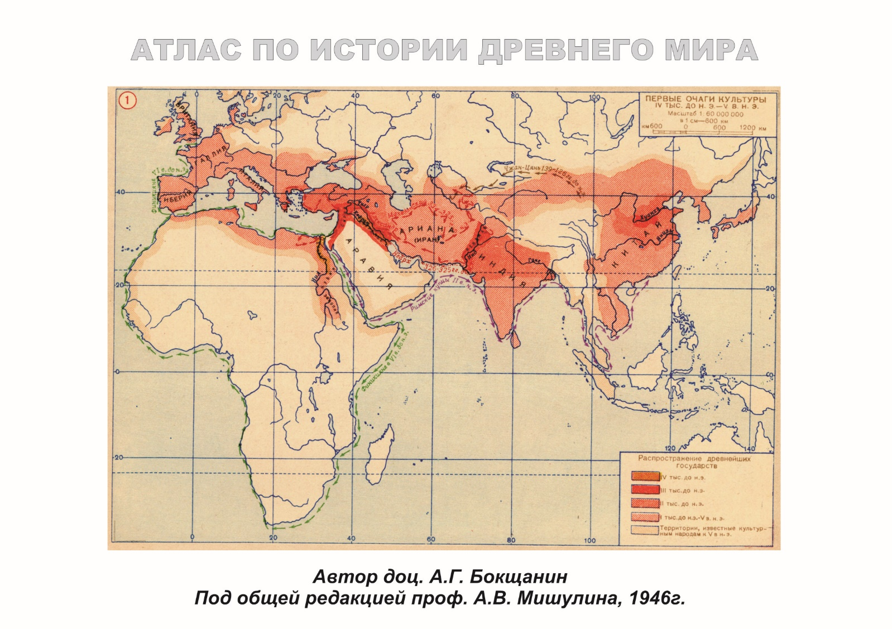
Central Asia as a territory of habitat of the Aryans Map of the Ancient world showing the area of distribution of Aryan tribes
Lecture 8. Restoration in Central Asia in the Modern Era (the second half of the XIX - early XХ centuries)
The Middle Asia in a narrow geographical concept does not cover the entire Central Asia, but only, mainly, the territories of the Soviet republics of the former USSR (Uzbekistan, Turkmenistan, Tajikistan and Kyrgyzstan), as well as Kazakhstan. Almost all this territory in ancient times was the territory of habitat of Aryan tribes, whose direct descendants are the Tajiks (Persians, Iranians, Tajiks). There are many publications and convincing scientific justifications about this. Therefore, when it comes to the conditions for the development of restoration in the Middle Asia, we reasonably talk about the development of historical and artistic, construction, historical and architectural phenomena in the specified territory of the spread of Tajik culture, architecture and urban planning.
In the history of architectural creativity on the territory of the spread of Aryan (Persian, Iranian, Tajik) culture from antiquity to the time of the establishment of Soviet statehood, there was no general theory of the formation of theoretical concepts of restoration, protection and use of architectural constructions of the past. The architectural structures remaining from the previous era, with their good preservation, were used for their intended purpose or for new functions without any evaluation of their artistic and aesthetic merits (for example, Buddhist temples could be used during partial or capital reconstruction for the needs of temples of another religion, in particular, temples of fire or temples dedicated to Greek gods, etc.).
During the change of the state system, official palace buildings, temples, fortresses were often robbed and destroyed. However, according to long-standing traditions, buildings that served the new social, ideological or political needs of the next ruling dynasty reappeared on the foundations of destroyed buildings and constructions. This was the case after the arrival of the Arabs in Middle Asian territories, who, following the dogmas of Islam, destroyed temples of other religions or, at best, after minor alterations, adapted them to their needs. So, the temple of the idols of Bunjikat in the VIII-IX centuries by installing an attached clay mihrab on the western wall, was turned into a mosque.

Slide 7
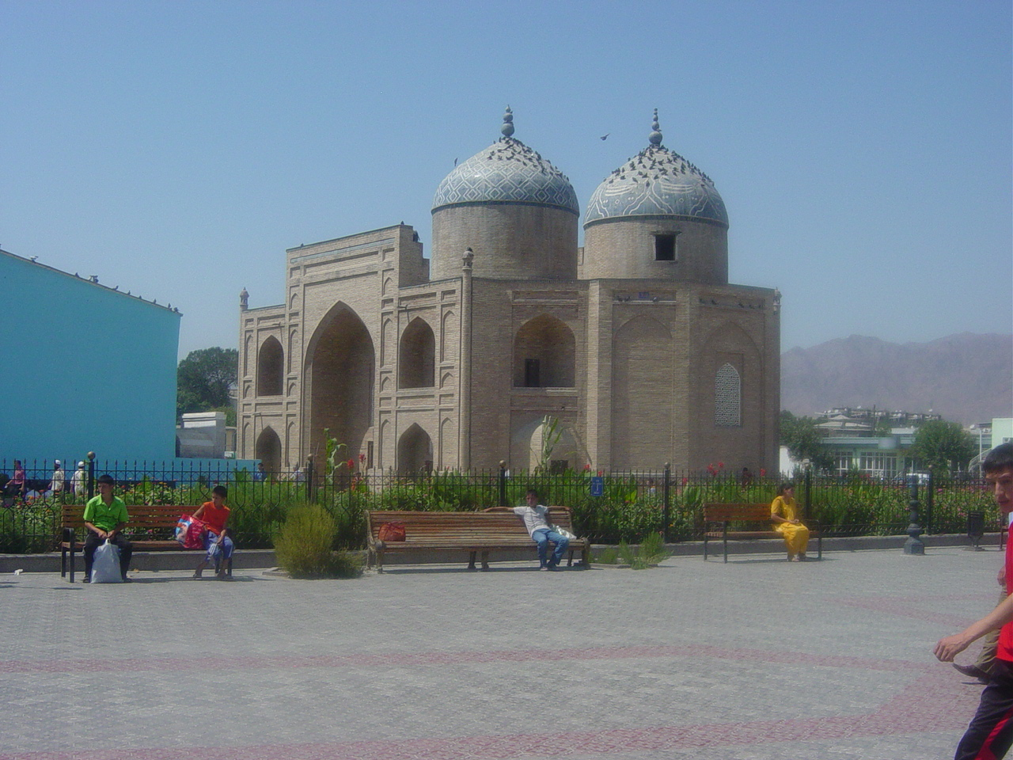
Religious buildings have been a special concern at all times in the history of the civilization of Middle Asia Tajikistan. Sheikh Muslihiddin Mausoleum in Khujand, XII, XIV, XVII centuries.
Lecture 8. Restoration in Central Asia in the Modern Era (the second half of the XIX - early XХ centuries)
The Mongols rarely used the captured buildings and constructions for their needs, there was no need for this, since they did not settle in the captured lands (this happened later). So it was under Timur, who, during campaigns outside his state, simply plundered and destroyed buildings, and killed the rebellious inhabitants (except for craftsmen, artisans, scientists, etc., whom he took to the central cities of Maverannahr and Khorasan).
Architectural constructions, especially religious and funerary ones, have always been a subject of concern. They were maintained, repaired, and sometimes restored. This was dictated, first of all, by utilitarian requirements: since they were created at one time for a certain function, and as long as this function corresponded to the needs of society, the buildings were needed. Sometimes the non-utilitarian side was put forward in the first place: this was the case with the sacred value of religious buildings, with the representative or memorial value of some specially erected constructions (arches, mausoleums, columns). However, such an attitude to architectural constructions was not an assessment of them as architectural monuments, i.e. as carriers of specific value, witnesses of the culture and art of the past. This is to some extent due to the fact that the culture of the early periods, including antiquity, as a whole was not characterized by a sense of historicity, progressive social development, and the historicism of the worldview of the Middle Ages was very specific and limited to the field of teaching about the development of the world in a purely religious sense.

Slide 8
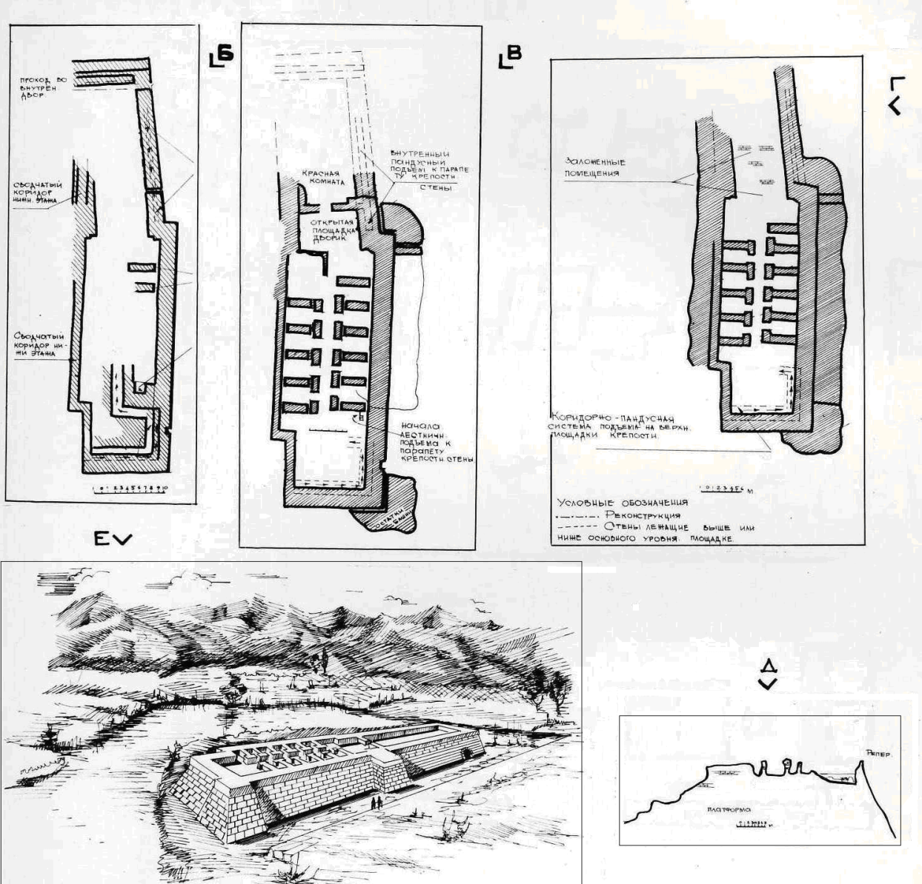
Conversions of the preserved part of old buildings
Lecture 8. Restoration in Central Asia in the Modern Era (the second half of the XIX - early XХ centuries)
In accordance with this attitude to ancient buildings, the activity of architects in their restoration or adaptation to changed needs was not aimed at preserving or revealing the features of their former architecture. The craftsmen who carried out the restoration, as a rule, relied on aesthetic ideas and construction experience of their time. Sometimes, in order to save the compositional unity, the preserved parts of the old building were subjected to changes. This was the case, for example, with Koi-Krylgan-Kala on the territory of Khorezm (IV-III centuries), which was rebuilt several times during the entire period of its existence and changed its purpose (the dynastic temple of the Khorezm kings, the monument of the astral cult, the observatory, the treasury). But most often, a dilapidated building was simply broken down and a new one was erected in its place (for example, the Kalai Bolo fortress in the Isfara district of the Sughd region of Tajikistan, which was dismantled several times and rebuilt on old foundations, starting from the early Middle Ages and up to the XIX century). The same thing happened with the Muhammad Bosharo Mausoleum in the Penjikent district or the Mirsaid Hamadoni Mausoleum in Kulyab.
Parts of old buildings were often considered as a material for creating a new architectural work. In the late Antique period, elements of decoration, including sculptural bas-reliefs, were transferred from one construction to another. The same was done by the masters of the early Middle Ages in the Middle Asia, using the details of ancient buildings in the construction of new buildings or modifying, for example, pre-Islamic temples for mosques or other buildings of Islamic worship. Such practice continued in Central Asia until the second half of the XIX century, when its territory was annexed to the Russian Empire under the name of Turkestan as a colony. After these political events, elements of European culture including the attitude to ancient monuments began to penetrate into the territory of Turkestan. Russia's attitude to restoration issues became a dogma for Turkestan.

Slide 9
Conversions of the preserved part of old buildings Upper figure: Tajikistan. Modification of the mosque into the Muhammad Bosharo mausoleum near Penjikent (XII-XIV centuries). Lower figure: Afghanistan. Conversion of the Greek temple (II century BC) to the Buddhist (II century AD) in Dilbergin
Lecture 8. Restoration in Central Asia in the Modern Era (the second half of the XIX - early XХ centuries)

Slide 10
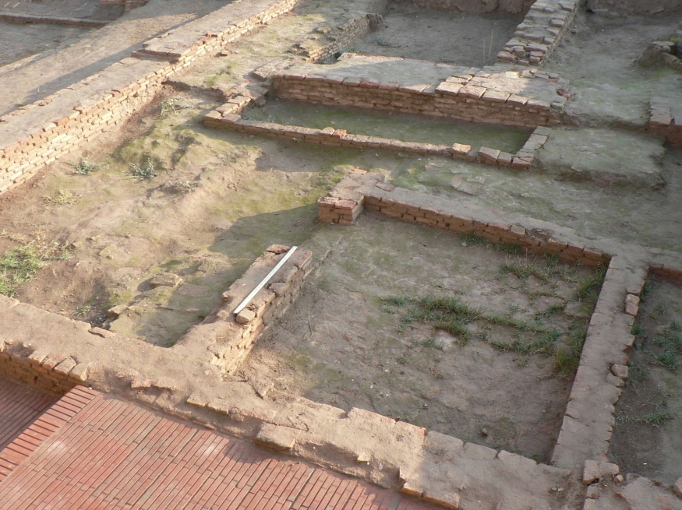
The method of archaeological conservation of the walls in the citadel of Hulbuk (IX-XI centuries). Southern Tajikistan
Lecture 8. Restoration in Central Asia in the Modern Era (the second half of the XIX - early XХ centuries)
In Russia in the first half of the XIX century, restoration was not yet singled out as a special specialization of the architect and its own school of restoration was formed here under the influence of Russian scientists, including architects-restorers. The works of this school served as the starting point from which restoration activities began in the Soviet period. Despite the difficult military situation and huge economic difficulties, the Soviet Government from the first years paid great attention to the preservation of cultural monuments, which was reflected in the decrees of this period and in practical measures for the repair and restoration of the most valuable constructions. During the same period, fruitful activity began on the restoration of monuments of the Middle Asia, which was headed by one of the most outstanding Soviet restorers B.N.Zasypkin. These works testify to the complete triumph of the principles of archaeological restoration. They are distinguished by the completeness and thoroughness of the research, the validity of restoration decisions, often reduced to fragmentary restoration (restoration of Middle Asian monuments).
Important statements on the restoration methodology are also belong to B.N. Zasypkin, which were mentioned in the introductory part of the article on the restoration of monuments of Middle Asia (1928). Zasypkin paid special attention to the architectural and archaeological methods of studying monuments. The program of such study should be very broad: in addition to fixation, it includes technological and technical research, the study of structures, architectural forms, decor, identification of the original appearance or the oldest parts, disclosure and analysis of the obtained material.
The position of the famous Russian antiquity researchers I.E. Grabar and B.N.Zasypkin was based on the consistent implementation of the principles of archaeological restoration. The restoration of monuments in the Soviet Union during this period was at the same level with the restoration in advanced European countries, that, in particular, was emphasized by Grabar himself in his article "Restoration in our country and in the West" (1926).

Slide 11
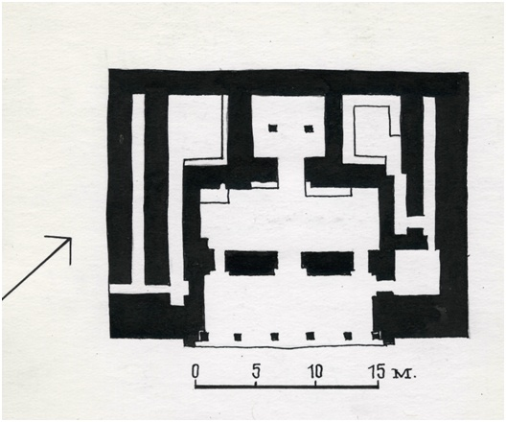
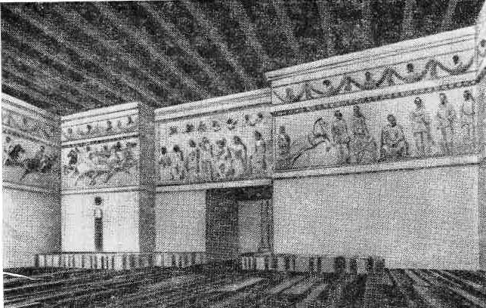
Implementation of the fundamental documents on the protection of architectural monuments. The palace in Khalchayan (south of Uzbekistan). Plan, interior, reconstruction of the general appearance and interior
Lecture 8. Restoration in Central Asia in the Modern Era (the second half of the XIX - early XХ centuries)
Let's consider some regulations on the protection, restoration and use of architectural monuments adopted in different years in the USSR. Great attention was paid to the problems of conservation and restoration of architectural monuments in the former USSR. In November 1917, the "Appeal of the Council of Workers' and Soldiers' Deputies" calling for saving everything that the people got from the "old masters“, was disseminated. Council of People's Commissars of the Russian Soviet Federative Socialist Republic (CPC RSFSR) declared the registration and protection of cultural monuments as a national matter in Decree "On registration, acceptance and preservation of monuments of art and antiquity" in 1918. This decree proclaimed "the study and possibly full acquaintance of the broad masses of the population with the treasures of art and antiquity...". According to this decree, special scientific and restoration production workshops were created. “The Instruction on the registration and protection of monuments of Art, Antiquity, Household and Nature“, which was published in 1924, for the first time put forward a regulation on the formation of a protection zone around the monuments.
The basic principle of preserving cultural heritage found its fullest embodiment in the Law on the Protection and Use of Historical and Cultural Monuments approved by the Supreme Council of the USSR in 1976 and in the new Constitution of the USSR adopted in 1977. In the same year this law was issued in each individual Union Republic of the former USSR as a fundamental local document for the protection and restoration of historical and cultural monuments.
The Resolution of the Council of Ministers of the USSR of 1948 "On measures of improvement of the protection of cultural monuments" and the "Regulation on the Protection of Cultural Monuments" that was added to it, prescribed, among other measures, the establishment of protection zones around historical, archaeological and architectural monuments.

Slide 12
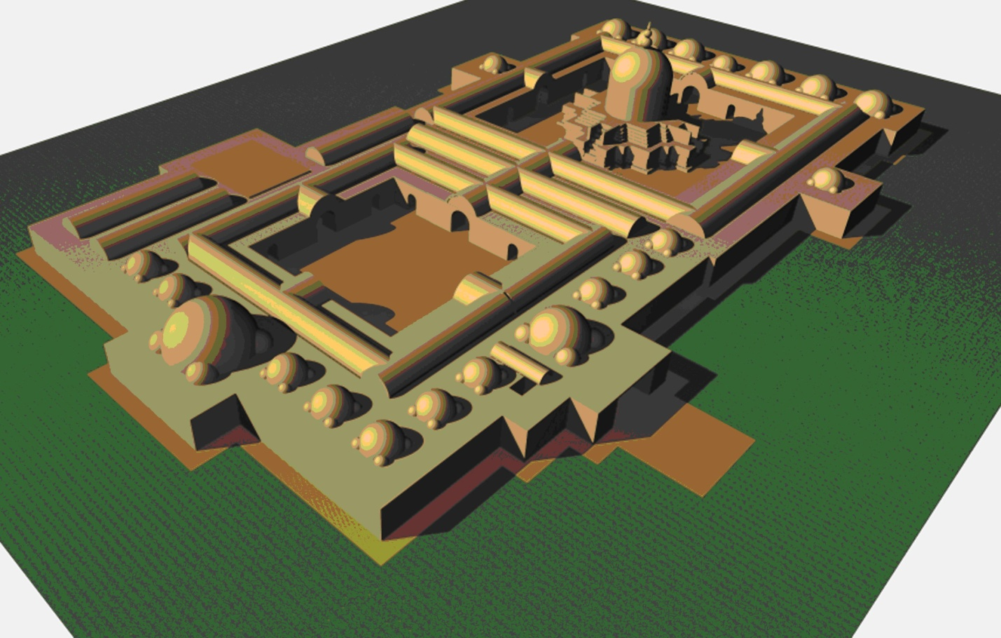
Fundamentals of the formation of theoretical concepts of restoration Tajikistan. Graphic reconstruction of the Ajinatepa Buddhist monastery made with account of the recommendations of the Venice Charter of 1964
Lecture 8. Restoration in Central Asia in the Modern Era (the second half of the XIX - early XХ centuries)
In the USSR in the 60-70s of the last century, a number of important documents were adopted to speed up the process of forming the concept of restoration. These measures had a certain impact on the formation of the system of protection, restoration and use of historical and architectural heritage in the republics of Middle Asia, including Tajikistan. Thus, in May 1966, the Council of Ministers of the Russian Soviet Federative Socialist Republic (RSFSR) issued a resolution "On the state and measures to improve the protection of historical and cultural monuments in the RSFSR“. In the same 1966 the State Committee for Construction (Gosstroy) of the RSFSR, the Presidium of the Central Council of the All-Soviet Society for the Protection of Historical and Cultural Monuments, and the Ministry of Culture of the RSFSR issued the "Temporary instruction on the organization of protection zones and zones of building regulation for historical and cultural monuments in the RSFSR".
The long process of the emergence and formation of theoretical concepts of restoration, which was initiated by the critical speeches of scientists back in the 40s of the XIX century, was summed up in our time by the resolution of the II International Congress of Architects and Technical Specialists on Historical Monuments in Venice, in which the Soviet delegation participated (1964, the so-called Venice Charter). In its text, the purpose of restoration is defined as the protection of the monument that has come down to us, the identification of its aesthetic and historical value with its simultaneous strengthening.
The definition of the purpose of restoration in the charter of 1964 differs from that given in the "Methodology for the Restoration of Architectural Monuments" - a manual for architects-restorers, where the wording of the Venice Charter is noted only as one of the main tasks facing architects-restorers, along with which there is a second "most important" task - the restoration of the lost appearance of an architectural work.
The resolution of the II Congress of Architects and Technical Specialists on Historical Monuments of 1964, adopted with the participation of the Soviet delegation, reflected advanced, progressive ideas and principles, including the Soviet restoration school.

Slide 13
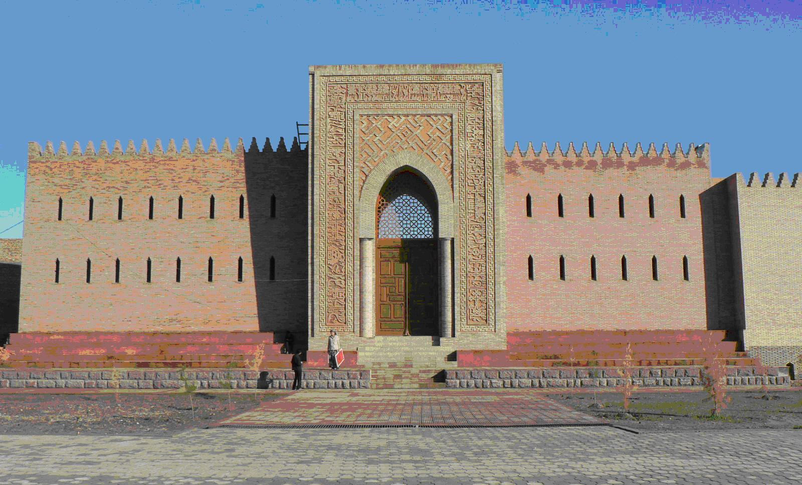
Complete reconstruction of the entrance part of the citadel of Hulbuk, based on scientific methods of restoration (2006) (the original remains of the portal with decorative details and fragments of brick walls have been preserved)
Lecture 8. Restoration in Central Asia in the Modern Era (the second half of the XIX - early XХ centuries)
The current condition of preservation and use of historical and cultural heritage in the Republic of Tajikistan.
Great importance is attached to the protection and restoration of architectural monuments in our Tajik state. After the collapse of the USSR and the acquisition of sovereignty, the Republic of Tajikistan was one of the first among the Central Asian countries in 1992-1993 to ratify most international agreements, conventions and charters in the field of preservation, restoration and use of cultural heritage monuments. Our country also considers itself the legal successor of all regulatory documents and state acts on the protection, use and restoration of historical and cultural monuments adopted in various years on the basis of the "Law of the USSR on the Protection and Use of Historical and Cultural Monuments", adopted in 1976. Moreover, in 2006, Majlisi Oli of the Republic of Tajikistan adopted the national law "On the Protection and Use of Cultural Heritage in the Republic of Tajikistan", signed by the President of the Republic of Tajikistan on March 3, 2006 for No. 178.
In the Republic of Tajikistan, since the 70s of the last century, there has been an extensive network of state and public organizations on the protection and use of historical and cultural monuments. The Ministry of Culture of the Republic of Tajikistan has the State Inspectorate for the Protection of Monuments and Artistic Expertise. The Republican Society for the Protection and Use of Historical and Cultural Monuments has regional, city, district and primary organizations in educational institutions, enterprises, departments and executive councils of People's deputies at all levels.

Slide 14
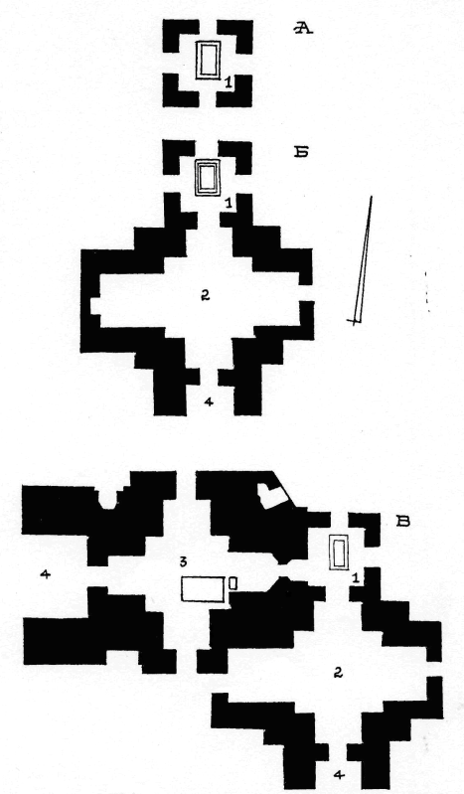
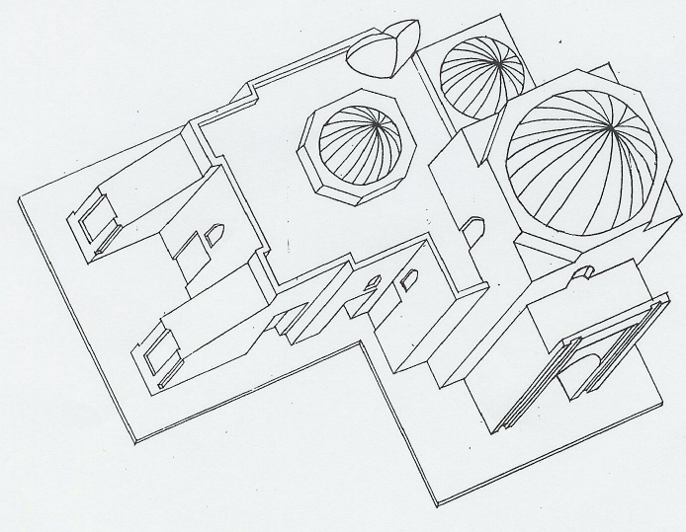
The creation of historical and cultural reserves as an urgent problem of restoration and preservation of the monuments of cultural heritage Tajikistan. Medieval Hissar. Makhdumi Azam Mausoleum, X-XI; XII-XVI centuries. Axonometry; on the left - the stages of formation of Makhdumi Azam Mausoleum: A - X-XI centuries; Б - XI-XII centuries; В - XV-XVI centuries. 1 - gurkhona-tomb; 2 - zieratkhona-memorial; 3 - tomb; 4 - portal-aivan.
Lecture 8. Restoration in Central Asia in the Modern Era (the second half of the XIX - early XХ centuries)
Currently, under the Ministry of Culture of the Republic of Tajikistan there are Scientific and Methodological Council which includes competent scientists and specialists in the field of architecture, art, construction, history, archeology, etc. During the period from 1976 to 1989, the Government of the Republic of Tajikistan adopted a number of Resolutions for improvement and further development of the system of protection and use of historical and cultural monuments in the country. One of the examples of the implementation of Resolutions of the Government of the Republic of Tajikistan, for example, is the creation of the Hissar Historical and Cultural Reserve in 1979, Archaeological Reserve on the territory of ancient Penjikent, etc. Subsequently, there were created the Khulbuk Historical and Architectural Reserve and the Sarazm Archaeological Reserve, were developed restoration projects and dozens of architectural monuments in various regions of the country were restored according to them (Mirsaid Hamadoni Mausoleum in Kulyab, Khoja Durbod Mausoleum, Khoja Mashad Mausoleum in Shaartuz district, Sheikh Muslihiddin in Khujand and many others). 14 of the most outstanding monuments of the Tajik heritage have been nominated in the UNESCO Department of Cultural Heritage for their inclusion in the World Heritage List. In 2006-2008, there was carried out a joint (UNESCO, Tajikistan, Japan) long - term project "Preservation of the Ajinateppa Buddhist monastery”. In 2006 the Sarazm Historical and Archaeological Reserve was included in the UNESCO World Heritage List.
There are currently about four thousand archaeological, architectural and historical-memorial monuments in Tajikistan. They are sources of the richest information about the life of the society that created them. Being at the same time monuments of art and construction technique, they give a vivid idea of the aesthetic norms of the era, ideology, the development of production forces and the organization of crafts, and sometimes the political situation of that time.

Slide 15
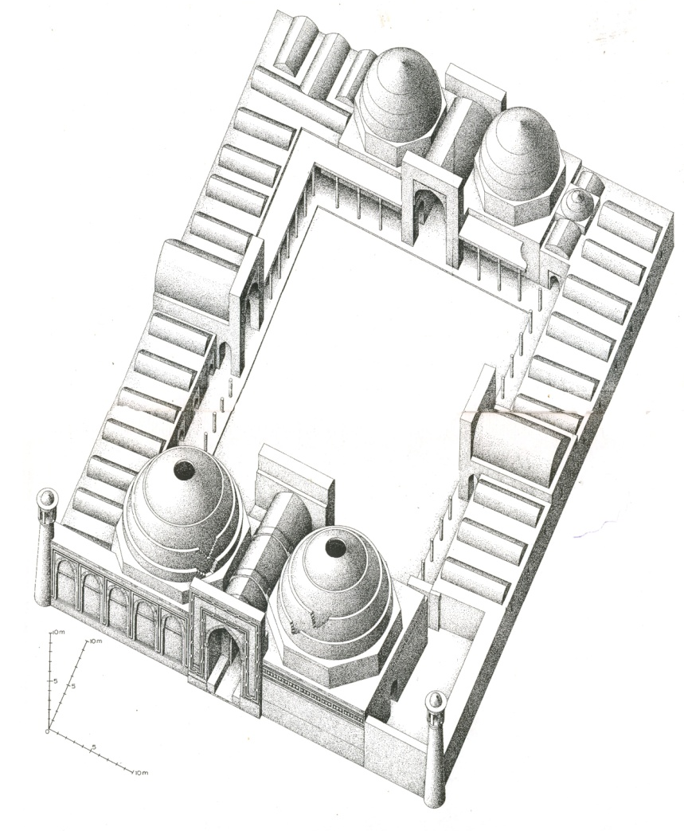
Khoja Mashhad Mosque-Mausoleum in Southern Tajikistan XI-XII centuries.
Lecture 8. Restoration in Central Asia in the Modern Era (the second half of the XIX - early XХ centuries)
International charitable foundations and organizations are doing a lot to preserve the cultural heritage in the Tajik state. In particular, to preserve and protect the cultural heritage of Tajikistan, the U.S. Ambassadors Fund for Cultural Preservation has funded eight projects in the amount of $209,859. Significant funds were allocated for recovery, restoration and preservation of such monument as the 14-meter "Buddha in Nirvana", for preservation and reconstruction of the exhibits of the archaeological museum in Sarazm near the Penjikent city, for the protection and reconstruction of the Khoja Mashhad madrasah-mausoleum in the Shakhritus district and others. This Fund has been operated since 2001, and currently finances activities for the preservation and protection of cultural monuments.
Dozens of memorial and other architectural monuments have been restored at the expense of local government authorities with the support of international and domestic public organizations. Among them are Ozakh Mazar and domullo Kobuli Mazar in Yavan, Nazarkhandi Mazar in Semiganch, Kiyakbai Mazar of Kumsangir district, domullo Ikromcha Mazar, Said Jaloliddin Guldasta Mazar in Muminabad, Zainalobiddin Mazar, Karaburabobo Mazar in Jillikul district, Khoja Mir Ibodi Aslikhoh Mazar in Shar-Shar pass, Khoja Goib Mazar in Shakhritus district of Khatlon region, Khoja Iskhok Mazar in Aini district, Hazrati Bobotagoi Vali Mazar in Istaravshan of Sughd region and many others in other regions.

Slide 16
The new mausoleum building over the underground crypt of Mavlono Yusuf Charkhi in the Churtak village, 2004 (complete reconstruction was carried out without the original remains of the overground part of the building)
Lecture 8. Restoration in Central Asia in the Modern Era (the second half of the XIX - early XХ centuries)
However, the lack of an appropriate method of restoration of raw walls leads to the death of ancient monuments of architecture and archeology. In this regard, experimental works on fixing raw walls with an induction plasma torch, which forms a vitreous waterproof film on the surface of clay walls after processing, deserves attention. Experimental works on wall preservation by burning are carried out. All these techniques are tested in restoration works.
Unfortunately, many unique monuments of cultural heritage are in the form of ruins, gradually losing their valuable qualities. Thus, one of the earliest mausoleums on the territory of Tajikistan – Khoja Mashhad Mausoleum in Shaartuz district is still in ruined condition (only brick mausoleums have been restored). There are also other objects in the form of ruins, for example such mausoleums of Tajikistan of the IX-XII centuries as Tillo Khaloji Mausoleum in Shaartuz district, Khoja Bulhak Mausoleum in Isfara district, Khoja Nakhshron Mausoleum in Tursunzade district. Due to the lack of appropriate control, the unique Mausoleum-Mosques of the XII-XIV centuries, restored in the 80s of the last century, began to collapse again. Muhammad Bosharo in the Penjikent district, Shokhi Khomush in the Kulyab district, the gates of the Hissar Arch, the medieval mausoleums of Kobadian and dozens of other buildings of the Islamic period will soon completely disappear.

Slide 17
Restoration problems
Lecture 8. Restoration in Central Asia in the Modern Era (the second half of the XIX - early XХ centuries)
Due to the lack of restoration specialists, restoration works on monuments is often carried out without an appropriate restoration project.
A frequent phenomenon is the involvement of folk masters in restoration, who carry out restoration activities based on their own experience in the construction of folk works of architecture. This experience is not supported by qualified restoration personnel.
Currently, there are no previously functioning Special Scientific and Restoration Production Workshops in Tajikistan.
In Tajikistan, there is no system of training the middle-level restorers (restoration workers), as well as top-level ones (certified architects-restorers).

Slide 18
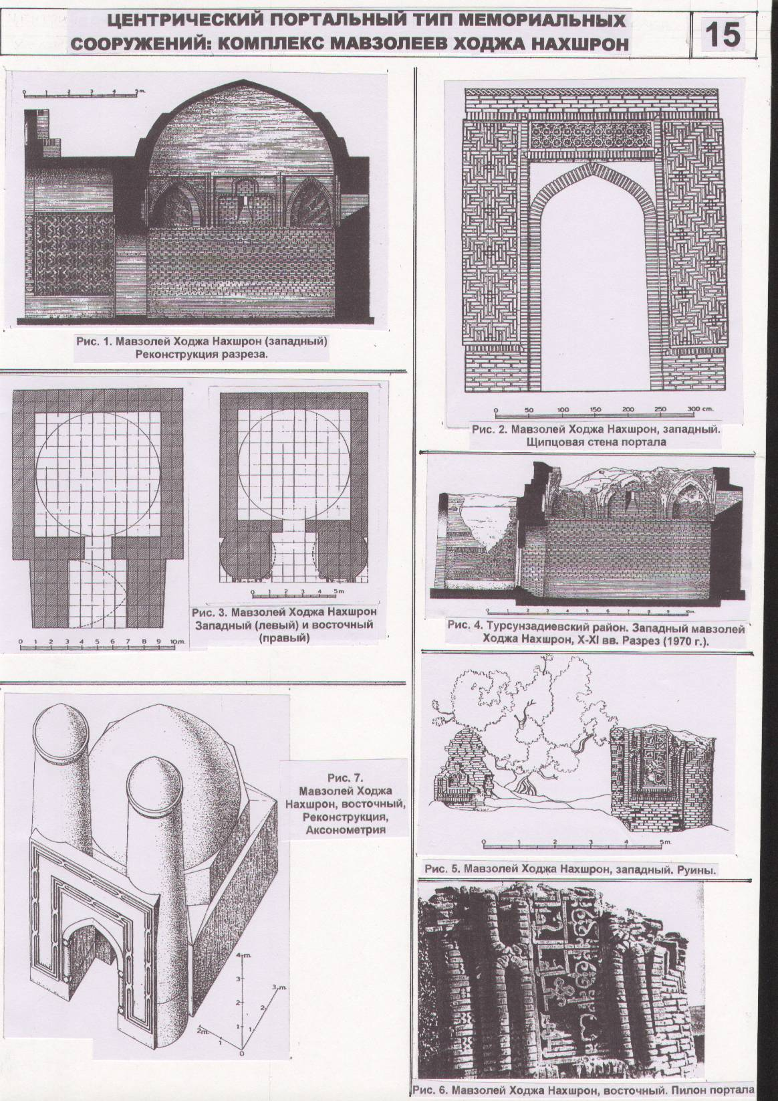
Conclusion and recommendations
Lecture 8. Restoration in Central Asia in the Modern Era (the second half of the XIX - early XХ centuries)
Only persons with diplomas of architects-restorers should be allowed in the restoration works by the Ministry of Culture of the Republic of Tajikistan (MС RT)
Projects of rearrangement, reconstruction and restoration of architectural monuments of urban, district and republican significance should be considered and discussed at the Scientific and Methodological Council for the preservation and restoration of historical and cultural heritage (SMC) in the presence of scientists specializing in the history, theory of architecture, restoration and reconstruction of historical and architectural heritage. A permission for the restoration or reconstruction of cultural heritage sites should not be issued without the decision of the SMC.
The Ministry of Culture of the Republic of Tajikistan together with the National Academy of Sciences of the Republic of Tajikistan (NASRT) should be recommended to develop proposals for the Government of the Republic of Tajikistan on the reopenning the "Special scientific and restoration production workshop", and to open the Scientific Research and Design Institute of Restoration on its basis.
The Ministry of Culture of the Republic of Tajikistan should be recommended to open a Bachelor's degree in restoration at the Tajik Technical University named after academician M.S.Osimi.
The Ministry of Culture of the Republic of Tajikistan should be recommended to submit annually proposals for the training of qualified specialists and scientific restorers - bachelors, masters and PhD students.
Tajikistan. The complex of Khoja Nakhshron funeral constructions near Tursun-Zade, X-XII centuries.

Slide 19
References
Lecture 8. Restoration in Central Asia in the Modern Era (the second half of the XIX - early XХ centuries)
Zasypkin B.N. (1928). Architectural monuments of the Middle Asia. Problems of research and restoration // Restoration issues. Issue 2. Moscow.
Grabar I.E. (1966). On Ancient Russian art. – Moscow.
Grabar I.E. (1944). Scientific foundations of restoration of the art monuments // Bulletin of the Academy of Sciences of the USSR. No. 3.
Grabar I.E. (1926). Restoration in our country and in the West // Science and Art. – №1.
Lenin V.I. (1956). About culture and art. – Moscow.
ICOMOS. International Council of Monuments and Sites (1966) - «International Charter for the conservation and restoration of Monuments and Sites». § 3.
Methods of restoration of architectural monuments (1961). Manual for architects-restorers. - M. p. 123.
Mamadnazarov M. (2015). Monuments of architecture of Kazakhstan. - M.: Progress-Tradition. 496 p., ill
The modern appearance of monuments of the past: historical and artistic problems of restoration of architectural monuments (1983). Moscow: Stroyizdat.
Gulyanitsky N.F. (1972). On the modern meaning of the "monument of architecture“ concept. // Collection of works "Theory and practice of restoration works" – Moscow.
David D.A. (1972). Some issues on the theory of restoration of architectural monuments. // Collection "Theory and practice of restoration works". - M., Conservation and restoration of monuments and historical buildings (1978). Translated from French. - Moscow: Stroyizdat.
Maksimov P.N. (1958). The main terms of the scientific methodology of restoration of architectural monuments. // The practice of restoration works. Issue 2. – Moscow
International Charter for the Conservation and Restoration of Historical Monuments and Sites (1974) // Methodology and practice of preservation of architectural monuments. – Moscow.
Methods of restoration of architectural monuments (1977). M.: Stroyizdat
Mikhailovsky E.V. (1984). Fundamentals of the modern approach to the restoration of cultural monuments. // Methodology and practice of preservation of architectural monuments. – Moscow.
Mukimov R.S. (2002). History and theory of the Tajik architecture. - Dushanbe: TNIIPAG
Protection of historical and cultural monuments (1973). Collection of documents. - M., 1973.
Architectural monuments and modern urban development (1973). Moscow: Stroyizdat

