Slide 1
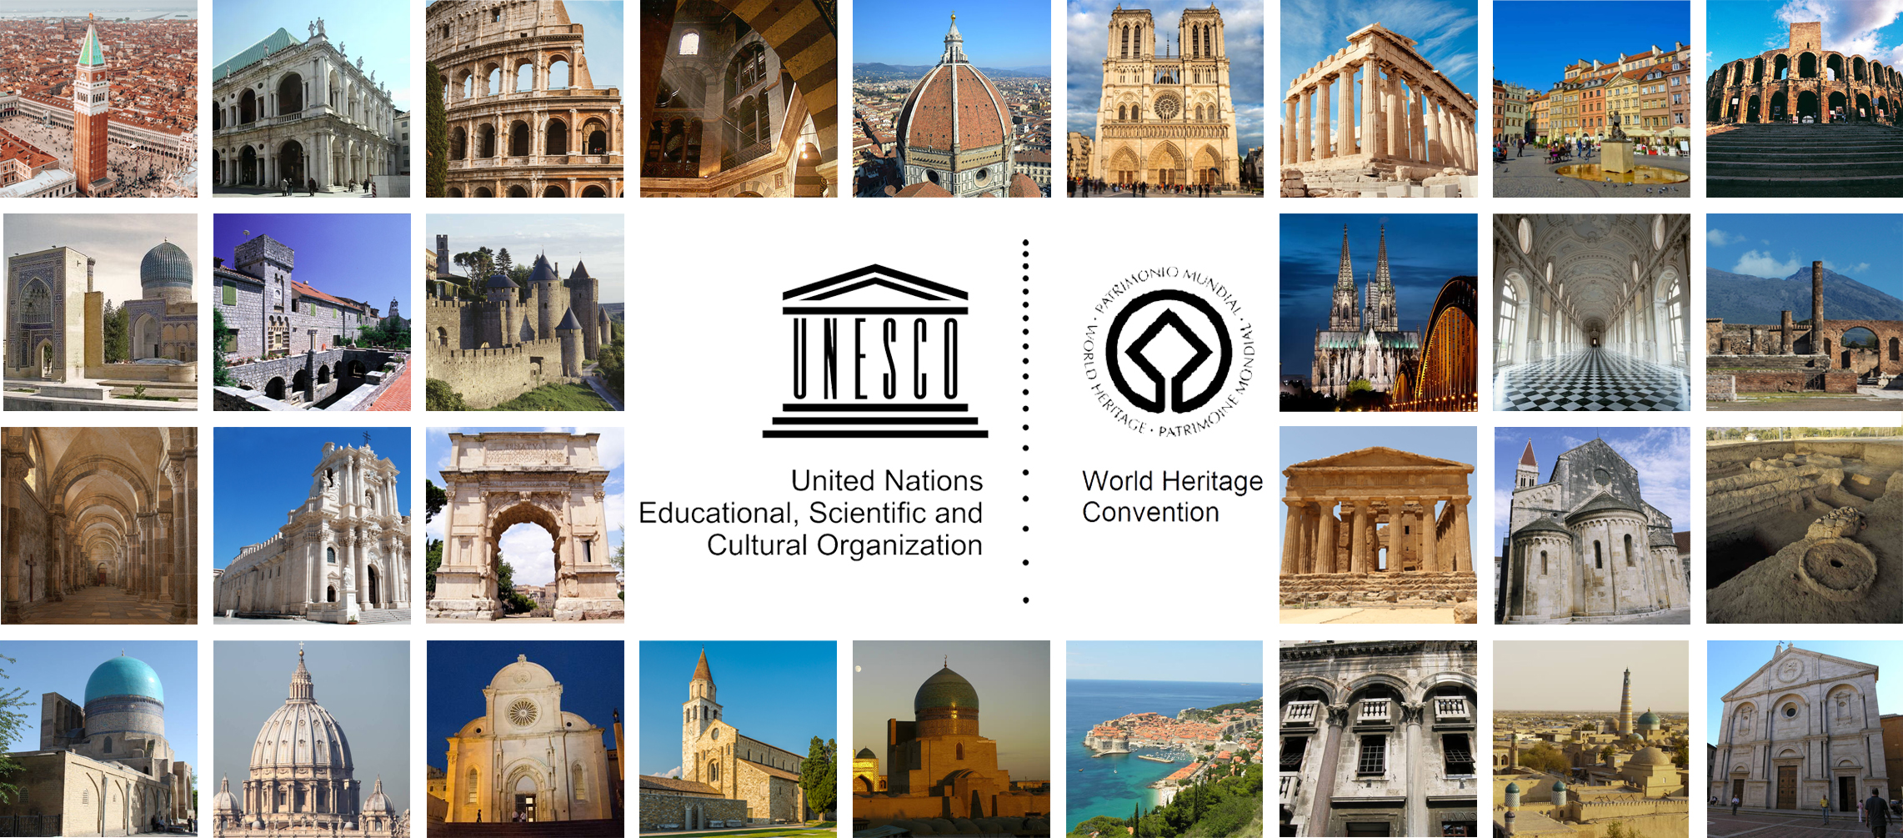
Restoration 0: History and theories in Europe. CONTENT
Prof. Carla BARTOLOZZI – Politecnico di Torino

Slide 2
CONTENT
LECTURE 1: INTRODUCTION
LECTURE 2: RESTORATION IN THE EARLY 19TH CENTURY IN FRANCE
LECTURE 3: VIOLLET-LE-DUC AND RUSKIN
LECTURE 4: RESTORATION IN THE EARLY 19TH CENTURY IN ITALY
LECTURE 5: RESTORATION IN THE 19TH CENTURY - THE ITALIAN PANORAMA
LECTURE 6: RESTORATION IN THE 20TH CENTURY
LECTURE 7: INTERNATIONAL LAWS AND CHARTERS

Slide 3
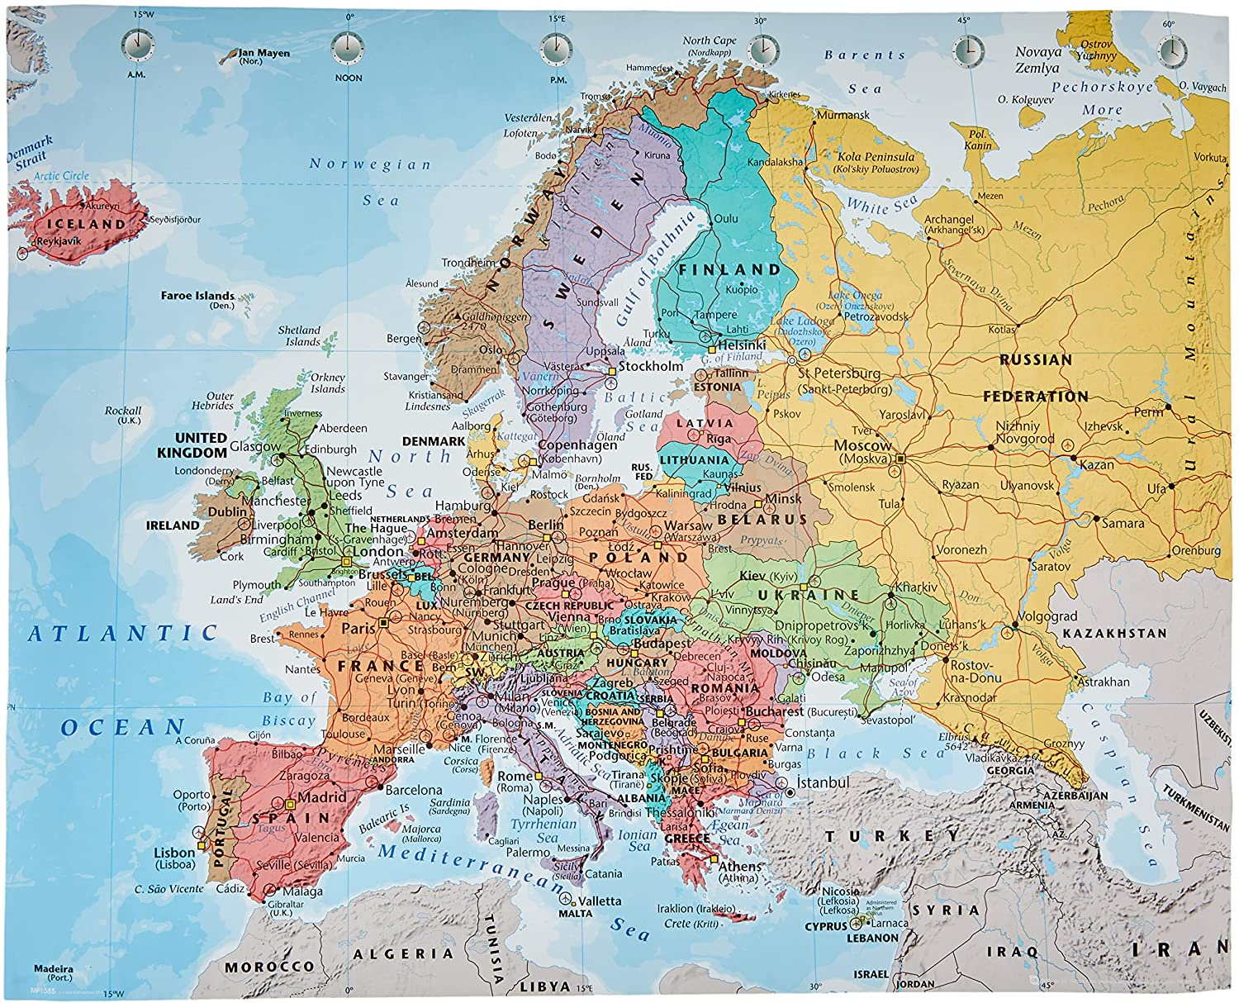
GEOGRAPHICAL FRAMEWORK: EUROPE

