Slide 1
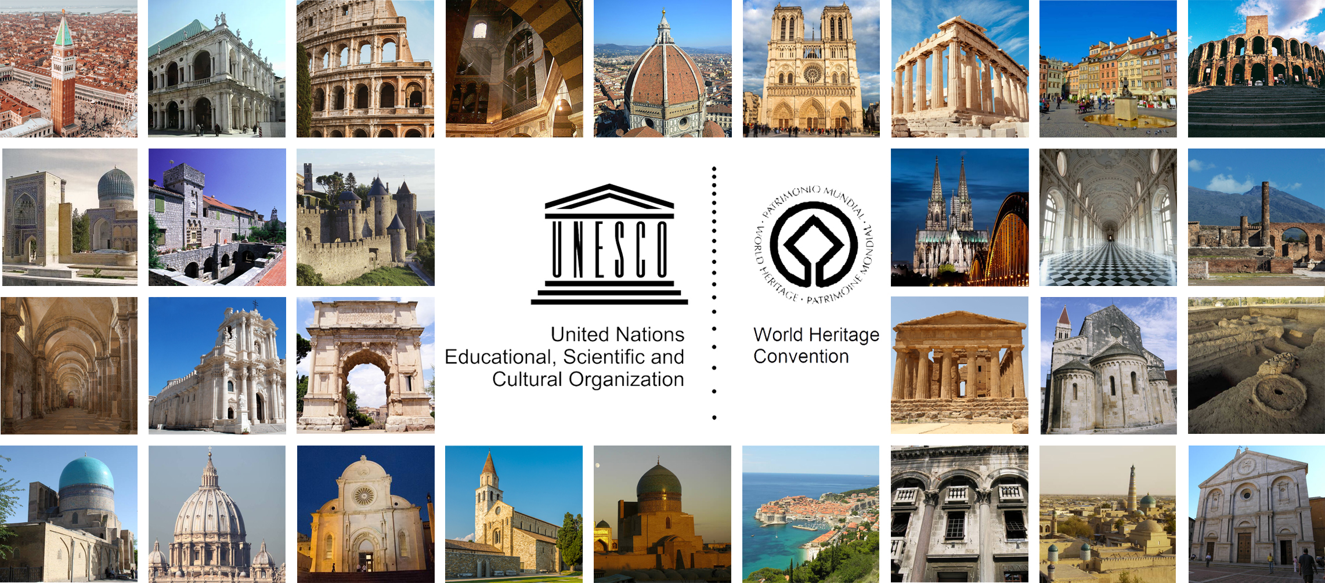
Restoration 1: History and theories. VIOLLET-LE-DUC AND RUSKIN
Prof. Carla BARTOLOZZI – Politecnico di Torino

Slide 2
EUGÈNE EMMANUEL VIOLLET-LE-DUC (1814-1879)
Training through the observation and direct study of the monuments, graphically analyzed with extraordinary skills and attention
Influence of the "archeologists" who dedicated to the rediscovery of the middle ages, from Arcisse De Caumont to P. Mérimée and L. Vitet
Methodology of the restoration project:
careful study of the building in all its parts;
historical documentation;
the study of coeval buildings of the same region;
knowledge of construction processes, according to a method defined by Viollet-le-Duc himself as "scientific”
Major work: Reasoned Dictionary of French Architecture (1854-1868).
Definition of restoration: “to restore a building is not the same as maintaining, repairing or making it; rather, it means to lead it back to a state of completion that may never have existed in a given time”

Slide 3
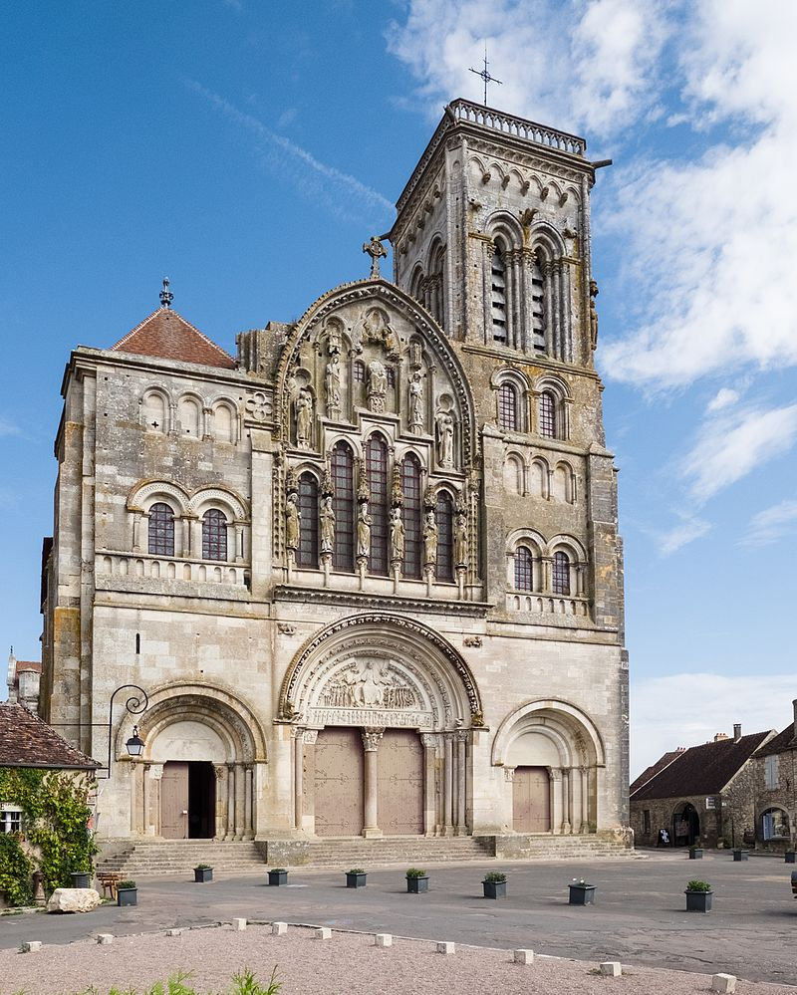
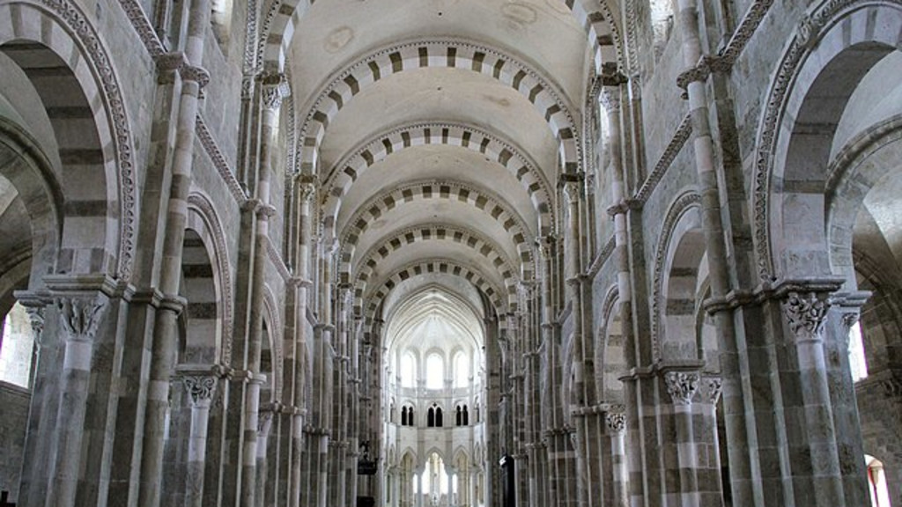
EUGÈNE EMMANUEL VIOLLET-LE-DUC (1814-1879)
Church of the Madeleine at Vézelay, France

Slide 4
EUGÈNE EMMANUEL VIOLLET-LE-DUC (1814-1879)
Church of the Madeleine at Vézelay
Plan of the church

Slide 5
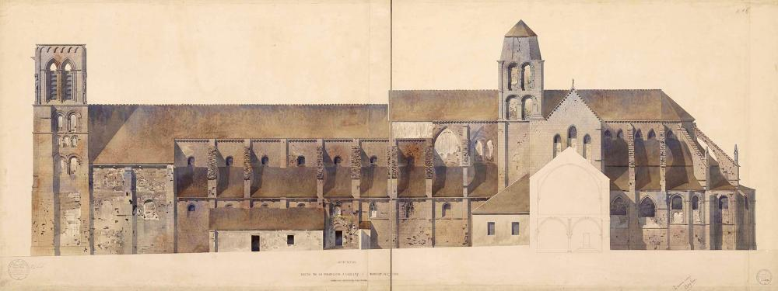
EUGÈNE EMMANUEL VIOLLET-LE-DUC (1814-1879)
Church of the Madeleine at Vézelay
South elevation, state of the art before the restoration, drawing by Viollet-le-Duc

Slide 6
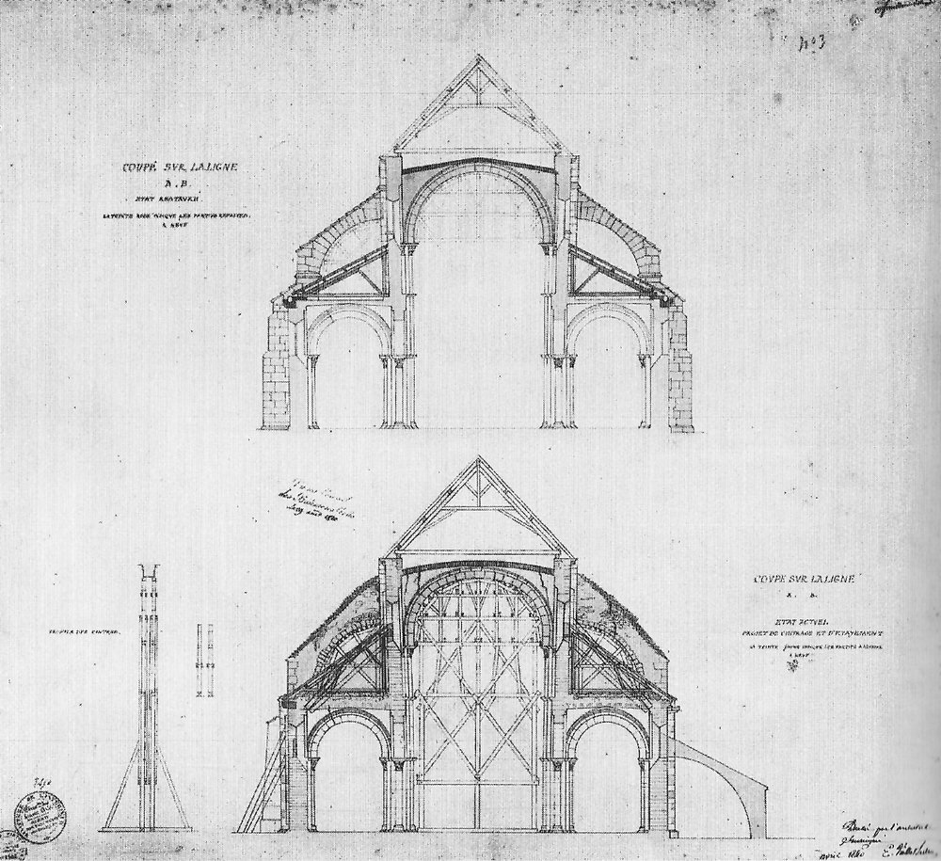
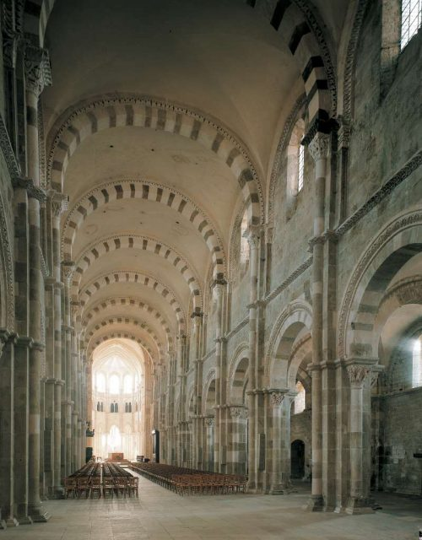
EUGÈNE EMMANUEL VIOLLET-LE-DUC (1814-1879)
Church of the Madeleine at Vézelay
(left) Below, survey of the structures, project proposal for provisional works.
Above, restoration project, drawing by Viollet-le-Duc, 1840
(right) Interior of the church, current state

Slide 7
EUGÈNE EMMANUEL VIOLLET-LE-DUC (1814-1879)
Church of the Madeleine at Vézelay
(left) Facade, state of the art before the restoration, drawing by Viollet-le-Duc
(right) Facade, current state

Slide 8
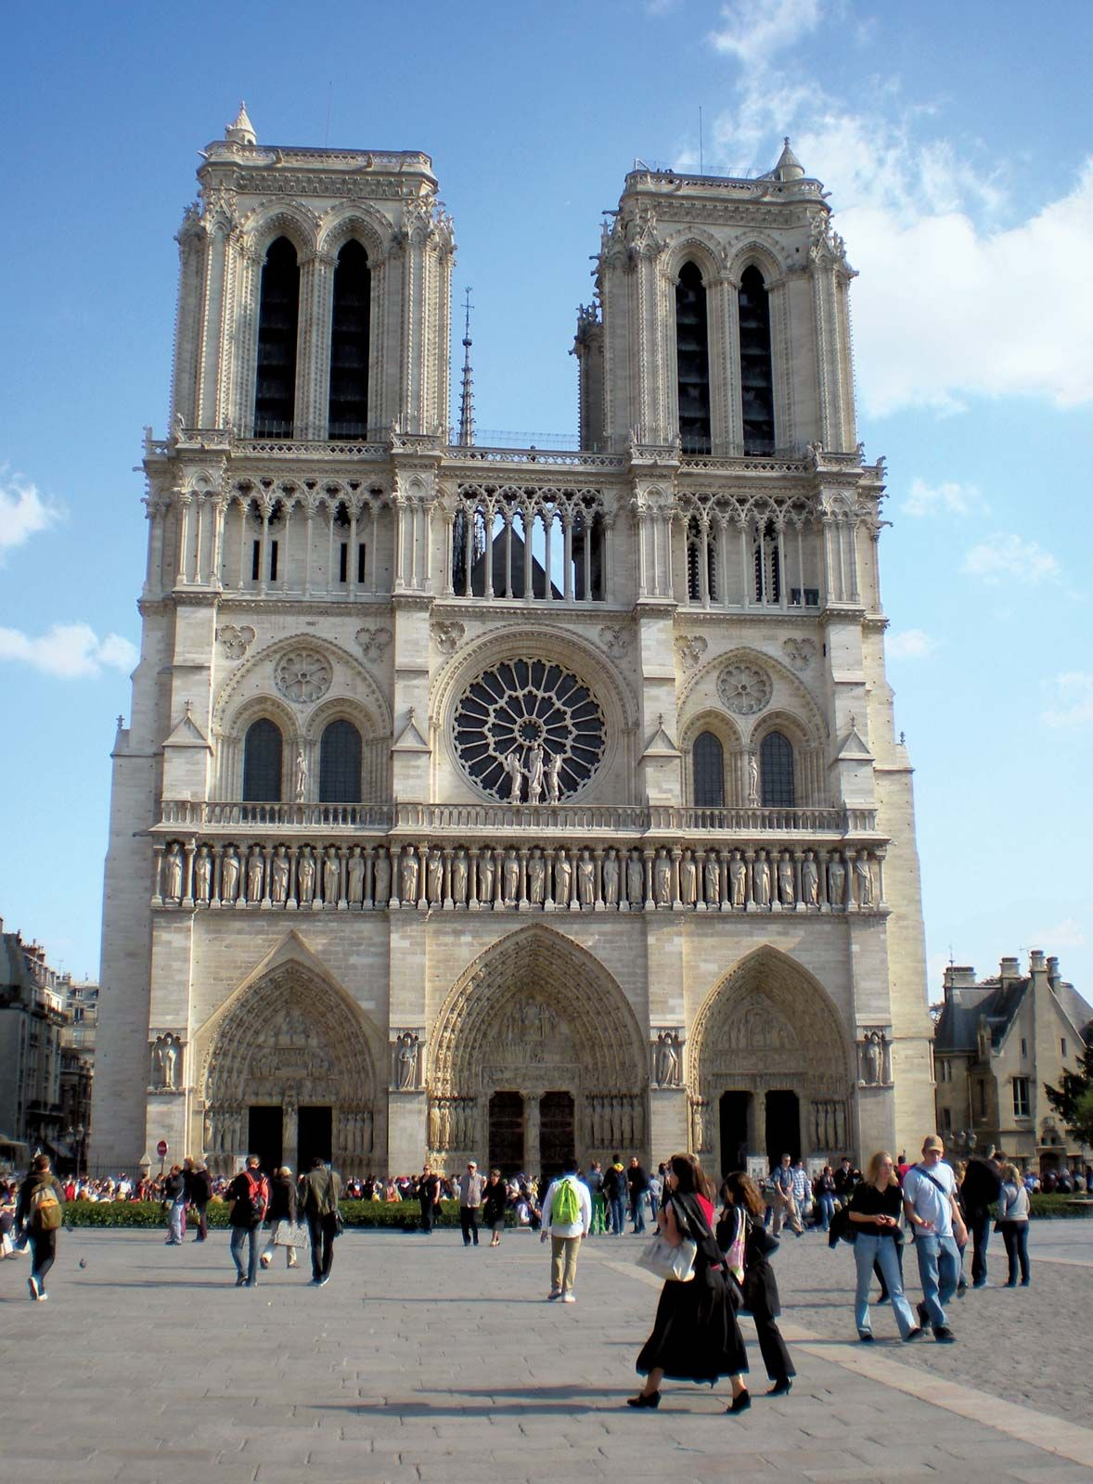
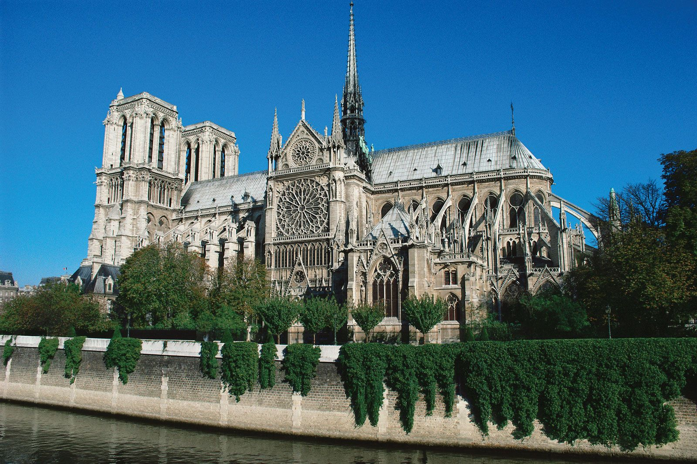
EUGÈNE EMMANUEL VIOLLET-LE-DUC (1814-1879)
Cathedral of Notre Dame, Paris

Slide 9
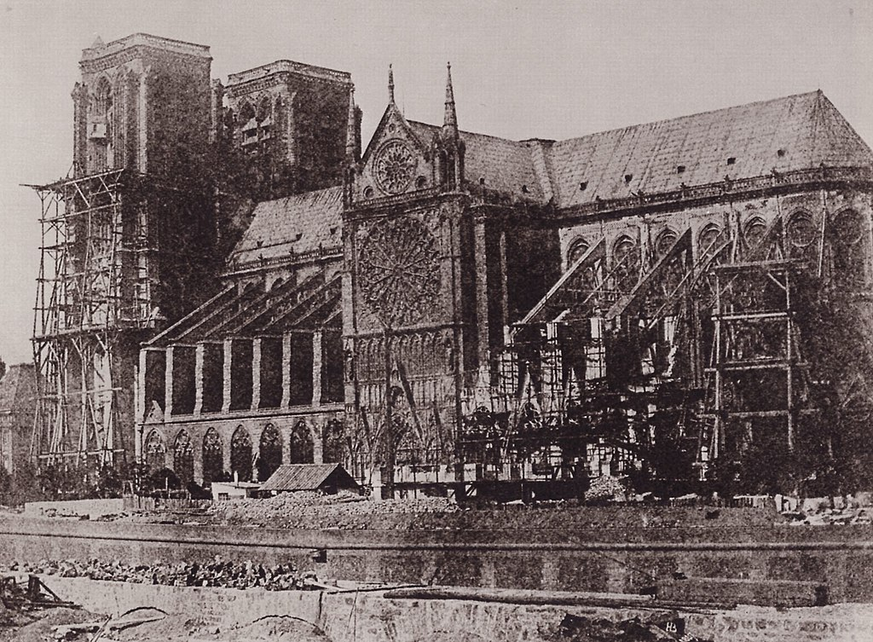
EUGÈNE EMMANUEL VIOLLET-LE-DUC (1814-1879)
Cathedral of Notre Dame, Paris
State of the art before the restoration

Slide 10
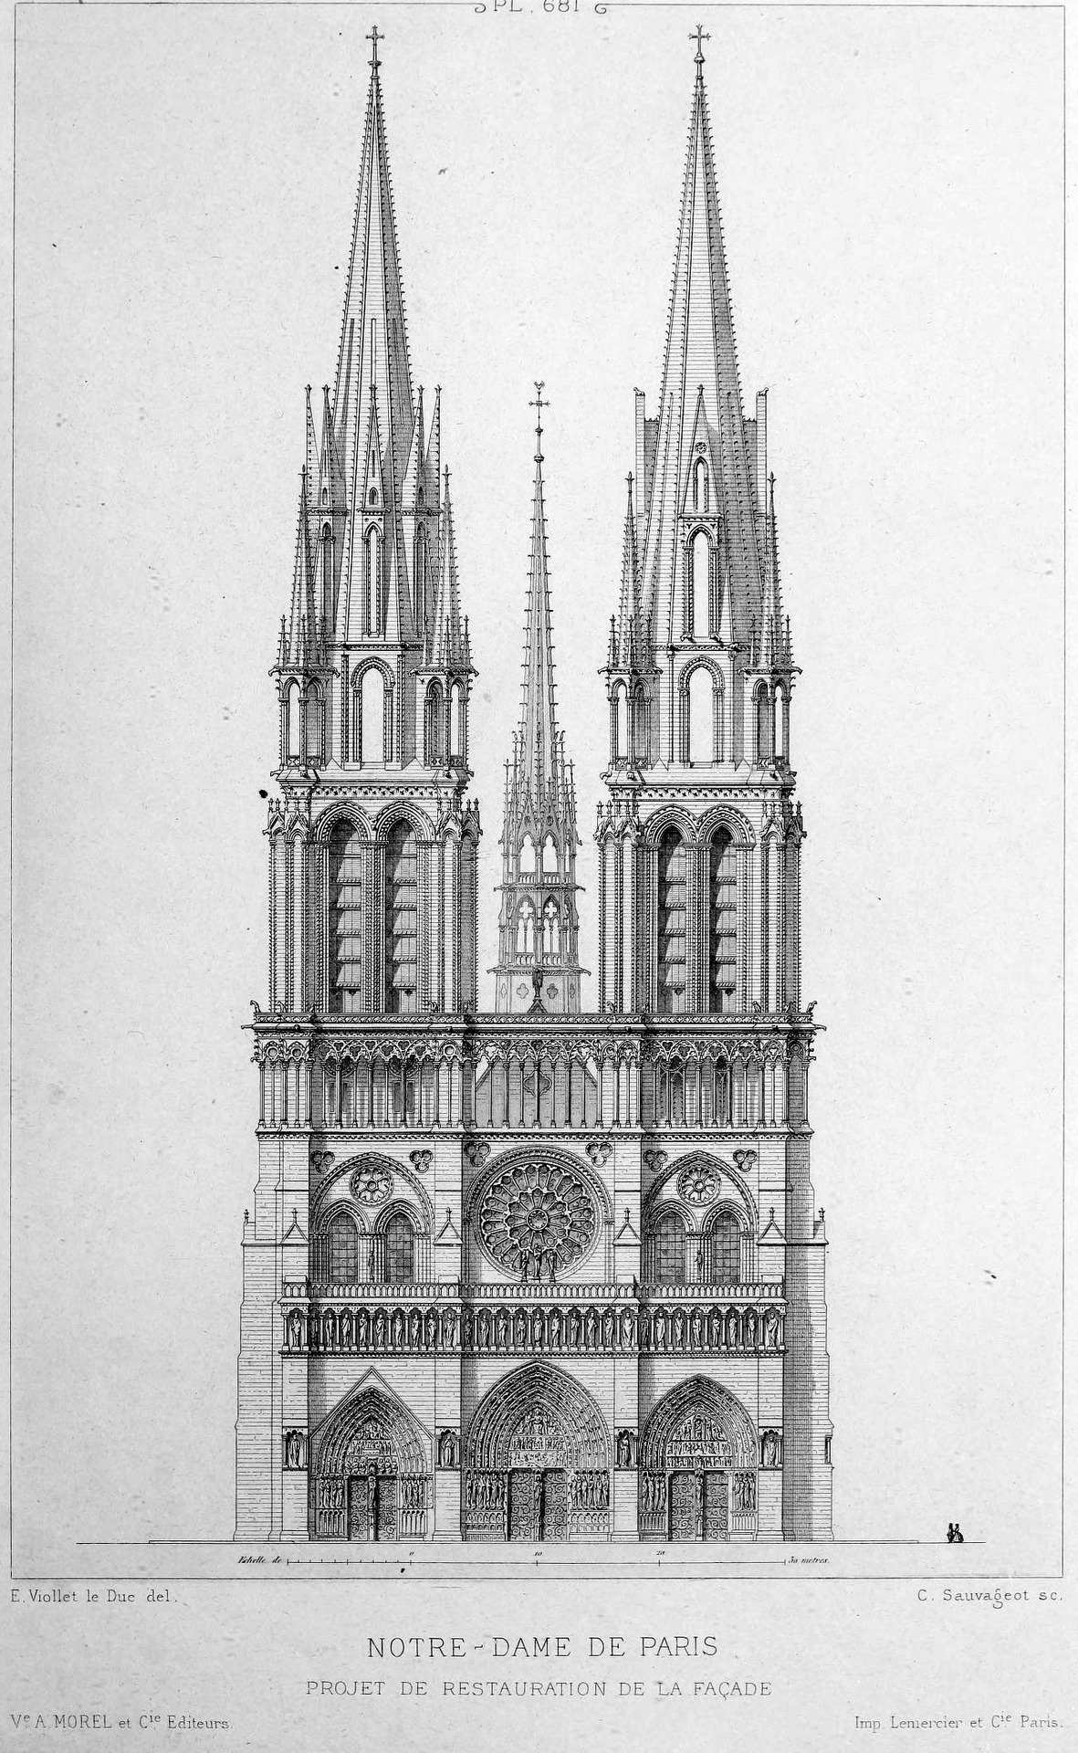
EUGÈNE EMMANUEL VIOLLET-LE-DUC (1814-1879)
Cathedral of Notre Dame, Paris
(left) State of the art before the restoration
(right) Unrealised project for the façade (drawing by Viollet-le-Duc)

Slide 11
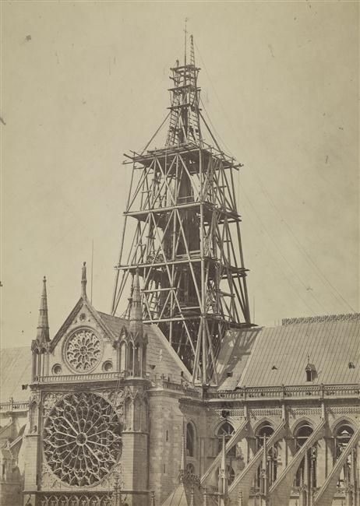
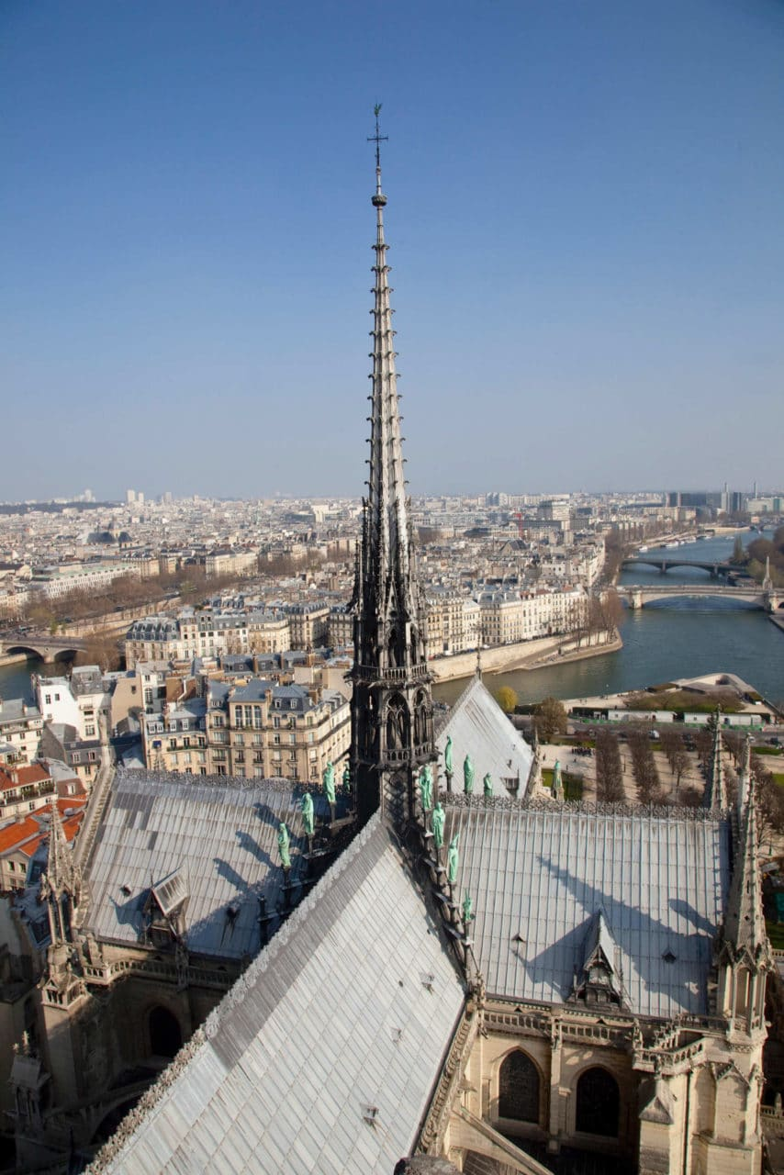
EUGÈNE EMMANUEL VIOLLET-LE-DUC (1814-1879)
Cathedral of Notre Dame, Paris
(left) Spire of Notre Dame, drawing by Viollet-le-Duc
(center) Construction site of the spire
(right) State of the art before the fire of 2019

Slide 12
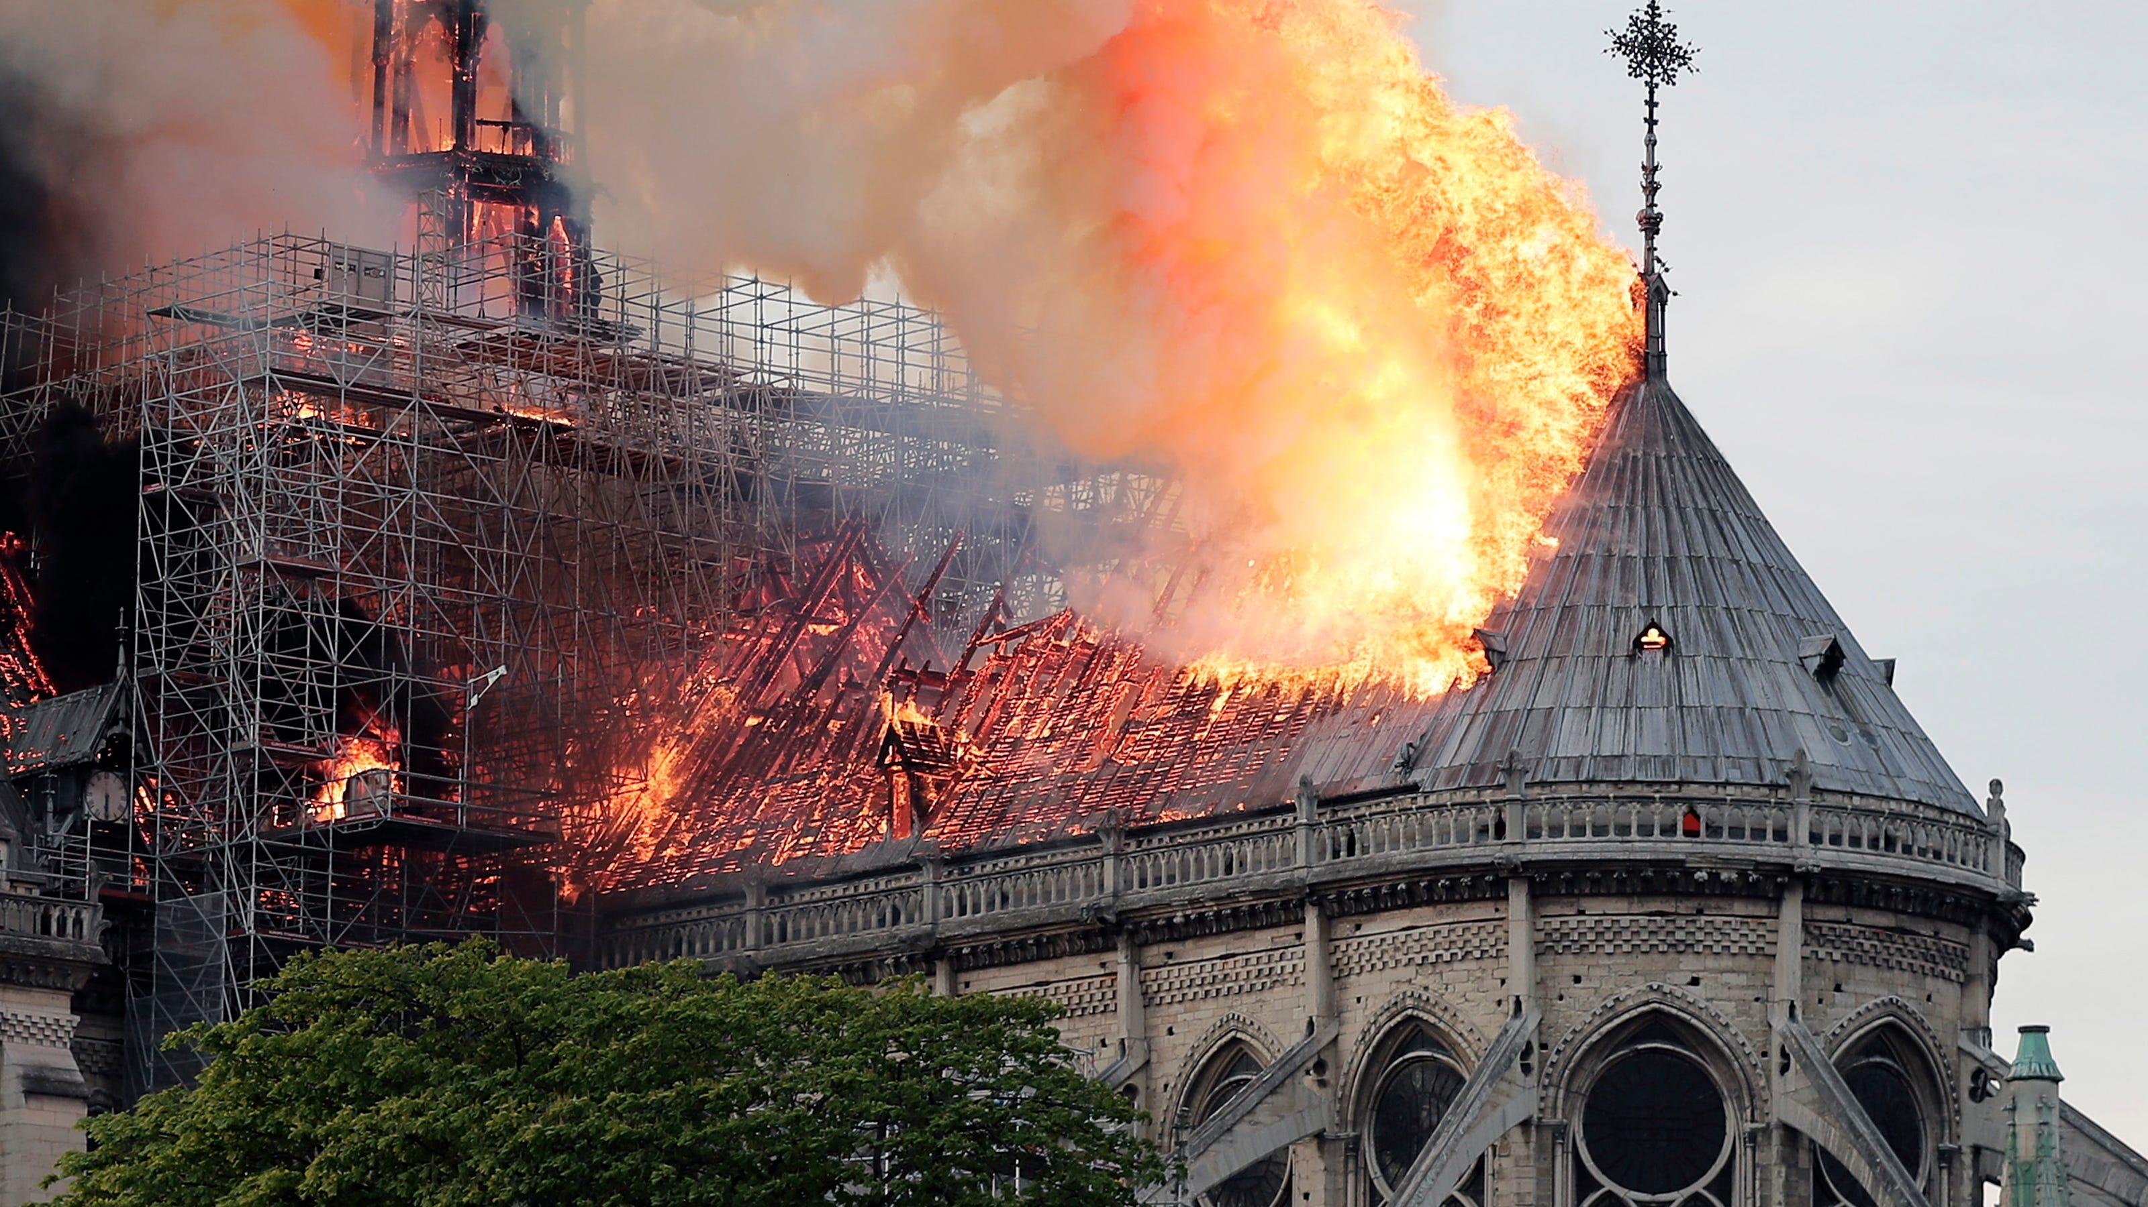
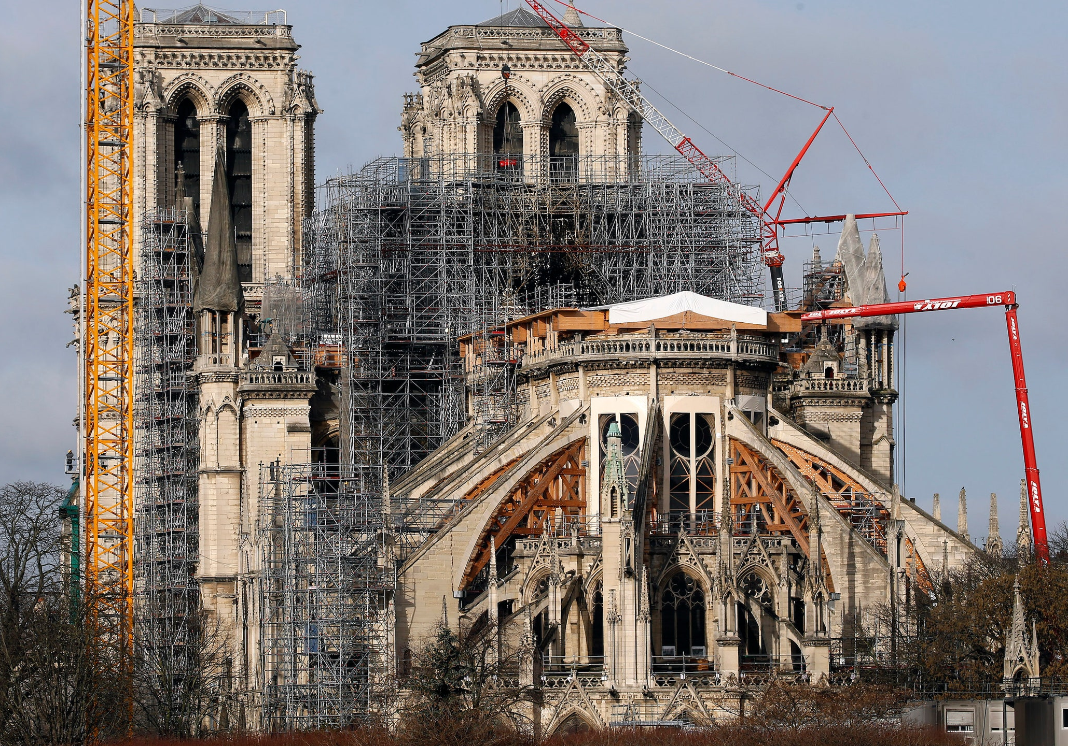
EUGÈNE EMMANUEL VIOLLET-LE-DUC (1814-1879)
Cathedral of Notre Dame, Paris
State of the art after the fire of 2019

Slide 13
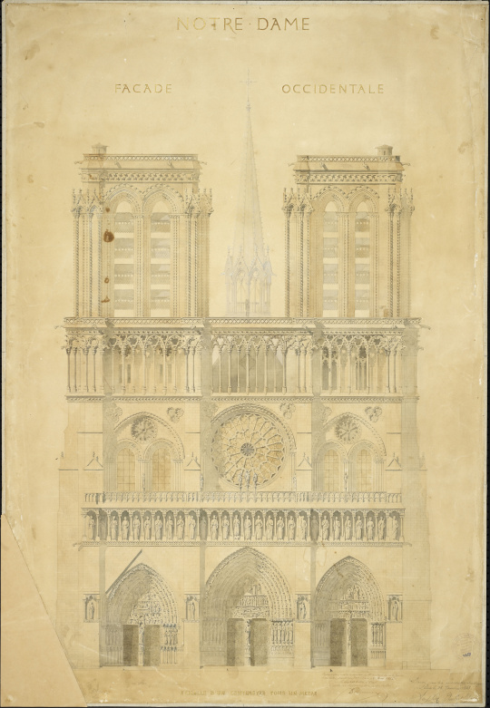
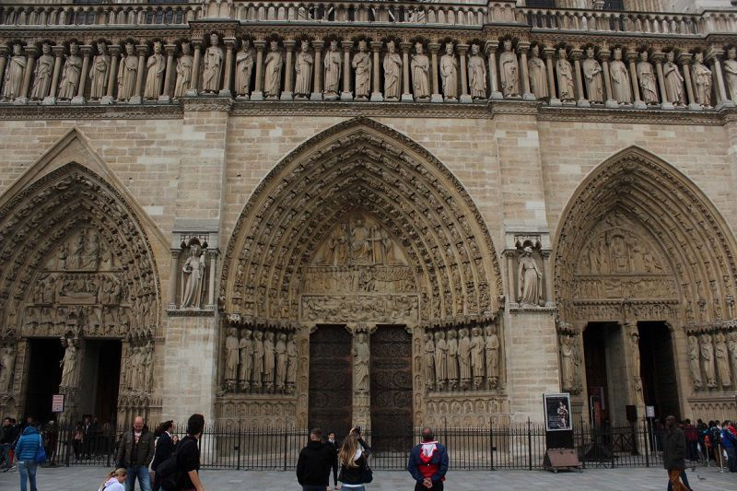
EUGÈNE EMMANUEL VIOLLET-LE-DUC (1814-1879)
Cathedral of Notre Dame, Paris
(left) Restoration project, drawing by Viollet-le-Duc and Lassus
(right) Façade, current state

Slide 14
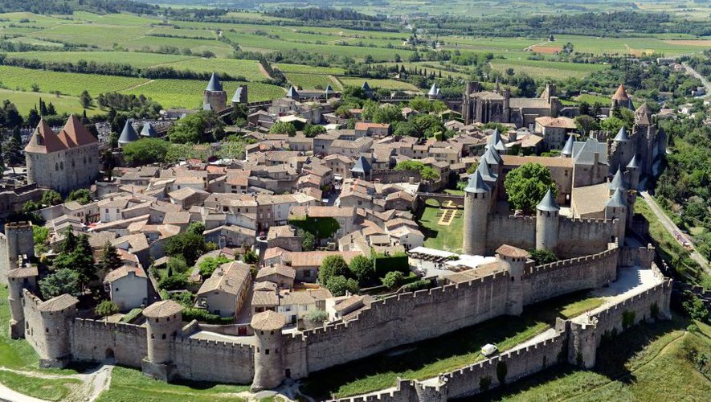
EUGÈNE EMMANUEL VIOLLET-LE-DUC (1814-1879)
City of Carcassonne, France

Slide 15
EUGÈNE EMMANUEL VIOLLET-LE-DUC (1814-1879)
City of Carcassonne, France
State of the art before the restoration

Slide 16
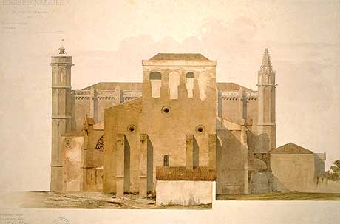
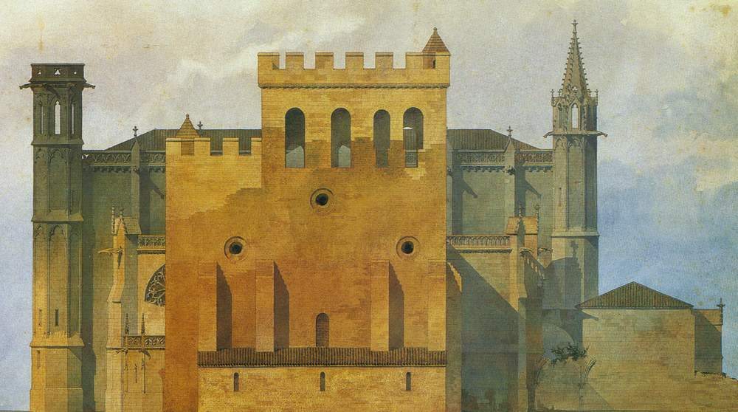
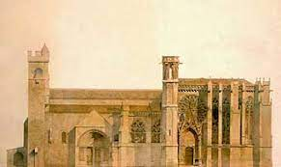
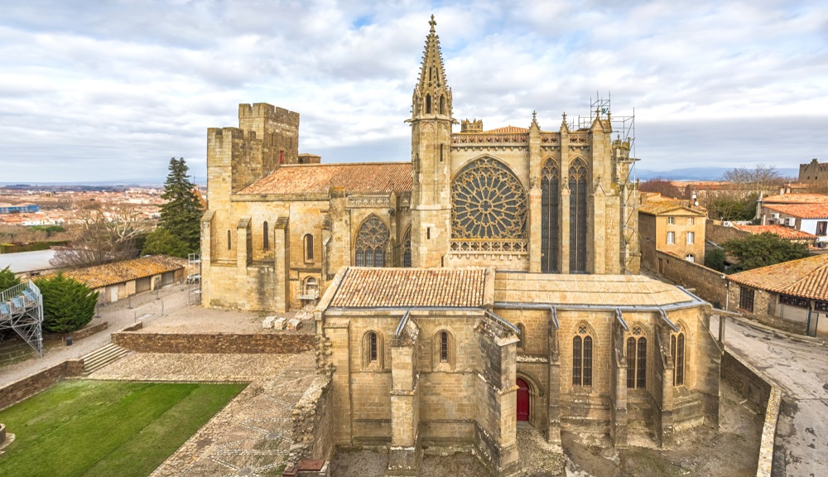
EUGÈNE EMMANUEL VIOLLET-LE-DUC (1814-1879)
City of Carcassonne, France – church of Saint Nazaire
(left) State of the art before the restoration
(right) Restoration project
Drawings by Viollet-le-Duc
(left) Restoration project, drawing by Viollet-le-Duc
(right) Current state

Slide 17
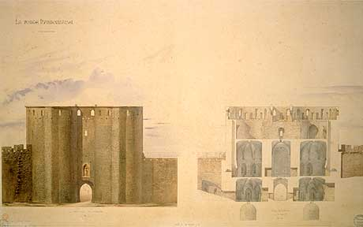
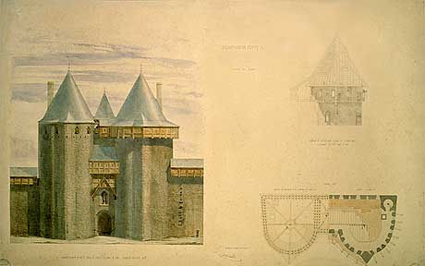
EUGÈNE EMMANUEL VIOLLET-LE-DUC (1814-1879)
City of Carcassonne, France - Narbonnaise entrance door
(left) Survey, drawing by Viollet-le-Duc
(right) Restoration project, drawing by Viollet-le-Duc

Slide 18
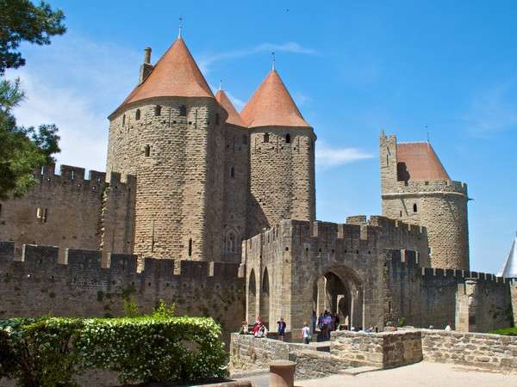
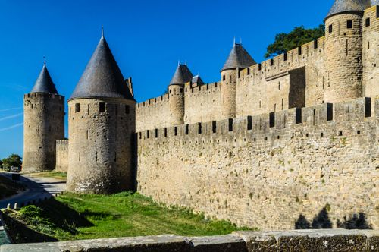
EUGÈNE EMMANUEL VIOLLET-LE-DUC (1814-1879)
City of Carcassonne, France

Slide 19
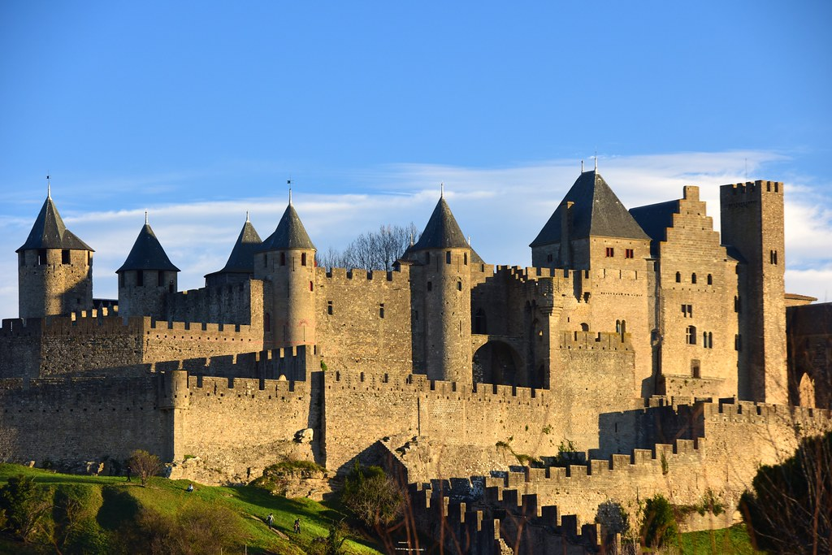
EUGÈNE EMMANUEL VIOLLET-LE-DUC (1814-1879)
City of Carcassonne, France

Slide 20
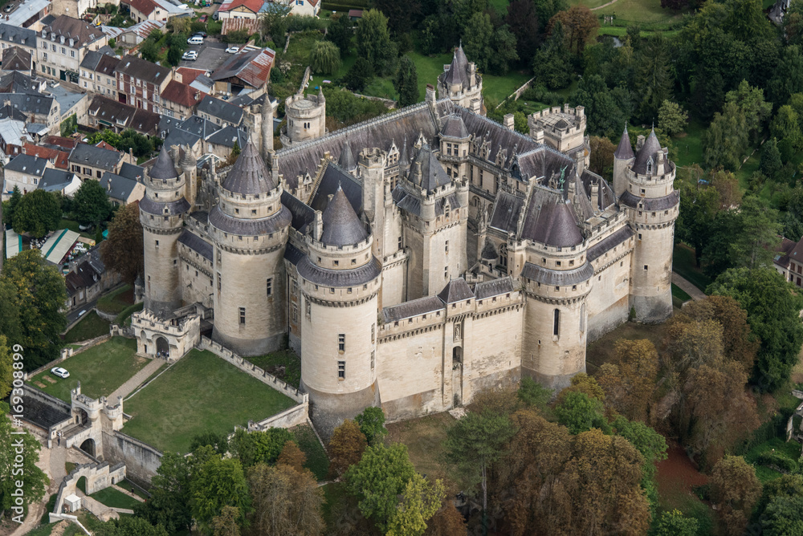
EUGÈNE EMMANUEL VIOLLET-LE-DUC (1814-1879)
Pierrefonds castle, France

Slide 21
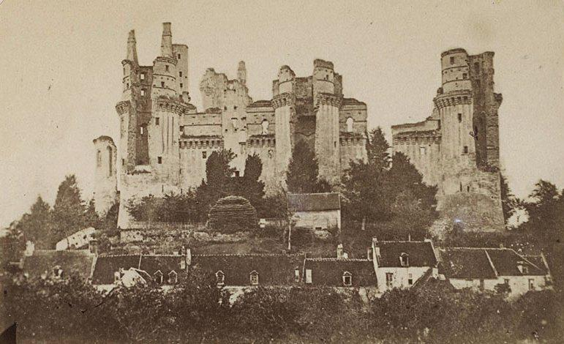
EUGÈNE EMMANUEL VIOLLET-LE-DUC (1814-1879)
Pierrefonds castle, France
State of the art before the restoration

Slide 22
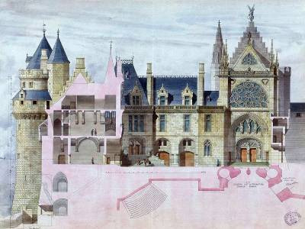
EUGÈNE EMMANUEL VIOLLET-LE-DUC (1814-1879)
Pierrefonds castle, France
(left) Initial design proposal (compromise between partial reconstruction and conservation in the state of ruin)
(right) Complete reconstruction project

Slide 23
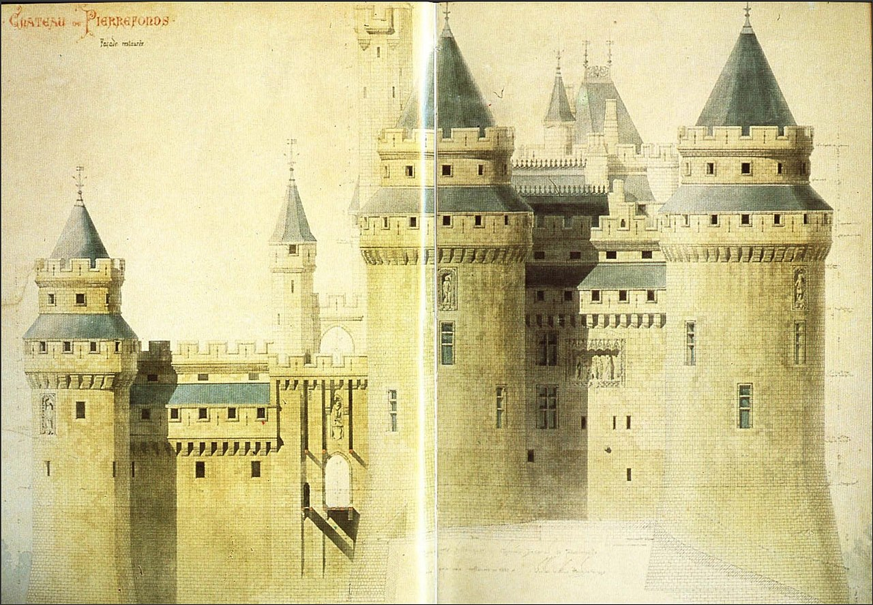
EUGÈNE EMMANUEL VIOLLET-LE-DUC (1814-1879)
Pierrefonds castle, France
(left) Elevation and section of complete reconstruction

Slide 24
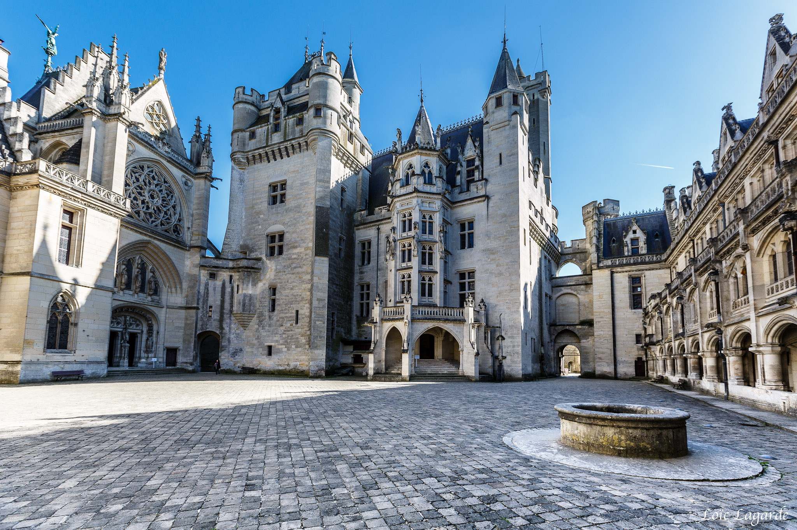
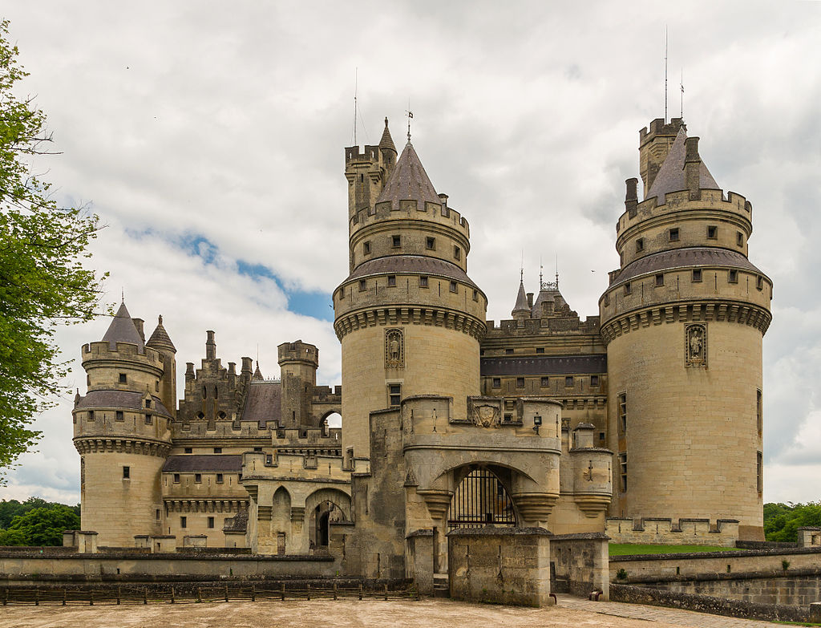
EUGÈNE EMMANUEL VIOLLET-LE-DUC (1814-1879)
Pierrefonds castle, France

Slide 25
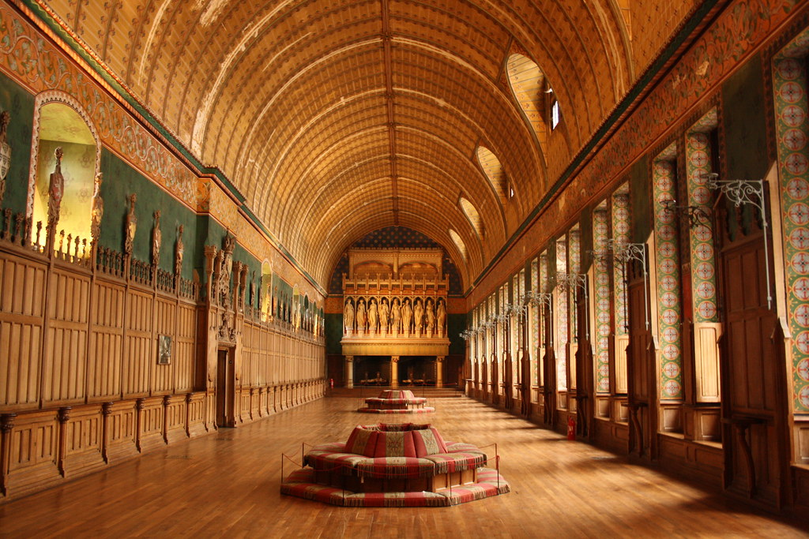
EUGÈNE EMMANUEL VIOLLET-LE-DUC (1814-1879)
Pierrefonds castle, France

Slide 26
JOHN RUSKIN (1819-1900)
Author of Seven lamps of architecture (1849): moral and social considerations mingled up with aesthetic concepts
Definition of restoration from the chapter "The lamp of memory":
«A lie from beginning to end […] the most total destruction which a building can suffer: a destruction out of which no remnants can be gathered ; a destruction accompanied with false description of the thing destroyed»
Contrary to restoration as something that takes away the materials and the authenticity of the works
Contrary to the practice of stylistic restoration, integration, substitution and completion
In favour of measures of maintenance and simple containment of the processes of decay
Recognition of the value connected with the age of a building:
«For, indeed, the greatest glory of a building is not in its stones, nor in its gold. Its glory is in its Age, and in that deep sense of voicefulness, of stern watching, of mysterious sympathy, nay, even of approval or condemnation, which we feel in walls that have long been washed by the passing wave of humanity»
The passing of time can impress a special beauty on a building. The decay of a building, sign of the passing of time, becomes a symbol of glory
For Ruskin it is impossible to restore a building without destroying its integrity

Slide 27
JOHN RUSKIN (1819-1900)
Need for conservation in order to avoid restoration:
«Take proper care of your monuments, and you will not need to restore them. A few sheets of lead put in time upon the roof, a few dead leaves and sticks swept in time out of a water-course, will save both roof and walls from ruin. Watch an old building with an anxious care; set watches about it as if at the gates of a besieged city; bind it together with iron where it loosens; stay it with timber where it declines; do not care about the unsightliness of the aid: better a crutch than a lost limb; and do this tenderly, and reverently, and continually, and many a generation will still be born and pass away beneath its shadow“
Conservation not as the moment preceeding the final phase of a building’s life, but a necessary aspect of its very existence
Constant maintenance through measures limited to simple technical operations
Conservation and preservation, not restoration, represent the proper way to preserve the built environment for future generations:
“We have no right whatever to touch them. They are not ours. They belong partly to those who built them, and partly to all the generations of mankind who are to follow us. The dead have still their right in them: that which they laboured for, the praise of achievement or the expression of religious feeling, whatever else it might be which in those buildings they intended to be permanent, we have no right to obliterate”

Slide 28
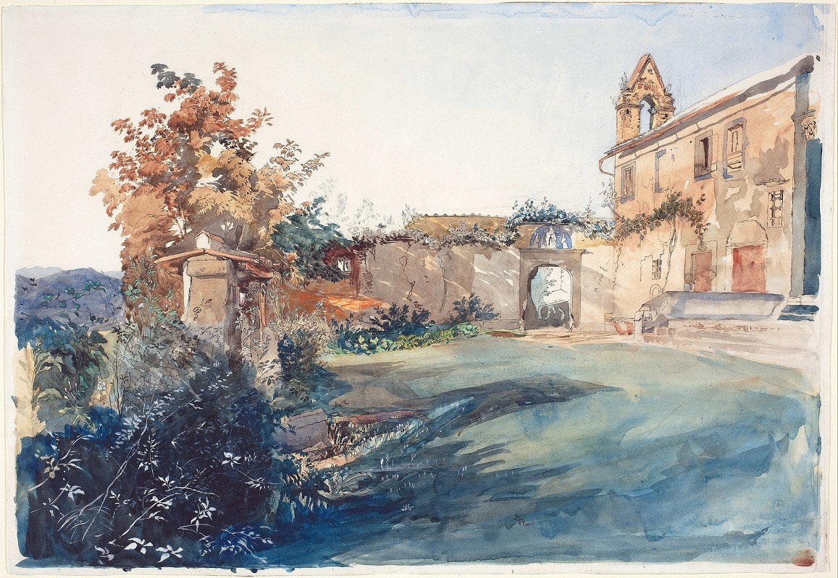
JOHN RUSKIN (1819-1900)
The garden of San Miniato near Florence (1845)

Slide 29
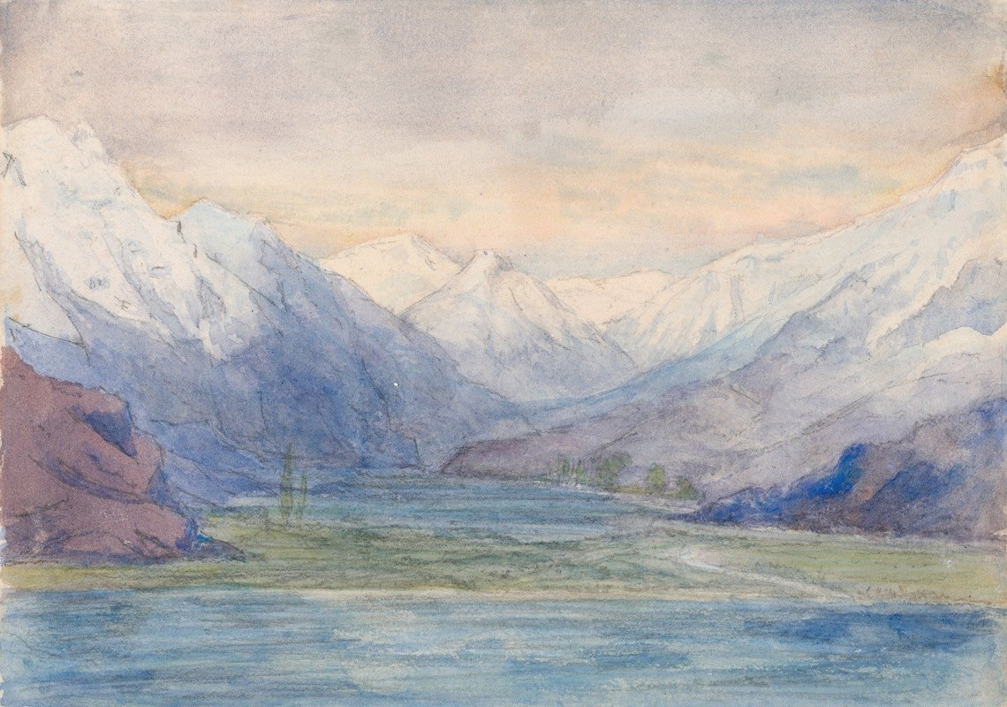
JOHN RUSKIN (1819-1900)
Mountain landscape (ca. 1841-1851)

Slide 30
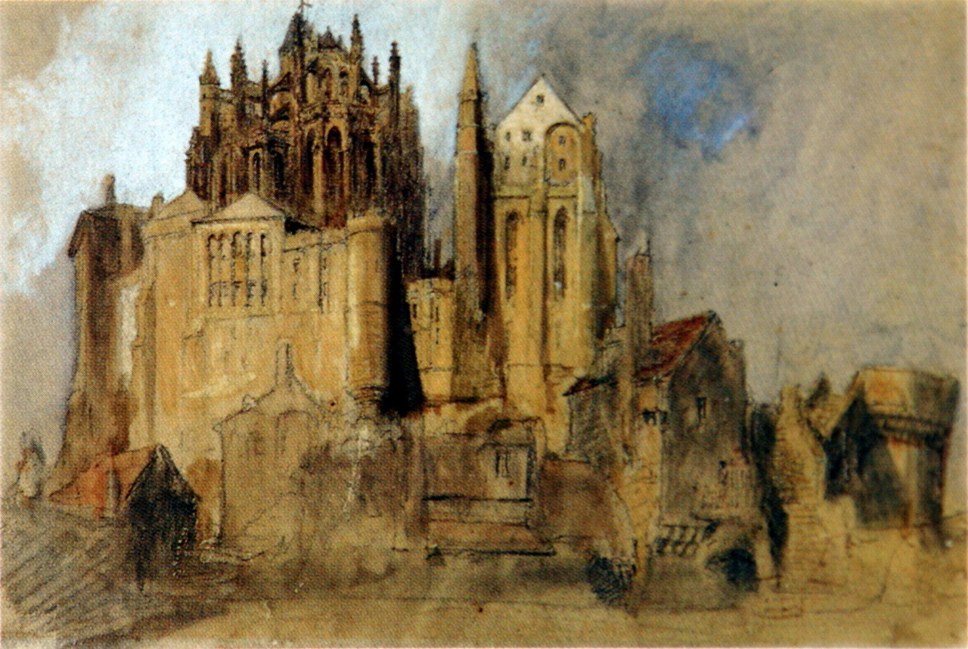
JOHN RUSKIN (1819-1900)
La Merveille, Mont St Michel, Normandy (1848)

Slide 31
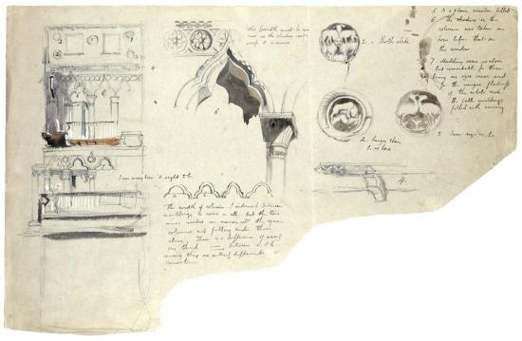
JOHN RUSKIN (1819-1900)
Sketch of an architectural detail by John Ruskin (The Stones of Venice, 1851)

Slide 32
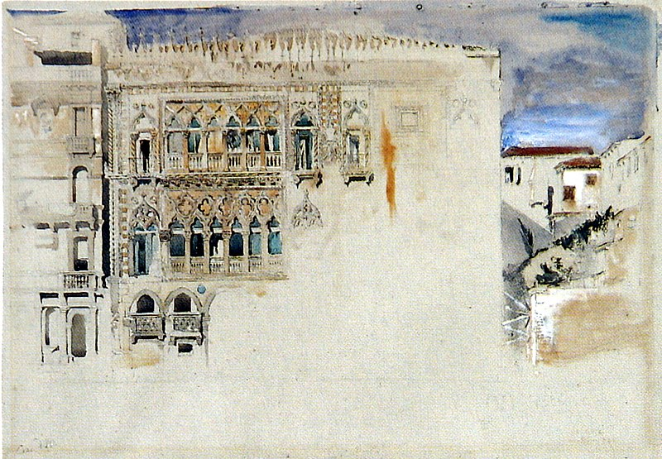
JOHN RUSKIN (1819-1900)
The Ca’ d’Oro, Venice
(The Stones of Venice, 1851)

