Slide 1
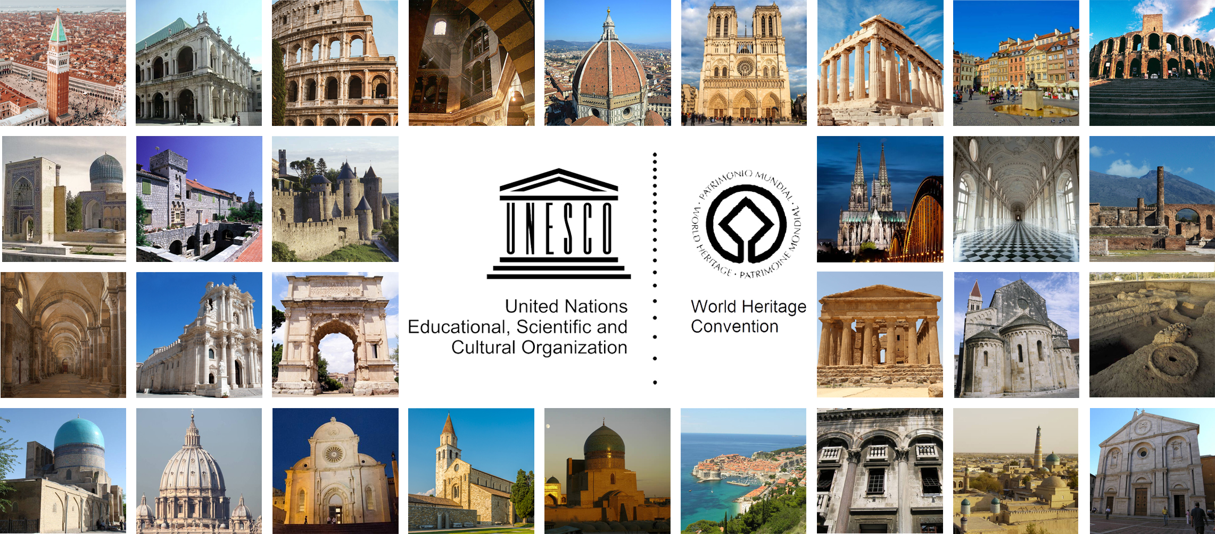
Restoration 1
Third part: International law for preservation (1 credit)
International Chartres for preservation
Activity of internationalal bodies in Cultural Heritage preservation
Prof. Dina Stober, Faculty of Civil Engineering and Architecture Osijek
Prof. Margareta Turkalj Podmanicki, The Academy of Arts and Culture in Osijek
Josip Juraj Strossmayer University Osijek Croatia

Slide 2
INTERNATIONAL HERITAGE POLICY DOCUMENTS
Prof. Lana Skender
The Academy of Arts and Culture in Osijek
Assist. Nikolina Raguz Lucic
Faculty of Civil Engineering and Architecture Osijek
Josip Juraj Strossmayer University Osijek Croatia

Slide 3
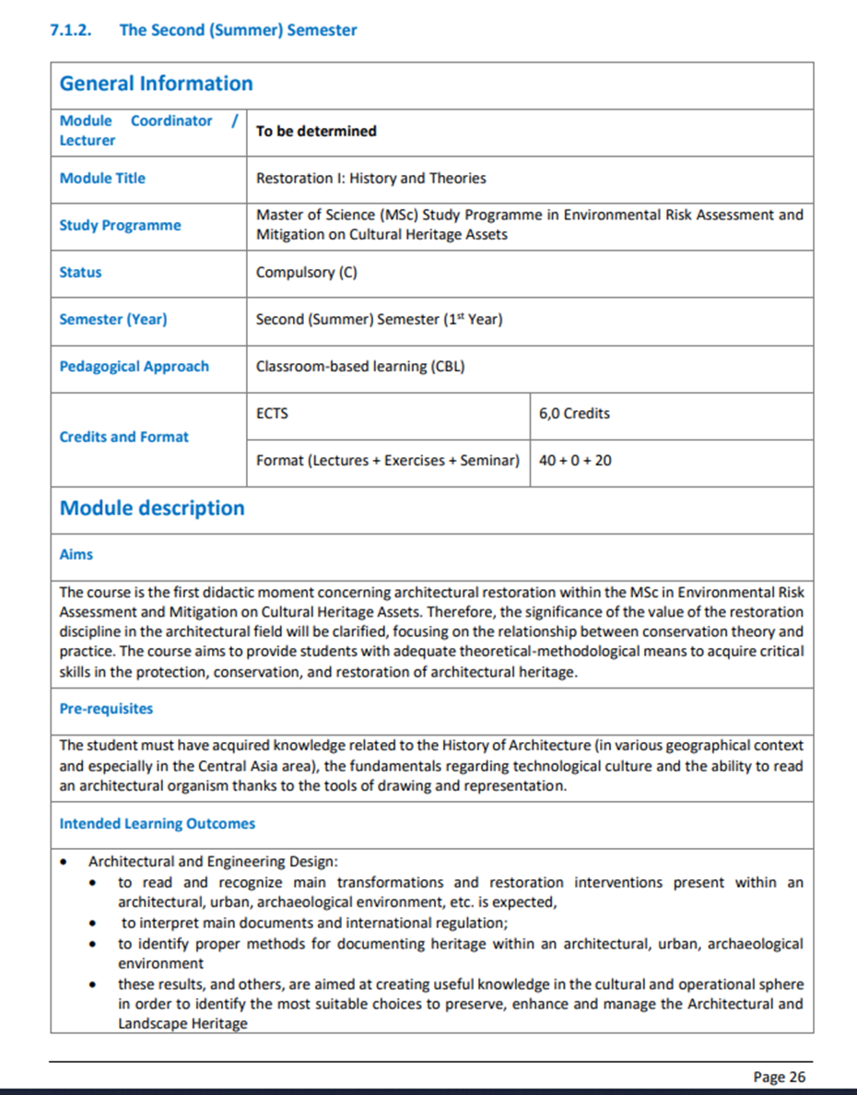
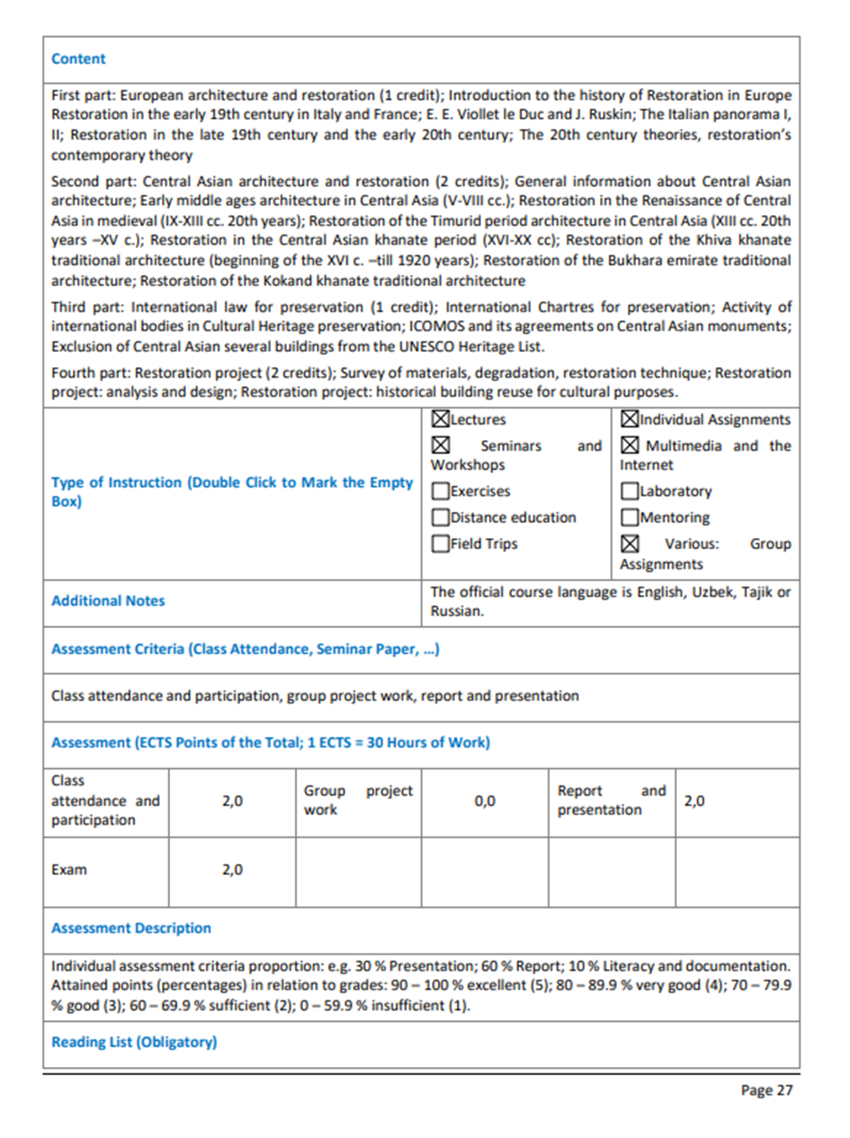
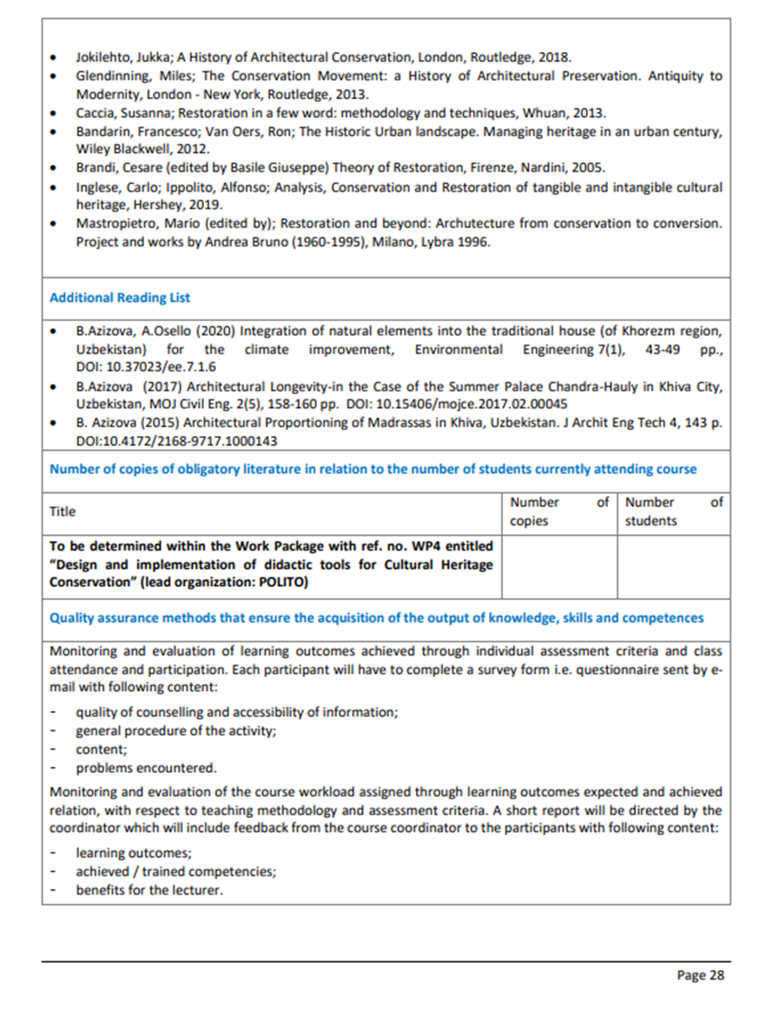

Slide 4
PART I - Content
Basic terms
Timeline overview of heritage policy documents
Principles and objectives in heritage policy documents
Thematic overview of heritage policy documents content
General policies about Conservation and Restoration of Monuments and Sites

Slide 5
Basic terms
Agreements
The term "international agreement" in its generic sense consequently embraces the widest range of international instruments.
Memorandum of Understanding
A memorandum of understanding is an international instrument of a less formal kind. It often sets out operational arrangements under a framework international agreement. It is also used for the regulation of technical or detailed matters.
Protocols
The term "protocol" is used for agreements less formal than those entitled "treaty" or "convention".

Slide 6
Basic terms
Treaties
a binding formal agreement, contract, or other written instrument that establishes obligations between two or more subjects of international law (primarily states and international organizations).
Charters
The term "charter" is used for particularly formal and solemn instruments, such as the constituent treaty of an international organization. A document granting certain specified rights, powers, privileges, or functions from the sovereign power of a state to an individual, corporation, city, or other unit of local organization.
Conventions
The term "convention" can have both a generic and a specific meaning. Convention as a specific term: Whereas in the last century the term "convention" was regularly employed for bilateral agreements, it is generally used for formal multilateral treaties with a broad number of parties.

Slide 7
Basic terms
Declarations
The term "declaration" is used for various international instruments. Declarations are not always legally binding.
Declarations that are intended to have binding effects could be classified as follows:
A declaration can be a treaty in the proper sense
An interpretative declaration is an instrument that is annexed to a treaty with the goal of interpreting or explaining the provisions of the latter.
A declaration can also be an informal agreement with respect to a matter of minor importance.
A series of unilateral declarations can constitute binding agreements.

Slide 8
Conventions and recommendations emanate from intergovernmental organizations and other public international agencies. Once conventions are signed and ratified, they are binding for the member states.
Recommendations do not have the force of law, they bring together for public authorities and other stakeholders highly recommended management guidelines.
Charters, codes of ethics, principles, and other documents have moral rather than legal authority. They usually set forth principles and codes of good conduct that professionals set for themselves to serve as guidelines for their practices.

Slide 9
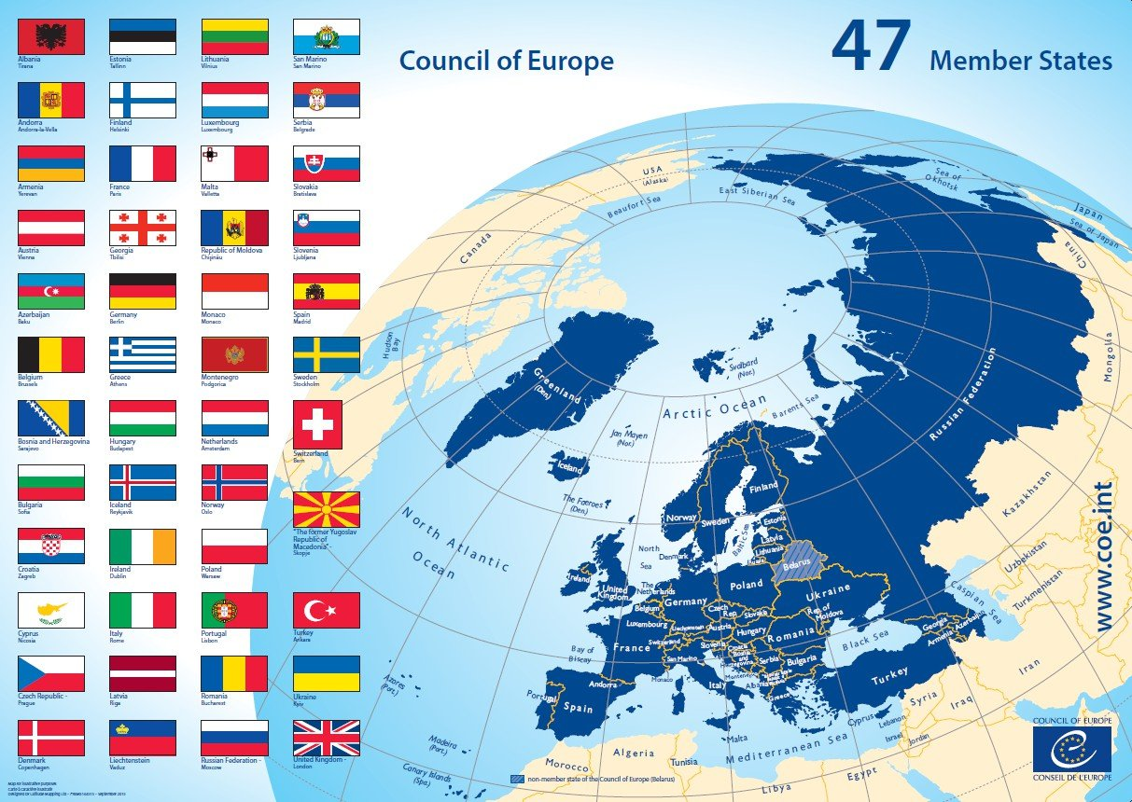
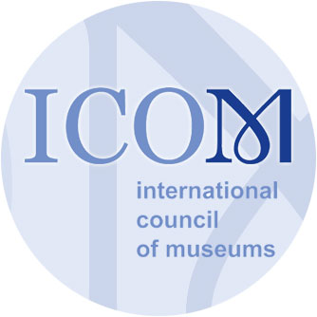
Intergovernmental organizations, international agencies and other institutions for cultural heritage policy documents
Council
of Europe
ICOM (International Council of Museums)
https://edoc.coe.int/en/

Slide 10
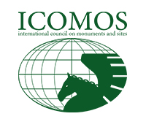
Intergovernmental organizations, international agencies and other institutions for cultural heritage policy documents
ICOMOS (International Council on Sites and Monuments)
ICAHM (International Committee on Archaeological Heritage Management (a committee of ICOMOS)

Slide 11
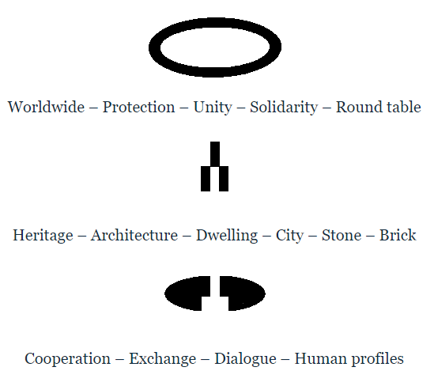
Intergovernmental organizations, international agencies and other institutions for cultural heritage policy documents
IFLA (International Federation of Library Associations and Institutions)
OWHC (Organization of World Heritage Cities)

Slide 12
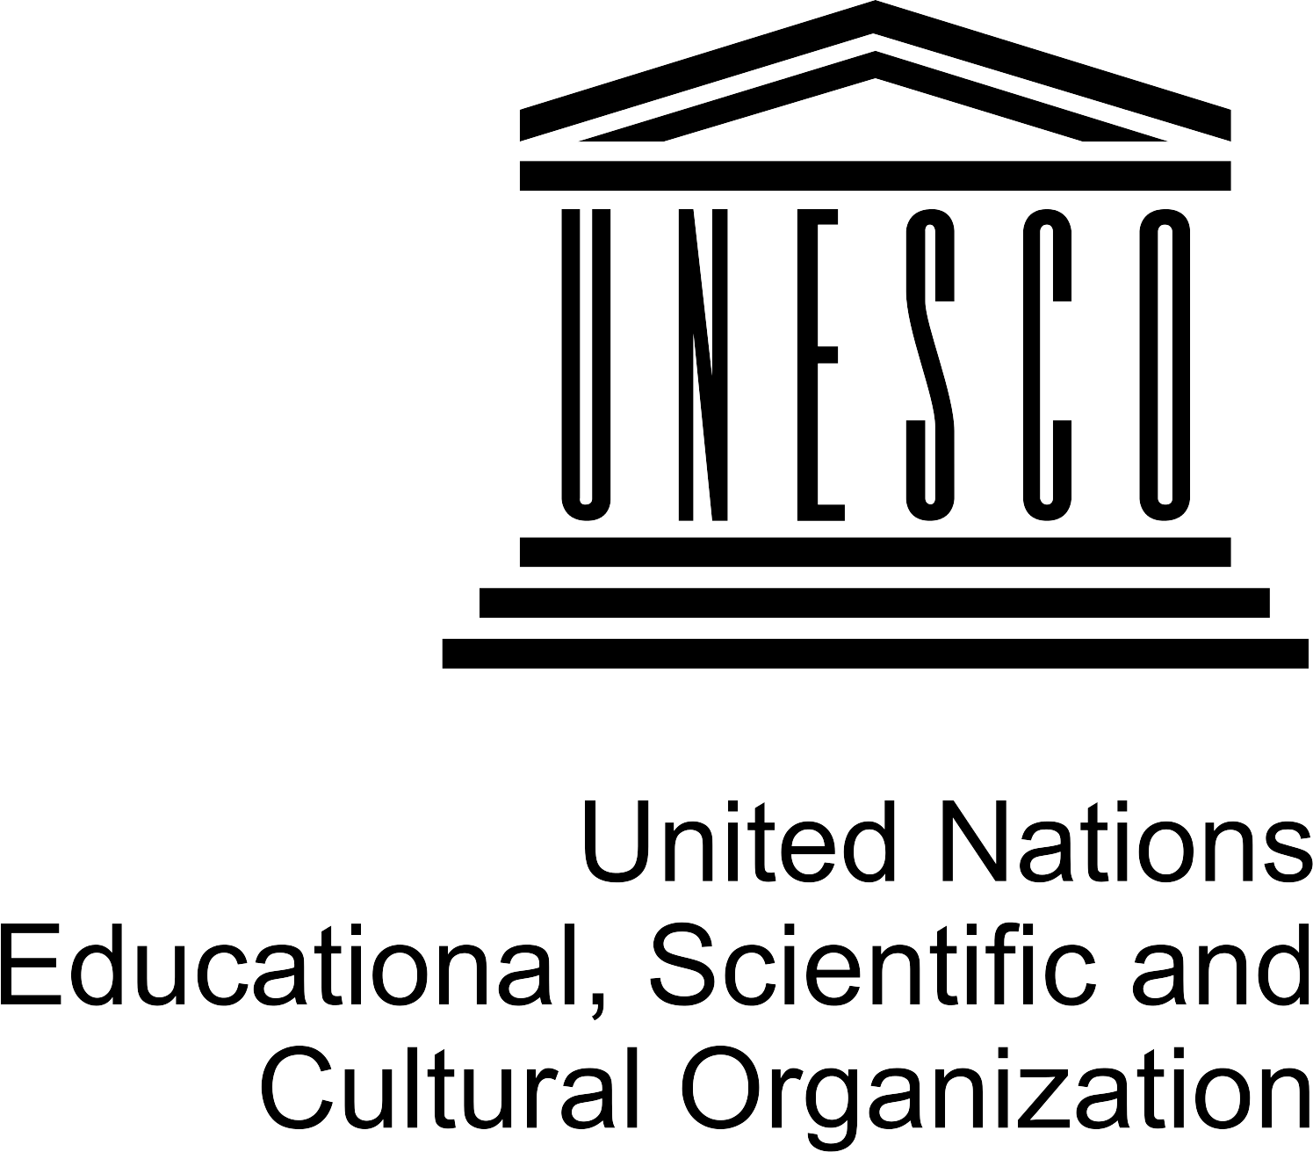
Intergovernmental organizations, international agencies and other institutions for cultural heritage policy documents
UNESCO (United National Education, Scientific and Cultural Organization)
WMF (World Monuments Fund)
The Organization has 193 Members and 11 Associate Members.
https://en.unesco.org

Slide 13
Prior to the nineteenth century - conservation was primarily concerned with a set of measures to eliminate the erosive factors and improve the physical condition of the architectural heritage
A CHANGE IN THE ATTITUDES
preserve the physical aspects of the buildings, but also as a process dealing with the semantic and intangible aspects of the architectural heritage

Slide 14
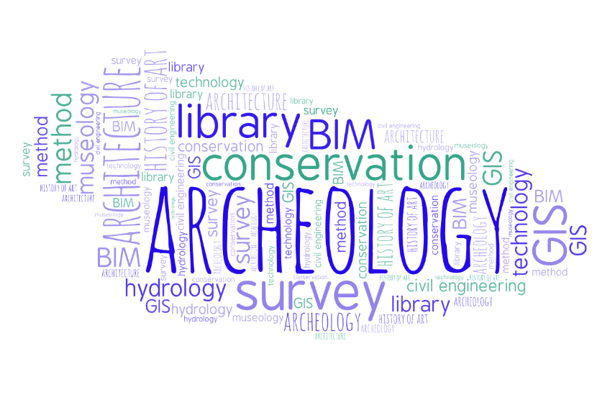
GENERAL PRINCIPLES AND OBJECTIVES IN HERITAGE POLICY DOCUMENTS
Multi-disciplinary teams
Objective-driven methodology and tools
Careful documentation of process and asset
Authenticity-definition and presentation

Slide 15
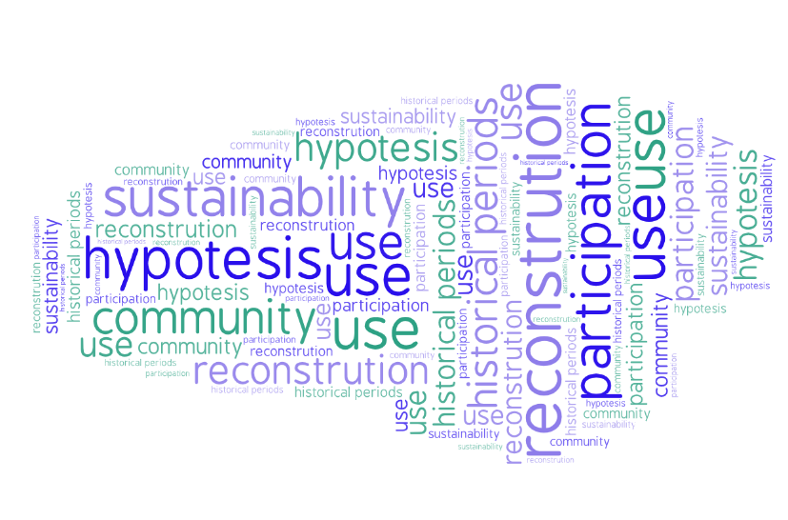
GENERAL PRINCIPLES AND OBJECTIVES IN HERITAGE POLICY DOCUMENTS
Type of reconstruction and level of certainty
Alternative hypotheses
Multiple historical periods
Respectful use of the heritage
Community engagement – participation and sustainability

Slide 16
CONTENTS AND SCOPES IN HERITAGE POLICY DOCUMENTS
Prohibiting and Preventing the Illicit Export, Import and Transfer of Ownership of Cultural Property
Protection of Cultural Property in the Event of Armed Conflict, Intentional Destruction and Disaster Risk Management – Heritage at Risk
General policies
Education and Training in the Conservation of Monuments
Conservation of Historic Towns and Urban Areas
Protection specific types of CH
Archeological heritage
Underwater cultural heritage

Slide 17
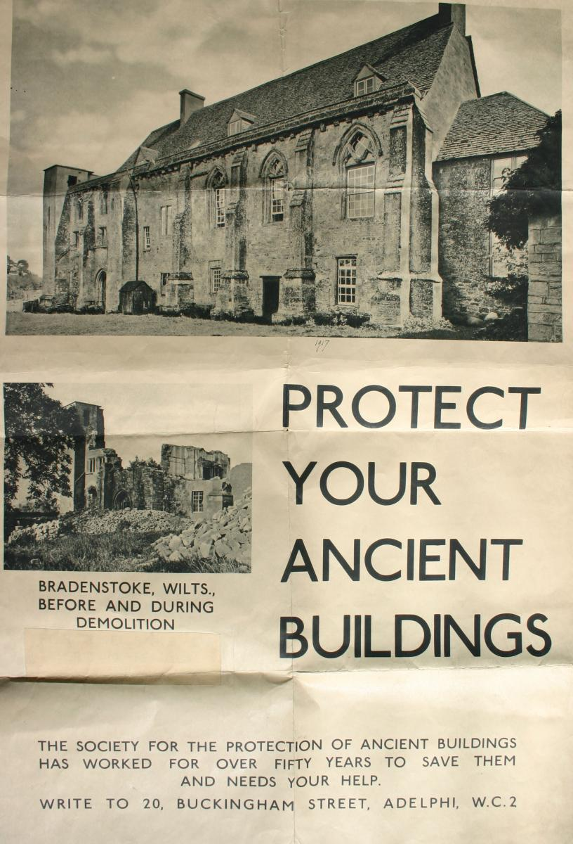
First heritage policy documents
1877
The Principals of the Society for the Protection of Ancient Buildings as Set Forth upon its Foundation (The SPAB Manifesto)
1904
Recommendations of the Madrid Conference
Madrid urban block

Slide 18
1931
1931
1940
1949
1958
1967
1976
1985
1994
2003
2012
2020
The Athens Charter 1931
UNESCO Charter on the Preservation of the Digital Heritage 2003
Today
The Venice Charter 1964
The London Charter 2006 - 2009
UNESCO Convention concerning
the Protection of the World Cultural and Natural Heritage 1972
The Sevilla Principles 2011
European Charter of the Architectural Heritage 1975
Québec Declaration 2008
The Florence Charter 1981
Québec Charter 2008
Declaration of Dresden 1982
Declaration of Tlaxcala 1982
Washington Charter 1987
Lausanne Charter 1990
The Nara Document of Authenticity 1994
Sofia Charter 1996
1 day
Sofia Principles 1996
Jan 1 - Nov 1
Stockholm Declaration 1998
International Cultural Tourisme Charter 1999
Jan 1 - Jan 1
International Declarations and Conventions – UNESCO
Charters and Declarations ICOMOS
Jan 1 - Jan 3
Mexico Charter 1999
Mexico Principles 1999
The Charter of Krakow 2000
Budapest Declaration on World Heritage, UNESCO 2002
Victoria Falls Charter 2003
Victoria Falls Principles 2003
Xi'an Declaration 2005
Charter on Cultural Routes Quebec 2008
UNESCO World Heritage Information Kit 2008
Lima Declaration 2010
The Dublin Principles 2011
The Valletta Principles 2011
The Paris Declaration 2011
The Florence Declaration 2014
UNESCO Operation Guidelines 2016
Delhi Declaration 2017
Delhi Principles Rural Landscapes 2017
Delhi Principles Wooden Built Heritage2017
Buenos Aires Declaration 2018

Slide 19
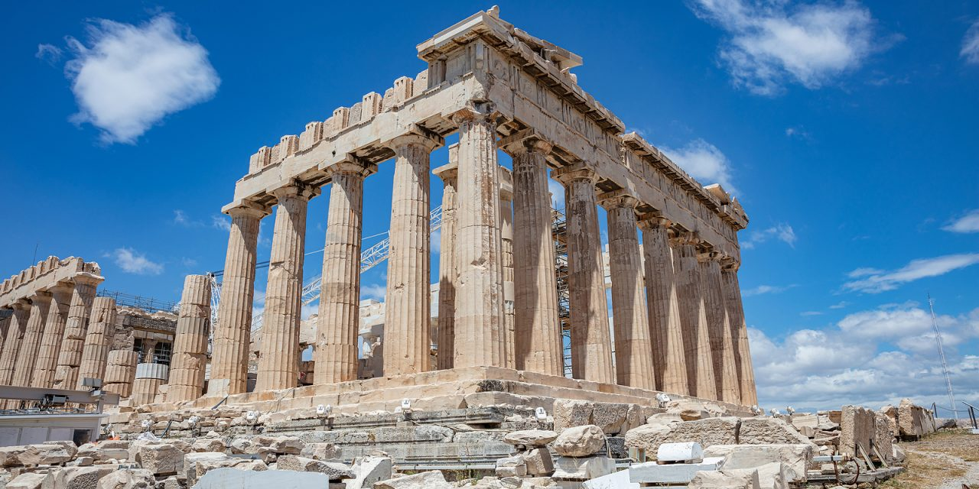
General policies about Conservation and Restoration of Monuments and Sites
1931 The Athens Charter for the Restoration of Historic Monuments
• International organizations for Restoration on operational and advisory levels are to be established.
• Proposed Restoration projects are to be subjected to knowledgeable criticism to prevent mistakes which will cause loss of character and historical values to the structures.
• Problems of preservation of historic sites are to be solved by legislation at national level for all countries.
• Excavated sites which are not subject to immediate restoration should be reburied for protection.
• Modern techniques and materials may be used in restoration work.
• Historical sites are to be given strict custodial protection.
• Attention should be given to the protection of areas surrounding historic sites.
Acropolis of Athens

Slide 20
General policies about Conservation and Restoration of Monuments and Sites
1964
The Venice Charter: International Charter for the Conservation and Restoration of Monuments and Sites
• Provides guidelines and an international framework for the conservation of historic buildings.

Slide 21
General policies about Conservation and Restoration of Monuments and Sites
1967
The Norms of Quito
“Every national monument is implicitly designed to fulfill a social function. It is the responsibility of the state to ensure this social function and to determine in each case the extent to which it is compatible with private property and private interests.”
1968
Recommendation concerning the Preservation of Cultural Property Endangered by Public or Private works

Slide 22
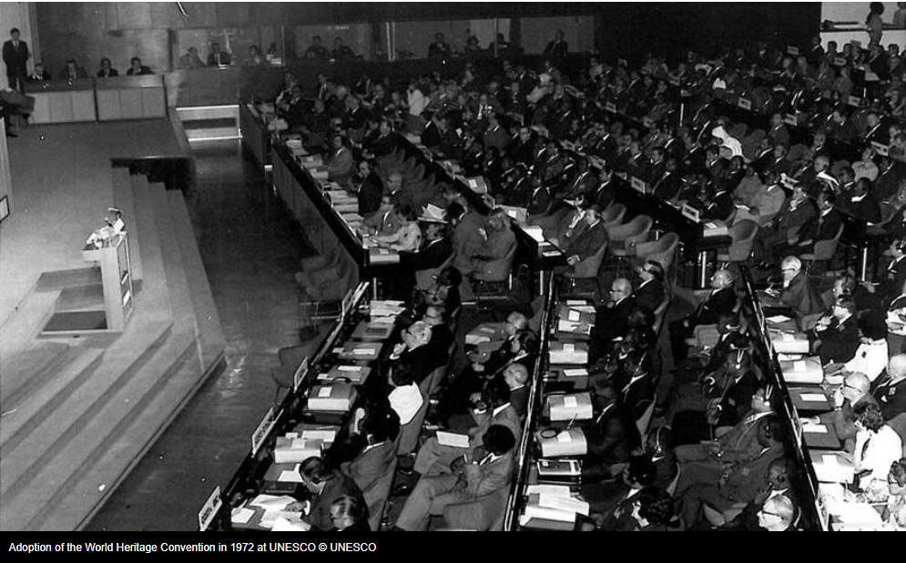
General policies about Conservation and Restoration of Monuments and Sites
1972
UNESCO Convention Concerning the Protection of the World Cultural and Natural Heritage.
Signing countries pledge to defend and protect their cultural and natural heritage.
It determines the uses and management of the World Heritage Fund.
ratified by a record 178 states, which is consequently the flagship of the fleet of conventions
UNESCO 1972

Slide 23
General policies about Conservation and Restoration of Monuments and Sites
1976
Recommendation concerning the Safeguarding and Contemporary Role of Historic Areas
1976
Convention on the Protection of the Archaeological, Historical and Artistic Heritage of the American Nations (Convention of San Salvador)
To “identify, register, protect, and safeguard the property making up the cultural heritage of the American nations in order:
to prevent illegal exportation or importation of cultural property; and
to promote cooperation among the American states for mutual awareness and appreciation of their cultural property.”

Slide 24
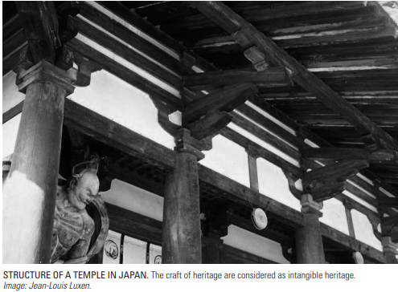
General policies about Conservation and Restoration of Monuments and Sites
1994
The Nara document on authenticity
“Depending on the nature of the cultural heritage, its cultural context, and its evolution through time, authenticity judgements may be linked to the worth of a great variety of sources of information. Aspects of the sources may include form and design, materials and substance, use and function, traditions and techniques, location and setting, and spirit and feeling, and other internal and external factors. The use of these sources permits elaboration of the specific artistic, historic, social, and scientific dimensions of the cultural heritage being examined.”

Slide 25
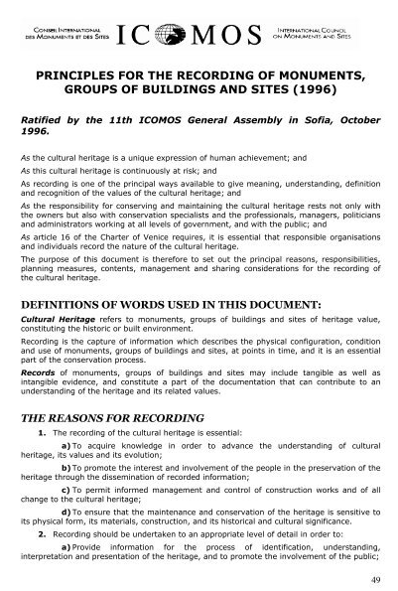
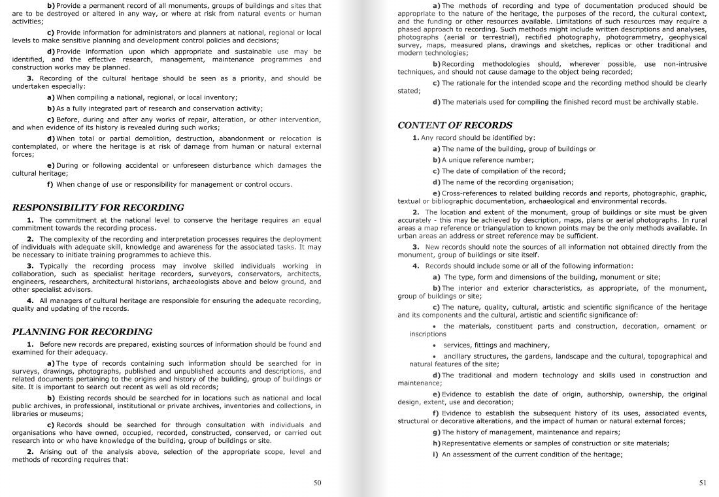
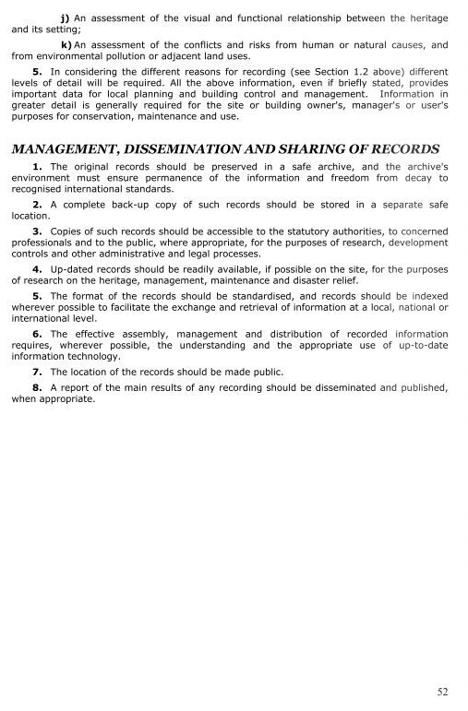
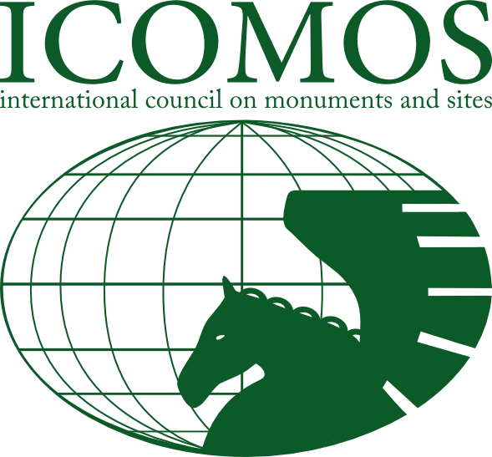
General policies about Conservation and Restoration of Monuments and Sites
1996
Principles for the recording of monuments,
groups of buildings and sites Recording of the cultural heritage should be seen as a priority.

Slide 26
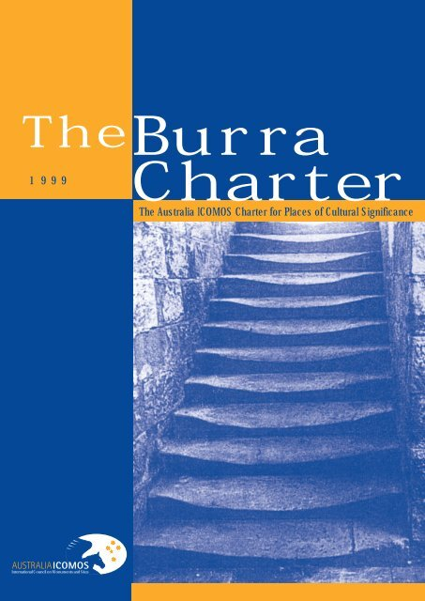
General policies about Conservation and Restoration of Monuments and Sites
1999
The Burra Charter for Places of Cultural Significance
“…provides guidance for the conservation and anagement of places of cultural significance (cultural heritage places), and is based on the knowledge and experience of Australia ICOMOS members.”

Slide 27
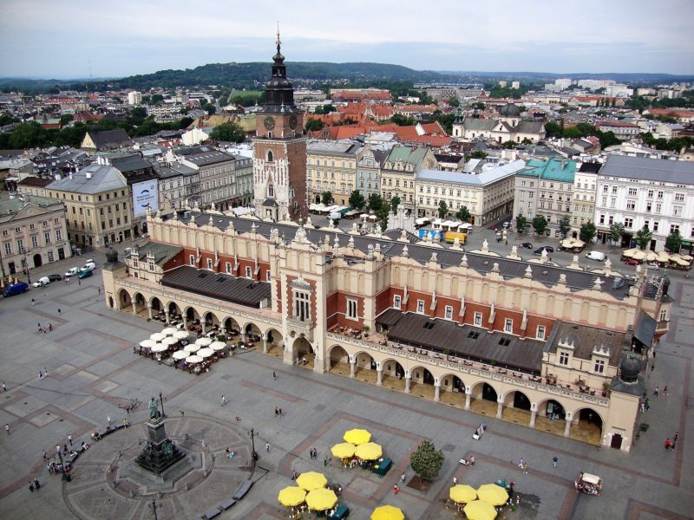
General policies about Conservation and Restoration of Monuments and Sites
2000
The Charter of Krakow: Principles for conservation and restoration of built heritage.
2003
ICOMOS Charter – Principles for the analysis, conservation and structural restoration of architectural heritage
Krakow's Rynek Glowny Central Square

Slide 28
PART II - Content
Thematic overview of heritage policy documents content
Conservation of Historic Towns and Urban Areas
Protection specific types of CH
Archeological heritage
Underwater cultural heritage
Prohibiting and Preventing the Illicit Export, Import and Transfer of Ownership of Cultural Property
Heritage and Society

Slide 29
PART II - Content
Challenges in heritage policy documents
Conclusion
Literature

Slide 30
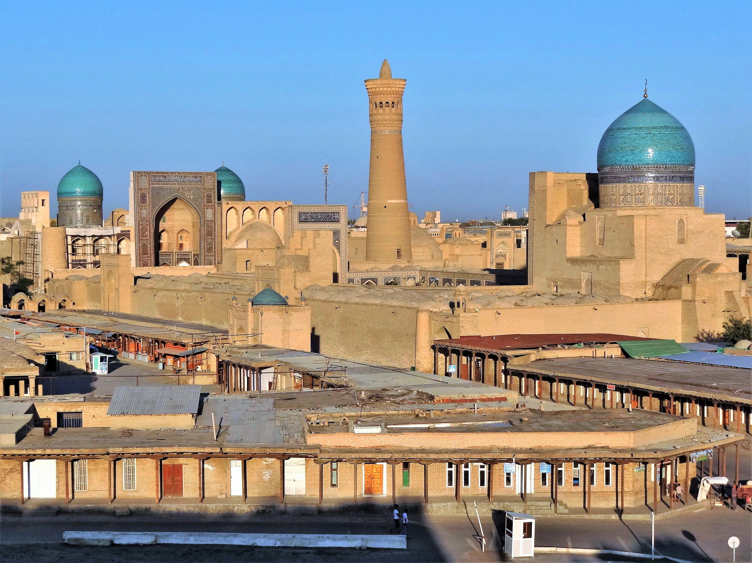
Conservation of Historic Towns and Urban Areas
1975
Bruges Resolutions of the International Symposium on the Conservation of Smaller Historic Towns
(10 conclusions that determined the importance of historical cities for the culture and social development of man)
1987
The Washington Charter: Charter for the Conservation of Historic Towns and Urban Areas
(principles and guidelines for the protection and conservation of historic towns as well as their development and harmonious adaptation to contemporary life)
Historic Centre of Bukhara, Uzbekistan
https://whc.unesco.org/en/list/602/

Slide 31
Protection specific types of CH
1982
The Florence Charter for Historic Gardens
• Guidelines for the preservation of historic gardens
defines historic gardens as architectural compositions and recommends their preservation as living monuments
outlines strategies for maintenance, conservation, restoration, and reconstruction of gardens, including their plans, vegetation, structural and decorative features, and use of water.
Gardens, Royal Palace of Caserta – San Leucio, Italy

Slide 32
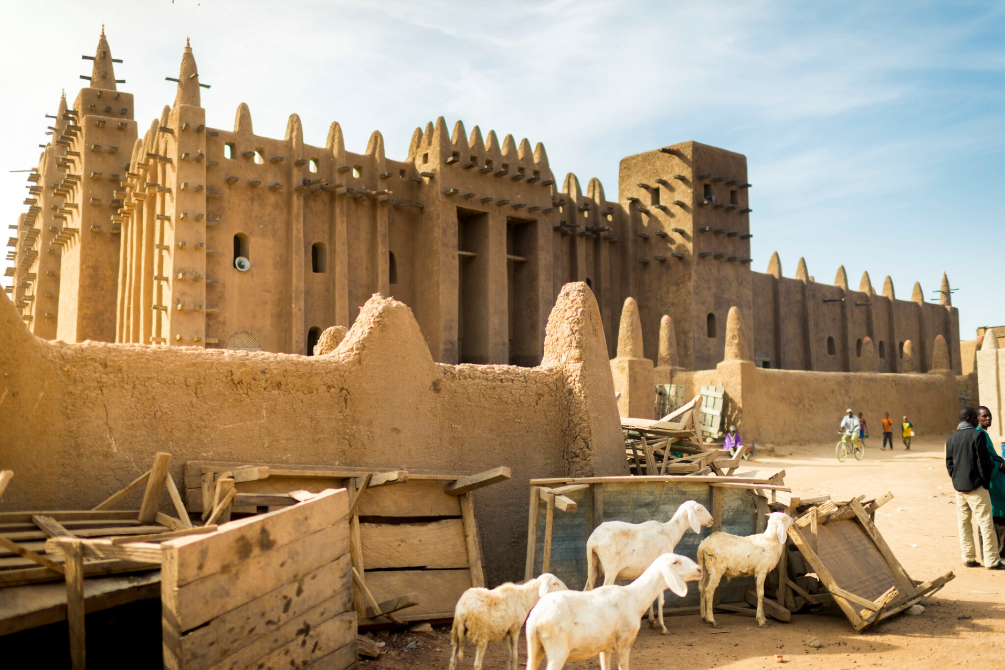
Protection specific types of CH
1999
Charter on the Built Vernacular Heritage (Mexico)
protection of vernacular buildings as expressions of the local culture of a community
Vernacular heritage has been accepted as a characteristic and attractive product of society
It has values for contemporary life and at the same time it is a record of society’s history
The vernacular is only seldom represented by single structures, and it is best conserved by maintaining and preserving groups and settlements of a representative
The Old Towns of Djenné (Mali)
were inscribed on the World Heritage List in 1988. The traditional houses are built to withstand seasonal flooding and have thus survived for hundreds of years.

Slide 33
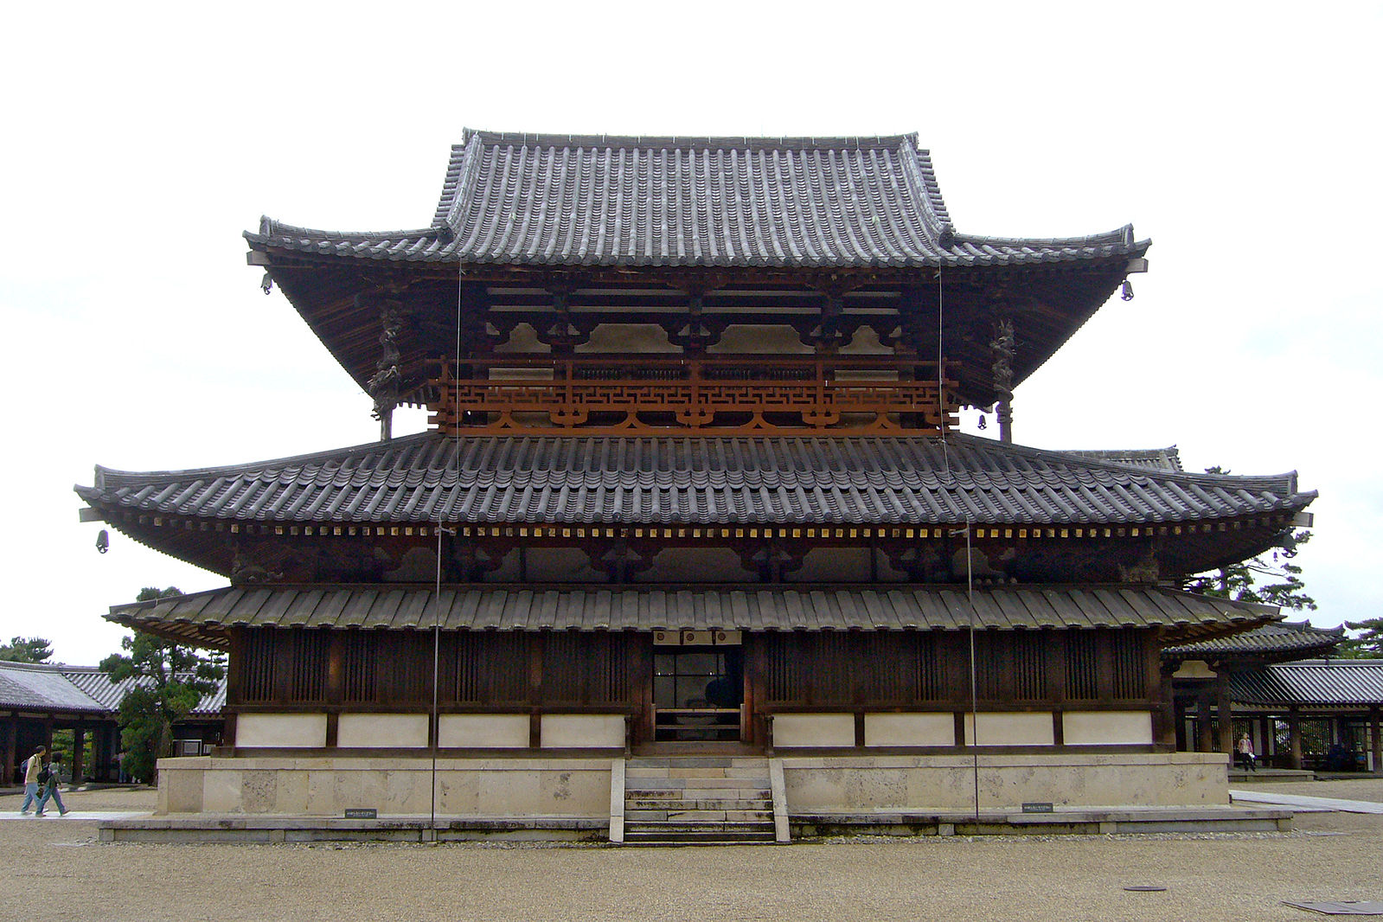
Protection specific types of CH
1999
Principles for the Preservation of Historic Timber Structures (Mexico)
define basic and universally applicable principles and practices for the protection and preservation of historic timber structures with due respect to their cultural significance
calls attention to the diversity and scarcity of historic timber structures and their vulnerability to material decay and degradation
The Golden Hall (Kondo) of the Horyu-ji Buddhist temple
in Nara, Japan — a World Heritage Site. Built in the late seventh century, this is the oldest timber structure in the world

Slide 34
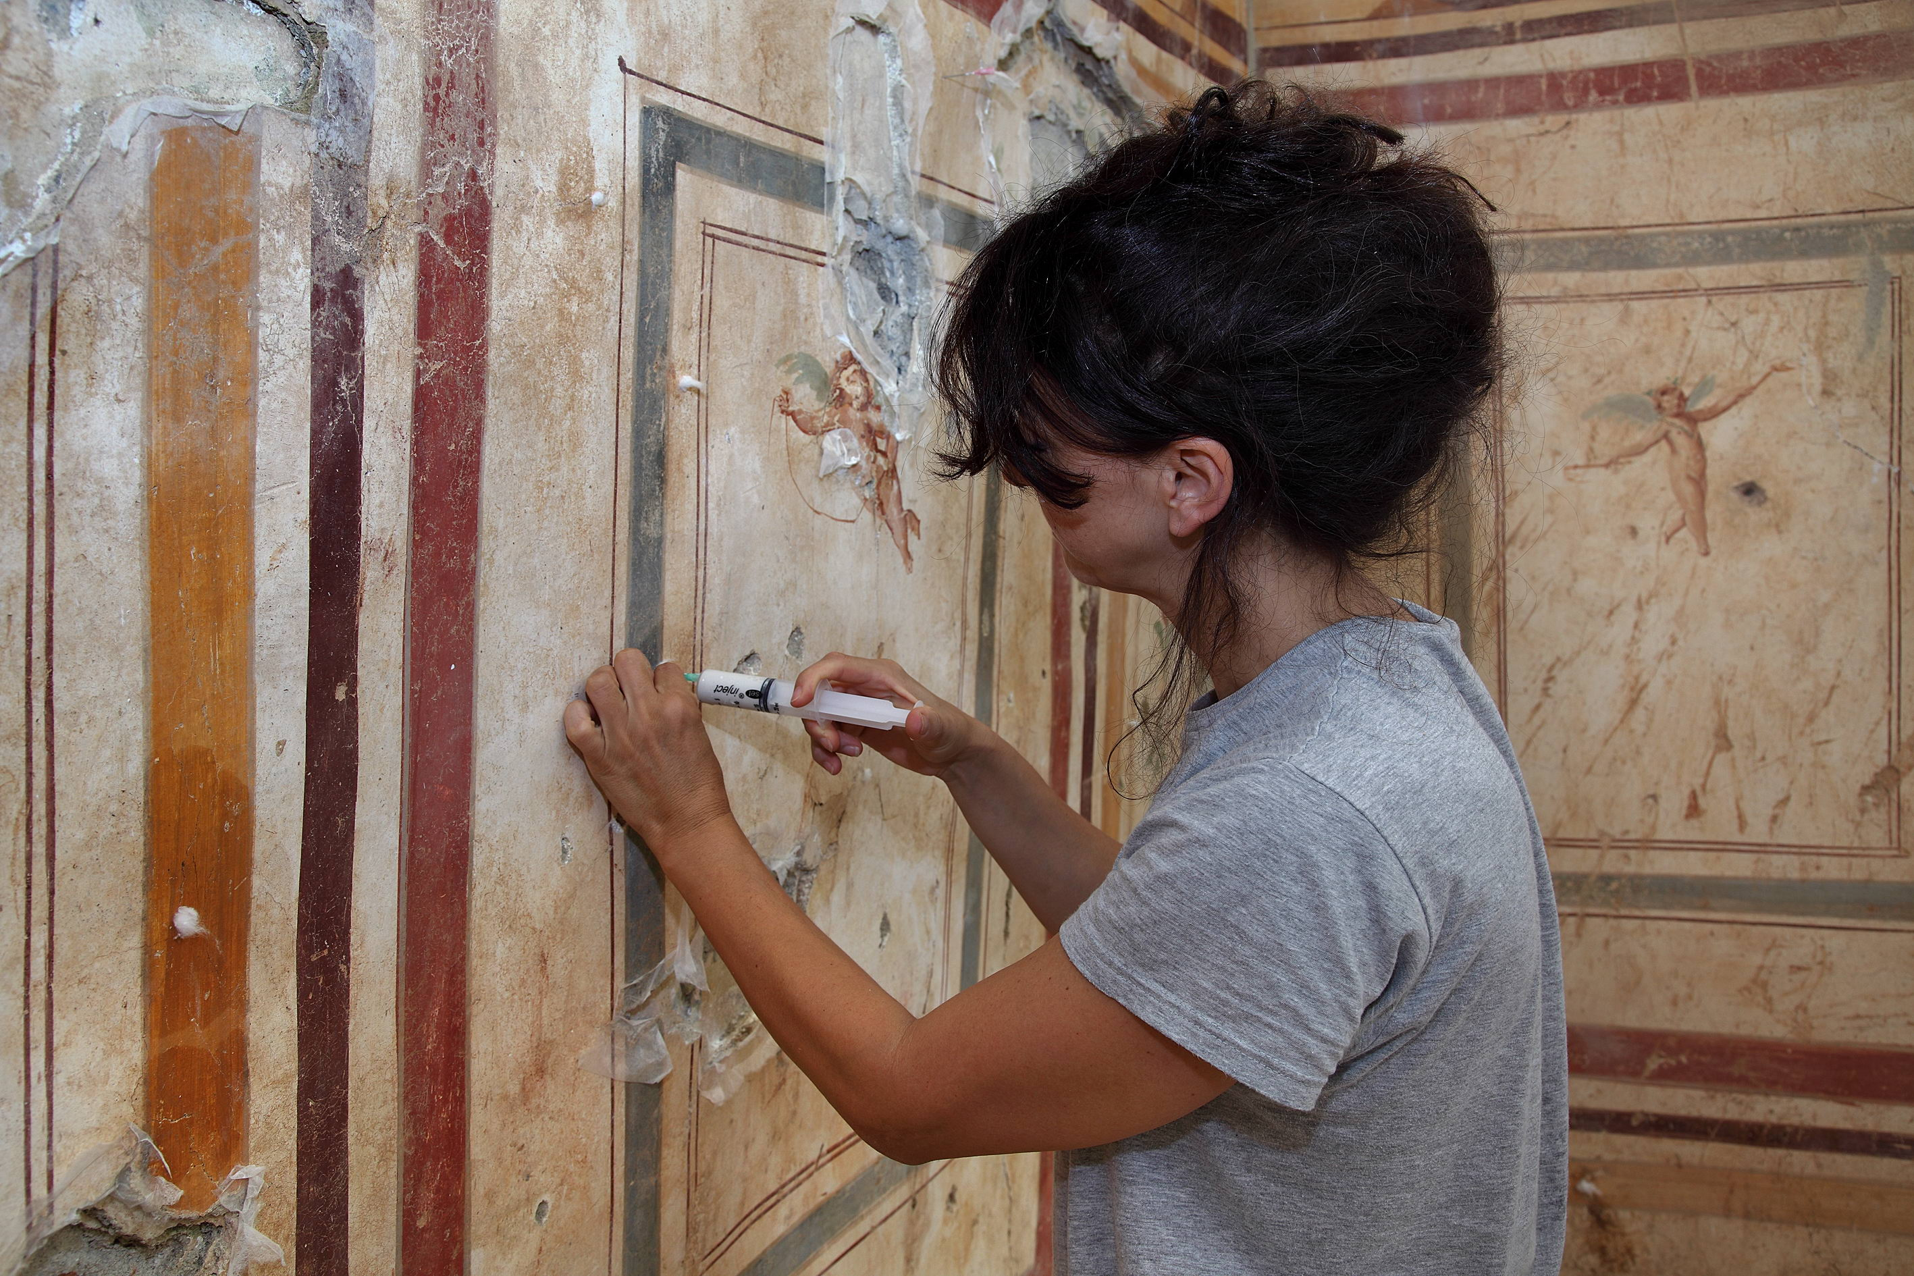
Protection specific types of CH
1999
ICOMOS Principles for the preservation and conservation /restoration of wall paintings
have been cultural expressions of human creation throughout history, from the earliest beginnings, such as rock art, extending up to present-day murals
Wall paintings are an integral part of monuments and sites and should be preserved in situ
problems affecting wall paintings are linked to the poor condition of the building or structure, its improper use, lack of maintenance, and frequent repairs and alterations.
Restoration Wall Paintings, Ephesus

Slide 35
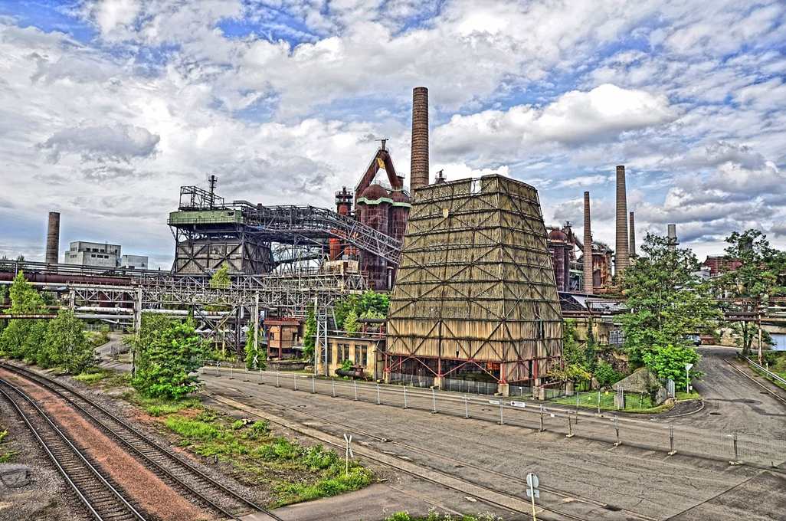
Protection specific types of CH
2003
The Nizhny Tagil Charter for the Industrial Heritage
Buildings and structures built for industrial activities, the processes and tools used within them and the towns and landscapes in which they are located, are of fundamental importance.
They should be studied, their history should be taught, characteristic examples should be identified, protected and maintained, for the use and benefit of today and of the future.
Industrial heritage consists of the remains of industrial culture which are of historical, technological, social, architectural or scientific value.
The Völklingen Ironworks, Germany
In 1994, it was declared by UNESCO as a World Heritage Site.

Slide 36
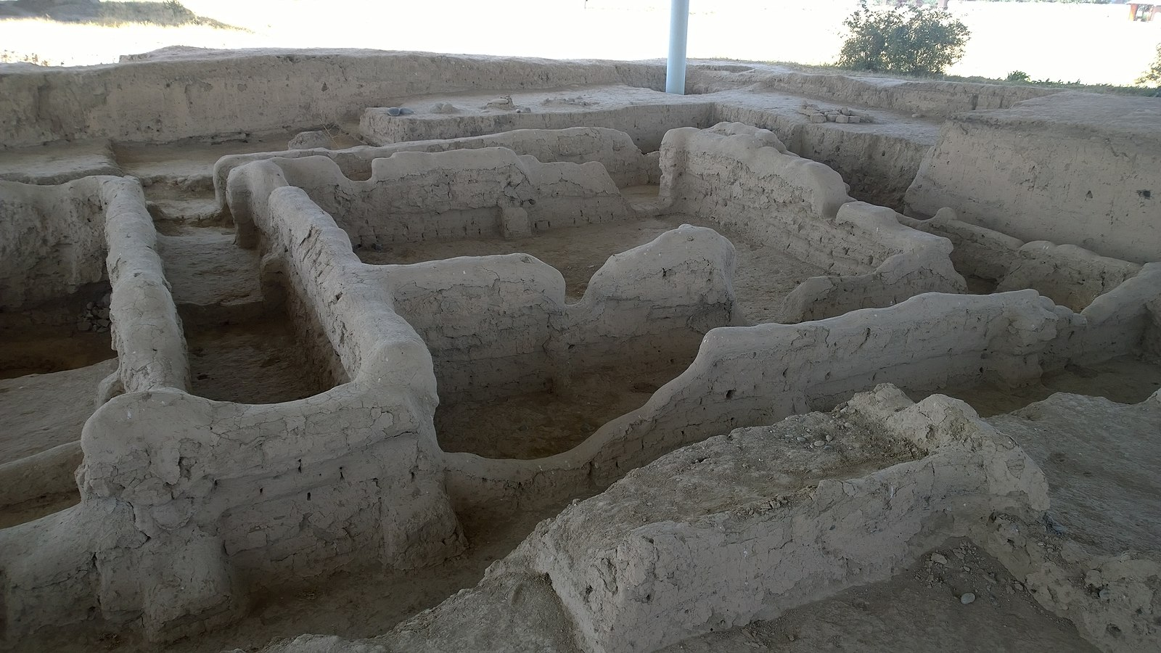
Archeological heritage
1956
Recommendation on International Principles Applicable to Archaeological Excavations (The New Delhi recommendations)
The recommendations considers regulative for definitions, general principles of protection, public education, Authority to excavate granted to foreigners, International collaboration, Access to excavation sites
Proto-urban Archeological Site of Sarazm, Tajikistan. One of the most ancient settlements of Central Asia inhabited in the 4th millennium BCE.
1990
Charter for the protection and management of the archaeological heritage
Includes guidelines for policies for the protection of archaeological heritage.

Slide 37
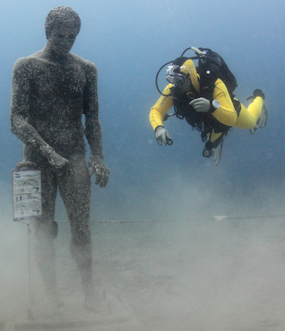
Underwater cultural heritage
1996
Charter on the protection and management of underwater cultural heritage Intended to “encourage the protection and management of underwater cultural heritage in inland and inshore waters, in shallow seas and in the deep oceans.”
2001
UNESCO Convention on the Protection of the Underwater Cultural Heritage Underwater cultural heritage is defined as all traces of human existence of a cultural, historical or archaeological nature which, for at least 100 years, have been partially or totally immersed, periodically or permanently, under the oceans and in lakes and rivers
Sets out basic principles for the protection of underwater cultural heritage
https://www.youtube.com/watch?v=yu5D4TEH8Jk
Historic Underwater Park Čikat, Mali Lošinj, Croatia - site where is discovered ancient statue of Apoxyomenos

Slide 38
Prohibiting and Preventing the Illicit Export, Import and Transfer of Ownership of Cultural Property
1964
Recommendation on the Means of Prohibiting and Preventing the Illicit Export, Import, and Transfer of Ownership of Cultural Property
1970
Convention on the Means of Prohibiting and Preventing the Illicit Import, Export and Transfer of Ownership of Cultural Property. Encourages States to prevent the illegal transfer of cultural property by enforcing appropriate documentation of items, procedures for legal transport of objects, and criminal inditement of transgressors.
1976
Recommendation concerning the International Exchange of Cultural Property
1995
UNIDROIT Convention on Stolen or illegally Exported Cultural Objects Sets out the application of laws for stolen or illegally exported cultural objects.
Logo of UNESCO Convention

Slide 39
Protection of Cultural Property in the Event of Armed Conflict, Intentional Destruction and Disaster Risk Management – Heritage at Risk
1954
Hague Convention for the Protection of Cultural Property in the Event of Armed Conflict. Set out a minimum level of protection for the cultural property regardless of conflict and occupation.
First Protocol for the Hague Convention for the Protection of Cultural Property in the Event of Armed Conflict. Prohibits the export of movable cultural property during the territorial occupation and forbids the retention of cultural property as war reparations.
1982
ICOMOS Declaration of Dresden on the "Reconstruction of Monuments Destroyed by War"

Slide 40
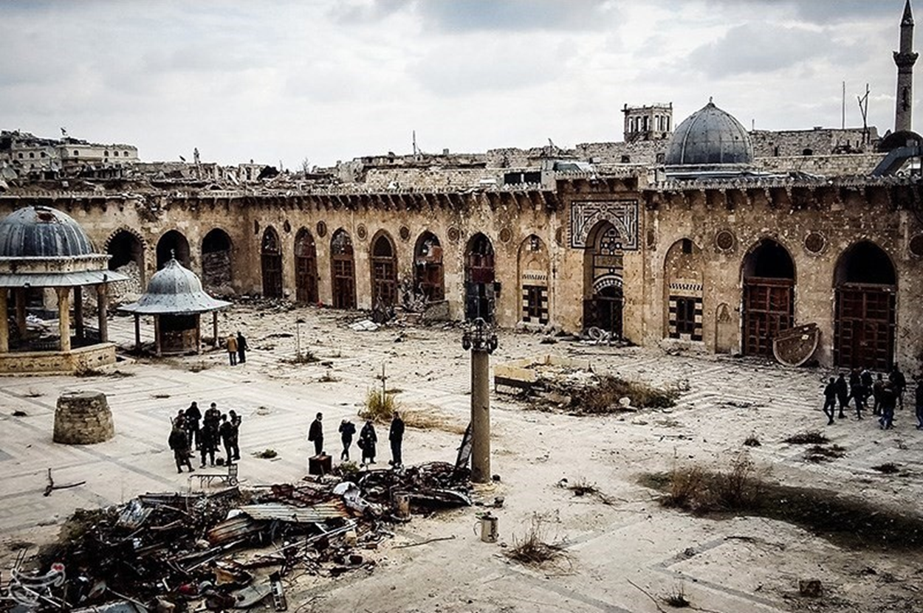
Protection of Cultural Property in the Event of Armed Conflict, Intentional Destruction and Disaster Risk Management – Heritage at Risk
1999
Second Protocol for the Hague Convention for the Protection of Cultural Property in the Event of Armed Conflict. “The Second Protocol further elaborates the provisions of the Convention relating to the safeguarding of and respect for cultural property and the conduct of hostilities; thereby providing greater protection than before.”
2003
UNESCO Declaration concerning the Intentional Destruction of Cultural Heritage States should take all appropriate measures to prevent, avoid, stop and suppress acts of intentional destruction of cultural heritage, wherever such heritage is located.
The ruins of the 11th century Great Umayyad Mosque, Aleppo, Syria
https://www.youtube.com/watch?v=mqdgj1aPHqs

Slide 41
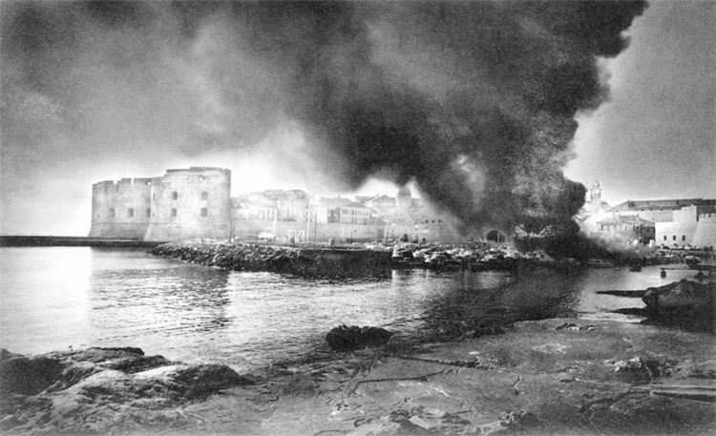
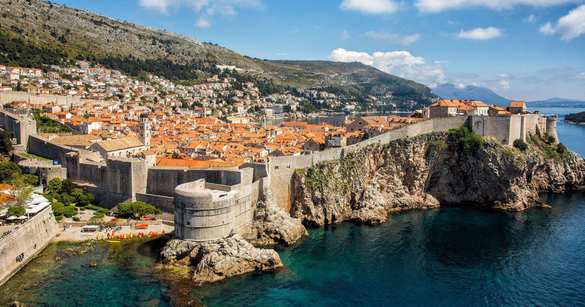
City of Dubrovnik, Croatia, photographer Pavo Urban
https://whc.unesco.org/en/list/95/
The 'Pearl of the Adriatic,’ situated on the Dalmatian coast, became an important Mediterranean sea power from the 13th century onwards. Although severely damaged by an earthquake in 1667, Dubrovnik managed to preserve its beautiful Gothic, Renaissance, and Baroque churches, monasteries, palaces, and fountains. Damaged again in the 1990s by armed conflict, it is now the focus of a major restoration program coordinated by UNESCO.

Slide 42
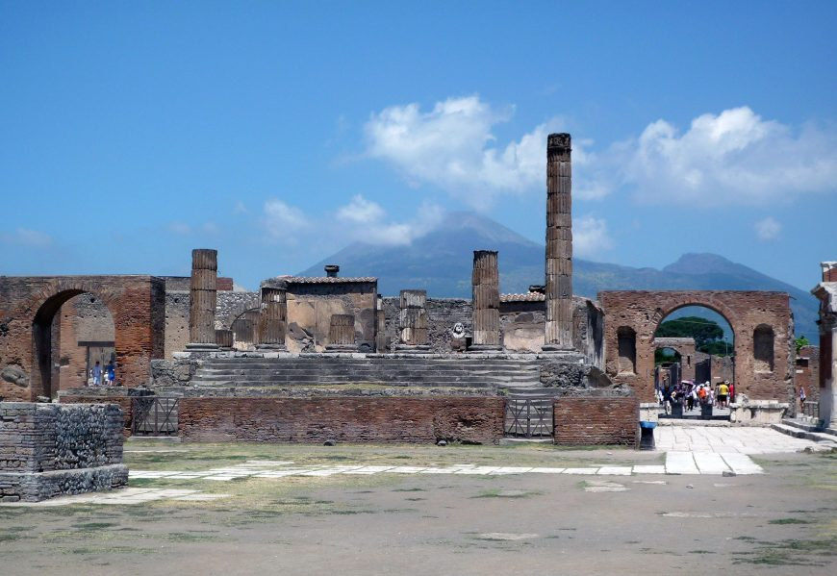
Protection of Cultural Property in the Event of Armed Conflict, Intentional Destruction and Disaster Risk Management – Heritage at Risk
2010
Lima Declaration for Disaster Risk Management of Cultural Heritage
Heritage conservation could be accomplished through education by organizing updated courses, seminars, and training activities.
Academic institutions would play an essential role by including cultural heritage and tourism studies for the sustainable development of heritage sites.
Forum of Pompeii, looking toward Mount Vesuvius
The eruption of Mount Vesuvius in 79 C.E. destroyed and largely buried the city of Pompeii

Slide 43
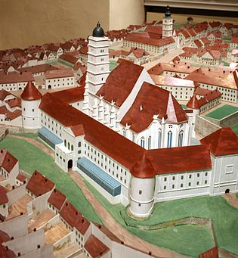
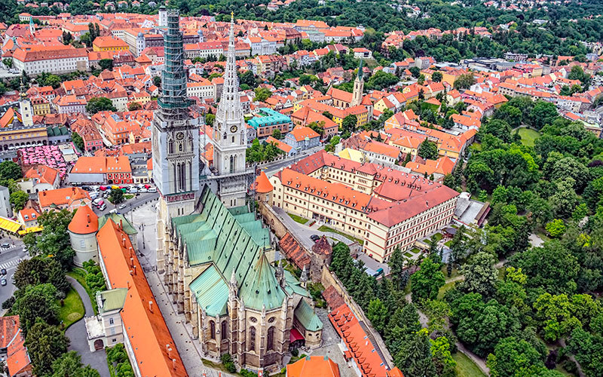
13th century – gotic style
19th century – Herman Bolle – neogotic style
Zagreb Cathedral of the Assumption of the Blessed Virgin Mary

Slide 44
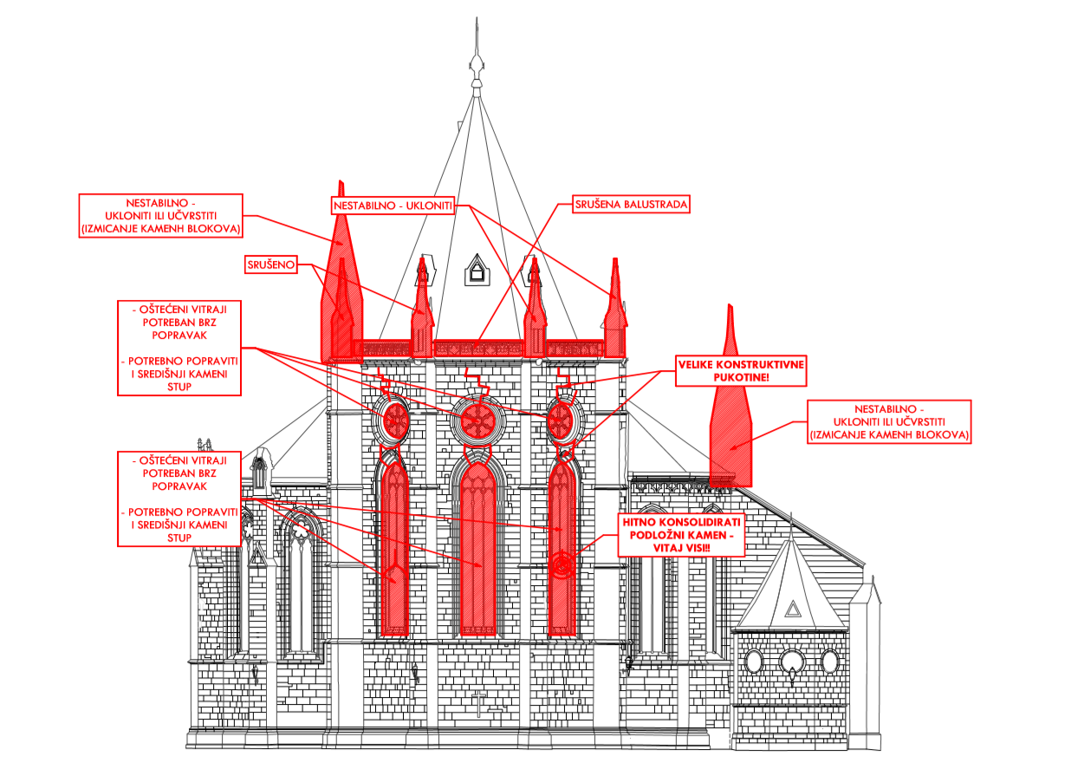

Slide 45
Heritage and Society
2005 Faro Convention on the Value of Cultural Heritage for Society
emphasizes the important aspects of heritage as they relate to human rights and democracy
promotes a wider understanding of heritage and its relationship to communities and society
encourages us to recognize that objects and places are not, in themselves, what is important about cultural heritage. They are important because of the meanings and uses that people attach to them and the values they represent
https://www.youtube.com/watch?v=74eMTcLFydM&t=18s

Slide 46
From "how to conserve?" to "why conserve?"—and then to "for whom to conserve?”
better dissemination is required
simple and clear language is often missing
public awareness campaigns and training needed for their effective implementation
avoid divergent interpretations
to adapt international norms to the specific situations of regions or countries, in more accessible, explicit, and detailed guidelines and in the local language
CHALLENGES IN HERITAGE POLICY DOCUMENTS
The search for a universal dimension for norms that are more in line with the rich diversity of heritage and culture has led to a new definition of the concept of authenticity
The Nara Charter - identification of the introduced heritage values, the conservation depends on the ability to understand the intangible values
The Burra Charter - conservation is a set of measures enabling a person to achieve the values, meanings, messages, and concepts latent in the heritage spaces

Slide 47
Conclusion
international debates have deepened and expanded the notions of heritage and conservation
the norms expressed in charters and conventions have had a positive effect all over the world
there has been tremendous progress in heritage conservation over the last 40 years
the affirmation of universal values and the encouragement of mutual understanding

Slide 48
Literature:
https://www.iccrom.org/sites/default/files/ICCROM_05_HistoryofConservation01_en.pdf
World Heritage Policy Compendium (unesco.de)
Cultural Heritage Policy Documents | Getty Conservation Institute
International conventions - International Council on Monuments and Sites (icomos.org)
https://whc.unesco.org/

Slide 49
Recommendations of the Madrid Conference (1904), http://www.getty.edu/conservation/publications_resources/research_resources/charters/charter01.html
Carta Di Atene (1931), The Athens Charter for the Restoration of Historic Monuments - 1931. Advisory Council for Antiquities and Fine Arts, https://www.icomos.org/en/167-the-athens-charter-for-the-restoration-of-historic-monuments
The Venice Charter: International Charter for the Conservation and Restoration of Monuments and Sites (1964)
Norms of Quito: Final Report of the Meeting on the Preservation and Utilization of Monuments and Sites of Artistic and Historical Value (1967) ICOMOS, https://www.icomos.org/en/charters-and-texts/179-articles-en-francais/ressources/charters-and-standards/168-the-norms-of-quito
Convention Concerning the Protection of the World Cultural and Natural Heritage (1972) UNESCO, https://whc.unesco.org/en/conventiontext/ http://whc.unesco.org/uploads/activities/documents/activity-562-4.pdf
The Nara Document on Authenticity (1994), ICOMOS Symposia, https://www.icomos.org/charters/nara-e.pdf
Framework Convention on the Value of Cultural Heritage for Society , Council of Europe, 2005 10 27, Faro, https://rm.coe.int/1680083746
ICOMOS Charter on the Interpretation and Presentation of Cultural Heritage Sites (2008), ICOMOS, https://www.icomos.org/charters/interpretation_e.pdf

