Slide 1
GEOMATICS I
Terrestrial Laser Scanner
Dr. Saidislomkhon Usmanov,
Civil Engineering and Architecture Department
Tashkent Turin Polytechnic University
Notes:
Hello every one, My name is SU and I belong to Civil Engineering Department of TTPU. Welcome to Land Surveying Course.

Slide 2
Contents
Laser Scanner Geometry
Main Instrument Axes
Local coordinate system of the scanner
Coordinate transformation
Systematic and random Errors

Slide 3
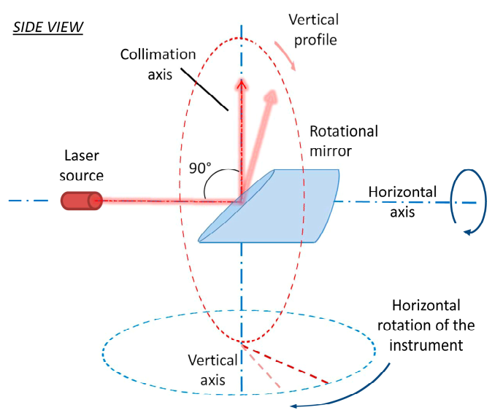
Laser Scanner Geometry
The laser source ﬁres the laser beam on the center of the rotational mirror.
The rotational mirror is placed on its mount and it is inclined in the way that it intersects the secondary rotational axis with an angle of 45◦.
The laser beam is reﬂected in the direction of a measured point forming an angle of 90◦.
The mirror rotates around the primary rotational axis realizing the proﬁle measurements.
Whole instrument revolves around the secondary rotational axis.

Slide 4
Laser Scanner Geometry
Finally, the third or collimation axis is perpendicular to the primary axis.
It is defined by the line passing through the middle point of the mirror and spanning in the direction of the reflected part of the laser beam.
At the beginning of each profile measurement, the collimation axis is coincident with the secondary axis.
Panoramic laser scanners are usually used in the upright position and leveled within the horizontal plane by using an compensator.
Primary axis is usually horizontal and secondary axis is vertical in space.

Slide 5
Laser Scanner Geometry
Two different scans of whole surrounding from the same position.
First scan (first face or front face), instruments completes the circle around vertical axis and horizontal angles range between 0-180.
Second scan (second face or back face) horizontal angles range between 180-360.
In each scan, points are measured both in the front and the back of the instrument.
One full 3D scans contains some points in the first and some in the second face.

Slide 6
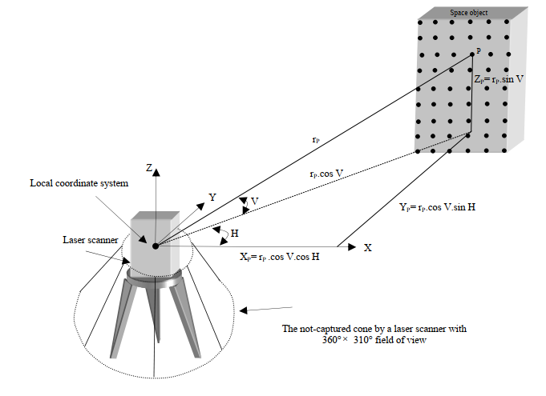
Laser Scanner Geometry
The laser field of view is 270-310 degrees vertically and 360 degrees horizontally. The laser scanner will rotate upon the tripod and spin the mirror at the same time to capture the full scene

Slide 7
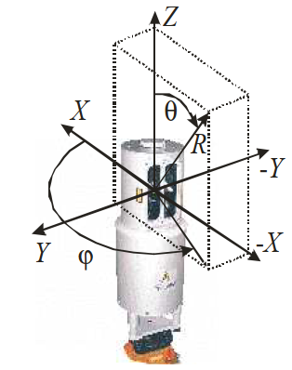
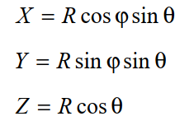
Polar Coordinates of Measured Points
Final results of both scans are cartesian coordinates of all measured points.
They are derived from measured range, horizontal and vertical angles
$$R −measured range (Distances)$$
$$φ −horizontal angle$$
$$θ −Zenithal angle$$

Slide 8
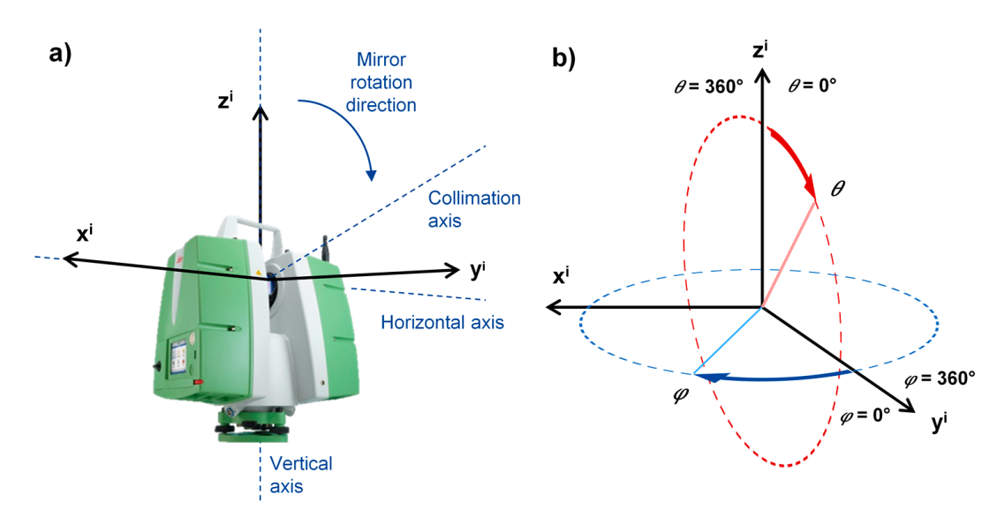
Local coordinate system of the scanner
A terrestrial laser scanner is positioned at the origin of its observed coordinate system (i.e., x,y,z = 0,0,0 m).
This coordinate system is sometimes referred to as the Scanner’s Own Coordinate System – SOCS
Two consecutive scans will share the same Cartesian coordinates.
Even though they are derived from the different set of polar coordinates.

Slide 9
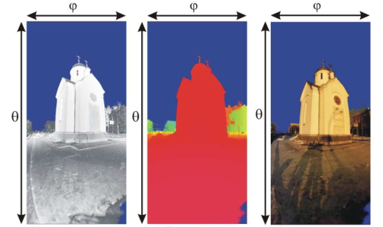
Results of Scan
Results of 3D scan will be in raster format which contain following information:
Intensity
Range
True color (RGB),
And X, Y, Z values
Reflectance
Range
True color (RGB)

Slide 10
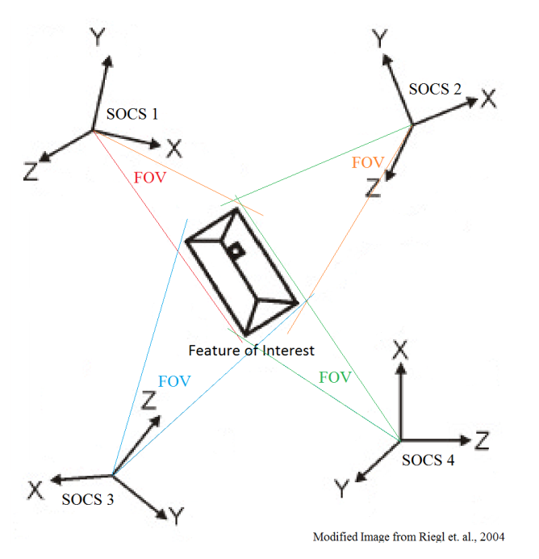
Multiple Laser Scanner Point Clouds Registration
Recovering the geometry of a complete 3D object requires more than one stand position for the laser scanner.
The resulted point clouds captured at each stand point of the scanner have different coordinate systems.
These point clouds have to be registered together in one coordinate system in order to achieve a complete object representation.
In order to relate the individual scanner defined coordinate frames together, common points within each respective point cloud must exist.

Slide 11
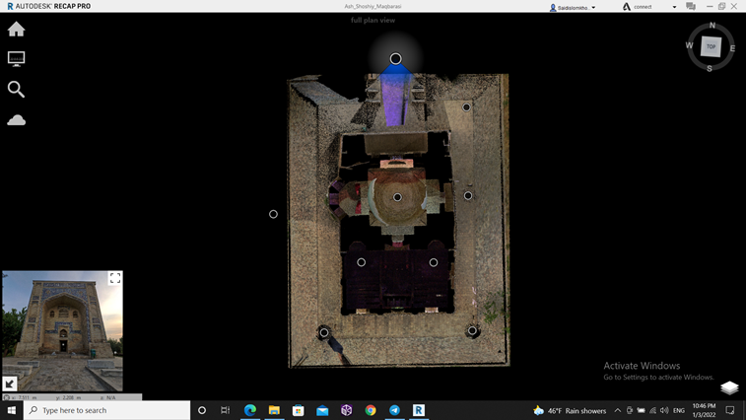
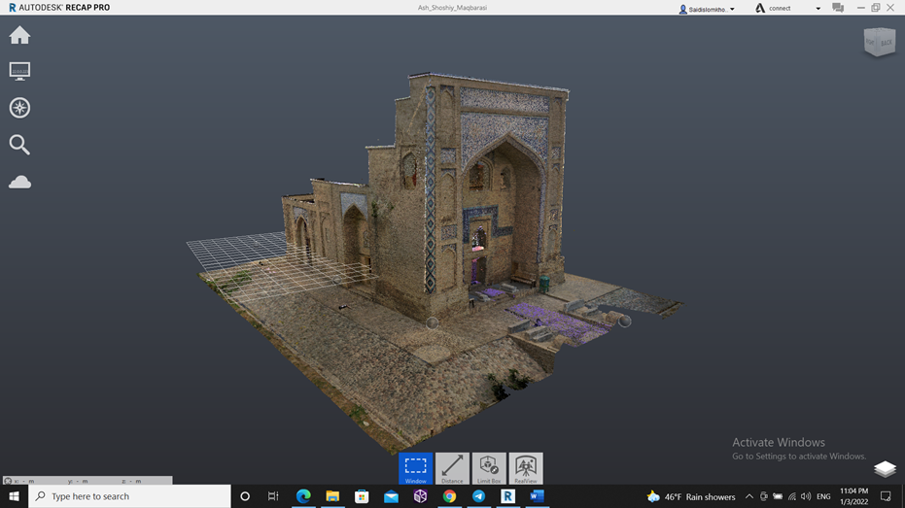
Multiple Laser Scanner Point Clouds Registration

Slide 12
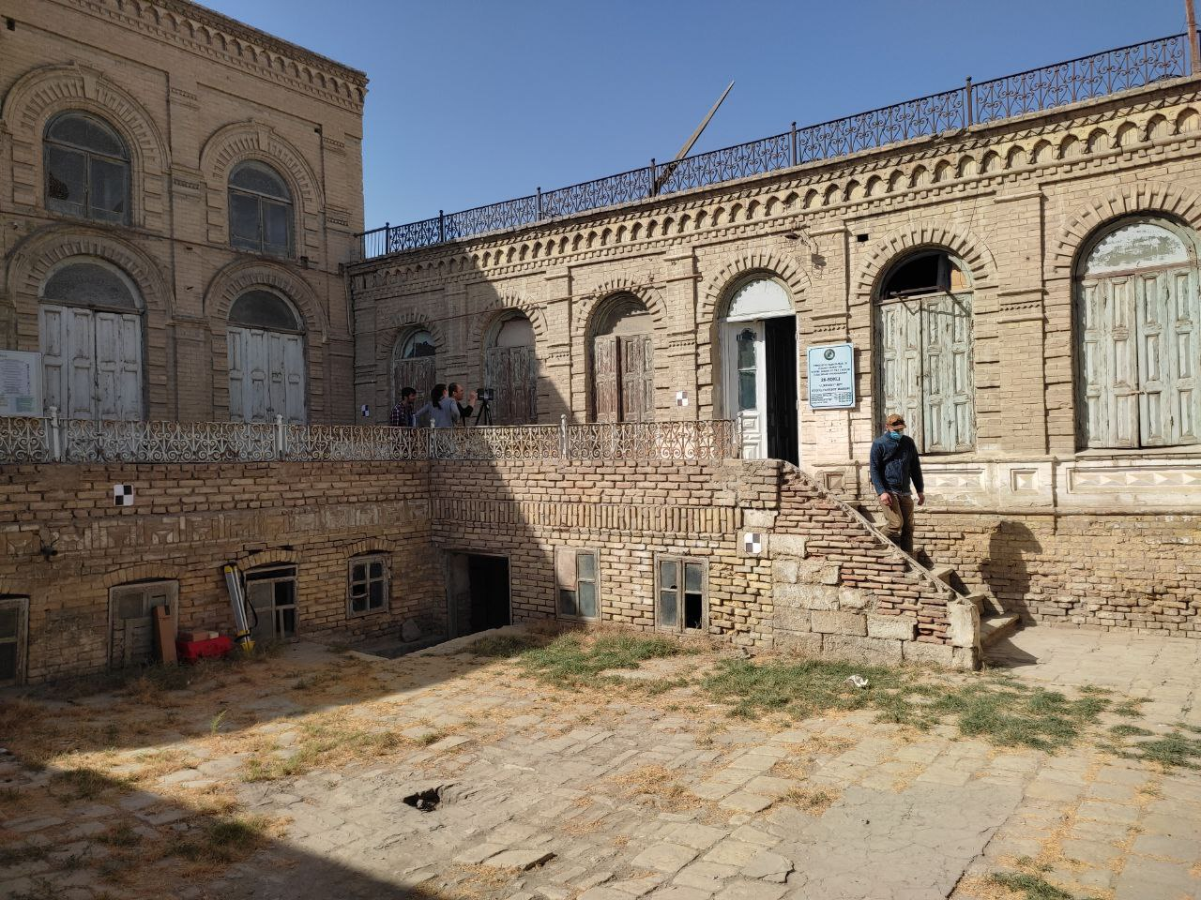
Target Based Registration
The registration between two point clouds can be achieved through assigning the space coordinates of three corresponding points or more at each point cloud.
In case of having more than three points, the least squares technique is applied.
These points can be either artificial or natural targets. Whereas natural targets are assigned manually.
Artificial assigning process is based on detecting certain shapes of targets like spheres or black and white targets.

Slide 13
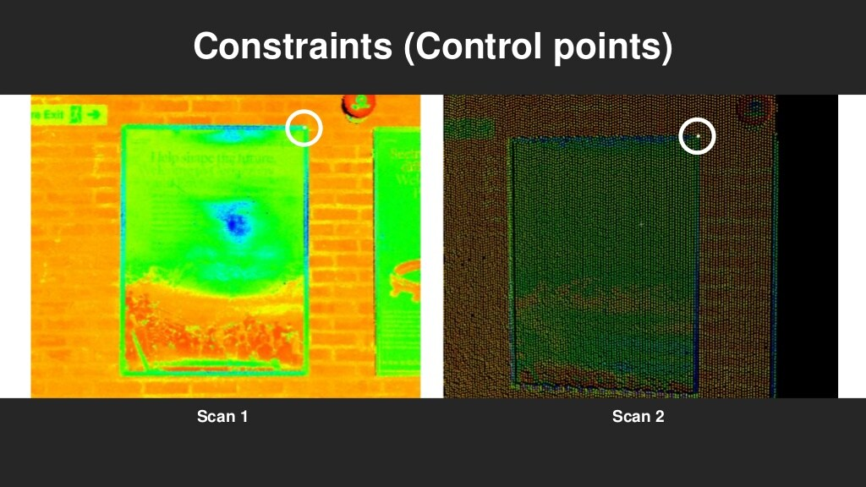
Natural Targets
This method makes use of the camera attached to some modern laser scanners.
The photos orientations are obtained from a traditional photogrammetric solution.
Therefore it is called image based registration.
The method requires only overlap between the photos and does not require any overlap between the point clouds.
One further benefit of the image based registration method is that the selection of conjugate points in digital imagery is generally more straightforward and less error.

Slide 14
Coordinate Transformation
Transformation applies a uniform scale change, axes rotations and origin translations to a single point within the raw coordinate.
The traditional formulation of this transformation is given below:
λ is the uniform scale factor
R κ ϕ ω - is a combined rotation matrix consisting of three two dimensional rotation matrices
The combined rotation matrix (R κ ϕ ω) is expressed as:
Finally by applying all the matrix operations necessary the three individual observation equations for computing the control coordinate frame coordinates (X, Y, Z) of a raw coordinate frame point (x, y, z) can be expressed as:

Slide 15
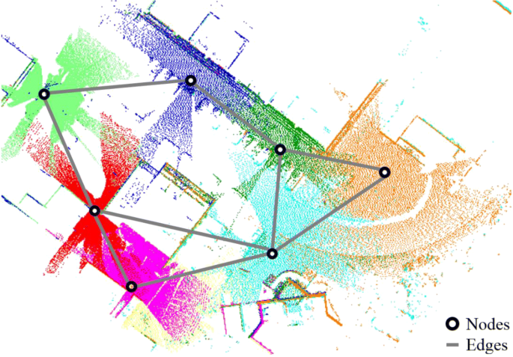
Targetless Registration
Target-less registration is also called point to point registration (point2point), the calculation involves points which overlapped from different scan areas.
If a number of scans are carried out in an enclosed room, target-less registration is very exact, because in this case the calculation involves millions of identical points.
This creates a very precise calculation of the average and the scans can be calculated very well in relation to one another.
On the subject of overlaps as the area that is identical between 2 scans: the larger the overlapping area, the better the expected result.

Slide 16
Targetless Registration
In small indoor areas, target-less registration can be a good alternative to registration with targets.
In doing so, the number of scans should not be too high and there should always be good overlaps between the scans.
For many scanners, the average measuring accuracy is approx. 2 mm per scan, i.e. with only 10 scans, there can be an error of more than 2 cm.
The new registration methods in FARO SCENE – cloud2cloud and top-view-based registration – are additional interesting tools that can reduce the overhead of a well-versed user.

Slide 17
Scanning Workflows
In General, scanning of objects consist of following steps
Determine the goals and objectives of the scanning survey
Examine deliverable requirements
Search for and gather as much information as possible for the scanning task (Reconnaissance)
Determining scan stations
Determining target placements
Point cloud data processing

Slide 18
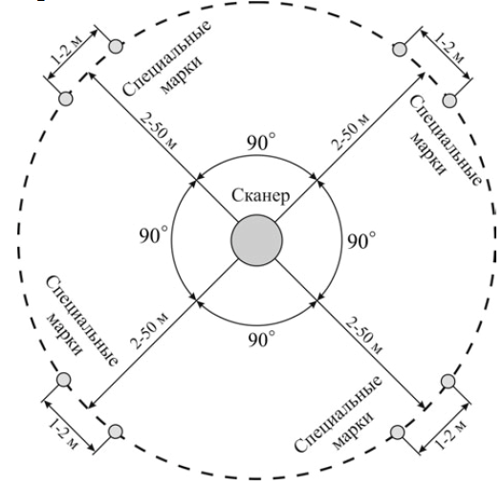
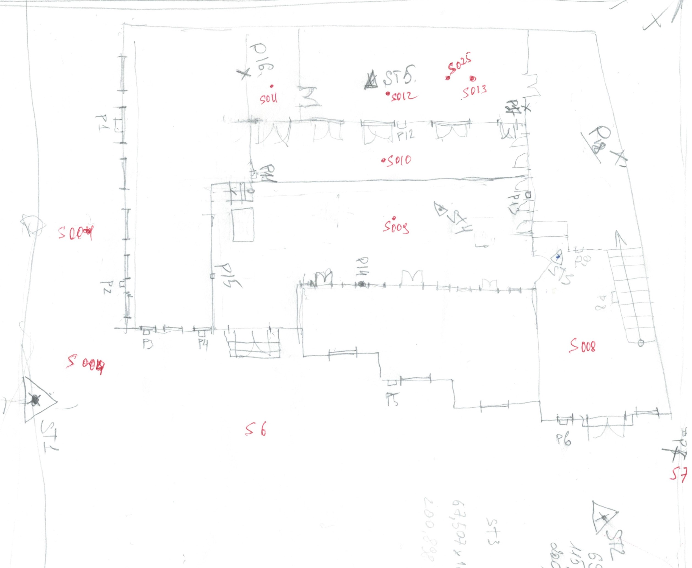
Reconnaissance
The reconnaissance survey is an extensive study of an entire area through existing maps and aerial photographs. Contour maps show the terrain features and the relief of an area.
Draw a raw sketch or plans or scanning side.
Identify the possible location of scanners and targets.

Slide 19
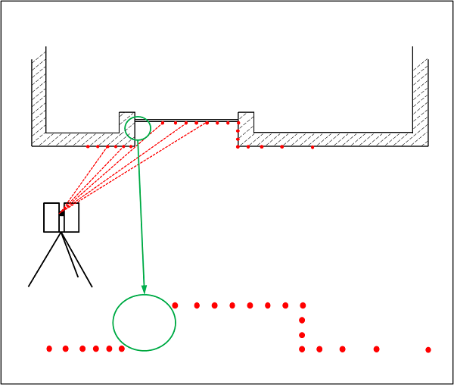
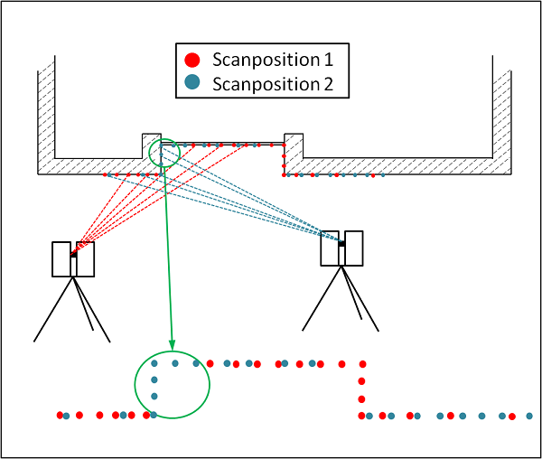
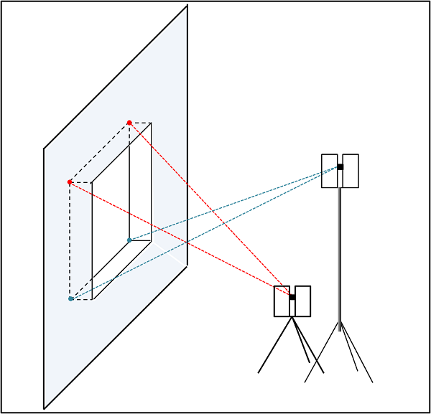
Location of Scanners and Targets
A laser scanner can only measure what is visible from its position like the human eye and can not scan an behind corners. It is important to scan an object from various locations in order to receive a complete image as a scan result (point cloud). The more complex the scanned object is, the more measuring points make sense.

Slide 20
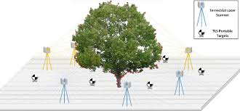
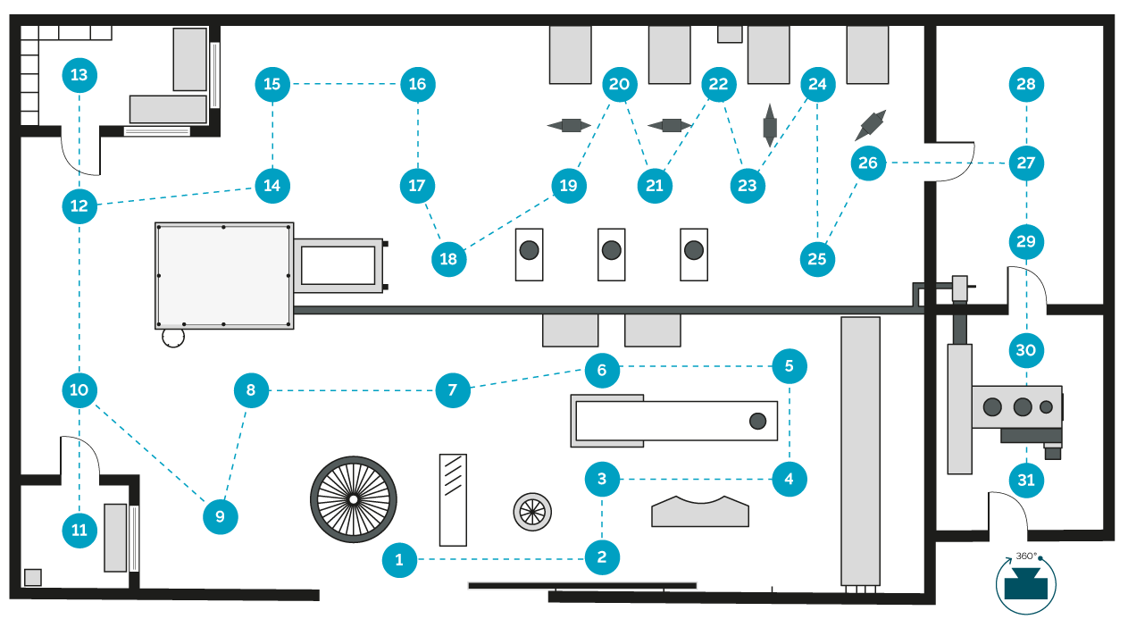
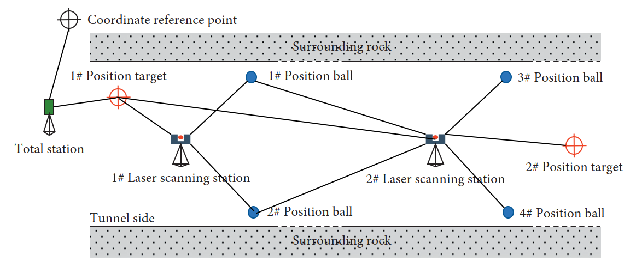
Location of Scanners and Targets
In practical point of view, scanning for engineering and building structures the distance between scanners should be 50-60 m.
Scanning for open spaces the distance between scanners should be 150-200 m, depending of the capability of scanner.

Slide 21
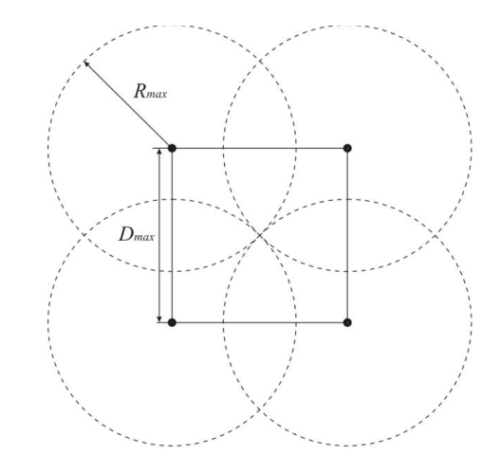
Location of Scanners and Targets
In general the distance between scanners can be find the following equation.
$$D_{max}=0.636×R_{max}$$
$$R_{max}=maximum scaning distance in case 4 and 20\% of reflectance$$
Location of scans

Slide 22
Scanning process of target object
Set up the TLS in position and adjust scanning parameters (resolution, point density, inside or outside of building, HDR or black and white.
Attach the targets and determine the local coordinates using total station. Then these coordinates being used coordinate transformation from TLS’s own coordinate system to local coordinate system of city.
Before start scanning remove any objects from scanning side.
After scanning in the first position remove TLS to second position according to schedule to complete whole object.

Slide 23
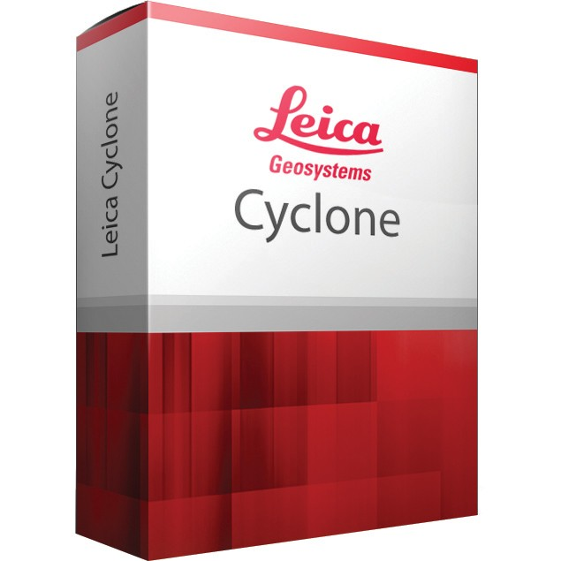
Scanning Workflows
Noise removal
Clean unnecessary points
Collecting the RAW data by Scanning
Scanned data registration
Processing
Ready 3D point Cloud
Target based registration
Image based registration (natural target and top view)
Cloud to cloud registration

